Slide 1


A Power Management System
By Loquen Jones & Sahil Verma
SCHOOL OF ENGINEERING

Slide 2
Background
Energy use increased around 30% since 1990
Individual energy use has increased by 10% since 1990
No smart way of energy management
Instead we rely on a central energy provider to manage our power

Slide 3
The Problem
Inefficient Grid Usage
  Goes over peak usage daily, up to 160%
  Not cost effective for both customer and supplier
The Current Solution
  Use of extra generators during peak hours harms environment
  Single grid managing load for everyone; single point of failure
Notes:
Sahil

Slide 4
Why the grid system is flawed…
Method of avoiding peak hours is flawed
  Electric Companies raise prices for peak hours
  Customers change which hours they use energy
  Doesn’t address individuals
This doesn’t solve any problems…
  Peak hours end up moving around
  But they are still there
  Money is lost when the power goes out
Notes:
does attempt to avoid peak, but not at individual level. Sahil

Slide 5
SPARTAN
Last years senior design group implementation
Built on ongoing SCU research
Point to point network of intelligent devices
Scheduling algorithm to avoid peak hours
User input to set appliance deadlines
Notes:
Loquen

Slide 6
What’s missing from SPARTAN?
Communication limited to pair wise nodes
No centralized smart device, a single SPARTAN device is needed for each appliance
Network topology 802.15.4 creates STAR topology, which creates a central point of failure
Range is limited to 30 meters
Notes:
Loquen

Slide 7
The Blue Plug: Solution Overview
Zigbee Mesh Network stack
  Uses least amount of power of available technologies
Three models: Coordinator, Router, End-Device
Allows for decentralized planning of networks and multiple nodes in 1 mile range
One Blue Plug to many appliances
Notes:
Loquen

Slide 8
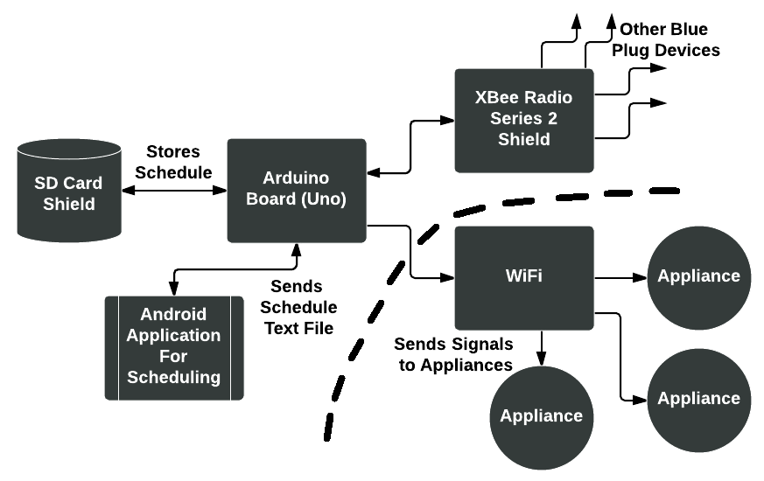
How the Blue Plug works
Notes:
Loquen

Slide 9
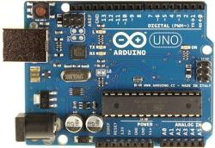


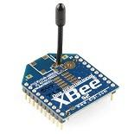
Technologies Used
Arduino Uno
Android
Java (Android)
C/C++ (Arduino)
XBee Series II Radios
XCTU
SD Card Shield
Notes:
Sahil

Slide 10
Design Rationale
No centralized point of failure
Dynamic Ad Hoc Network
Open source, ubiquitous
Flexibility to communicate with home appliances
Notes:
Sahil

Slide 11
Use Cases
Adding an appliance
Removing an appliance from scheduling
Viewing Schedule
Setting deadlines for appliances
Turning on appliances immediately
Setting up Ad-Hoc networks
Notes:
Loquen – Explain what use cases are

Slide 12
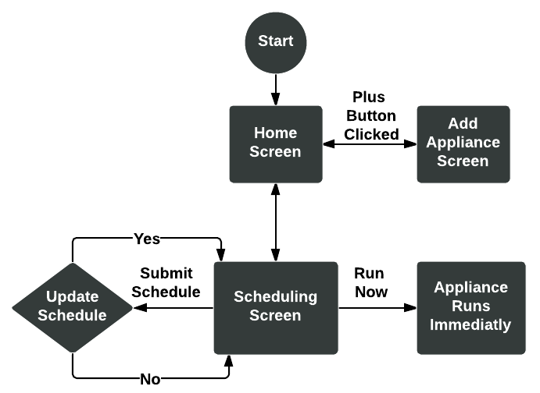
What a typical user will do
Notes:
Loquen

Slide 13
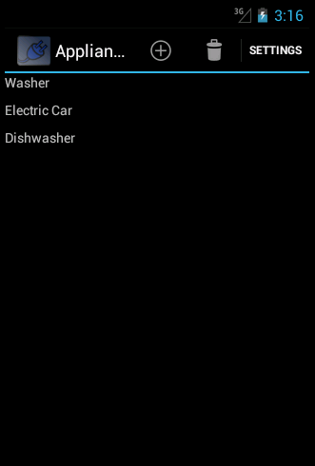
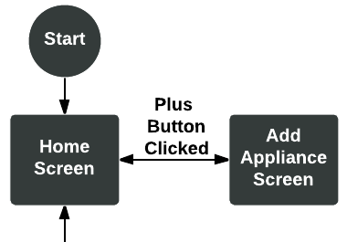
Home screen
Notes:
Loquen

Slide 14
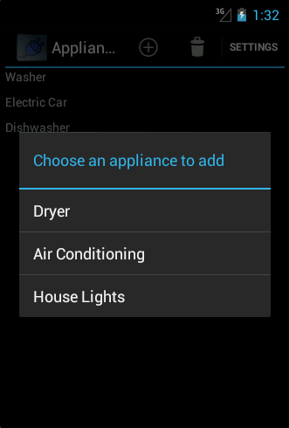
Add Appliance Screen
Notes:
Loquen

Slide 15
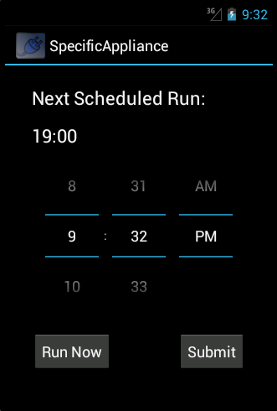
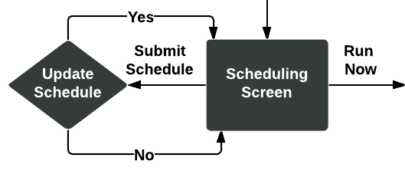
Scheduling screen
Notes:
Loquen

Slide 16
Demonstration
No Scheduling
Random Scheduling
Blue Plug Scheduling

Slide 17
Project Risks & Mitigation
Risk | Probability | Severity | Impact | Methods
Multiple technologies & complicated network arch. | .8 | .8 | .64 | -Books -Professor -Read Open Source Code
Infrastructure and materials | 1 | .4 | .40 | -Open Source Software -More With Less
Time management, deadlines, source code mgmt | 1 | .3 | .30 | - Google Hangouts - Github - Weekly Meetings
Notes:
Sahil

Slide 18
Development Timeline
 | July | Aug. | Sep | Oct. | Nov. | Dec.
Understanding Previous and Current Work
Document Design
Technology Research NOTE: Red is BOTH
Notes:
Sahil

Slide 19
Development Timeline (Cont.)
 | Jan. | Feb. | Mar. | Apr. | May
Implementation
Android Class
Arduino Architecture
Radio Comm.
File Storage
Android UX
Android <-> Arduino
 | <-- Sahil |  | <-- Loquen |  | <-- Both
Notes:
Sahil

Slide 20
Conclusion
Saves money
Reduces peak hour energy use
Even Random Scheduling is better than the current system
Ad Hoc network makes system dynamic
Does not effect current grid system
Notes:
Loquen

Slide 21
Steps for the future
We envision Wi-Fi Connectivity for appliances. However other methods are available
Single homes using Blue Plug will reduce peak hour energy usage
Understanding users freedom to schedule, we worry about scheduling on their behalf
Notes:
Loquen

Slide 22
Questions?

