Slide 1

International Islamic University Chittagong Department of Computer Science & Engineering
Course Title : Tools & Technologies for Internet Programming.
Course Code : CSE-3532
Submitted To : Md. Khaliluzzaman
Assistant Professor, DCSE, IIUC.
Presented By:
Section & Semester: 5AM
Group no:20 - 1.C193035: Niloy Sarkar Babu
2.C181102: Mainuddin Hasan Manik

Slide 2

Project On:
Chocolate Shop

Slide 3
The Language we’ll use:
html
css
JavaScript
Software:
Visual studio

Slide 4
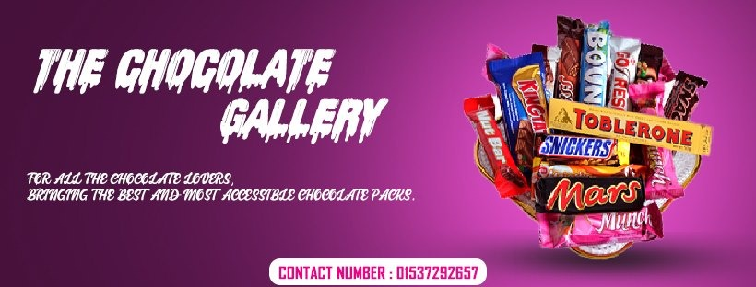
Welcome to our project:
This Project on “Chocolate shop” is one such website where people will find out about “Chocolate Gallery”. People will be able to customize their packages from this site.
Home:

Slide 5

Menubar:

Slide 6
Categories:
Chocolate Price List
Customize Package
Simple Gift package
Top on Demand

Slide 7
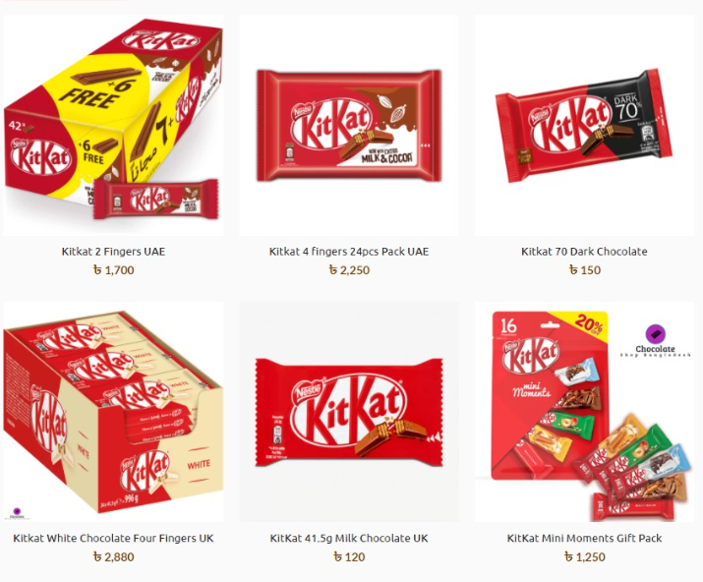
Arrivals:

Slide 8
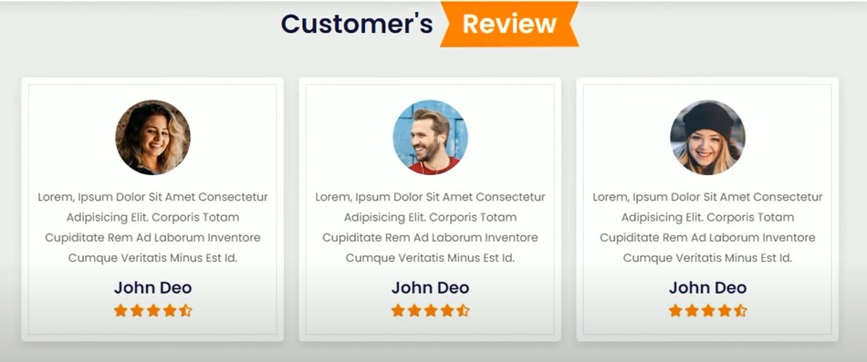
Review:

Slide 9
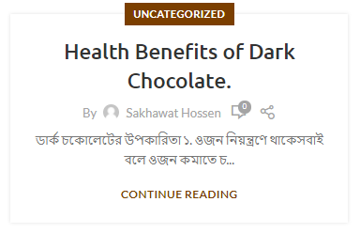
Blogs:

Slide 10
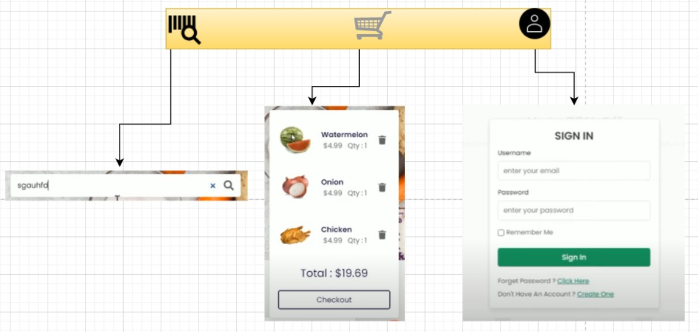
Search Shop Sign in

Slide 11
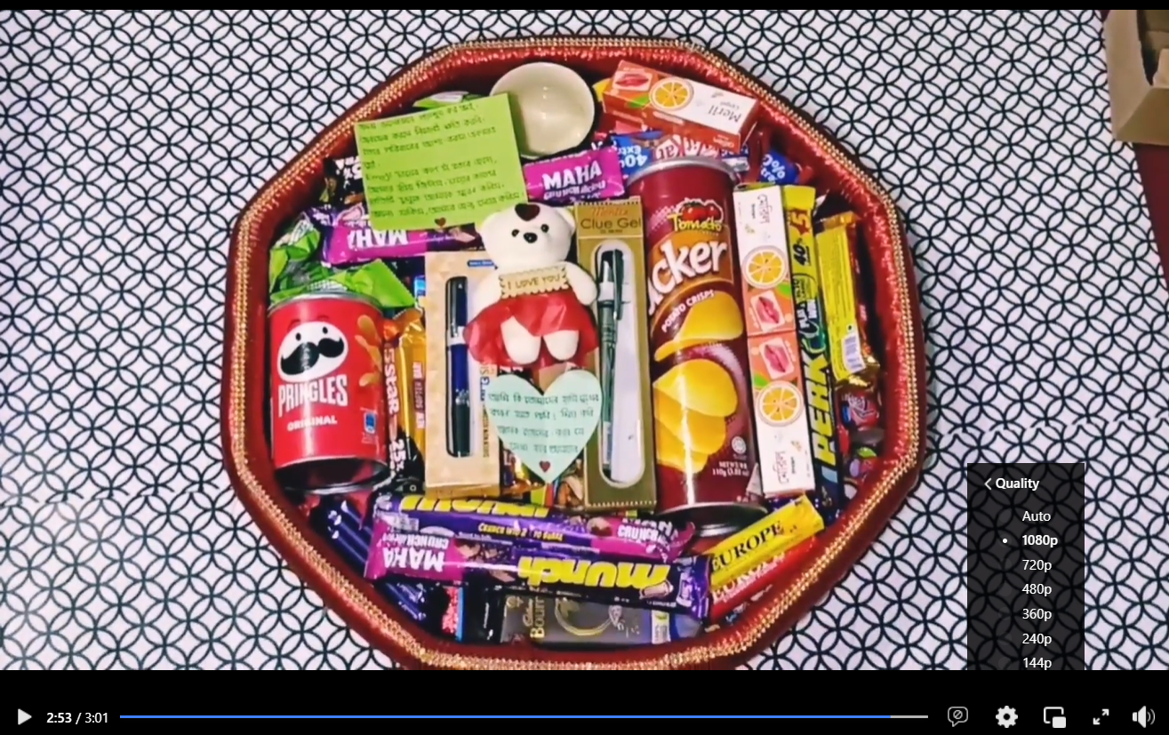
Our packages Video:

Slide 12
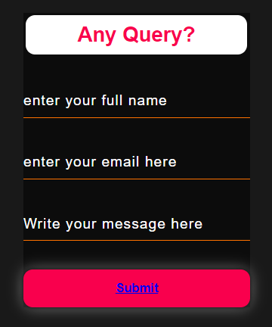
Any Query?

Slide 13
About Us:
Chocolate Gallery is dedicated to give you the appetizing flavor dipped in chocolates. Our products are effective not only in taste but also in supplying valuable energy to the body.Our authentic products maintain 100% hygiene. You can customize your package with your favourite chocolates.We provide good quality with low price and yummy taste to the last bites.
Location
Mobile No
Email

Slide 14
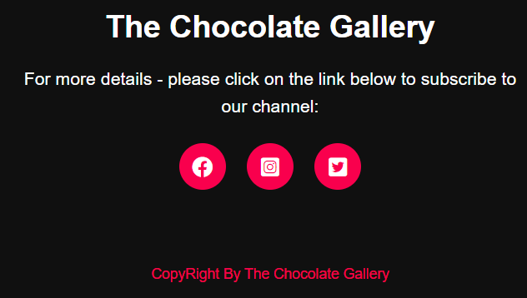
Footer Part:

Slide 15
Thanks for your time.

