Slide 1
Presentation on
Occupancy Detection

Slide 2

P- 01
Course Code: CSI 382
Course Title: Data Mining and Knowledge Discovery Sessional
Date of Submission: 28th May 2023
Submitted By
Name : Subrite Sarker
ID : CSE 070 08112
Name : Umme Habiba Naboni
ID : CSE 070 08119
Submitted To
Lomat Bhabi
Lecturer, Department of CSE
Stamford University Bangladesh

Slide 3
P- 02
INTRODUCTION
What is Occupancy Detection?
Occupancy detection refers to the process of determining whether a space, such as a room, building, or area, is occupied or unoccupied at a given time.
It involves using various sensors, data analysis techniques, and machine learning algorithms to infer the occupancy status based on collected data.

Slide 4
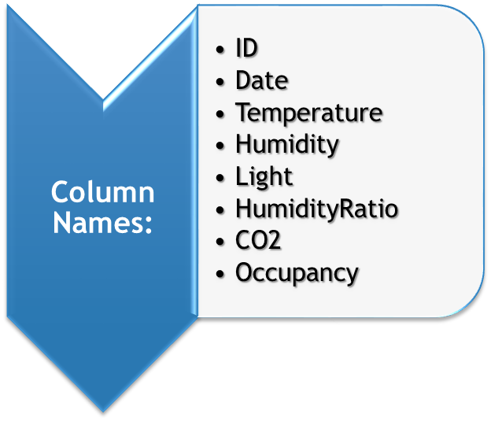
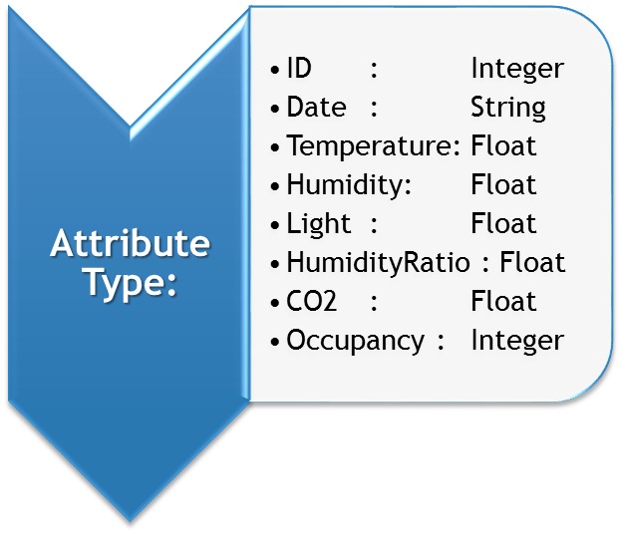
P- 03
DATASET INFORMATION
Our dataset has 20,560 rows and 8 columns.
Id, date ,Temperature, Humidity, Light, HumidityRatio, CO2 are the predictor variable and Occupancy is the target variable.

Slide 5
P- 04
DATA PRE-PROCESSING
Data pre-processing can refer to manipulation or cleaning or dropping of data before it is used in order to ensure or enhance performance.
Our dataset doesn’t contain any missing values; but the data of temperature, light, CO2, humidity contains large values. To do scaling the values of these attributes we used min-max normalization & Z-score normalization.

Slide 6
P- 05
EXPLORATORY DATA ANALYSIS
Exploratory Data Analysis (EDA) is an approach to analyse the data using visual techniques. It is used to discover trends, patterns, or to check assumptions with the help of statistical summary and graphical representations.
To determine pattern we tried to find co-related variables.
We used heatmap to find the co-related variables.

Slide 7
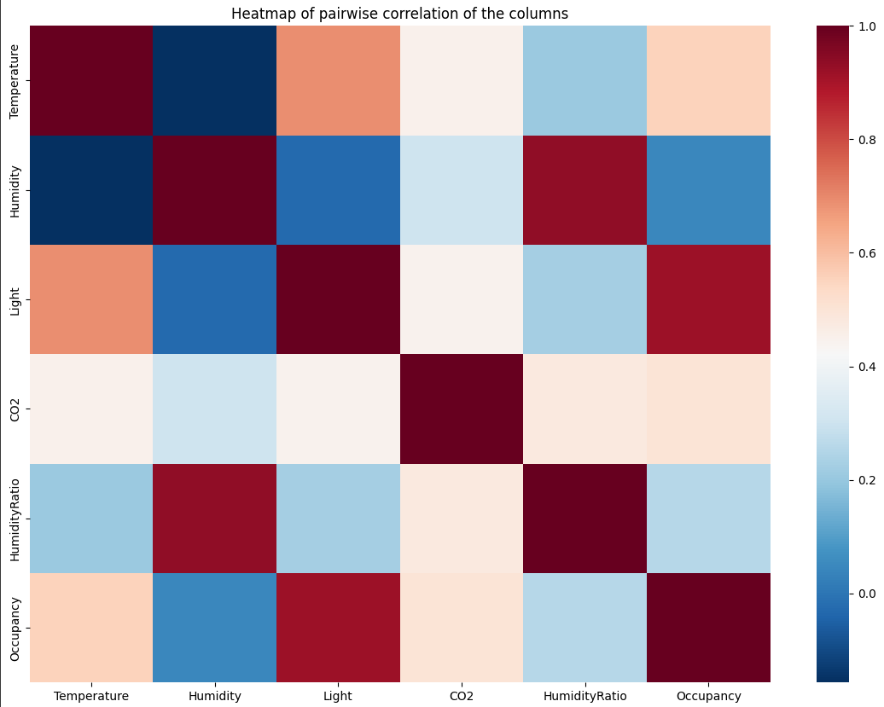
HEATMAP
P- 06
Figure: Heatmap of Co-related Variables
Inferences:
There doesn’t seem any relationship between humidity and temperature.
But there is a perfect relationship between light and occupancy.
Also between humidity and humidityRatio.

Slide 8
P-07
Clustering Algorithm:
Clustering is an unsupervised Machine Learning-based Algorithm which is a collection of records that are similar to one another and dissimilar to records in other clusters.
In this algorithm, there is no target variable for clustering.

Slide 9
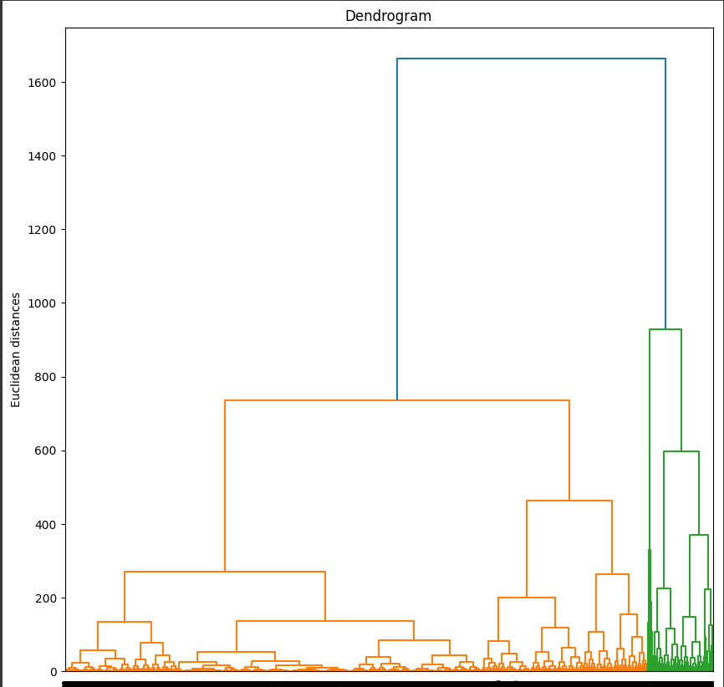
P-08
Hierarchical Clustering Methods:
Hierarchical clustering methods are a class of clustering algorithms that build a hierarchy of clusters.
They iteratively merge or split clusters based on their similarity, forming a tree-like structure called a dendrogram, which represents the hierarchical relationships between clusters.
Figure: Dendogram of Hierarchical Clustering Methods

Slide 10
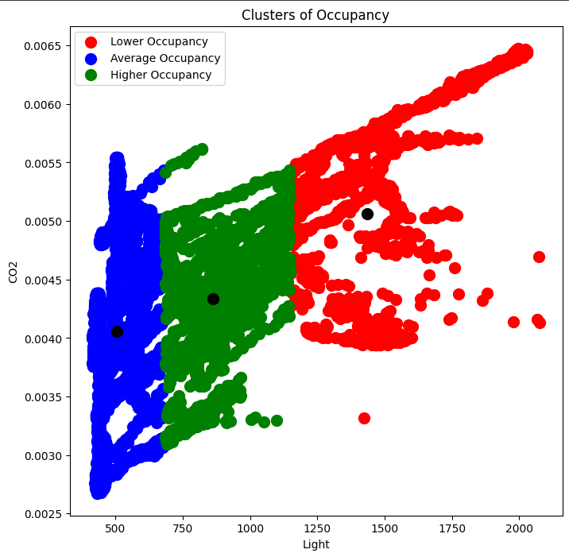
P-09
K-means Clustering: Light vs CO₂:
K-means clustering is an iterative algorithm that partitions a dataset into K clusters by minimizing the within-cluster sum of squares. It assigns data points to the nearest centroid, updates the centroids based on the assigned points, and repeats until convergence.
Figure: Light vs CO₂

Slide 11
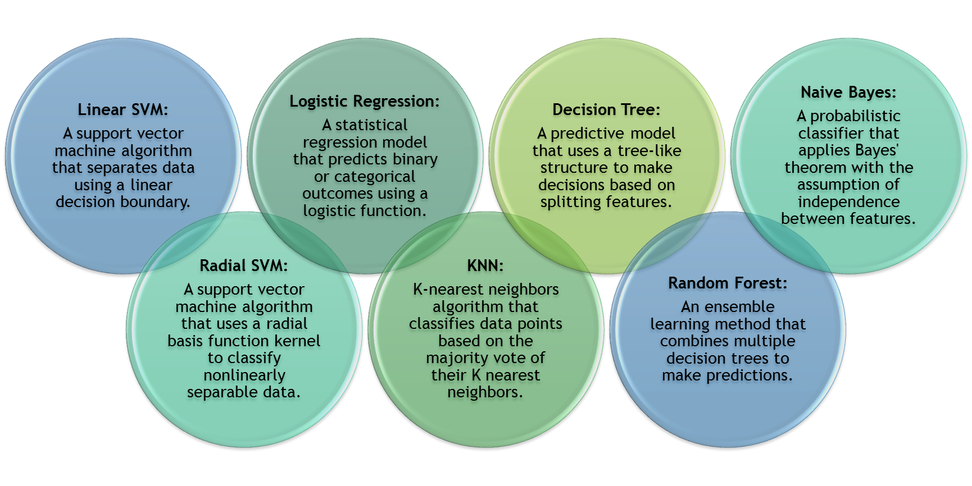
P- 10
MODEL IMPLEMENTATION

Slide 12
P- 11
COMPARISON
We calculate the accuracy of those models by two methods:
Holdout Method
K-fold Cross Validation Method

Slide 13
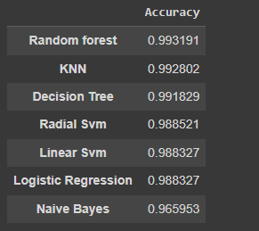
P- 12
Holdout Method:
Holdout Method is the simplest sort of method to evaluate a classifier.
In this method, the data set (a collection of data items or examples) is separated into two sets, called the Training set and Test set.
We see that Random Forest Classifier model has accuracy of 99.32%

Slide 14
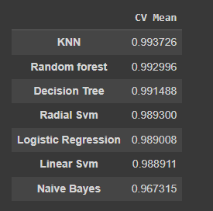
P- 13
K-fold Cross Validation Method:
In this approach, each record is used the same number of times for training and exactly once for testing.
Here, we can see that KNN Model has accuracy of 99.37%
Therefore, the accuracy of all models on our dataset at k-fold cross validation is better.

Slide 15
P-19
THANK YOU!

