Slide 1
Smarter Voice Control
By Daniel Verdagio
Robert Kiliszewski
Adrian Sypos

Slide 2
Objectives
To control the smarter coffee machine by voice activation using Cortana

Slide 3
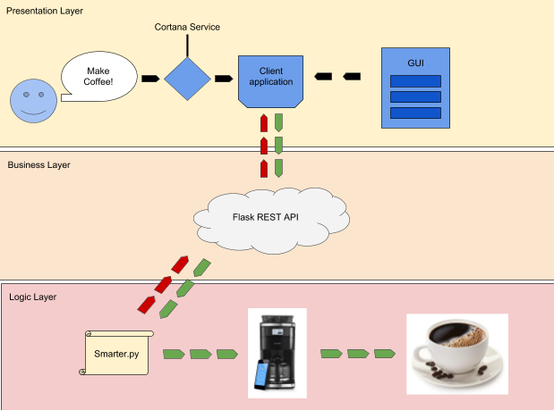
Architecture

Slide 4
Problems
Cortana creator update forced Cortana to only web search.

