Slide 1

Access Form— Role-Based Survey Management System
Sarmad Qadeer — BC220410808
This presentation explains the design, architecture, and user flows for AccessForm: a secure, role-aware web platform for building, sharing, and analyzing surveys.

Slide 2

Problem Statement
Manual data collection
Security gaps
Time-consuming, error-prone, and hard to scale.
No consistent authentication or access control for sensitive responses.
Role & storage issues
No role management and unstructured storage make analysis difficult.
Goal: Replace manual processes with a secure, role-based, structured survey platform.

Slide 3




System Overview
Secure Authentication
Dynamic Form Builder
Survey Sharing
Response Management
JWT-based sign-up / login flow with protected routes and role claims.
Visual editor for multiple question types: text, multiple choice, checkbox, rating, file upload.
Shareable links and access control so respondents register then respond.
Creator dashboard: preview, edit, analytics, delete, and copy link for each form.

Slide 4





User Flow
Landing
Login
Visitor sees main page and navbar
Authenticate to access role options
Register
Role
Create account with basic details
Choose Creator or Respondent
The diagram maps the primary navigation: visitors see a large landing page (navbar: Home, About, Contact, Settings, Login, Register). After registering they log in; role determines dashboard and available actions.

Slide 5




Creator Workflow
Create
From dashboard, click "Create Form" to open the form builder page.
Save
Save drafts or publish forms; saved forms appear as cards on the dashboard.
Share
Use "Copy link" or direct share. Set link permissions if needed.
Manage
Preview, Edit, View Analytics, Delete, or Copy Link from each form card.
After Save, creators return to dashboard where each form card exposes quick actions and analytics access.

Slide 6
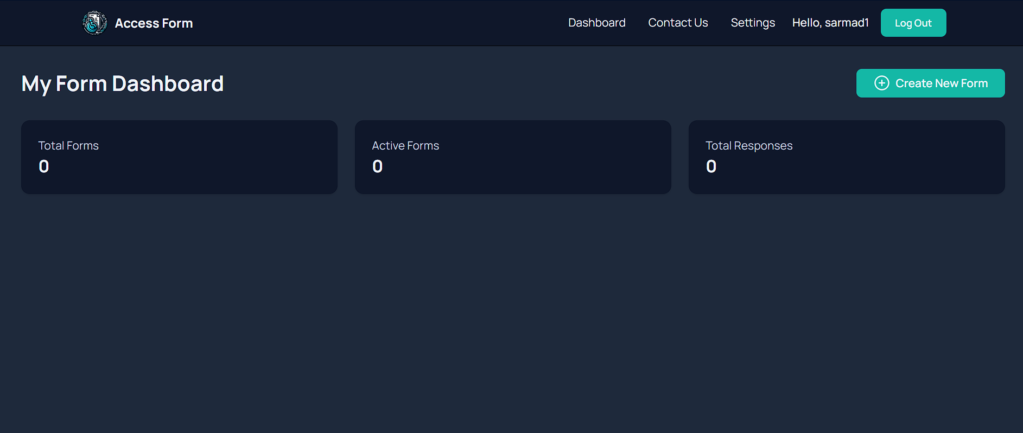

Slide 7
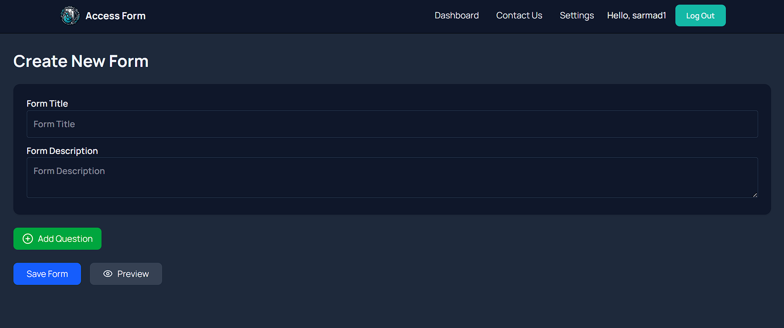

Slide 8
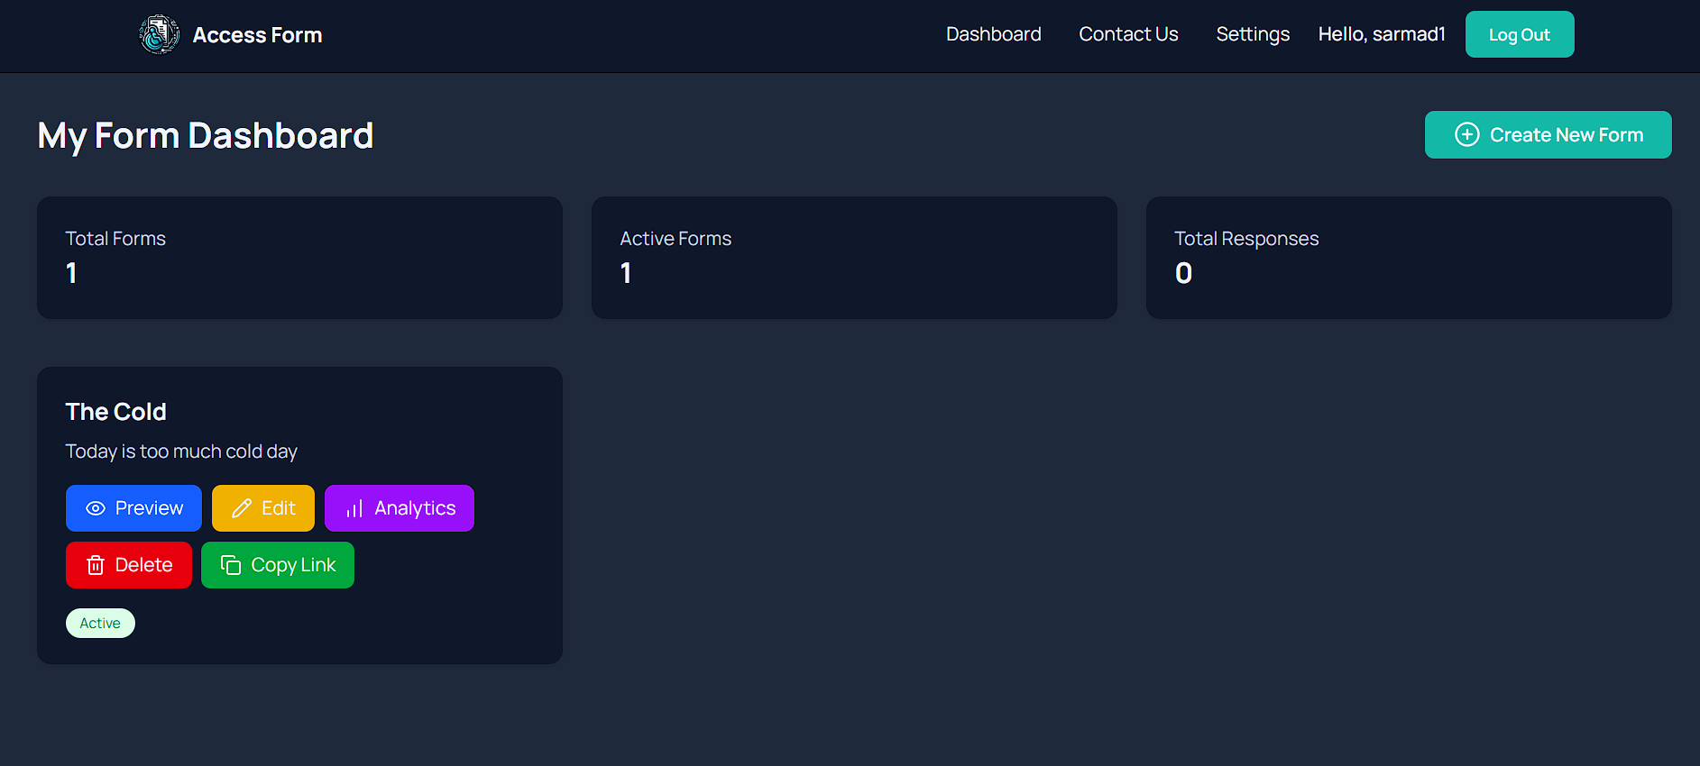

Slide 9




Survey Builder
Builder supports modular question types and drag-and-drop ordering. Each question includes validation rules, required toggles, and optional branching logic for advanced surveys.
Short / Long Text
Open-ended responses with character limits.
Multiple Choice
Single-select or multi-select with custom options.
Ratings
Numeric scales (1–5, 1–10) for quick quantification.
File Upload & Date
Collect attachments and structured date inputs.

Slide 10
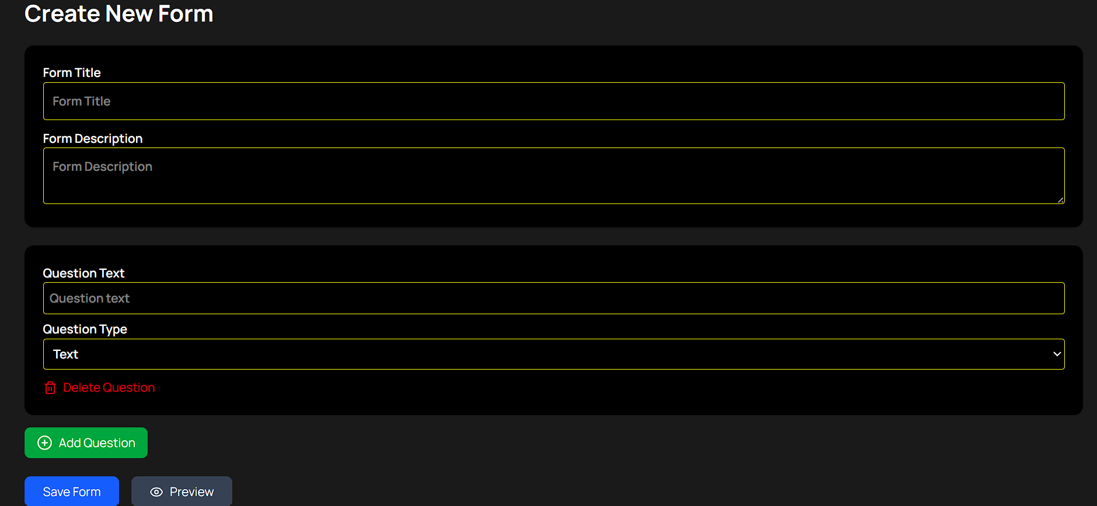

Slide 11
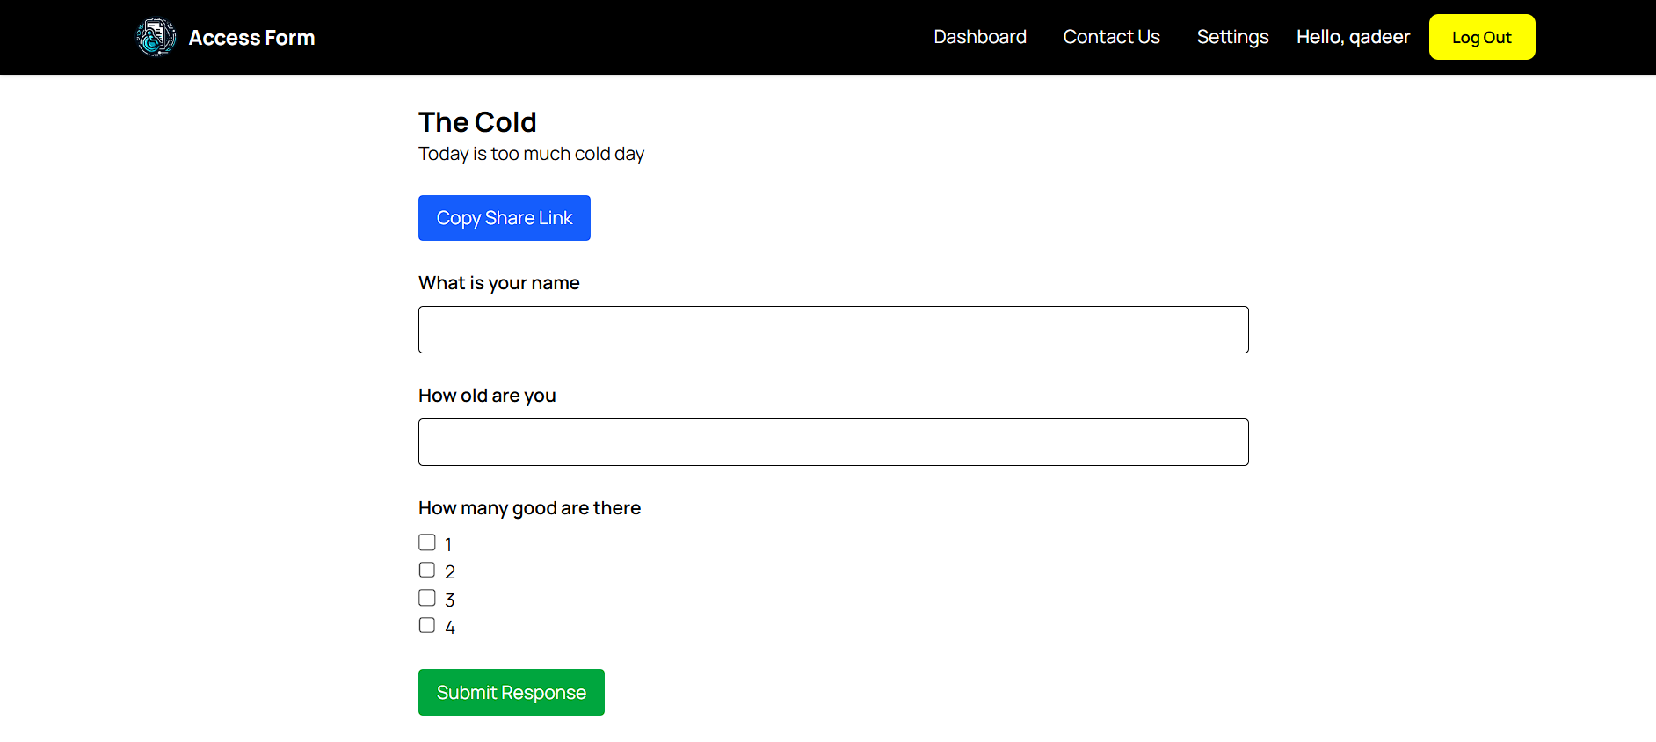
Respondent Workflow
Click shared survey link.
Register (if first time) → Redirect to Login.
Login → Route to the survey page tied to the link.
Complete survey → Submit → Confirmation and optional receipt.
Design ensures respondents register only once; role-based access prevents creators from accidentally taking their own unpublished tests.

Slide 12
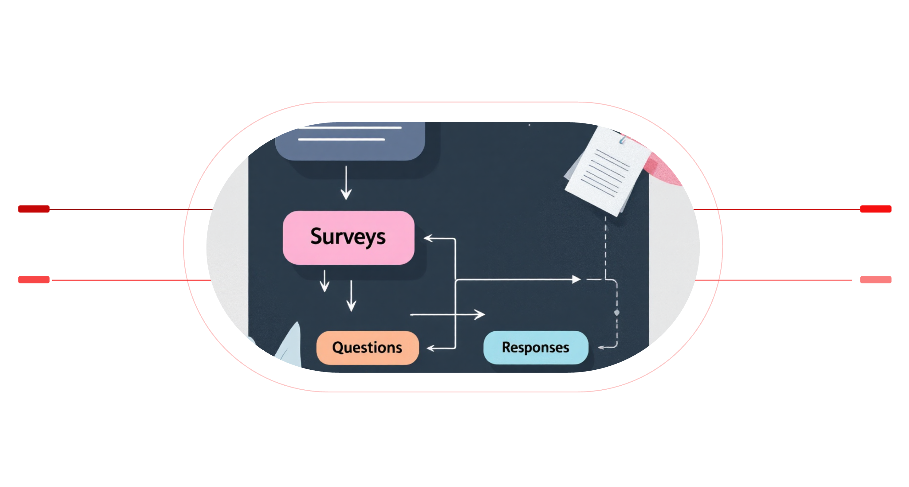
Database Architecture
Users
Surveys
Creators and respondents with role and JWT metadata
Created by users; contains question schema and settings
Questions
Responses
Belong to surveys; defined in survey schema
Submitted by respondents; linked to survey and question IDs
MongoDB Atlas stores documents: Users (with role and JWT metadata), Surveys (schema for questions and settings), Responses (linked by surveyId and respondentId). References used for lookups and aggregations.

Slide 13


Security Implementation
JWT Authentication: stateless tokens with role claims and expiration.
Role-based access control: middleware guards creator vs. respondent routes.
Protected routes: server enforces permissions for create/edit/analytics.
MongoDB Atlas: secure cloud database with IP whitelisting and encrypted storage.
Use HTTPS, rotate secrets, and limit token lifetime for best practice.

Slide 14



Challenges & Lessons
Challenges
Learning Outcomes
JWT debugging across client/server (token refresh, expiration).
Role-based routing complexities and authorization edge cases.
Handling MongoDB references vs. embedded documents for performance.
CORS and environment-specific deployment issues.
Full‑stack integration — frontend, backend, DB working together.
Designing and documenting REST APIs and protected endpoints.
Schema design tradeoffs for queries vs. writes.
Improved debugging workflow and deployment readiness.
Future Work
Analytics Dashboard
CSV Export & Email
Deployment
Visualize response trends, export CSV, and filter by user segments.
Allow bulk export and automated notification workflows.
CI/CD to cloud (Vercel / Heroku / AWS) and environment hardening.

Slide 15
Thank You

