Slide 1
CAPSTONE DEFENSE PRESENTATION | 5 MINUTES
Travellers Inn Sense
An AI-Powered Hotel Management and Reservation System with NLP Sentiment Analysis and Algorithmic Dynamic Pricing
CORE AI MODULE 1
NLP Sentiment Analysis
TextBlob polarity scoring & automatic theme extraction from customer reviews.
CORE AI MODULE 2
Algorithmic Dynamic Pricing
30-day occupancy & demand model with 1-click live room price synchronization.
RESERVATION & OPS
Secure Online Booking
Mandatory login gate, automated date validation, and interactive audit reports.

Slide 2
01. INTRODUCTION
Background & The Critical Problems in Boutique Hospitality
STATIC PRICING DILEMMA
Lost Revenue & Inflexible Rates
- Boutique hotels rely on static room rates throughout the year.
- High Demand Surges: The hotel misses out on optimized revenue due to fixed prices.
- Low Demand Periods: Rooms sit vacant because prices do not automatically adjust down.
- Manual Guesswork: Hotel owners lack dynamic demand calculation tools.
UNSTRUCTURED GUEST FEEDBACK
Feedback Overload & Slow Response
- Customer reviews are read manually or left unanalyzed across channels.
- Delayed Action: Recurring complaints (AC, cleanliness, staff) are identified too late.
- No Sentiment Scoring: Management has no automated polarity or priority metrics.
- Raw comments fail to translate into actionable operational improvements.
RESERVATION & OPS FRICTION
Unverified & Conflicted Bookings
- Unauthenticated visitors cause fake, duplicate, or ghost reservations.
- Date Conflict Risks: Lack of strict calendar validation allows invalid check-out dates.
- Manual Reporting: Gathering audit and revenue statistics is tedious and error-prone.
- No real-time room availability status filters for prospective guests.

Slide 3
02. OBJECTIVES
Project Goal & Specific Engineering Objectives
1. Automated Secure Booking Engine
Enforces customer authentication before reservation, prevents overlapping bookings, validates check-in/out date logic, and provides real-time room availability status filters.
GENERAL OBJECTIVE
To design and develop an intelligent, automated Hotel Management and Reservation System for Travellers Inn that integrates NLP-based Sentiment Analysis and Algorithmic Dynamic Pricing decision support.
Core Target:
Empower hotel management with data-driven decision tools to maximize room revenue and maintain guest satisfaction, while giving customers a secure, conflict-free online reservation experience.
2. NLP Sentiment Analysis & Theme Extraction
Integrates TextBlob Natural Language Processing to classify customer feedback into Positive, Neutral, and Negative sentiments, extracting actionable service themes.
3. Algorithmic Dynamic Pricing Decision Support
Formulates a dynamic pricing algorithm based on 30-day occupancy and demand metrics, featuring 1-click live price synchronization across all room listings.
4. Centralized Admin Management & Reports
Develops interactive administrative dashboards with filterable room maintenance status toggles and exportable revenue, booking, and guest feedback reports.

Slide 4
03. METHODOLOGY & ARCHITECTURE
Iterative Development & Technical Architecture
DEVELOPMENT METHODOLOGY
Iterative & Agile Software Engineering Model
- Phase 1: Requirements Gathering
Analyzed Travellers Inn manual reservation records, pricing policies, and customer review workflows.
- Phase 2: Architectural Design
Structured normalized relational PostgreSQL schemas and RESTful API contracts with Pydantic validation.
- Phase 3: Iterative Sprints
Developed React client interfaces, FastAPI backend endpoints, and integrated the TextBlob NLP & pricing algorithms.
- Phase 4: Verification & Refinement
End-to-end verification of date validation logic, mandatory auth gating, and automatic live price synchronization.
SYSTEM ARCHITECTURE & TECH STACK
3-Tier Enterprise Web Application
[Presentation Layer] React 18 + Vite + Tailwind CSS
High-performance SPA with client-side routing, interactive modals, and responsive layout.
[Application Layer] FastAPI (Python) + Uvicorn
Asynchronous RESTful APIs with JWT authentication, dependency injection, and Pydantic schemas.
[AI & Algorithm Layer] TextBlob NLP & Dynamic Pricing Model
Real-time polarity/subjectivity scoring and 30-day occupancy/demand recommendation formula.
[Data Layer] PostgreSQL + SQLAlchemy ORM
ACID-compliant storage for users, rooms, bookings, reviews, and dynamic pricing recommendations.

Slide 5
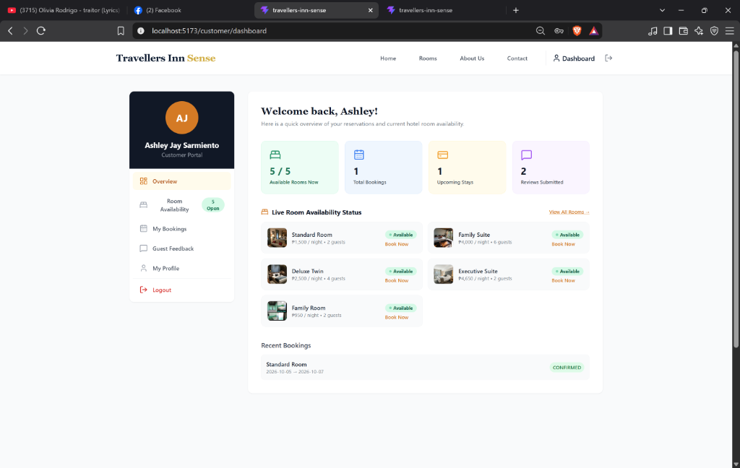
04. GRAPHICAL USER INTERFACE
Customer Portal & Frictionless Booking Workflow
KEY CUSTOMER CAPABILITIES
✓ Mandatory Auth Gate Before Booking
Unregistered visitors can browse rooms, but clicking 'Book Now' triggers an 'Account Required' modal requiring registration or login, preventing ghost bookings.
✓ Automated Date & Capacity Validation
Enforces check-out date > check-in date with automatic calendar minimum adjustments (minimum 1 night stay) and live room price calculation.
✓ Personalized Customer Portal
Dedicated dashboard displaying live room availability, confirmed booking statuses, upcoming stays, and direct 5-star review submission.

Slide 6
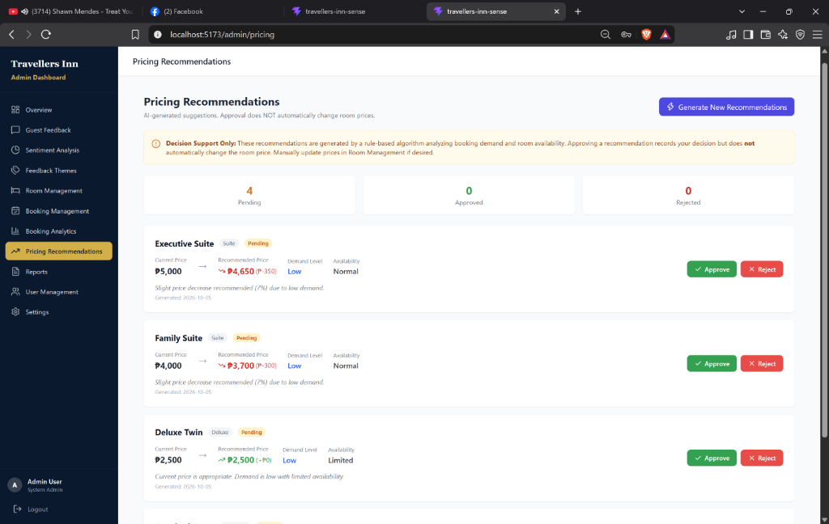
05. ADMINISTRATIVE & AI MODULES
Algorithmic Dynamic Pricing & NLP Sentiment Analytics
CORE ADMINISTRATIVE AI CAPABILITIES
★ 1-Click Algorithmic Price Synchronization
The dynamic pricing engine evaluates 30-day occupancy and market demand. Clicking 'Approve' immediately updates the live room price in PostgreSQL and syncs across all customer booking channels.
★ NLP Sentiment Analysis & Thematic Insights
TextBlob calculates Polarity (-1.0 to +1.0) and Subjectivity scores, classifying reviews into Positive, Neutral, or Negative, and categorizing feedback into themes (Cleanliness, Amenities, Staff).
★ Interactive Management & Audit Reports
Real-time room availability toggles (Available/Maintenance), local device image uploads with HTML5 canvas compression, and CSV/print exportable reports.

Slide 7
06. CONCLUSION
Project Summary & Ready for Live Demonstration
EFFORTLESS RESERVATION
100% Conflict-Free Booking
Guaranteed customer authentication, strict check-in/out date validations, and live room availability status filters.
ACTIONABLE NLP INSIGHTS
Automated Sentiment Triage
TextBlob natural language processing translates unstructured feedback into prioritized operational improvements.
REVENUE OPTIMIZATION
Dynamic Price Synchronization
Demand-driven price recommendations with instant live updates to capture peak revenue and minimize room vacancy.
Thank you very much! We are now ready for the LIVE SYSTEM DEMONSTRATION & Q&A.

