Slide 1
SIGN LANGUAGE RECOGNITION SYSTEM
21PT10 - Kiruthika V G
21PT27 - Sarmitha V D

Slide 2
TABLE OF CONTENTS
01
02
03
04
05
06
Introduction
Objective
Dataset & Data Preprocessing
ML Model
Methods
Estimation Metric

Slide 3
01
INTRODUCTION

Slide 4


This project aims to create a Sign Language Recognition System that can interpret and recognize hand gestures captured from a webcam in real-time, allowing users to communicate with the system through sign language.
This system utilizes computer vision and machine learning techniques to recognize and interpret hand gestures
In this context, the development of a Sign Language Recognition System has emerged as a transformative technological solution with the potential to bridge the communication gap between individuals who use sign language and those who may not understand it.

Slide 5
02
OBJECTIVE

Slide 6
The primary goal of this project is to train a robust machine learning model capable of accurately recognizing sign language gestures.
Our second objective is to enable real-time inference, allowing the system to interpret gestures on-the-fly.

Slide 7
03
DATA SET AND
DATA PREPROCESSING

Slide 8
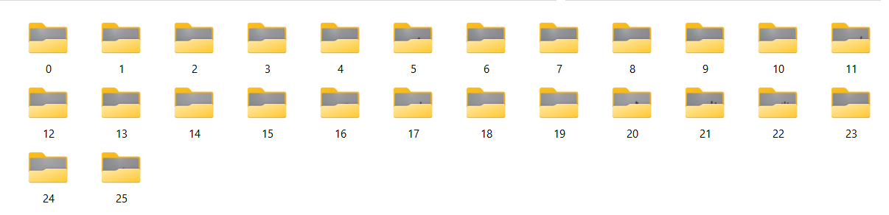

Slide 9
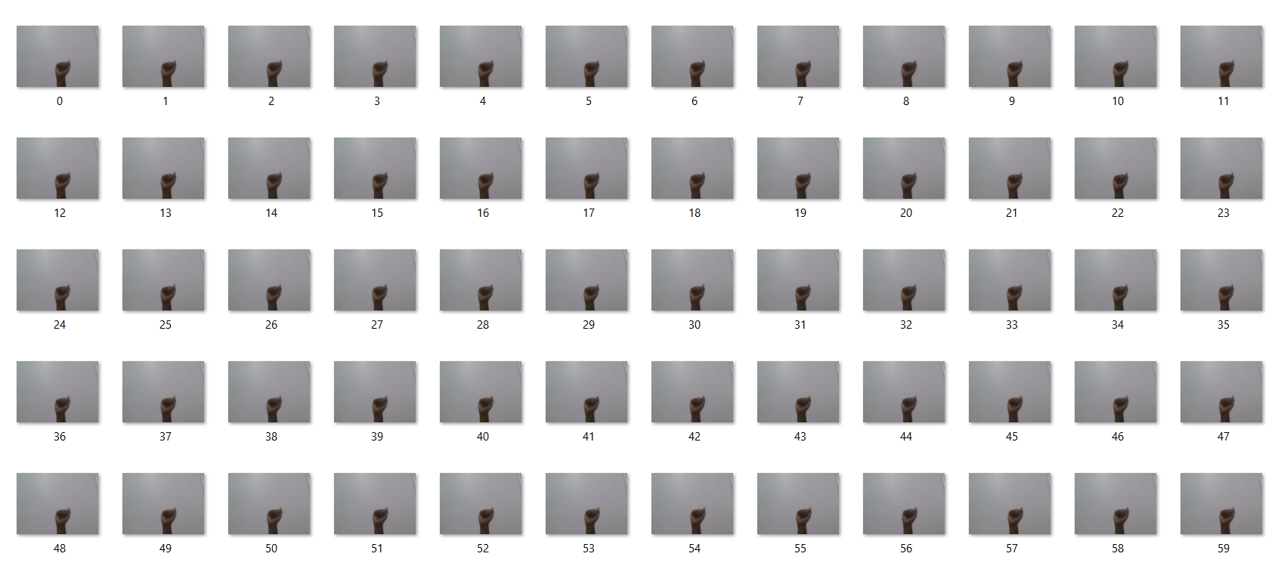


Slide 10
The extraction of hand landmarks from images which is the hardest part.
Normalization of data for training enhances the model's ability to generalize across different gestures, contributing to improved accuracy and reliability.
Saving the processed data and corresponding labels in a pickle file.

Slide 11
04
MACHINE LEARNING MODEL

Slide 12
Splitting Data: The data is split into training and testing sets using train_test_split from Scikit-learn.
RandomForestClassifier:
Able to handle complex relationships in data.
Perfect for grasping and decoding the noticeable and unique patterns in hand signs.
Model Training: The model learns to recognise the special and distinctive features of the gestures, optimizing its ability to make accurate predictions.

Slide 13
05
ESTIMATION METRIC

Slide 14
Prediction: Using the trained model to predict the labels for the test data.
Accuracy:
The accuracy_score function then compares the predicted labels with the actual labels from the test data and calculates the accuracy.
Provide insights into the model's performance, indicating the percentage of correctly classified gestures in the testing dataset.

Slide 15
06
METHODS

Slide 16
cv2: For computer vision tasks using OpenCV
MediaPipe library:
For hand landmark detection.
Enables precise localization of hand landmarks, forming the basis for accurate gesture recognition.

Slide 17
THANK-YOU

