Slide 1

Business forecasting during Covid times
Corona virus image courtesy
https://www.who.int
Timeseries analysis
Estimating covid impact
Forecasting future
Forecast for what-if scenarios
Speaker:
Sarnath Kannan
Data cleaner, wrestler, fighter, scrambler, scavenger, decorator, *.*
Data dinosaur as my friend Arun calls me…

Slide 2
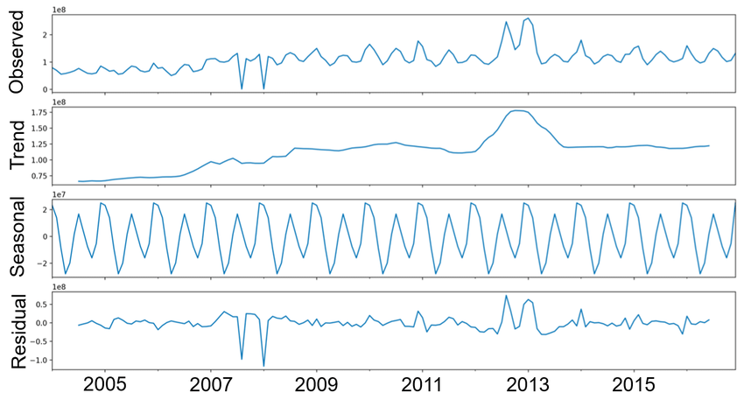
Figure courtesy:
https://www.researchgate.net/figure/ARIMAs-breakdown-of-time-series-data_fig1_330626000
Jin Cho

Slide 3
2020 begins!

Slide 4
2020 begins!

