Slide 1

Kubernetes Foundations
& Container Orchestration
Master the fundamentals of container orchestration at scale

Slide 2
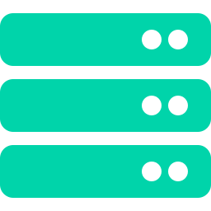
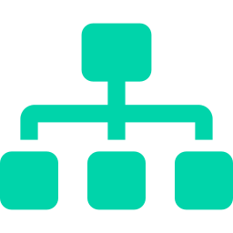
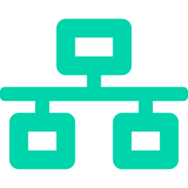
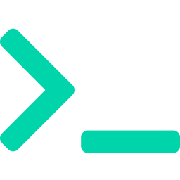
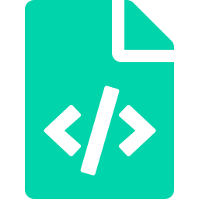

Learning Objectives
Understand why Kubernetes exists and what problems it solves
Learn Kubernetes architecture - Control Plane & Worker Nodes
Understand Pods, the smallest deployable unit in Kubernetes
Explore microservices and service discovery concepts
Master essential kubectl commands for cluster interaction
Understand YAML manifest structure and kubeconfig
Deploy your first application on Minikube

Slide 3
The Challenge We’re Solving
“We have 50 containers running... and everything is on fire.”
Without Orchestration
With Kubernetes
Manual container start/stop on each server
No auto-restart when containers crash
Manual scaling - guess how many to run
No load balancing between instances
Deployment = SSH + pray
No health monitoring or self-healing
Declarative: define desired state, K8s enforces it
Auto-restarts crashed containers instantly
Horizontal auto-scaling based on CPU/memory
Built-in load balancing and service discovery
Rolling updates with zero downtime
Self-healing: detects and replaces failures

Slide 4
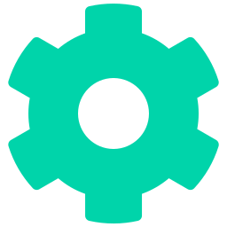
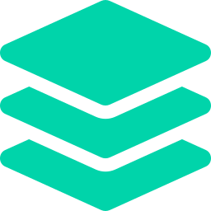

What is Kubernetes?
An open-source container orchestration platform that automates deployment, scaling, and management of containerized applications
Self-Healing
Auto-Scaling
Service Discovery
Automatically restarts failed containers, replaces unhealthy ones, kills unresponsive pods
Scales pods horizontally based on CPU, memory, or custom metrics. Scales nodes via cloud ASGs
Built-in DNS (CoreDNS) gives every service a stable name. No hardcoding IPs between microservices

Slide 5
Kubernetes Architecture
Control Plane (Master)
Worker Nodes
API Server
kubelet
Gateway to the cluster. All communication goes through it.
Agent on each node. Communicates with API Server, manages containers.
etcd
kube-proxy
Key-value store. Saves the entire cluster state.
Manages network rules. Routes traffic to the right pods.
Scheduler
Container Runtime
Assigns pods to worker nodes based on resources.
Runs containers (containerd, CRI-O). Pulls images, starts processes.
Controller Manager
Pods
Ensures desired state matches actual state.
Your workloads run here. Smallest deployable unit in K8s.

Slide 6
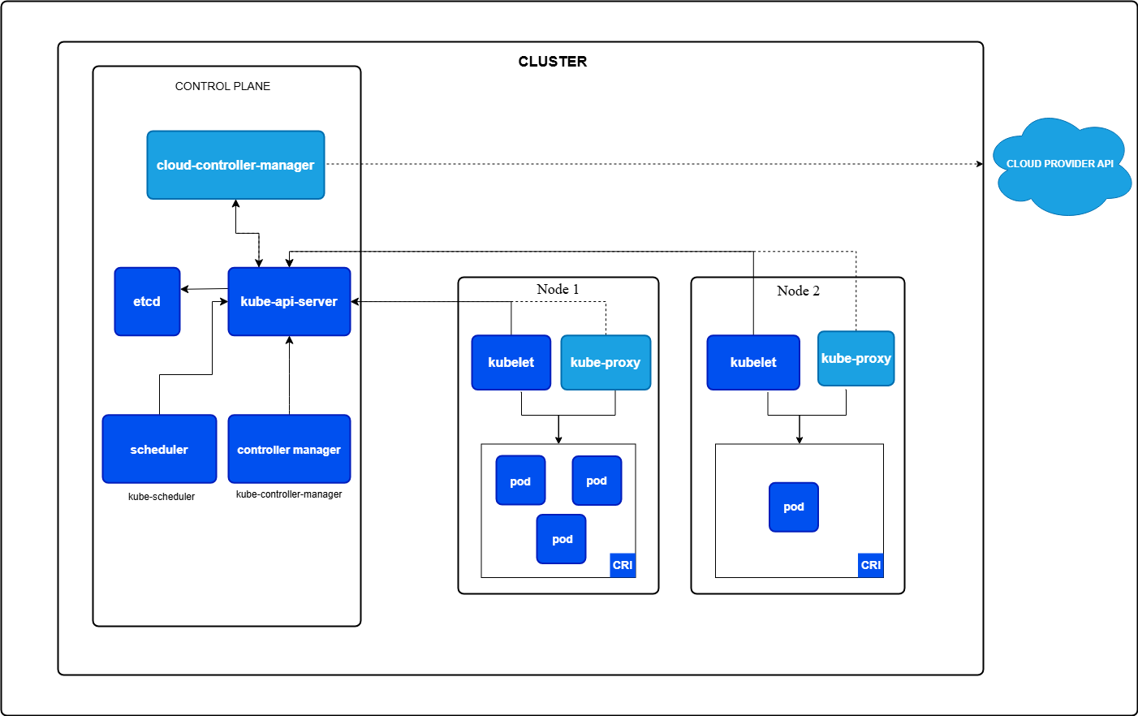
Kubernetes Architecture

Slide 7
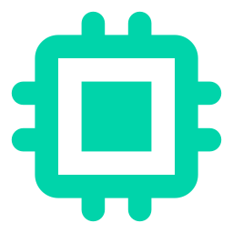
How It All Works Together
1
User runs: kubectl apply -f deployment.yaml
2
API Server validates the request and stores desired state in etcd
3
Scheduler finds the best worker node with available resources
4
kubelet on that node pulls the image and starts the container
5
kube-proxy sets up networking so traffic can reach the pod
6
Controller Manager watches and ensures desired state is maintained

Slide 8
Pods: The Smallest Deployable Unit
A Pod wraps one or more containers that share the same network namespace and storage. Containers in a pod communicate via localhost.
Single-Container Pod (Most Common)
Multi-Container Pod (Sidecar Pattern)
One main application container per pod
Most common pattern in production
Managed by Deployments for scaling
Example: nginx pod, Flask API pod
Main app + supporting containers
Share network (localhost) and storage
Sidecar examples:
Log collector (Fluentd)
Metrics exporter (Prometheus)
Redis cache sidecar

Slide 9
Microservices & Service Discovery
In a microservices architecture, services need to find and talk to each other reliably - without hardcoding IPs
Frontend
Cart
Payment
Notification
CoreDNS + Kubernetes Services = Reliable service discovery. No hardcoded IPs needed.
Real-World Microservice Examples:
E-commerce
User Service → Cart → Payment → Notification
Streaming
User Profile → Recommendation → Streaming → Billing
Banking
Account → Transaction → Fraud Detection → Notification

Slide 10
Kubernetes YAML Structure
Every Kubernetes manifest follows the A-K-M-S pattern
A
apiVersion
Which K8s API version to use
v1, apps/v1, networking.k8s.io/v1
K
kind
What type of resource to create
Pod, Deployment, Service, ConfigMap
M
metadata
Identity - name, labels, namespace
name: my-app, labels: {app: web}
S
spec
Desired state - the actual configuration
containers, replicas, ports, volumes

Slide 11
Sample Pod Manifest
apiVersion: v1
kind: Pod
metadata:
name: my-first-pod
labels:
app: hello-k8s
spec:
containers:
- name: nginx
image: nginx:latest
ports:
- containerPort: 80
A = apiVersion | K = kind | M = metadata | S = spec

Slide 12
Essential kubectl Commands
kubectl get pods -A
List all pods across all namespaces
kubectl describe pod <name>
Show detailed info about a pod
kubectl apply -f <file>.yaml
Create or update resource from YAML
kubectl delete -f <file>.yaml
Delete resource defined in YAML
kubectl logs <pod-name>
View container logs
kubectl exec -it <pod> -- bash
Get interactive shell inside a pod
kubectl get nodes
List all cluster nodes and their status
kubectl config get-contexts
List all available cluster contexts

Slide 13
Kubeconfig: Cluster Access
The kubeconfig file (usually at ~/.kube/config) tells kubectl which cluster to talk to and how to authenticate
Clusters
Defines the K8s clusters you can connect to - server address, certificate authority.
Users
Authentication credentials - certificates, tokens, or AWS IAM for EKS clusters.
Contexts
Combines a cluster + user + namespace into a named shortcut. Switch with kubectl config use-context.
current-context
Which context is active right now. All kubectl commands run against this context.
kubectl config get-contexts | kubectl config use-context minikube

Slide 14
Minikube: Your Local K8s Cluster
Minikube runs a single-node Kubernetes cluster locally for learning and development
Why Minikube?
Quick Start Commands
Free - no cloud costs for learning
Fast - starts in under a minute
Full K8s - same API as production clusters
Safe - experiment without breaking anything
Cross-platform - Windows, macOS, Linux
minikube start
Start local cluster
minikube status
Check cluster health
minikube ip
Get cluster IP address
minikube dashboard
Open K8s web UI
minikube stop
Stop cluster (preserves state)
minikube delete
Delete cluster entirely

Slide 15
Hands-on Labs
Time to Practice!

