Slide 1
SAROBIN SILVIYA
Final Project
3/21/2024 Annual Review

Slide 2
IDENTIFYING RISK FACTORS FOR HEART DISEASE USING CNN
3/21/2024 Annual Review

Slide 3


AGENDA
PROBLEM STATEMENT
PROJECT OVERVIEW
WHO ARE THE END USERS ?
YOUR SOLUTION AND ITS VALUE PROPOSITION
THE WOW IN YOUR SOLUTION
MODELLING
RESULTS
3/21/2024 Annual Review

Slide 4

PROBLEM STATEMENT
Heart disease is a leading cause of death globally. Early detection of risk factors can lead to effective prevention and treatment. However, the identification of these risk factors is often complex due to the interplay of various physiological and lifestyle variables.
The goal of this project is to develop a Convolutional Neural Network (CNN) model that uses patient data to identify key risk factors for heart disease. This model should be able to take in relevant patient information and output the significant risk factors and the likelihood of the patient developing heart disease.
3/21/2024 Annual Review

Slide 5

PROJECT OVERVIEW
This project aims to develop a Convolutional Neural Network (CNN) model to identify key risk factors for heart disease using patient data.
Data Collection: Gather a dataset that includes a wide range of potential risk factors. This could include demographic information, physiological factors, and lifestyle factors.
Data Preprocessing: Clean the dataset by handling missing values and outliers. Perform necessary transformations for the CNN algorithm.
Model Development: Develop a CNN model using the preprocessed dataset. The model should be able to identify the most significant risk factors and predict the likelihood of heart disease.
Model Evaluation: Evaluate the performance of the CNN model using appropriate metrics. Analyze the results to understand the model’s strengths and weaknesses.
Risk Factor Identification: Use the CNN model to identify the key risk factors for heart disease. Analyze the results and provide insights.
3/21/2024 Annual Review

Slide 6

WHO ARE THE END USERS?
The end users for the heart disease risk factors identification project would primarily be healthcare professionals such as doctors, nurses, and medical researchers. They can use the CNN model to identify key risk factors for heart disease in their patients and predict the likelihood of the disease, which can aid in early detection and treatment. Additionally, health-conscious individuals could also use this model to understand their own risk factors and take preventive measures.
3/21/2024 Annual Review

Slide 7

YOUR SOLUTION AND ITS VALUE PROPOSITION
Personalized Healthcare: By using individual patient data, the model can provide personalized risk assessments. This can help healthcare professionals tailor prevention and treatment strategies to each patient’s unique risk profile.
Resource Optimization: By identifying patients at high risk of heart disease, healthcare providers can prioritize resources and interventions for those who need them most.
Research Tool: The model can also serve as a valuable tool for medical researchers studying heart disease, providing insights into the relative importance of different risk factors.
Health Awareness: For health-conscious individuals, the model can provide valuable information about their own risk factors and encourage preventive measures.
3/21/2024 Annual Review

Slide 8

THE WOW IN YOUR SOLUTION
The “wow” factor in the solution lies in its potential to revolutionize healthcare through personalized risk assessments. The CNN model can analyze a multitude of factors simultaneously and provide a detailed risk profile for each individual. This level of personalization can lead to more effective prevention strategies and treatments tailored to each patient’s unique needs. Moreover, the model’s ability to predict the likelihood of heart disease can potentially save lives through early detection.
3/21/2024 Annual Review
8

Slide 9
MODELLING
Data Collection: Gather a dataset of medical images (like ECG or MRI scans) and patient data (like age, gender, lifestyle habits, etc.) with labels indicating whether the patient has heart disease or not.
Data Preprocessing: This might involve normalizing the images, handling missing values in the patient data, and splitting the data into training and validation sets.
Model Architecture: Design a CNN that takes as input the medical images and patient data, and outputs a probability of the patient having heart disease. The CNN might have convolutional layers to process the images and fully connected layers to process the patient data.
Model Training: Train the CNN on the training data using a suitable loss function (like binary cross-entropy for a binary classification problem) and optimizer (like Adam or SGD).
Model Evaluation: Evaluate the performance of the CNN on the validation data using appropriate metrics (like accuracy, precision, recall, AUC-ROC, etc.).
3/21/2024 Annual Review
9

Slide 10
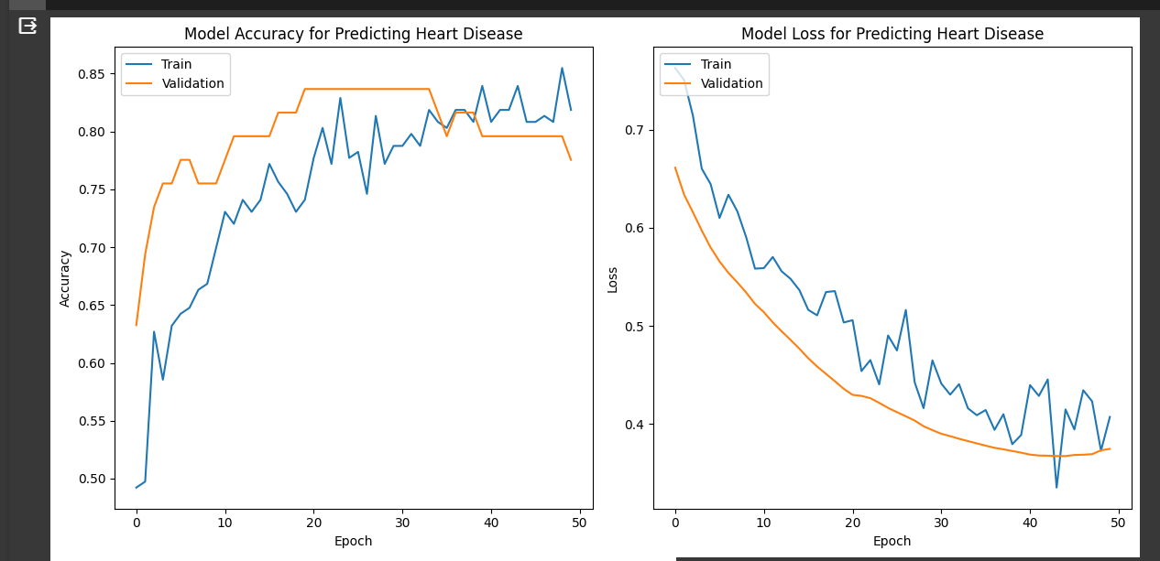
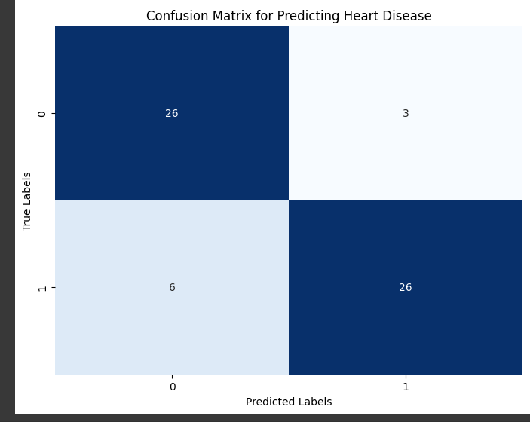
RESULTS
3/21/2024 Annual Review
10

