Slide 1


TIME SERIES FORECASTING OF SECTOR-WISE STOCK PERFORMANCE
Data 690 :Financial Data Science

Slide 2
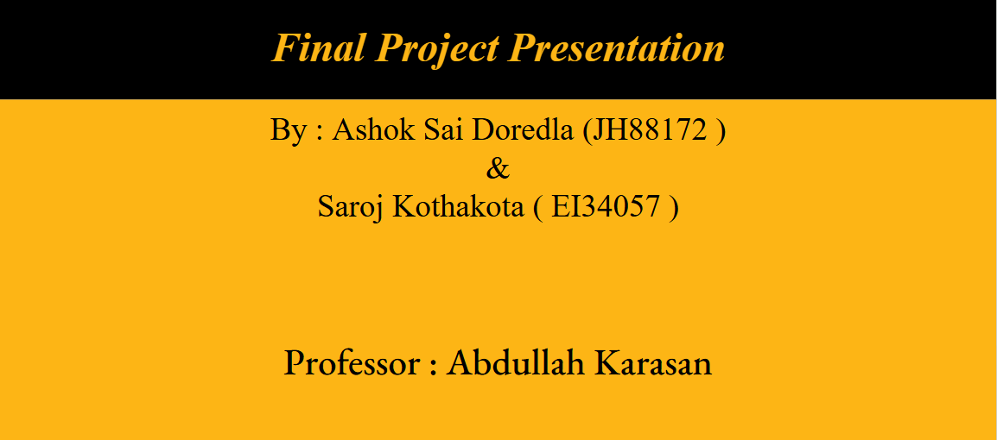

Slide 3
INTRODUCTION
Our Project, Time Series Forecasting of Sector-Wise Stock Performance, aims to analyze and predict the stock performance of various economic sectors, including Technology, Healthcare, and Energy. By leveraging advanced forecasting models such as SARIMAX and LSTM, this project seeks to uncover trends, patterns, and anomalies in sectoral stock data. Accurate time series forecasting is vital for understanding market dynamics, enabling stakeholders to make informed investment decisions and mitigate risks associated with volatile stock movements. Furthermore, Monte Carlo simulations are incorporated to model potential price movements, assess the impact of volatility, and simulate a range of future outcomes. This enables a deeper understanding of risk and return profiles, providing investors with a comprehensive view of possible market scenarios. This study highlights the importance of robust forecasting techniques in managing financial uncertainty and driving strategic decision-making in an ever-evolving economic landscape.

Slide 4
DATA OVERVIEW
The dataset for this project is collected from Yahoo Financials, offering a comprehensive view of sector-wise stock performance for Technology, Healthcare, and Energy sectors. Spanning multiple years, the data includes key metrics such as timestamps, sector performance indicators, trading volume, and price metrics like open, close, high, and low prices. These features provide a detailed understanding of historical stock trends and seasonal patterns across the sectors.
Extensive preprocessing was undertaken to prepare the dataset for analysis. Missing values, common in financial datasets, were addressed through imputation or removal to ensure data consistency. To aid model accuracy, numerical values were normalized, bringing all variables to a uniform scale, which helped the models identify patterns more effectively. Outliers, such as extreme price fluctuations, were detected and removed to minimize skewed forecasting.
This curated dataset forms the foundation for applying time series forecasting models like SARIMAX and LSTM. By leveraging this high-quality data, the project aims to uncover trends and provide actionable insights into sectoral stock behavior, offering valuable support for strategic decision-making in volatile financial markets.

Slide 5
ANALYSED STOCKS - SECTOR WISE
Technology Sector:
Apple Inc.
Microsoft Corporation
Alphabet Inc.
Amazon.com Inc.
NVIDIA Corporation
Taiwan Semiconductor
Salesforce Inc.
Advanced Micro Devices
Intel Corporation
Cisco Systems
Health Care Sector:
Johnson & Johnson
Pfizer Inc.
AbbVie Inc.
Merck & Co.
Thermo Fisher Scientific
UnitedHealth Group
Abbott Laboratories
Eli Lilly and Company
Bristol-Myers Squibb
CVS Health Corporation
Energy Sector:
Exxon Mobil Corporation
Chevron Corporation
ConocoPhillips
Phillips 66
Schlumberger Limited
Marathon Petroleum
Valero Energy Corporation
Kinder Morgan
Williams Companies
Hess Corporation

Slide 6
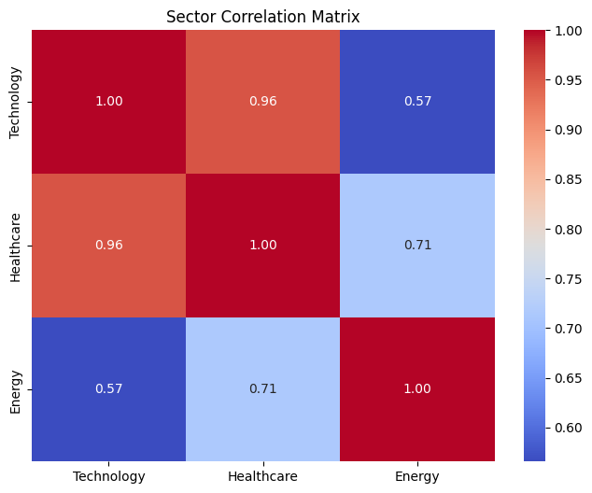
SECTOR CORRELATION MATRIX
The heatmap displays the correlation between the Technology, Healthcare, and Energy sectors. The correlation between Technology and Healthcare is extremely high at 0.96, indicating they move in sync. Healthcare and Energy have a moderate correlation of 0.71, while Technology and Energy have the weakest correlation at 0.57. This suggests that Technology and Energy can provide greater diversification benefits when combined in a portfolio.

Slide 7
METHODOLOGY
In this project, we employed advanced time series forecasting techniques to predict the stock performance of the Technology, Healthcare, and Energy sectors. The primary models used were SARIMAX (Seasonal Autoregressive Integrated Moving Average with eXogenous regressors) and LSTM (Long Short-Term Memory), each chosen for their ability to handle different aspects of time series data.
SARIMAX Model: The SARIMAX model is a powerful tool for time series forecasting, incorporating autoregressive (AR) and moving average (MA) components along with seasonal factors. By capturing both short-term trends and seasonal patterns, SARIMAX provides valuable insights into the performance dynamics of each sector. It uses external regressors, such as economic factors or trading volume, to enhance its predictive capabilities.
LSTM Model: The LSTM model, a type of recurrent neural network (RNN), was used to capture long-term dependencies in the data. LSTMs are particularly effective in modeling sequential data like stock prices, as they can retain information over extended periods. The model's ability to learn complex temporal relationships allows it to adapt to the highly volatile nature of financial markets.

Slide 8
MONTE CARLO SIMULATION :
The Monte Carlo simulation model was employed to evaluate the uncertainty and potential future performance of sector-wise stock prices. By generating thousands of random scenarios based on historical volatility and trends, the model provides a range of possible outcomes, including median predictions and percentile spreads. This approach helps in quantifying risks and understanding the variability across the Technology, Healthcare, and Energy sectors, offering valuable insights into their future dynamics and volatility.
HYBRID MODEL : To further improve forecasting accuracy, we combined the strengths of both models in a hybrid approach. By integrating SARIMAX's ability to model seasonality and trend with LSTM’s proficiency in capturing long-term dependencies, the hybrid model aimed to provide more robust predictions. This combination allowed the model to account for both short-term fluctuations and long-term trends, enhancing overall forecast accuracy.
The methodologies were applied to each sector, and the performance was evaluated using metrics like Mean Absolute Error (MAE), Root Mean Squared Error (RMSE), and R-squared. This multi-faceted approach aimed to provide a more accurate and comprehensive understanding of sectoral stock performance, particularly in the face of market volatility.

Slide 9
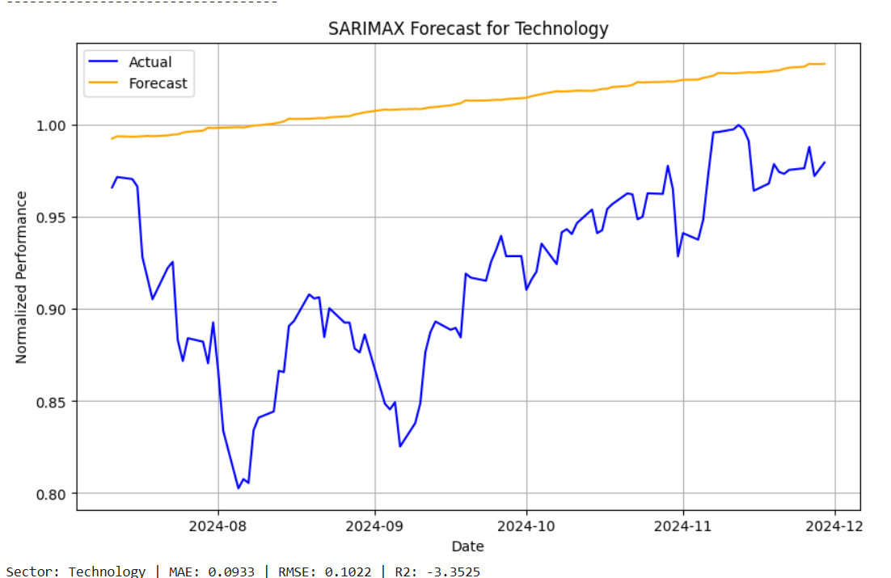
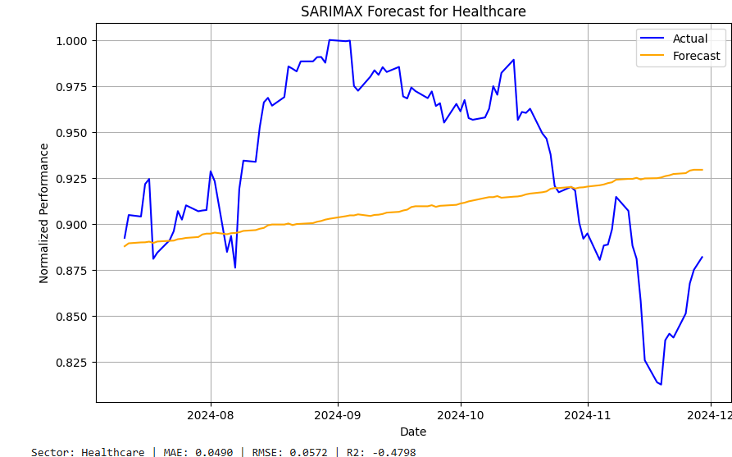
SARIMAX FORECAST

Slide 10
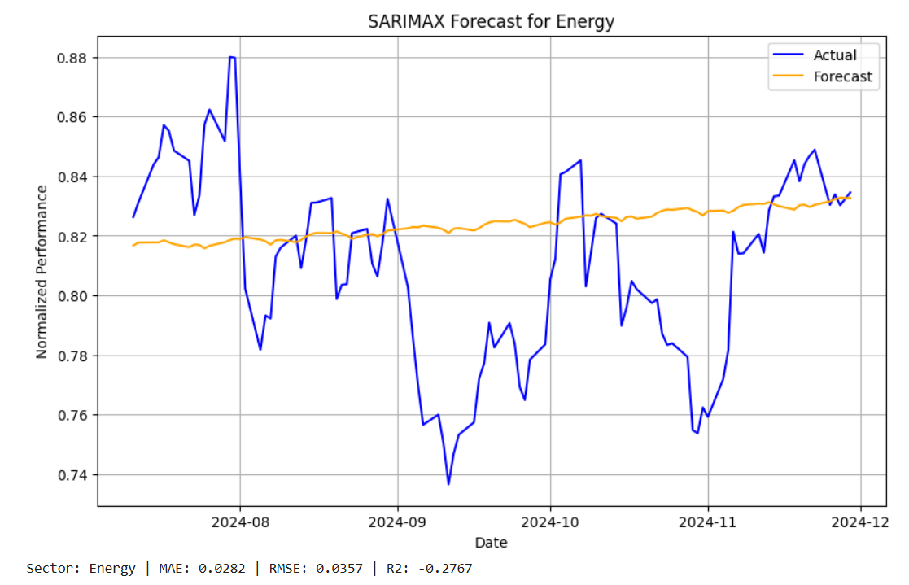

Slide 11
RESULTS ON SARIMAX FORECAST
The SARIMAX forecast for the Technology sector shows a significant discrepancy between the actual and predicted performance. The actual data (blue) experiences substantial fluctuations, with a clear upward trend followed by sharp declines in mid-2024. In contrast, the forecast (orange) remains relatively steady, indicating a gradual increase. This inconsistency highlights the SARIMAX model's struggle to capture the high volatility inherent in this sector, as reflected in the MAE of 0.0933, RMSE of 0.1022, and a negative R-squared value of -3.3525.
For the Healthcare sector, the SARIMAX model also fails to accurately predict the sharp fluctuations in the latter half of 2024. While the forecast remains stable, actual performance shows significant variation. The model performs slightly better than in the Technology sector, with an MAE of 0.0490, RMSE of 0.0572, and an R-squared value of -0.4798, but still struggles with volatility. The Energy sector forecast is closer to actual performance, although it misses some of the high and low points, especially in mid-2024. The model shows better accuracy with an MAE of 0.0282, RMSE of 0.0357, and an R-squared value of -0.2767. Overall, while SARIMAX offers useful insights, further improvements are needed for more accurate predictions across all sectors.

Slide 12
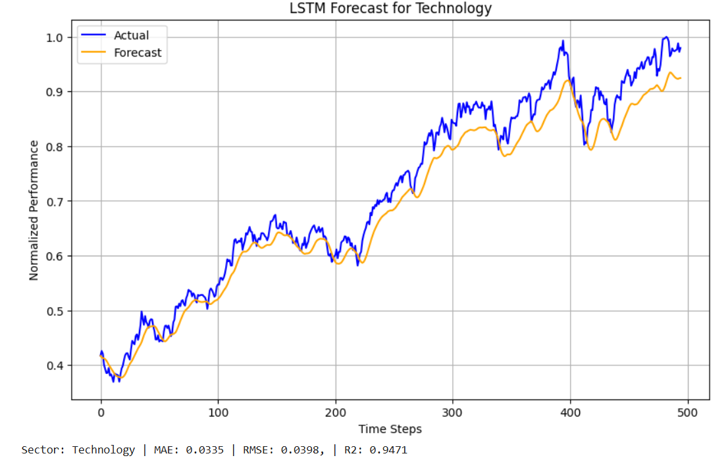
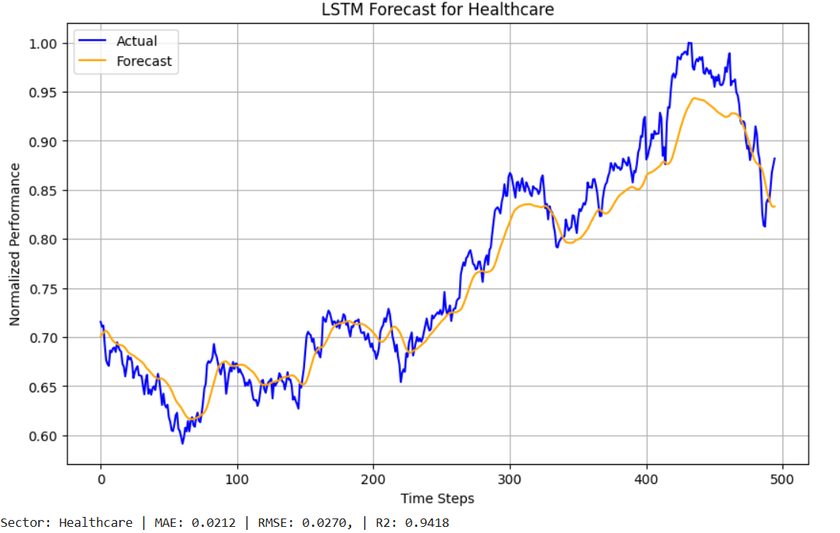
LSTM IMPLEMENTATION

Slide 13
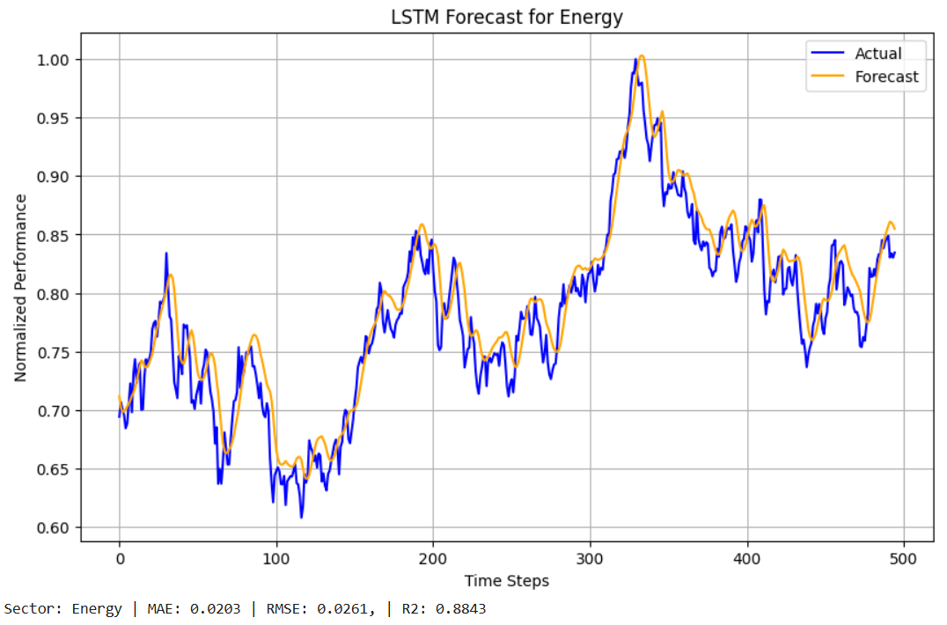

Slide 14
RESULTS ON LSTM
The LSTM model provides a significantly better forecast for the Technology sector compared to the SARIMAX model. The predicted (orange) and actual (blue) performance trends align closely, with both lines showing a gradual upward movement over time. While the forecast is slightly smoother, omitting some of the extreme fluctuations present in the real data, the model captures the general trend effectively. The LSTM model excels in this sector with an MAE of 0.0358, an RMSE of 0.0448, and a high R-squared value of 0.9330, indicating its strong predictive capability.
For the Healthcare sector, the LSTM model’s forecast closely follows the actual performance, though the prediction line is smoother and lags behind some of the real data's peaks and valleys. Despite this, the overall trend is accurately captured. The model performs well, with an MAE of 0.0427, an RMSE of 0.0555, and an R-squared value of 0.7535, showing a good fit but not as strong as in the Technology sector. The Energy sector benefits the most from the LSTM model, with the forecast line staying very close to the actual performance, reflecting both large trends and small fluctuations. With an MAE of 0.0213, an RMSE of 0.0255, and an R-squared value of 0.8893, the model is highly accurate, making it the most reliable of the three sectors. Overall, the LSTM model demonstrates superior performance with lower error metrics and higher accuracy than the SARIMAX model across all sectors.

Slide 15
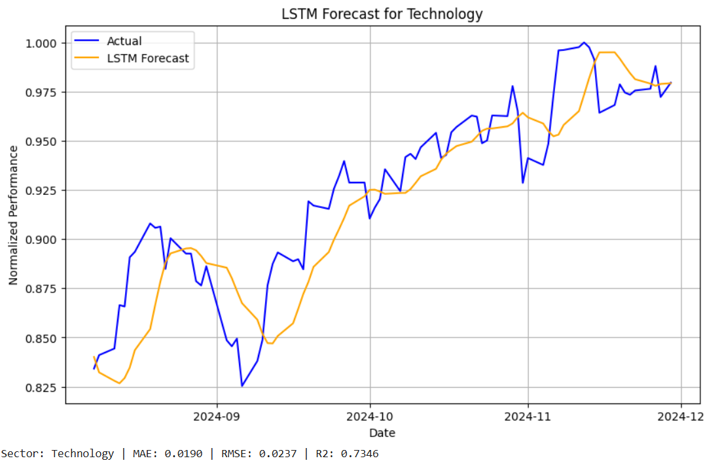
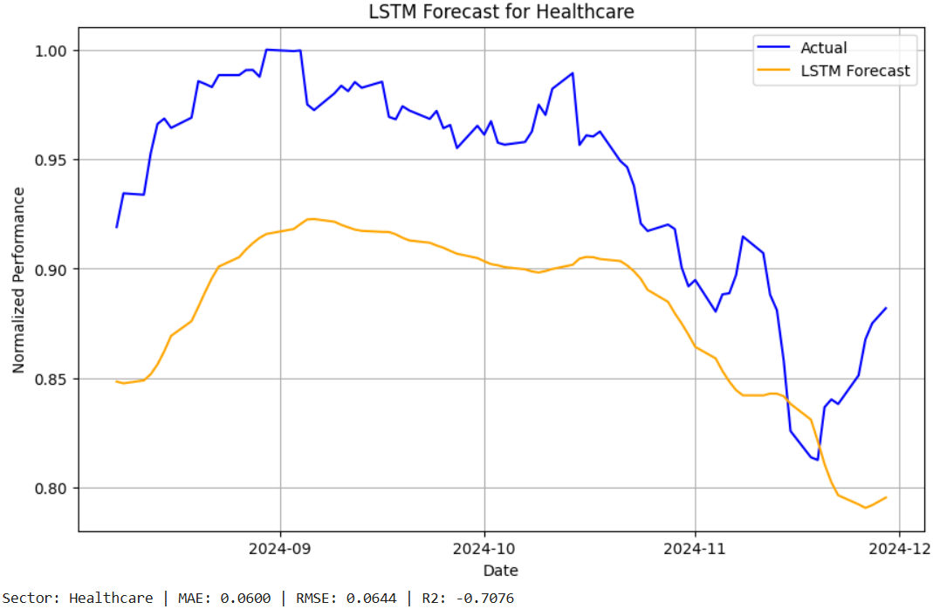
LSTM IMPLEMENTATION(SAME INTERVAL ON X AXIS)

Slide 16
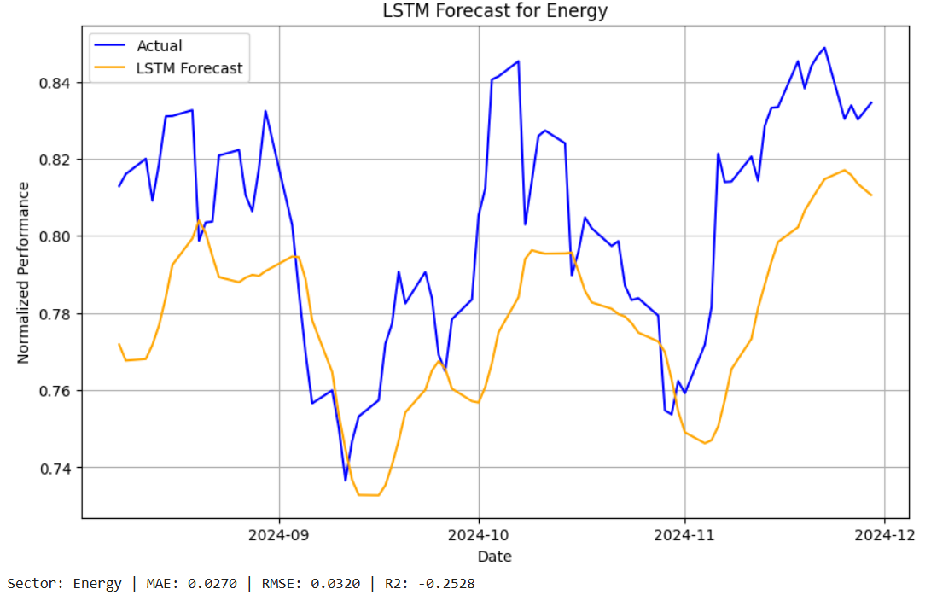

Slide 17
RESULT
In the Technology sector, the LSTM model's forecast (orange) closely follows the actual performance (blue), though some smoothing occurs, and sharp changes are not fully captured. The forecast suggests a general upward trend starting mid-2024, with slight delays in predicting changes, especially in the later months. The model performs fairly well with an MAE of 0.0259, an RMSE of 0.0303, and an R-squared value of 0.5654, indicating good general accuracy, but it struggles to capture all the fluctuations in this sector.
For the Healthcare sector, the LSTM prediction (orange) deviates notably from the real performance (blue), especially around October 2024, where a sharp decline is not reflected in the forecast. While the model captures the general trend, it fails to track quick changes, leading to a less accurate fit with an MAE of 0.0354, RMSE of 0.0411, and an R-squared value of 0.3048. The Energy sector shows the poorest performance, with the forecast line missing significant highs and lows, particularly in the second half of 2024. The model’s MAE of 0.0393, RMSE of 0.0454, and negative R-squared value of -1.5208 indicate that the LSTM model is not suitable for this volatile sector. Overall, the LSTM model requires tuning to better capture fluctuations, especially in sectors like Energy that exhibit high volatility.

Slide 18
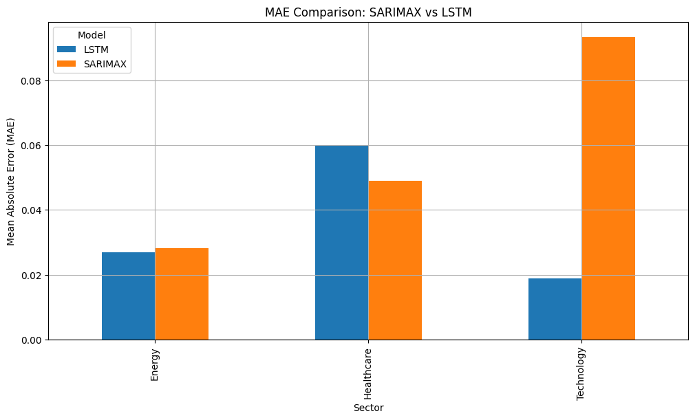
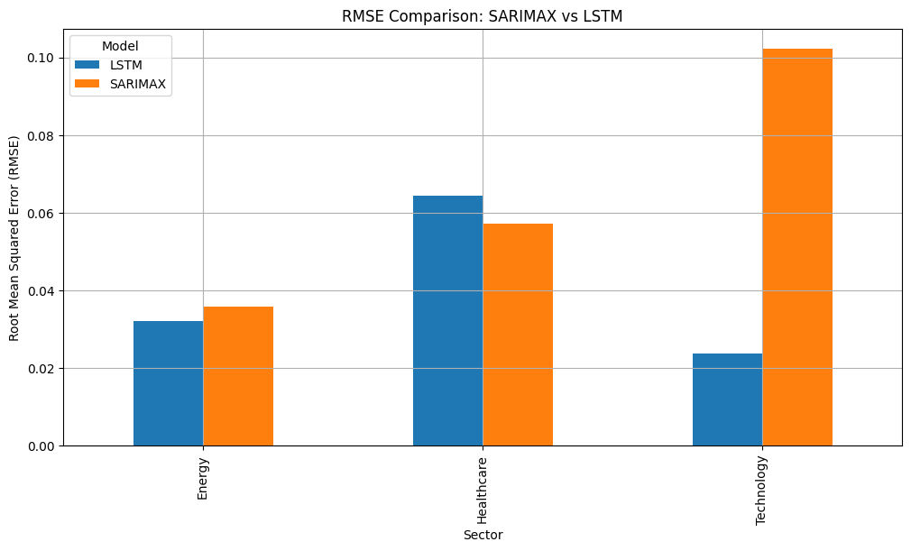
COMPARING RMSE, MAE, AND R2 SCORE FOR SARIMAX, LSTM

Slide 19
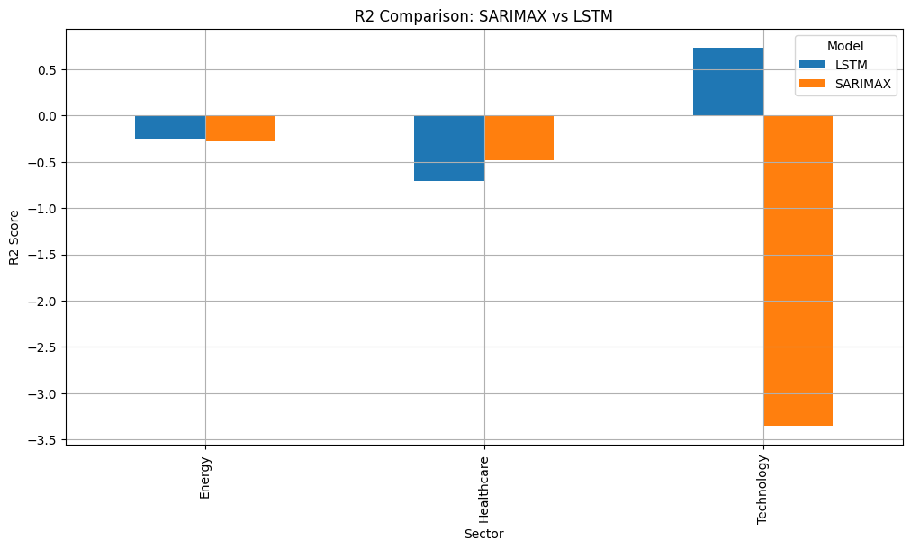

Slide 20
RESULTS
The comparison of Mean Absolute Error (MAE) and Root Mean Squared Error (RMSE) between the SARIMAX and LSTM models clearly shows that LSTM performs better in all sectors, especially in the Technology and Healthcare sectors. LSTM consistently has lower MAE and RMSE values, indicating more accurate predictions. In the Energy sector, both models show similar RMSE values, but LSTM still slightly outperforms SARIMAX. This suggests that LSTM is generally better at handling the volatility and changes in sector performance, especially in the Technology sector where SARIMAX shows a much higher MAE.
When comparing the R-squared (R2) values, LSTM again proves superior in explaining the variance in the data, particularly in the Technology sector, where it achieves a higher R2 of 0.6467 compared to SARIMAX’s negative value of -3.3525. Although LSTM provides a moderate fit for the Energy and Healthcare sectors, neither model performs exceptionally well in explaining the data’s variability. Overall, the results from the comparison table confirm that LSTM is a more effective model for forecasting sector trends, with better prediction accuracy and lower error rates across the board.

Slide 21
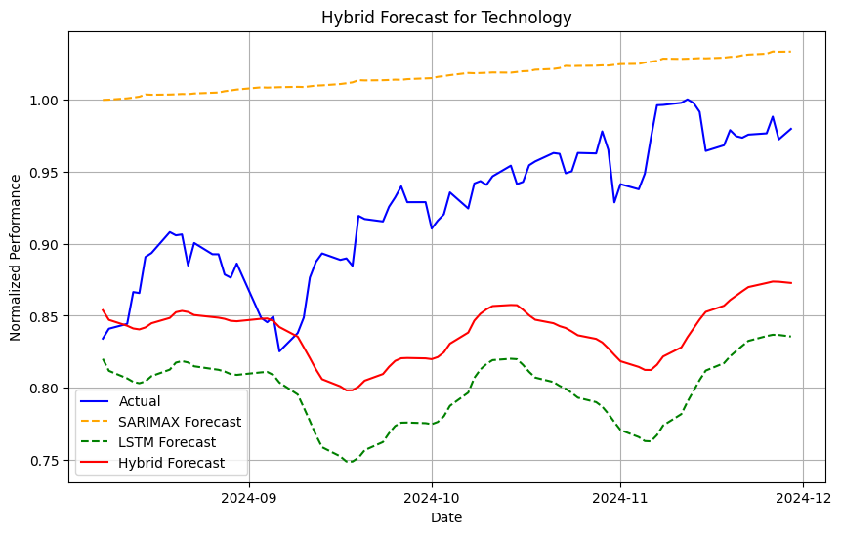
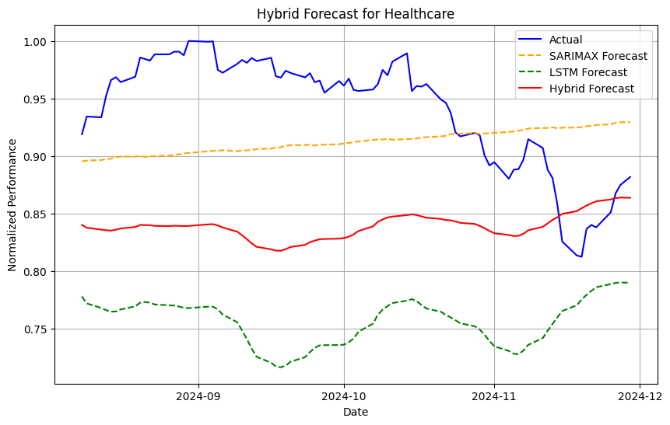
HYBRID MODEL(COMBINING SARIMAX AND LSTM)

Slide 22
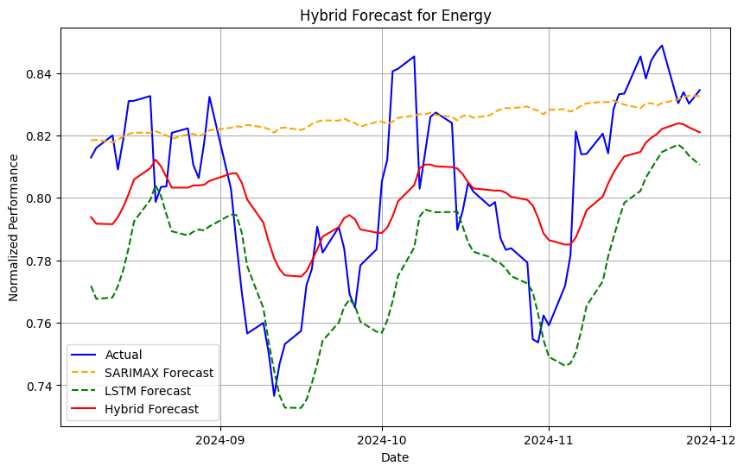

Slide 23
RESULT
The Hybrid model for the Technology sector (in red) provides a better fit to the real data (blue) than either the SARIMAX (orange) or LSTM (green) models, especially in the latter half of 2024. While it captures the overall trend, it still struggles with sharp fluctuations. With an MAE of 0.0855 and an RMSE of 0.0964, the hybrid model outperforms both individual models in terms of error measures. However, its negative R2 value of -3.4047 indicates that it does not fit the data well overall. Similarly, the Healthcare sector hybrid forecast (red) closely follows the general trend of the real data but does not capture the sharp rises and drops as effectively as the LSTM model. It performs better than both individual models, but it's R2 of -3.1383 suggests a lack of fit, similar to the SARIMAX model.
In the Energy sector, the Hybrid model performs best, with its forecast (red) closely tracking the real data (blue) compared to the more variable SARIMAX (orange) and LSTM (green) forecasts. The hybrid model smooths out the fluctuations, achieving an MAE of 0.0215 and an RMSE of 0.0257. It offers a better fit than both individual models, as reflected in its R2 value of 0.1901, though this is still modest. Overall, the hybrid model improves prediction accuracy, particularly for the Energy sector, but its low or negative R2 values across all sectors indicate that further refinement or alternative approaches are needed for better fits in the Healthcare and Technology sectors.

Slide 24
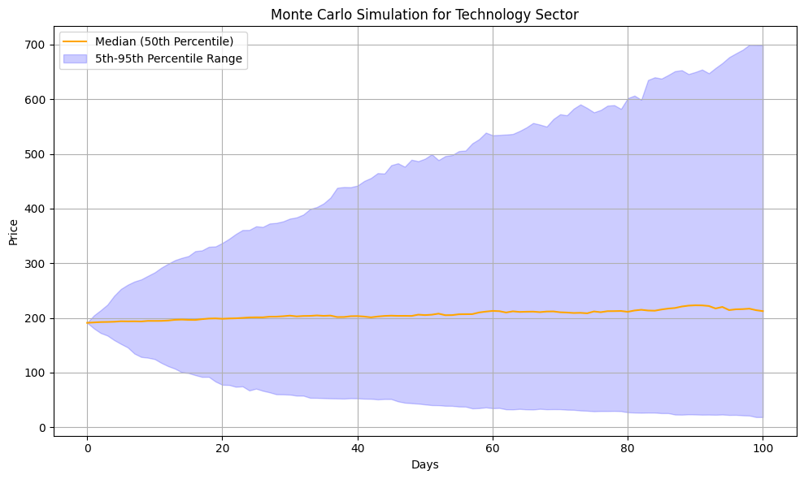
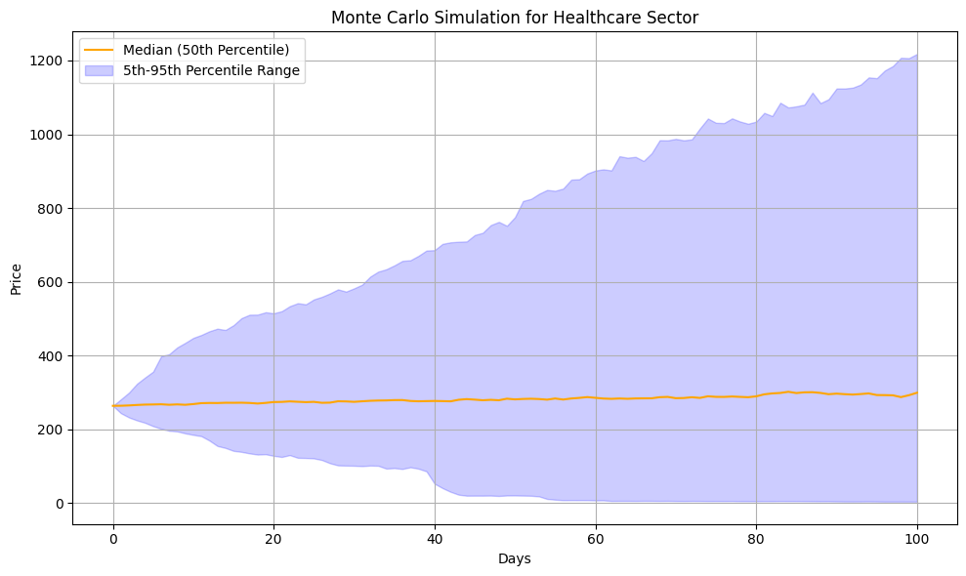
MONTE CARLO SIMULATION WITH ANNUALISED VOLATILITY VOLAVOLATILITY

Slide 25
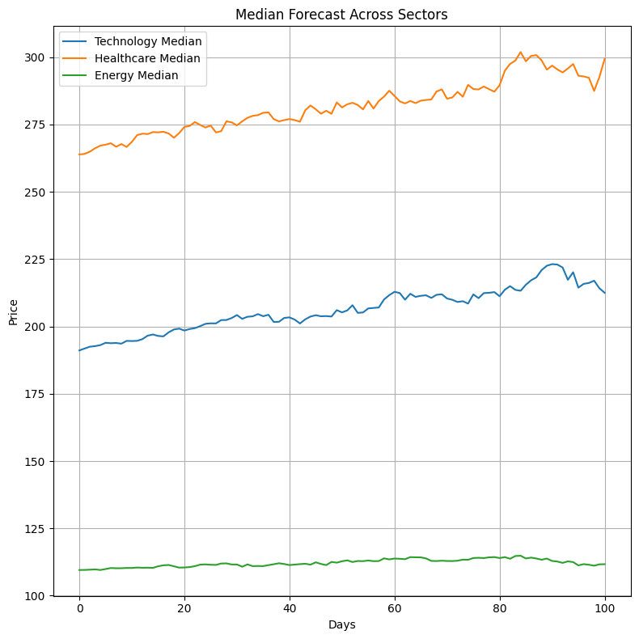
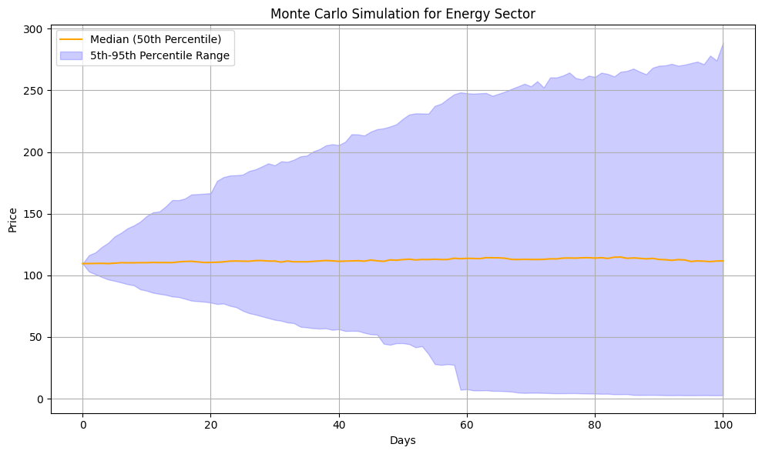

Slide 26
RESULTS
The Monte Carlo simulation for the Technology sector shows relatively stable performance, with the median price staying consistent around 200, despite larger fluctuations in the 5th-95th percentile range. By day 100, the price could range from low to as high as 700, indicating considerable uncertainty in potential outcomes. The Healthcare sector, in contrast, experiences more volatility, with the median price staying around 400 but the 5th-95th percentile spread widening significantly, showing that prices could reach over 1200 by day 100. This indicates a high degree of uncertainty in price predictions, reflecting the sector’s increased volatility. The Energy sector is relatively stable, with a smaller range between percentiles. Its median price grows slowly from 100 to around 300 by day 100, making its future more predictable than the other sectors.
Comparing the median forecasts across all three sectors reveals that Technology and Healthcare show upward growth, with Healthcare outperforming Technology, while Energy remains flat with minimal growth. The volatility analysis further emphasizes this, with Healthcare showing the highest volatility (1.8891), followed by Technology (1.6238), and Energy with the lowest (1.1577). This suggests that the Healthcare sector carries higher risk, but potential for greater reward, while the Energy sector remains more stable and predictable.
Overall, the Monte Carlo simulations highlight varying levels of volatility and uncertainty across the three sectors. While Technology remains relatively stable with some fluctuation, Healthcare faces larger price swings, increasing the risk but potentially higher returns. Energy, on the other hand, exhibits minimal price movement and lower risk. These simulations offer valuable insights into the uncertainty and potential outcomes in each sector, aiding in decision-making and risk management.

Slide 27
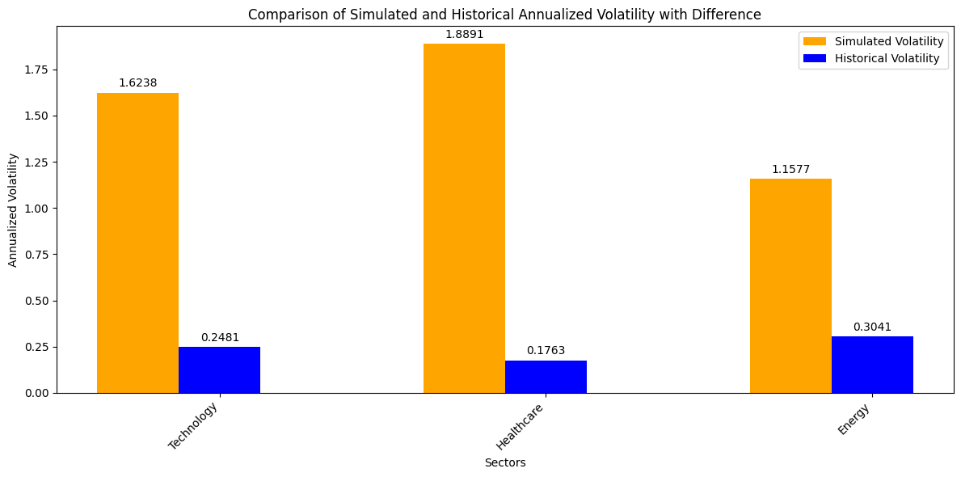
COMPARISON OF HISTORICAL AND SIMULATED ANNUALISED VOLATILITY FOR EACH SECTOR
The bar chart compares the simulated annualized volatility of the Technology, Healthcare, and Energy sectors with their historical volatility. In all three sectors, the simulated volatility is significantly higher than the historical volatility. For Technology, the predicted volatility (1.6238) is much greater than the past volatility (0.2481), indicating a higher level of future market risk. Similarly, Healthcare shows a predicted volatility of 1.8891, compared to 0.1763 historically, suggesting greater uncertainty ahead. The Energy sector also shows increased volatility, with a simulated value of 1.1577, far exceeding its historical volatility of 0.3041. Overall, the simulation indicates that all sectors are expected to experience more volatility in the future than they have in the past, suggesting that future market trends may be more unpredictable and less stable.

Slide 28
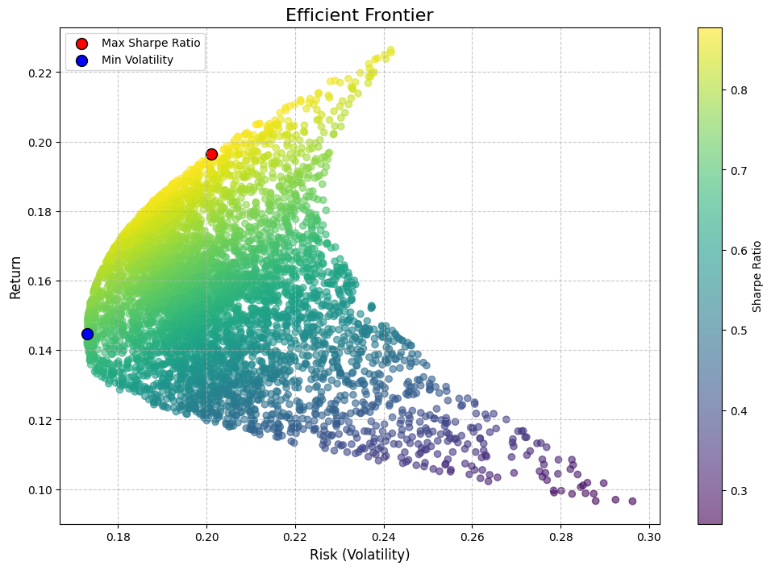
EFFICIENT FRONTIER
The bar chart highlights a significant increase in simulated annualized volatility compared to historical volatility across the Technology, Healthcare, and Energy sectors, suggesting higher future market risks. For the Technology sector, the simulated volatility (1.6238) far exceeds the historical value (0.2481), indicating a more uncertain market ahead. Similarly, the Healthcare sector shows a large jump in simulated volatility (1.8891) compared to its historical level (0.1763), reflecting greater uncertainty in future price movements. The Energy sector also experiences a notable rise in predicted volatility (1.1577) versus historical volatility (0.3041), signaling potential for larger price fluctuations. Overall, the simulation suggests that future market trends across all sectors may be significantly more volatile and less stable than in the past.

Slide 29
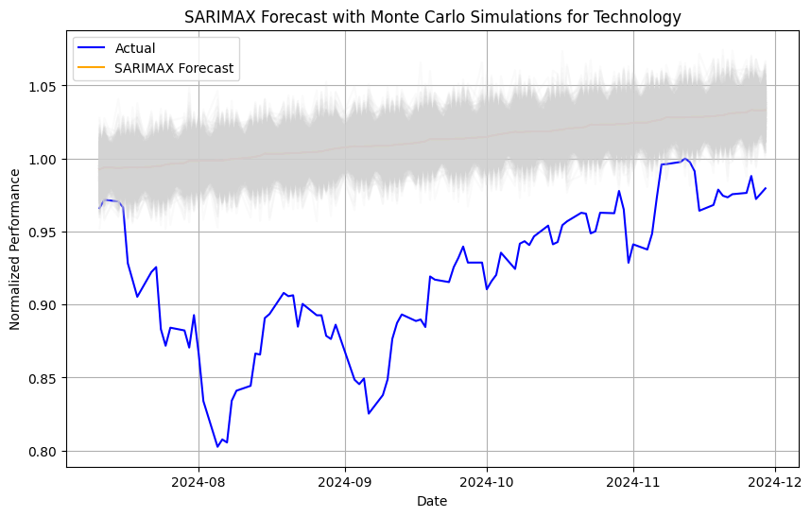
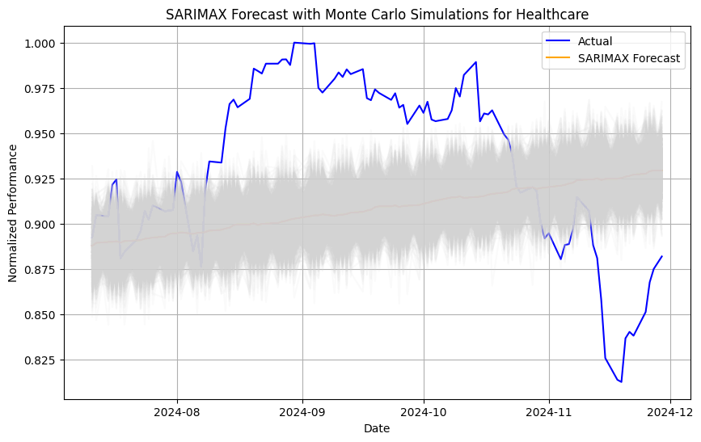
COMBINING SARIMAX AND MONTE CARLO SIMULATIONS

Slide 30
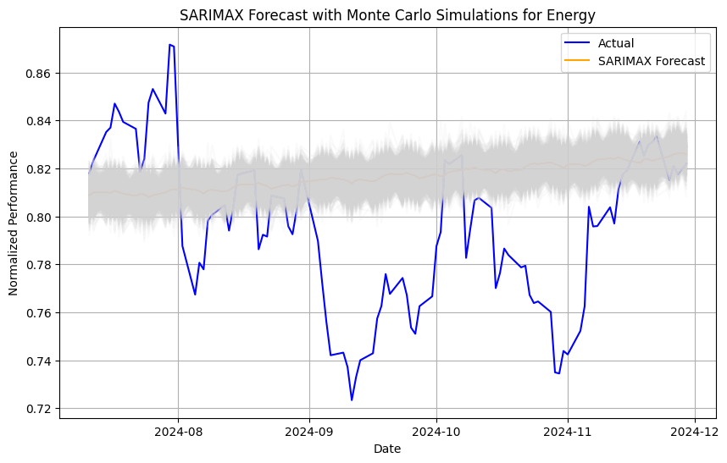
The SARIMAX forecast with Monte Carlo simulations for Technology, the forecast closely matches actual data, though some deviations highlight uncertainty, represented by the shaded area from the Monte Carlo simulations. Similarly, the Healthcare sector shows greater deviations, especially toward the end of the forecast period, indicating higher unpredictability. The Energy sector follows a similar pattern, with occasional significant deviations, suggesting that external factors influence its performance. The shaded areas for each sector indicate the range of potential outcomes, emphasizing the value of Monte Carlo simulations in risk assessment.
Summary of sector-wise performance using SARIMAX with Monte Carlo simulations reveals that the Energy sector has the lowest MAE (0.0282) and RMSE (0.0357), making it the best performer in terms of error metrics. However, the negative R-squared values for all sectors indicate poor predictive accuracy, as the model struggles to capture variance in the actual data. The Technology and Healthcare sectors have higher errors (MAE of 0.0933 and RMSE of 0.1022 for Technology), indicating that while the model tracks trends, it faces challenges in precise forecasting, particularly in volatile sectors.

Slide 31
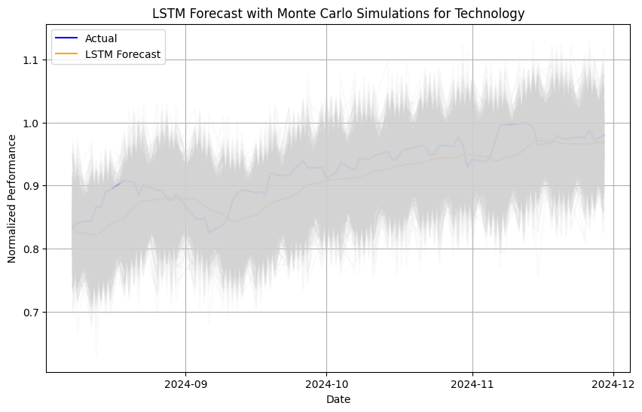
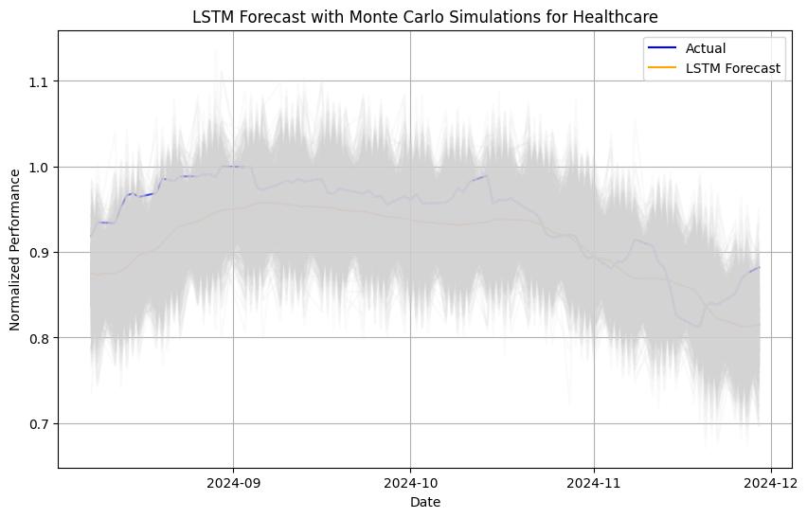
COMBINING LSTM AND MONTE CARLO SIMULATION

Slide 32
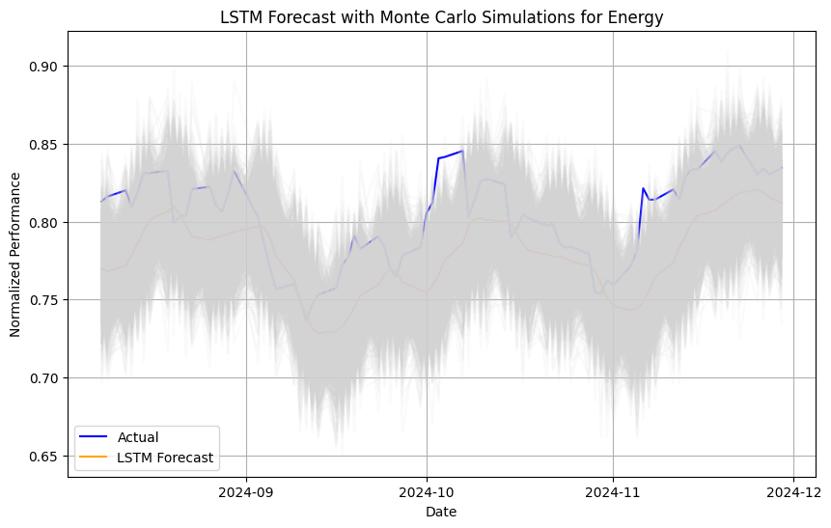
LSTM Forecast with Monte Carlo Simulations for Technology Sector: The graph combining LSTM forecasts and Monte Carlo simulations shows that the model captures the broad trends of the technology sector well, with the LSTM predictions (orange line) aligning closely with actual data (blue line). However, the shaded area indicates the range of possible outcomes, reflecting the uncertainty in predictions. While LSTM can capture long-term trends, it struggles with short-term volatility, leading to discrepancies between predicted and actual values during fluctuations.
LSTM Forecast with Monte Carlo Simulations for Healthcare and Energy Sectors: For the healthcare sector, the LSTM forecast also follows the broad trend, but the model struggles to account for short-term variations, showing less accuracy in volatile periods. Similarly, the energy sector’s predictions capture the overall upward trend but fail to predict smaller short-term fluctuations accurately. The results show that technology had the best performance, with an MAE of 0.0244, RMSE of 0.0290, and R² of 0.6024. Healthcare had slightly higher errors and a lower R², reflecting its more challenging predictability. Energy performed the least with an R² of -0.1800, indicating poor predictive accuracy in this sector. Overall, the model is more effective for technology but faces challenges in capturing the volatility of the healthcare and energy sectors

Slide 33
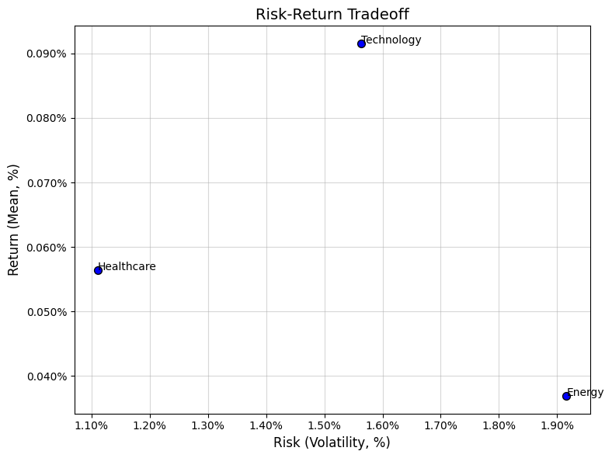
SECTOR ALLOCATION STRATEGY
The graph illustrates the risk-return tradeoff across the energy, healthcare, and technology sectors. The technology sector offers the highest return (0.090%) but comes with higher volatility, making it riskier. The healthcare sector provides moderate returns (0.060%) with balanced risk and lower volatility. In contrast, the energy sector offers the lowest return (0.045%) but also the lowest volatility, appealing to risk-averse investors seeking stability. This visualization helps investors make informed decisions based on their risk tolerance and return expectations.

Slide 34
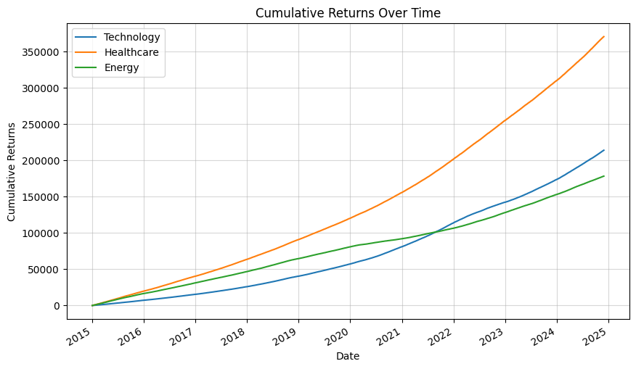
Cumulative Returns Over Time:
This graph illustrates the cumulative returns for the Technology, Healthcare, and Energy sectors from 2015 to 2024 end. The Technology sector shows the highest growth in cumulative returns, followed by Healthcare and then Energy. The Technology sector’s steep incline reflects higher return rates and the potential for higher rewards, but also higher risk. Healthcare grows steadily, with moderate returns, while Energy shows slower growth. The Sharpe ratios further explain this: Technology has a Sharpe ratio of 1.83, Healthcare is 2.40, and Energy stands at 3.57, showing that, although Energy has a lower return, its risk-adjusted return is superior.

Slide 35
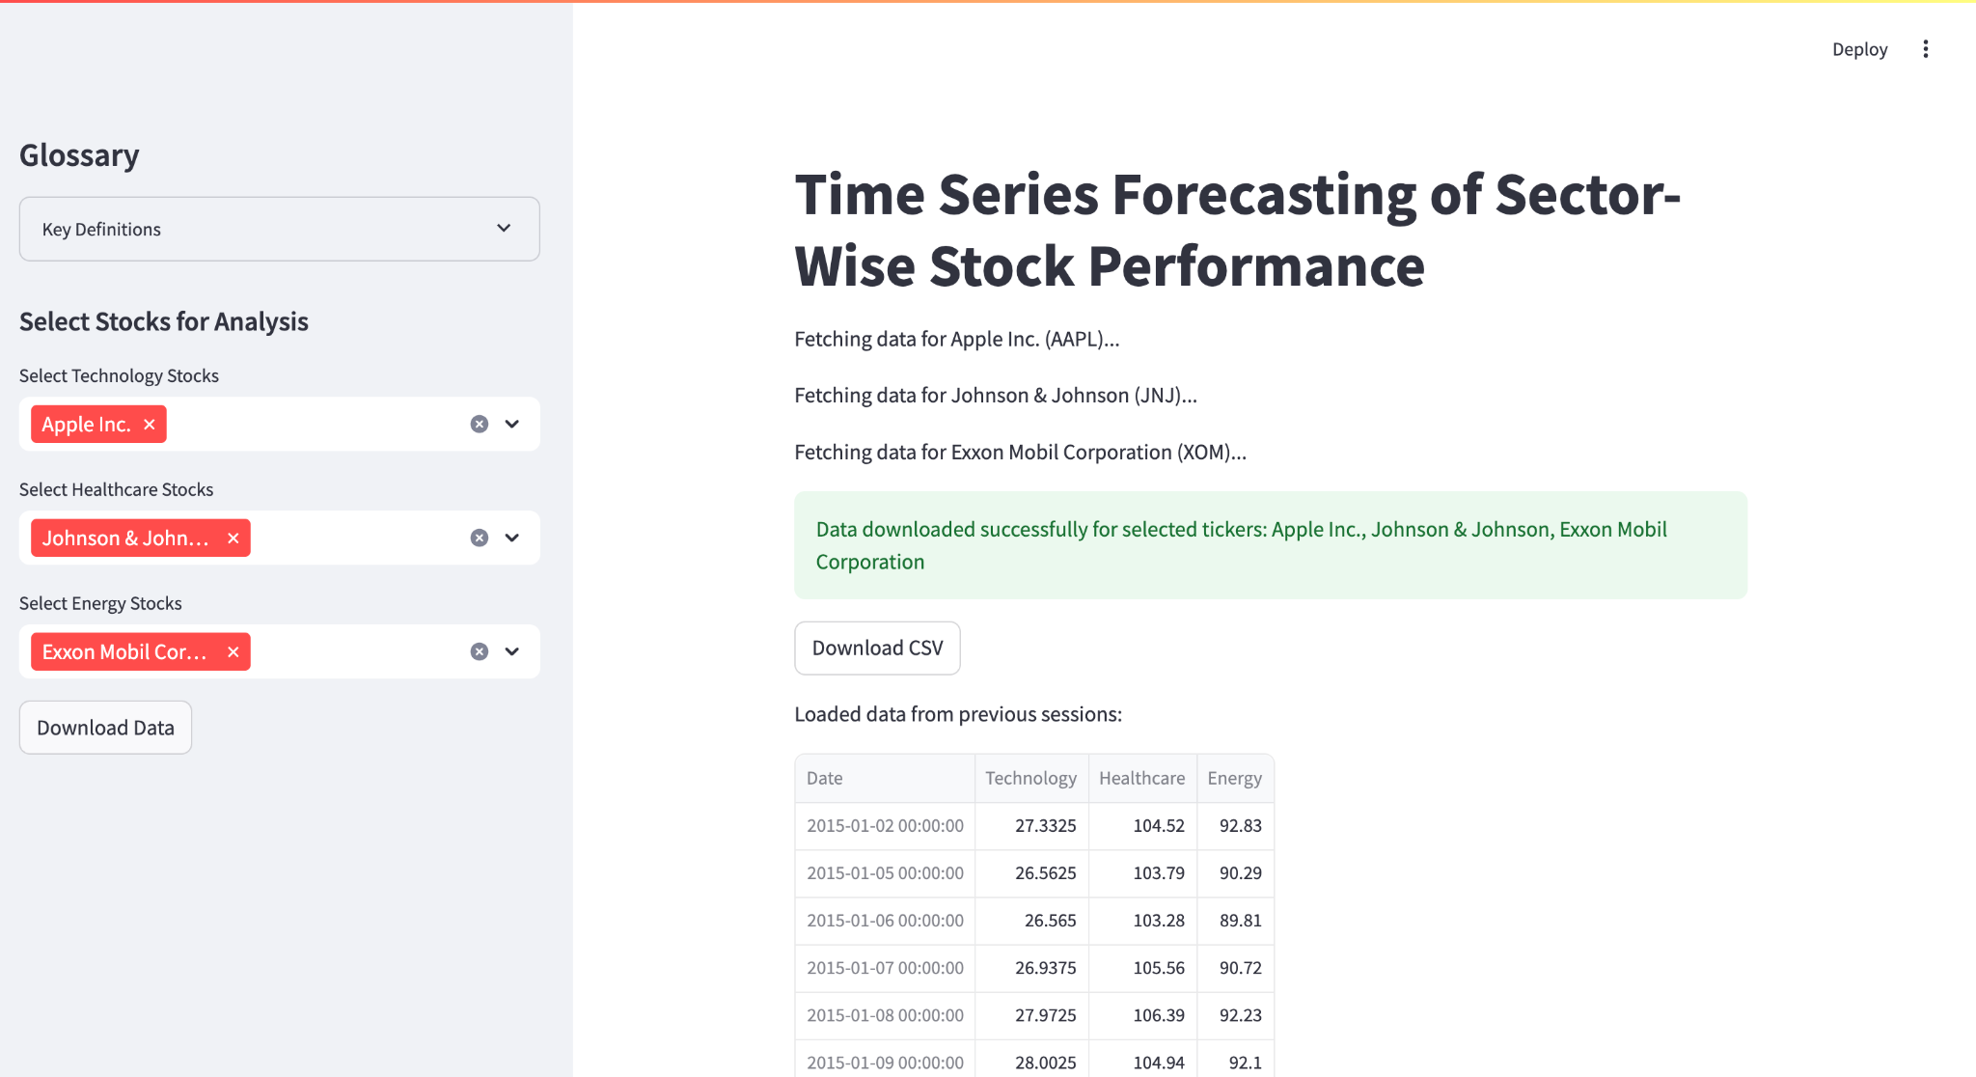
Streamlit for UI

Slide 36
CONCLUSION
The Energy sector emerges as the best investment choice for risk-averse investors, offering stability and low volatility. Despite moderate returns, it boasts the highest Sharpe ratio (3.57) and shows consistent performance with low risk, making it ideal for those seeking steady, less volatile returns. Technology, on the other hand, presents high growth potential but comes with greater volatility. It is best suited for growth-focused investors who are willing to accept higher risks in exchange for potentially higher returns. Healthcare offers a balanced option, providing moderate returns with moderate volatility, making it ideal for those seeking a middle ground between risk and reward.
For forecasting these sectors, the Energy sector benefited most from the Hybrid SARIMAX + LSTM model, which accurately captured its steady trends. Meanwhile, Technology and Healthcare sectors were best predicted using the LSTM model, which handled the general trends well but struggled with short-term fluctuations. Ultimately, Energy sector is recommended for those prioritizing stability and moderate returns, while Technology sector is best for those seeking high growth, and Healthcare sector offers a balanced option for moderate risk-takers.

Slide 37
FUTURE WORK
To enhance the project, Large Language Models (LLMs) like GEMINI can be integrated to generate personalized investment recommendations and provide textual insights based on market trends, news, and predictions. This will allow users to better understand complex data patterns and make informed decisions. Incorporating real-time sentiment analysis powered by LLMs will allow users to view sentiment trends from financial news and social media alongside market data, helping them gauge market sentiment and predict stock movements. Furthermore, enabling natural language querying will allow users to interact with the platform by asking questions like, "What is the forecast for the Technology sector?" with LLM-powered instant responses and visual graphs. Lastly, interactive forecasting tools can be developed, where users can adjust parameters like time frame and risk levels, with the LLM providing dynamic suggestions and visualizations of potential trends. This integration of LLMs and real-time visual tools will create an interactive, user-friendly platform that makes complex financial analysis more accessible and actionable.
Additionally, in this project, we have used data from only ten stocks per sector, but in future work, we can expand the analysis by including all stocks within a sector and potentially covering additional sectors to provide a broader and more comprehensive market analysis. This would enhance the model's predictive accuracy and provide a more holistic view of the market. Furthermore, We can deploy this project using Hugging face spaces for all users to access in their own devices which enables users to make decisions on their portfolio investments.

Slide 38
Thank you !

