Slide 1
DATA STRUCTURE
PROJECTS-6
SUBMISSION BY :
SYED MUHAMMAD QANDIL KHALIL , 2018-CE-66
SUBMISSION TO :
Miss . Aneeta Siddique

Slide 2
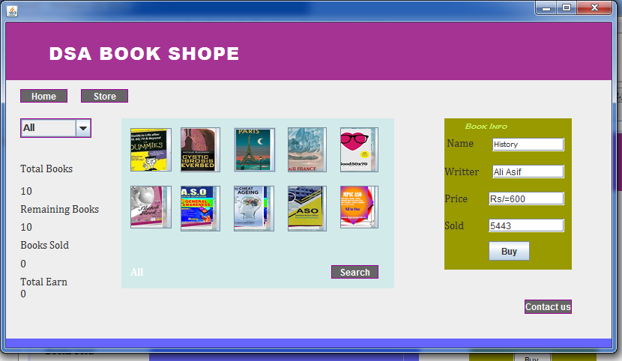
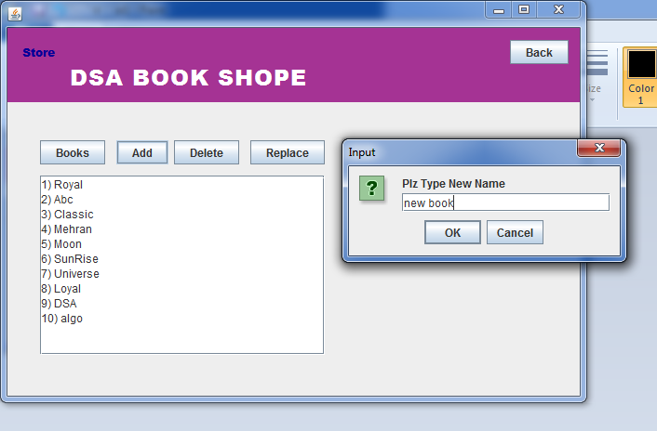
Project # 1 Array implement in a system
Project contains:
TRANVERSING
INSERTION’
DELETION
SEARCHING
SORTNG
Time complexity
Search O(N)
Searching O(N)
Delete O(N)
Insertion O(N)

Slide 3
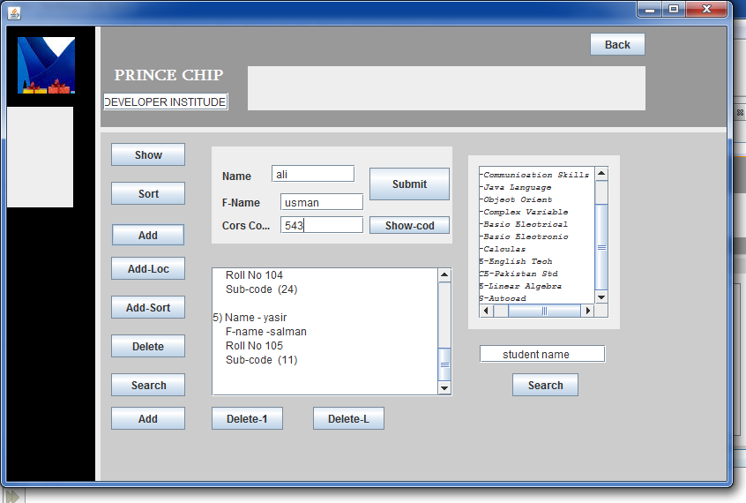
Project # 2 Linked List implement in a system
Project contains:
TRANVERSING
SEARCHING
INSERTION at specific location
INSERT IN SORTED LINKLIST
Insertion at last
Insertion at first
DELETION at specific location
DELETION at last
DELETION at first
sorting
Time complexity
Search O(N)
Traversing O(N)
Delete O(1)
Insertion O(1)

Slide 4
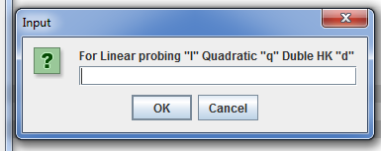
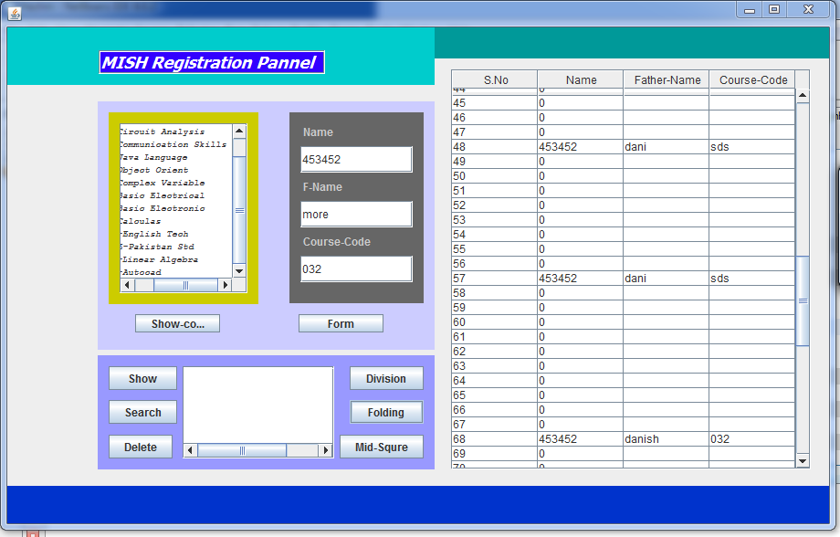
Project # 3 Hashing implement in a system
Project contains:
TRANVERSING
INSERTION’
DELETION
SEARCHING
Colission Handling by followinngs;
linear probing
Quadritic probing
Double hash function probing
Linked list chaining probing
Time complexity
Search O(1)
Traversing O(1)
Delete O(1)
Insertion O(1)

Slide 5
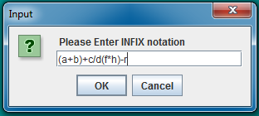
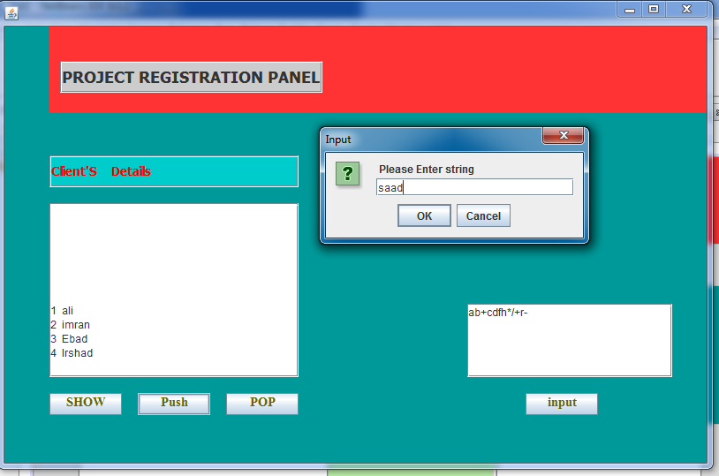
Project # 4 Stack implement in a system
Project contains:
INFIX TO POST FIX
TRANVERSING
INSERTION
DELETION
Time complexity
Forr searching O(n)
For Deleting O(1)
For Traversing O(n)
For Inserting O(1)

Slide 6
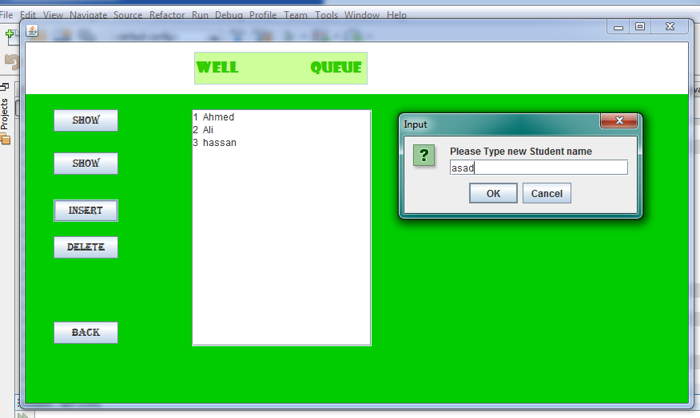
Project # 5 QUEUE implement in a system
Project contains:
TRANVERSING
INSERTION’
DELETION
Time Complexity of Queue
For searching O(n)
For Deleting O(1)
For Traversing O(n)
For Inserting O(1)

Slide 7
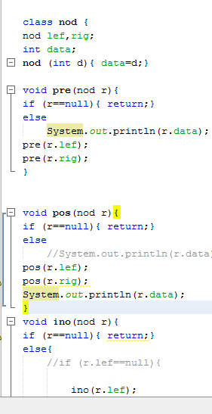
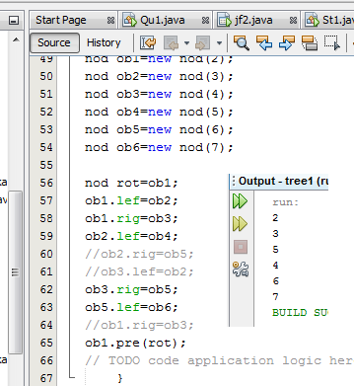
Project # 6 TREE implement in a system
Project contains:
TRANVERSING
INSERTION’
DELETION
SEARCHING (processing)

Slide 8
THANK YOU

