Slide 1
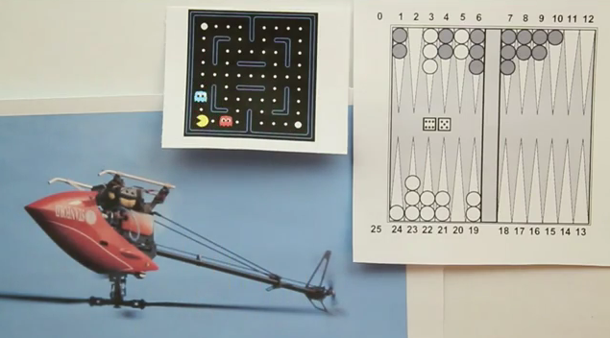
Unit 11-3 - Qlearning

Slide 2
Acknowledgement
Several examples of this lecture have been taken from Stanford AI class and Stanford Machine Learning class.

Slide 3
QLearning
Q-learning is a reinforcement learning algorithm that does not need a model of its environment and can be used online. Q-learning algorithms work by estimating the values of state-action pairs.
The agent can perform adaptively in a world without understanding it. All it tries to do is sort out good actions to perform from bad ones.

Slide 4
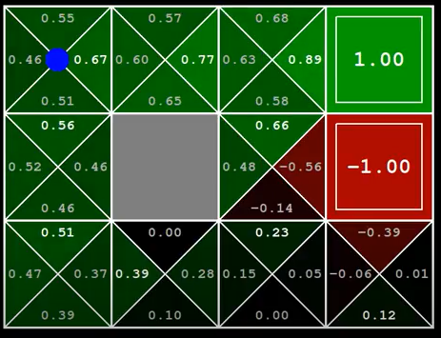
QLearning
Instead of having ‘value’ for each state. We now have a value/action pair for each state
(s,a)

Slide 5
QLearning
The value Q(s, a) is deﬁned to be the expected discounted sum of future payoﬀs obtained by taking action a from state s and following the current optimal policy thereafter. Once these values have been learned, the optimal action from any state is the one with the highest Q-value.

Slide 6
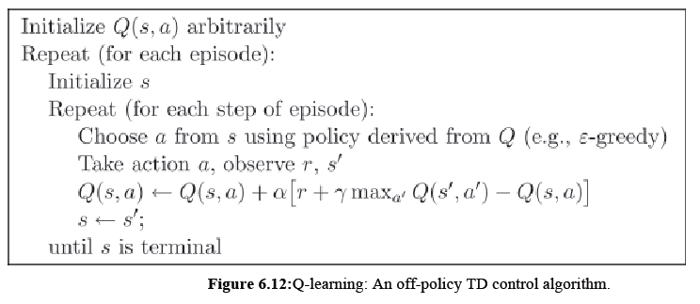
QLearning

Slide 7
Video
https://www.youtube.com/watch?v=AMnW-OsOcl8

Slide 8
QLearning
Q-learning is model-free(calls this primitive learning). The agent can perform adaptively in a world without understanding it. All it tries to do is sort out good actions to perform from bad ones.

Slide 9
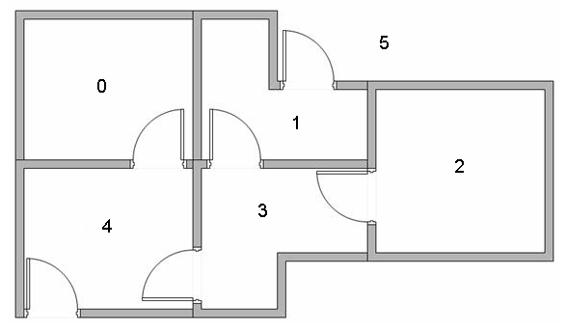
Example
we want to model some kind of simple evacuation of an agent from any room in the building. Now suppose we have an agent in Room 2 and we want the agent to learn to reach outside the house (5)
A Simple Intro to Q-Learning in R: Floor Plan Navigation
Q Learning Algorithm Solved Example

Slide 10
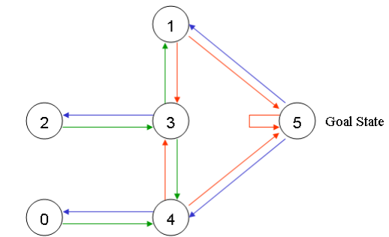

Slide 11
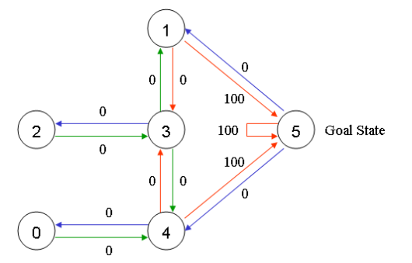

Slide 12
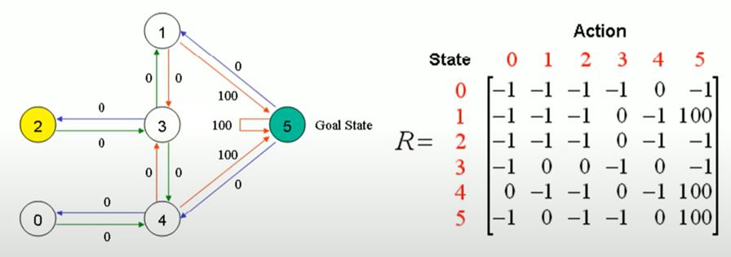
Step – Build the Reward Matrix
We build the reward matrix for the problem. For state 0 for example we can
Only go to state 4, therefore every other entry in the row is assigned ‘-1’ depicting
an impossible action.

Slide 13
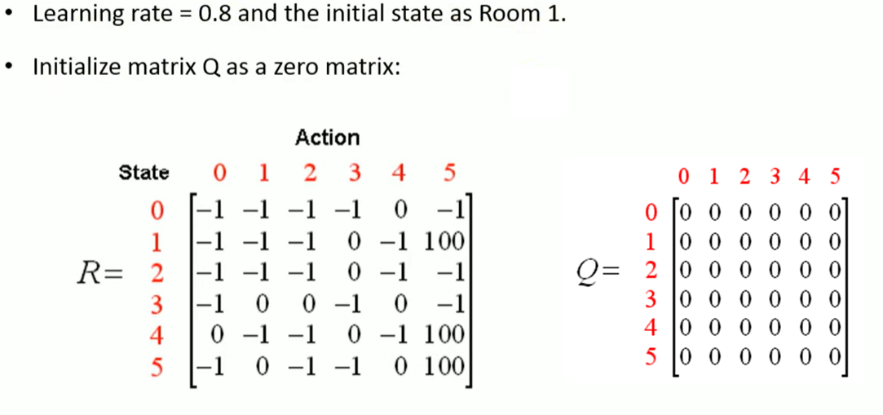

Slide 14
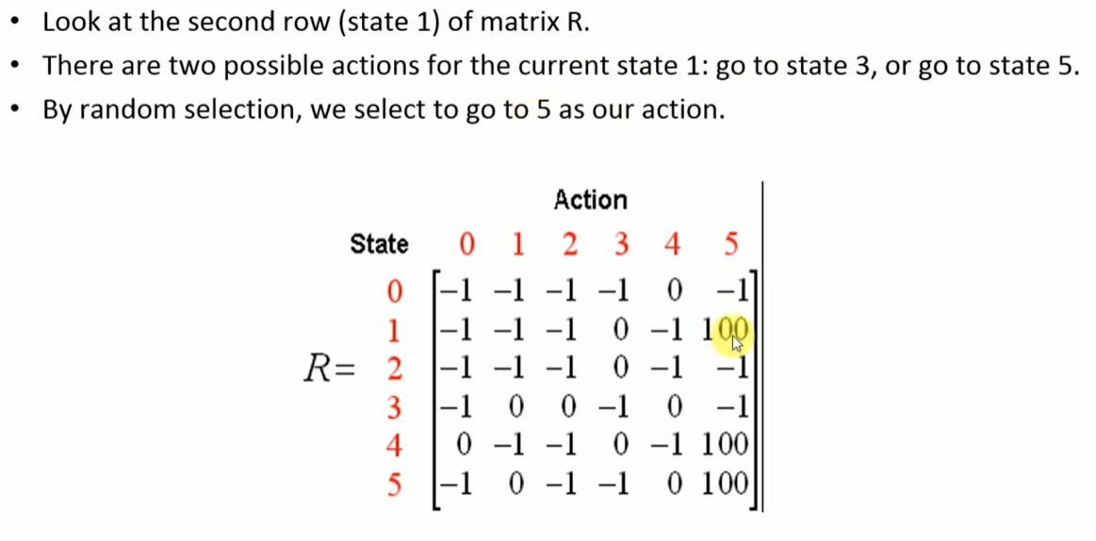
Updateing Q-values: We choose to start from state 1

Slide 15
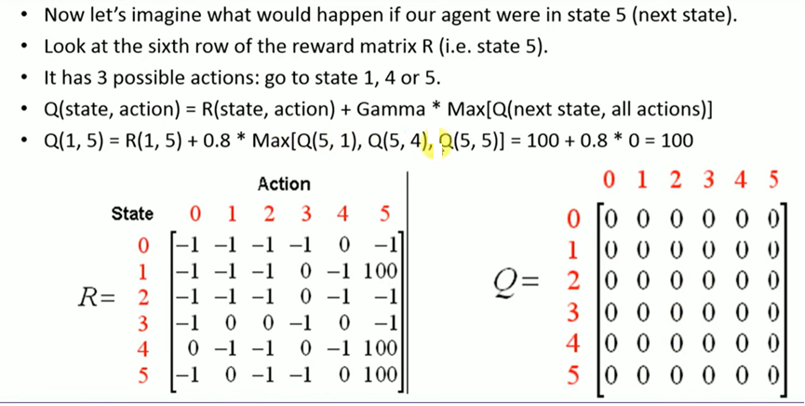
Learning Q-values

Slide 16
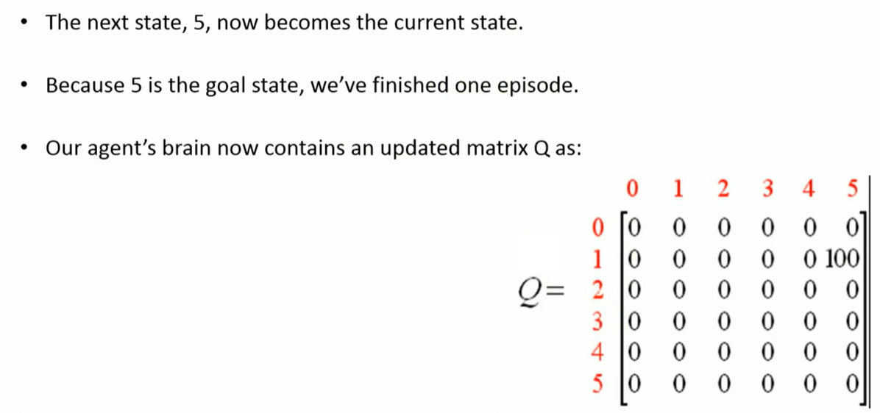

Slide 17
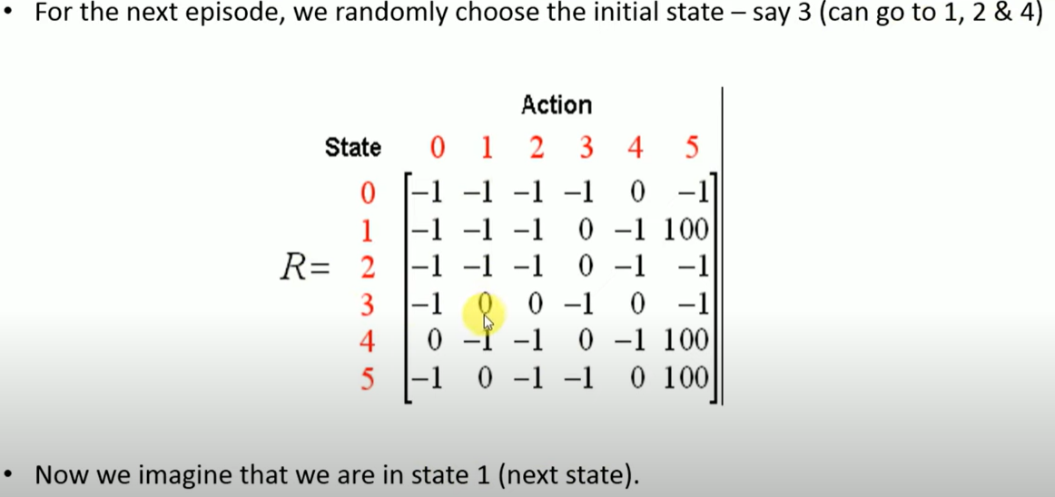

Slide 18
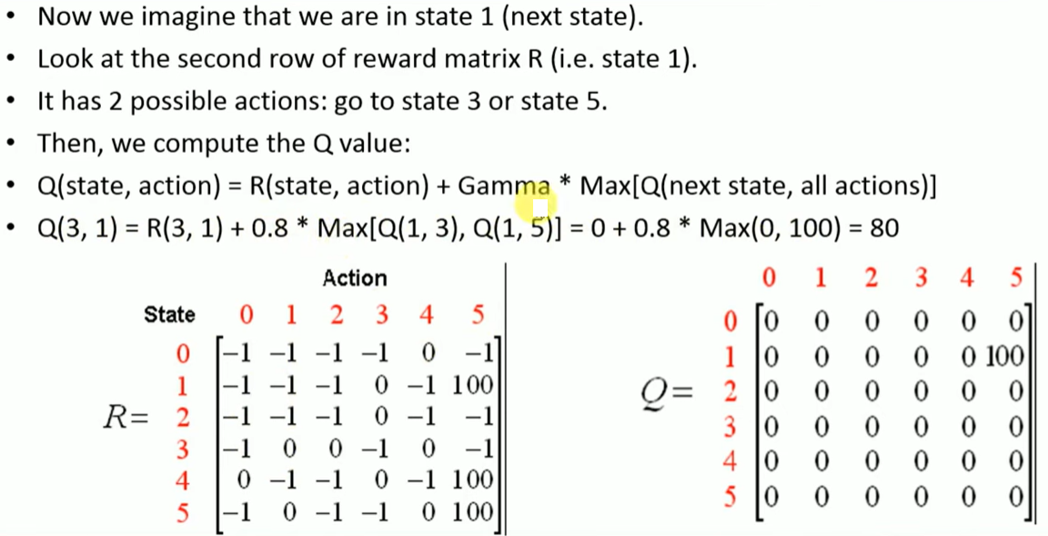

Slide 19
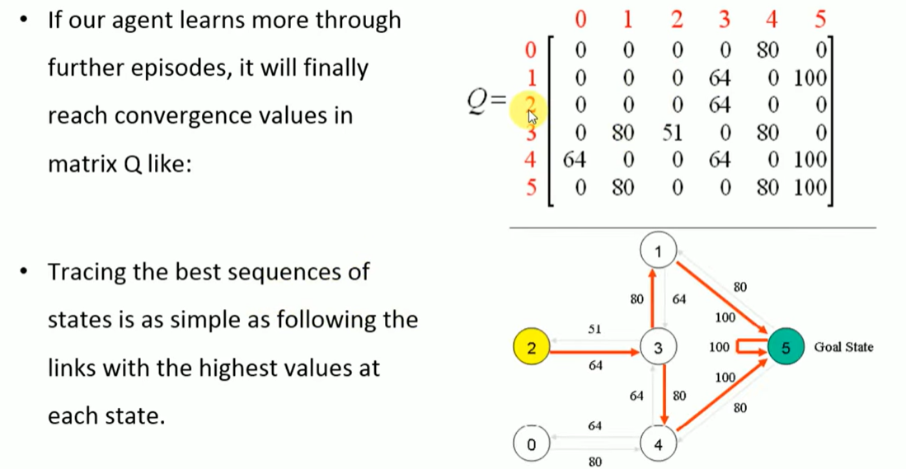

Slide 20
Choosing an action
how does the agent select actions during learning.
  We will model this with a function that assigns a probability of being chosen for each possible action in a given state.
  This function should tend to choose actions with higher Q values, but should sometimes select lower Q-value actions.
  The probability of selecting the highest Q-value action should increase over time.

Slide 21
Action Selection Policies
ε-greedy:
  With probability 1- epsilon – we choose action with maximum value
  With probability epsilon – we randomly choose an action from a set of all actions A

Slide 22
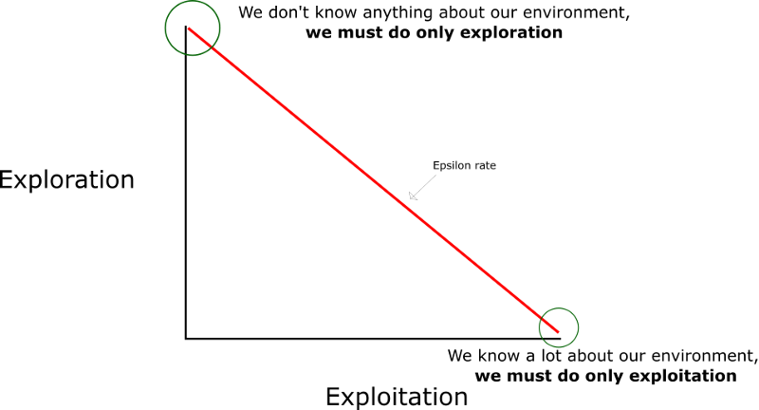
ε-greedy
The idea is that we must have a big epsilon at the beginning of the training of the Q-function. Then, reduce it progressively as the agent becomes more confident at estimating Q-values.

Slide 23

Action Selection - Boltzman distribution
One drawback of ε-greedy is that when it explores it chooses equally among all actions. This means that it is as likely to choose the worst-appearing action as it is to choose the next-to-best action.
In tasks where the worst actions are very bad, this may be unsatisfactory.
The obvious solution is to vary the action probabilities as a graded function of estimated value.
The k parameter (often referred to as temperature) controls the probability of selecting non-optimal actions. If k is large, all actions will be selected fairly uniformly. If k is close to zero, the best action will always be chosen. We begin with k large and gradually decrease it over time.

Slide 24
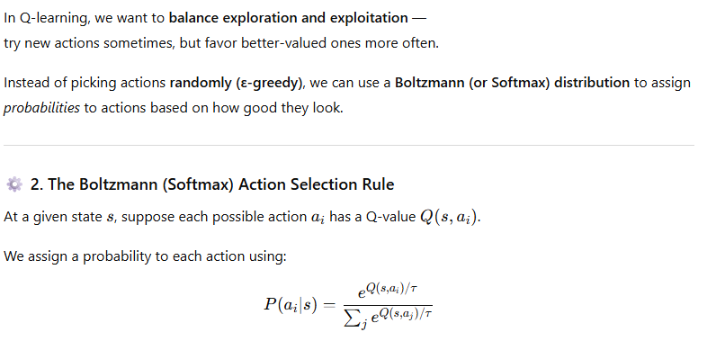
Action Selection – Boltzman Distribution

Slide 25
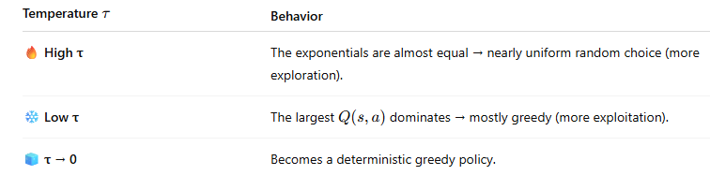
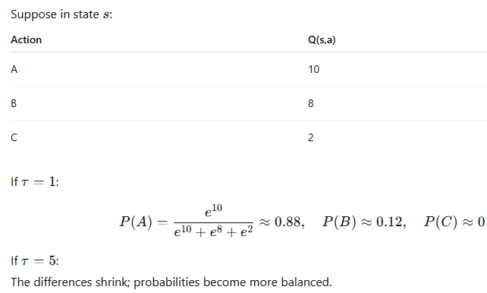
The temperature

Slide 26
Dealing with continuous environment

Slide 27
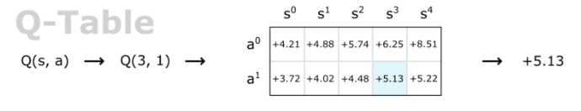
Function Approximation

Slide 28
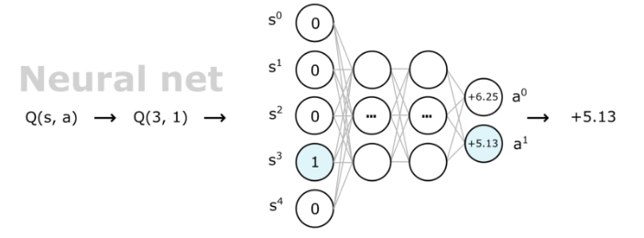
Function Approximation

Slide 29
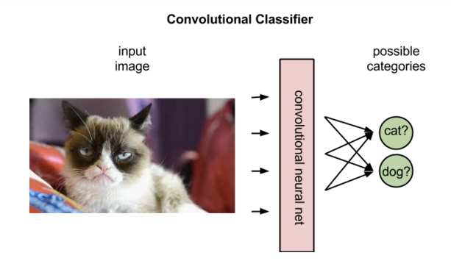
Neural Networks in classification
https://pathmind.com/wiki/deep-reinforcement-learning

Slide 30
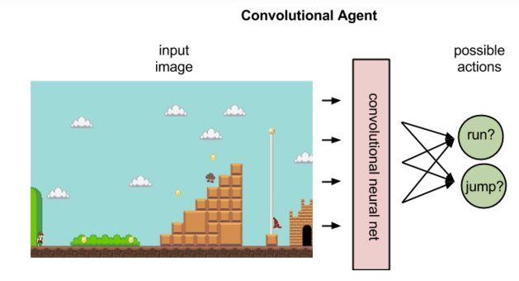
ANN in Qlearning
https://pathmind.com/wiki/deep-reinforcment-learning

Slide 31
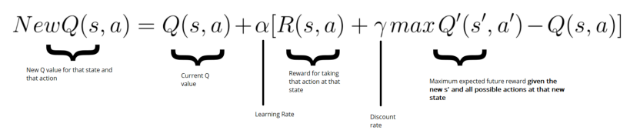
Calculating Error

Slide 32
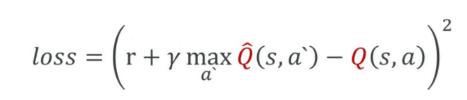
Loss
https://towardsdatascience.com/how-to-teach-an-ai-to-play-games-deep-reinforcement-learning-28f9b920440a

Slide 33
Deep Reinforcement Learning
A Q-Learning example (huggingface.co)
https://medium.freecodecamp.org/an-introduction-to-deep-q-learning-lets-play-doom-54d02d8017d8

Slide 34
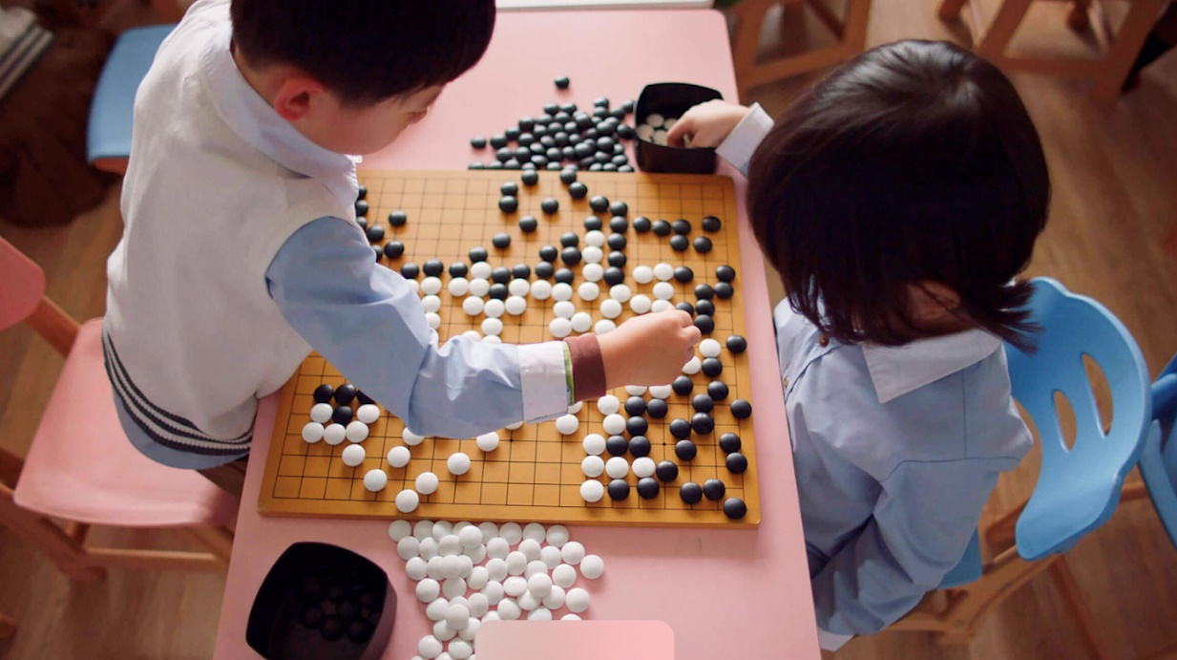
AlphaGo
Go is profoundly complex. There are an astonishing 10 to the power of 170 possible board configurations - more than the number of atoms in the known universe. This makes the game of Go a googol times more complex than chess.

Slide 35
AlphaGo
AlphaGo competed against legendary Go player Mr Lee Sedol, the winner of 18 world titles, who is widely considered the greatest player of the past decade. AlphaGo's 4-1 victory in Seoul, South Korea, on March 2016 was watched by over 200 million people worldwide.
While AlphaGo learnt the game by playing thousands of matches with amateur and professional players, AlphaGo Zero learnt by playing against itself, starting from completely random play.

Slide 36
Some Videos
https://www.youtube.com/watch?v=e3Jy2vShroE
http://www.youtube.com/watch?v=Xf_IhCbTQGY&feature=BFa&list=FLTnVTxTVQSBDkVSWPhBpRTQ

Slide 37
References
R. S. Sutton and A. G. Barto, Reinforcement Learning: An Introduction. MIT Press, 1998.
http://reinforcementlearning.ai-depot.com/Main.html
https://medium.freecodecamp.org/an-introduction-to-q-learning-reinforcement-learning-14ac0b4493cc
http://amunategui.github.io/reinforcement-learning/
http://mnemstudio.org/path-finding-q-learning-tutorial.htm
https://www.cs.swarthmore.edu/~bryce/cs63/s16/slides/3-21_value_iteration.pdf

