Slide 1
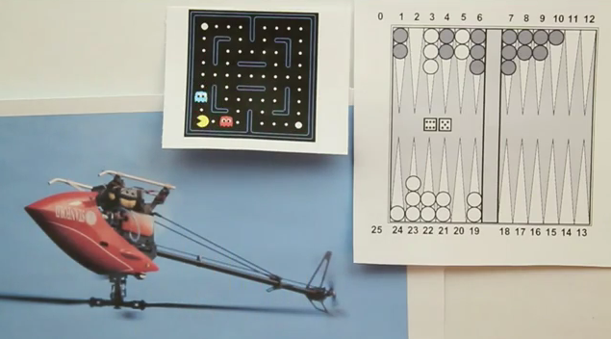
Reinforcement Learning

Slide 2
Acknowledgement
Several examples of this lecture have been taken from Stanford AI class and Stanford Machine Learning class.

Slide 3
Types of learning
Episodic: Collecting the rewards at the end of the episode and then calculating the maximum expected future reward.
Temporal Difference Learning: Estimate the rewards at each step

Slide 4
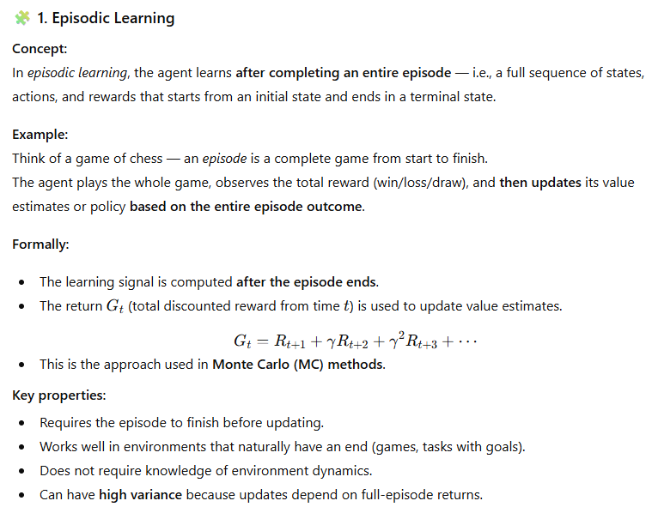

Slide 5
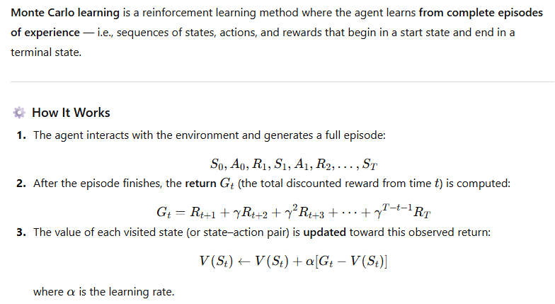
Episodic Learning: Monte-Carlo Method
G_t is the actual return following time ‘t’
In Monte Carlo method, the actual return is known
as the entire episode has been completed
Essentially, we are adjusting the
estimate by adding the error

Slide 6
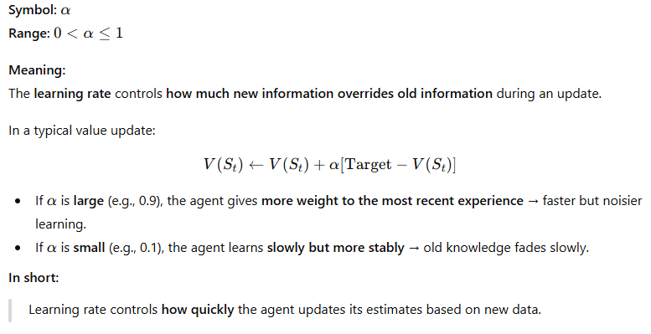
Monte Carlo – Learning Rate

Slide 7
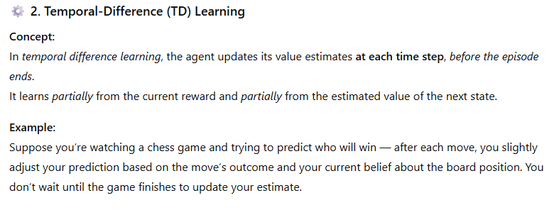

Slide 8
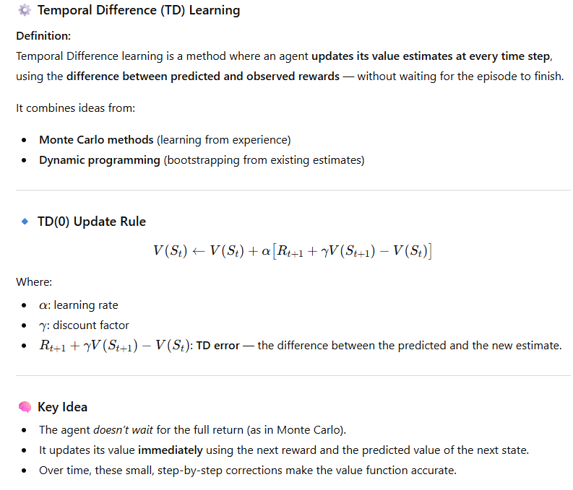
TD(O) -> we look one step ahead only

Slide 9
Driving Home Example
Each day as you drive home from work, you try to predict how long it will take to get home. When you leave your office, you note the time, the day of week, and anything else that might be relevant. Say on this Friday you are leaving at exactly 6 o'clock, and you estimate that it will take 30 minutes to get home. As you reach your car it is 6:05, and you notice it is starting to rain. Traffic is often slower in the rain, so you reestimate that it will take 35 minutes from then, or a total of 40 minutes. Fifteen minutes later you have completed the highway portion of your journey in good time. As you exit onto a secondary road you cut your estimate of total travel time to 35 minutes. Unfortunately, at this point you get stuck behind a slow truck, and the road is too narrow to pass. You end up having to follow the truck until you turn onto the side street where you live at 6:40. Three minutes later you are home.
R. S. Sutton and A. G. Barto: Reinforcement Learning: An Introduction

Slide 10
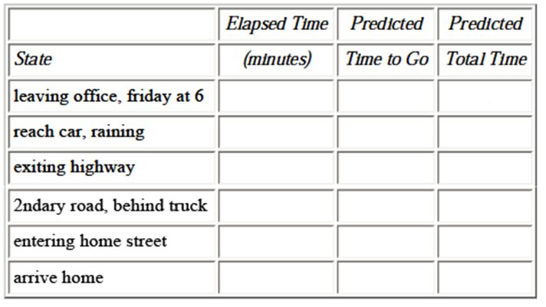
Driving Home Example
The sequence of states are as follows:
R. S. Sutton and A. G. Barto: Reinforcement Learning: An Introduction

Slide 11
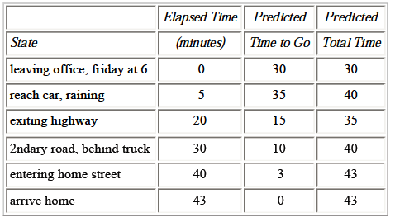
Driving Home Example
Reward
Value V(t+1)
The sequence of states, times, and predictions is thus as follows:
R. S. Sutton and A. G. Barto: Reinforcement Learning: An Introduction

Slide 12
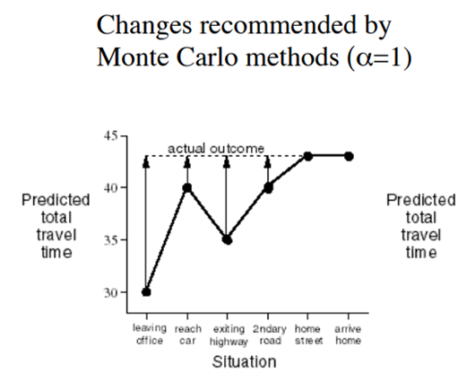
Driving Home Example
R. S. Sutton and A. G. Barto: Reinforcement Learning: An Introduction

Slide 13
Episodic Learning
Learning rate
The learning rate determines to what extent the newly acquired information will override the old information. A factor of 0 will make the agent not learn anything, while a factor of 1 would make the agent consider only the most recent information.

Slide 14
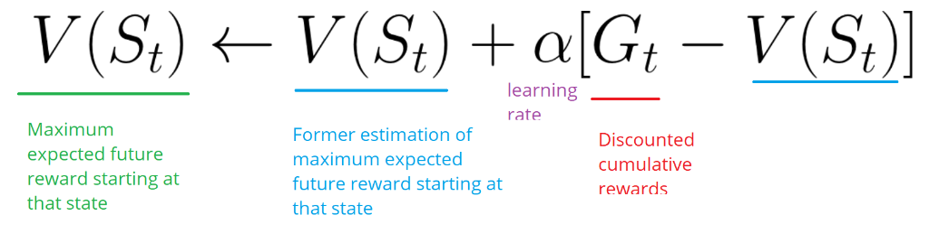
Monte Carlo

Slide 15
Temporal Difference Learning
The basic idea of TD methods is that the learning is based on the difference between temporally successive predictions. In other words, the goal of learning is to make the learner's current prediction for the current input pattern more closely match the next prediction at the next time step.

Slide 16
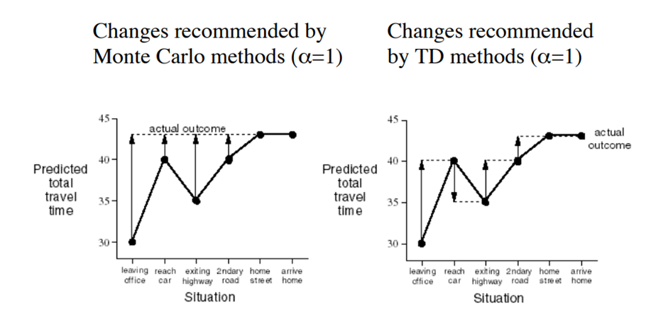
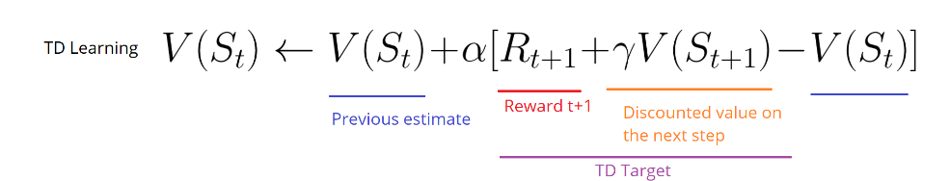
Driving Home Example
R. S. Sutton and A. G. Barto: Reinforcement Learning: An Introduction

Slide 17
Temporal Difference Learning

Slide 18
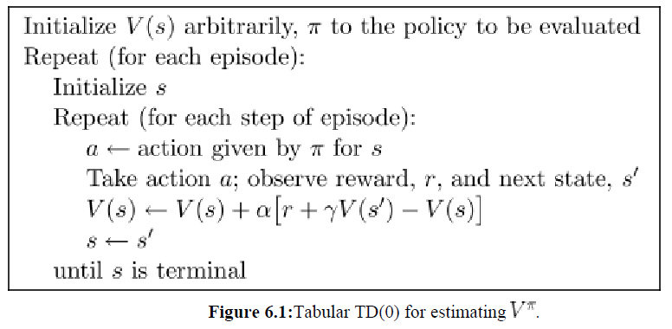
Temporal Difference Learning
R. S. Sutton and A. G. Barto: Reinforcement Learning: An Introduction

Slide 19
Temporal Difference Learning
Temporal difference learning is faster but less stable and may converge to the wrong solution.

Slide 20
Temporal Difference Learning
1 |  | 0.5 | 0.75 | +1
2 |  |  |  | -1
3 | S
4 | 1 | 2 | 3 | 4
+ve reward
-ve reward
Start state
Obstacle

Slide 21
Temporal Difference Learning
Let alpha = 0.5 and gamma = 1
All initial values and rewards are zero.
1 | 0 | 0 | 0.5 | +1
2 | 0 |  |  | -1
3 | 0
 | 1 | 2 | 3 | 4
The updated values as our RL agent moves are as follows:
      V(S21) = 0 + 0.5[0 + 1(0) – 0)] = 0
      Similarly,
      V(11) = V(12) = 0
      However,
      V(13) = 0 + 0.5[0 + 1(1) – 0] = 0.5

Slide 22
Temporal Difference Learning
Let alpha = 0.5 and gamma = 1
All initial values and rewards are zero.
1 | 0 | 0.25 | 0.75 | +1
2 | 0 |  |  | -1
3 | 0
 | 1 | 2 | 3 | 4
In next iteration, the following values will be updated:
      V(12) = 0 + 0.5[0 + 1(0.5) – 0] = 0.25
      V(13) = 0.5 + 0.5[0 + 1(1) -0.5] = 0.75

