Slide 1
AI AGILE DELIVERY GOVERNANCE
A governed two-agent system built on Microsoft Foundry
Governance
gate
Planning
Rosario Barbagallo · Software Architect
Notes:
Open: who you are and what the project does in one breath — a governed two-agent system that turns a raw user story into ready work or precise feedback.

Slide 2
THE PROBLEM
Stories enter the backlog inconsistently
Wasted planning
A typical “not ready” story
1
Time is spent refining stories that should never have reached the board.
“We need a fast, user-friendly dashboard that shows everything about trades.”
Wrong thing built
2
vague wording
Ambiguous stories get interpreted three different ways.
no acceptance criteria
Subjective quality
no user value
3
“Is this good enough?” is answered differently by every reviewer.
scope too large
Notes:
Every Agile team has this quiet problem. The cost is paid later: wasted planning, wrong builds, and a subjective bar.

Slide 3
THE IDEA
Two agents with opposite jobs
C
C
Backlog Governance
vs
Sprint Planning
CRITIQUE
CREATE
Evaluates a user story against INVEST and the Definition of Ready. Never plans.
Plans an already-approved story: points, tasks, DoD, risks. Never re-judges.
Critique vs creation — a real multi-agent system, not one prompt cut in two.
Notes:
Two agents, opposite jobs. One critiques, one creates. They never overlap.

Slide 4
ARCHITECTURE
The quality gate that branches
pass
User story
Backlog Governance
gate
Sprint Planning
Ready work
evaluate · INVEST + DoR
plan · points, tasks, DoD
fail
Feedback
back to author
Pass → planning. Fail → sent back with explicit issues, and stops. Bad stories never reach planning.
Notes:
The whole system. The key part is the gate — it BRANCHES. Pause here. That's the difference between a governed workflow and a pipe.

Slide 5
AGENT 1
Backlog Governance Agent — it evaluates
Scores against INVEST + the team Definition of Ready
structured verdict
{ "classification": "needs_refinement", "overall_score": 48, "gate_pass": false, "issues": [ "missing acceptance criteria", "vague or ambiguous wording" ]
}
Calls a tool that runs deterministic quality checks
Returns a structured JSON verdict — never plans
Notes:
Agent 1 calls a tool that runs INVEST and DoR checks, then returns a JSON verdict: score, gate decision, explicit issues. That structured output is the linchpin.

Slide 6
AGENT 2
Sprint Planning Agent — it plans
Receives a story that has already passed the gate
Story points
5 · with rationale
Takes its quality as given — never re-judges
Tasks
small, non-overlapping
Produces the delivery plan the team can pick up
Definition of Done
team DoD applied
Risks
named explicitly
Notes:
When a story passes, Agent 2 takes it as approved and produces the plan: estimate with rationale, tasks, DoD, risks. Work the team can pick up immediately.

Slide 7
WHY IT MATTERS
The gate is the differentiator
✓
PASS
↺
FAIL
The story flows to planning and becomes ready-to-build work.
The story is returned with explicit issues and stops. It never reaches planning.
Structured output does double duty: it makes the gate actionable and the agent measurable.
Notes:
Structured output makes the gate actionable AND the agent measurable. Without it, neither a reliable gate nor a real evaluation.

Slide 8
BUILT ON MICROSOFT FOUNDRY
Five pillars, end to end
1
Purpose-built agents
2
Tools & grounding
Two agents in the Foundry Agent Service
INVEST / DoR rules via a function tool
3
Observability
4
Quality evaluation
GenAI tracing into Application Insights
LLM-as-judge over a labelled golden set
5
Orchestration
Deployable workflow, invocable by name
Notes:
Everything runs on Foundry across the five hackathon pillars: agents, tools, tracing, evaluation, workflow.

Slide 9
TRUST
Observability + evaluation
◉
Observability
✔
Evaluation
Every agent call traced into App Insights
15-story hand-labelled golden set
Structured verdict travels with the trace
LLM-as-judge scoring in the portal
Gate pass-rate becomes a queryable metric
Measures correctness, not “looks good”
Monitoring says it is running. Evaluation says it is right.
Notes:
Governance becomes real here. Tracing gives operational signals; evaluation gives quality signals. Both required.

Slide 10
EVALUATION
Measured three ways
CORRECTNESS
OUTPUT QUALITY
SAFETY
does the gate decide right?
Foundry LLM-as-judge
Foundry safety evaluators
0.91
Issue precision
4.7 /5
Coherence
✔
0.98
Issue recall
4.9 /5
Intent resolution
Clean sweep
No violence, self-harm, sexual or hateful content. Protected-material, code-vulnerability and indirect-attack checks all pass.
0.93
Gate accuracy
4.0 /5
Fluency
offline harness · golden set
judge model gpt-5-mini · 15 cases
Correctness scored against ground truth offline · quality and safety from the Foundry evaluation run.
Notes:
Evaluation has three pillars. Correctness — does the gate decide right — from the offline harness against ground truth: precision 0.91, recall 0.98, gate accuracy 0.93. Output quality from the Foundry LLM-as-judge: coherence 4.7, intent 4.9, fluency 4. And a clean safety sweep across every dimension. Correctness offline, quality and safety on Foundry.

Slide 11
HUMAN-IN-THE-LOOP
The gate knows when to ask a human
PASS
REVIEW
REJECT
clear score → auto-plan
borderline or hard-blocked → a person decides
clear fail → sent back
A configurable review band and hard blockers (e.g. an unstated dependency) route uncertain stories to review —
the reviewer's decision is logged as a new ground-truth label, so the gate learns from the cases it found hard.
pass → plan · reject → feedback · review → human → decision feeds back into evaluation
Notes:
The gate is three-way: pass, reject, and review. Borderline scores and hard blockers go to a human. The decision becomes a new labelled example, so the gate improves on exactly the hard cases.

Slide 12
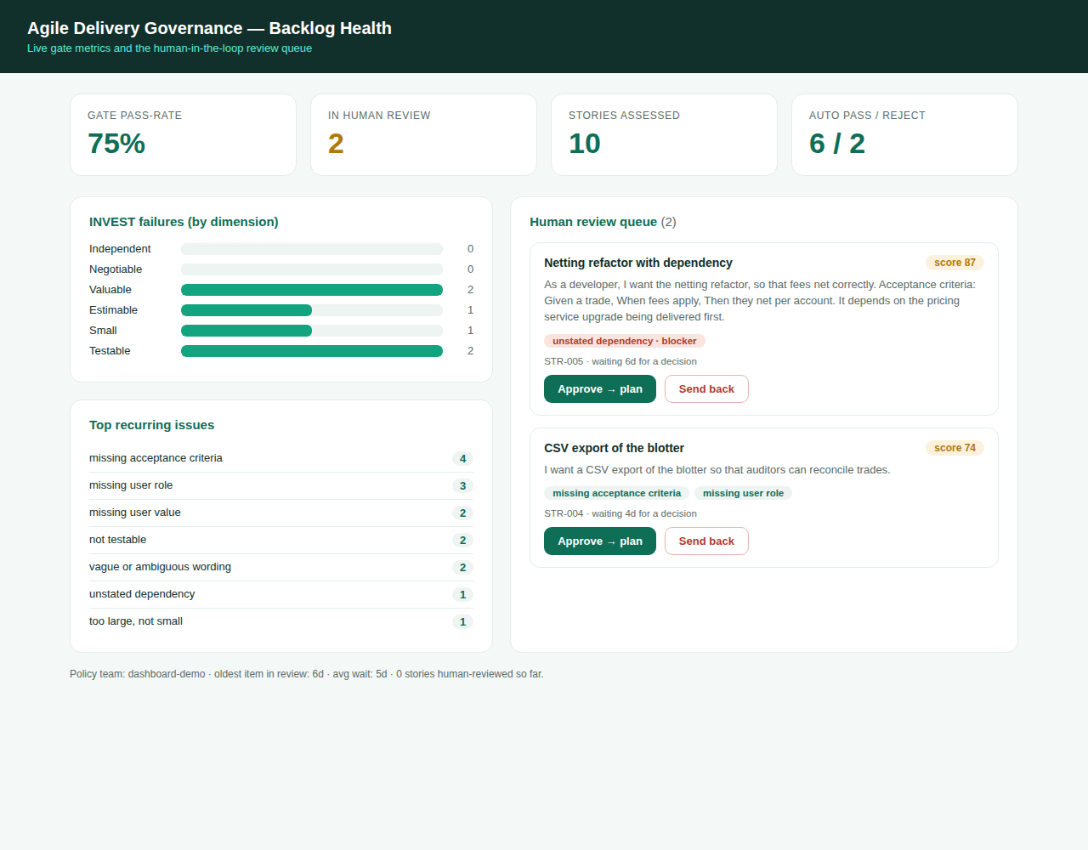
BACKLOG-HEALTH DASHBOARD
From workflow tool to health instrument
Gate pass-rate
is backlog quality trending up?
Recurring INVEST failures
which dimension to coach
Top recurring issues
the backlog's common gaps
Review queue + ageing
what's waiting on a human
Notes:
Because every verdict is structured and traced, aggregating them gives a backlog-health view: pass-rate, recurring INVEST failures, top issues, and the human review queue with ageing. This is the reviewer's suggested next step, built.

Slide 13
IMPACT
What this gives a team
1
Faster, consistent planning
Weak stories are filtered before they reach the board.
2
A measurable quality gate
Pass-rate is a backlog-health KPI, not a subjective call.
3
Itself governed
Every decision is traced; every agent is evaluated.
Notes:
Faster planning, a measurable gate, and a governance system that is itself governed. You trust the output because it is measured.

Slide 14
Governed delivery,
from requirement to ready.
Rosario Barbagallo · AI Agile Delivery Governance on Microsoft Foundry
Thank you
Notes:
Close cleanly: governed delivery, from requirement to ready. Thank you. Don't add more.

