Slide 1

LIVERPOOL ANALYSIS: THE KLOPP ERA
Elias Sarousavvidis &
Konstantinos Nikolopoulos

Slide 2


Nikolopoulos
Konstantinos
Sarousavvidis Elias
Aspiring Data Analyst with an Accounting and Finance degree.
Experience in accounting
2 years in retail market in spare car parts.
Shipping Operator / Data Analyst with Finance background
10+ years in Shipping Industry
Main goal is implementantion of AI / Big Data for the modernization and evolution of the Shipping World.

Slide 3






Sports Analysis
Team Analysis - Liverpool FC (2014- 2023)
Klopp era in the English Premier League (2016 - 2023)

Slide 4
Who is Jürgen Klopp
Jürgen Norbert Klopp is a German professional football manager of Liverpool club .
Football philosophy known as Gegenpressing,
Considered as one of the best managers in the world.
Inspiration for this Project:
Klopp changed the way we see this sport, he is one of the first manager who implement analytics in football
He has his own team with data analysts and scientists for analyzing players and team statistics.

Slide 5
Technical Analysis Methods
Retrieve data: API-FOOTBALL - By API-SPORTS https://rapidapi.com/api-sports/api/api-football
EDA in Jupyter => Cleaning process => Metrics Extracted
PowerBi Interactive Dashboard

Slide 6
Overview of Klopp era
Won 7 titles 2018-19 Uefa Champions League and the 2019-20 English Premier League after 30 years
Comeback kings: won 148 points from losing positions, more than anyone in Europe's big-five leagues.
Debuted 42 teenagers more than any manager in Liverpool’s history.
Most points in a season without winning the title 97p (2018/19)

Slide 7

..and some Records..
Most PL wins in a season - 32 - 2019/20
Most consecutive PL wins - 18 - 2019/20
Most PL home wins in a season - 18 - 2019/20
Most consecutive PL home wins - 24 - 2019/20
Most undefeated games in a season - 27 - 2019/20 Only 1 draw in between

Slide 8
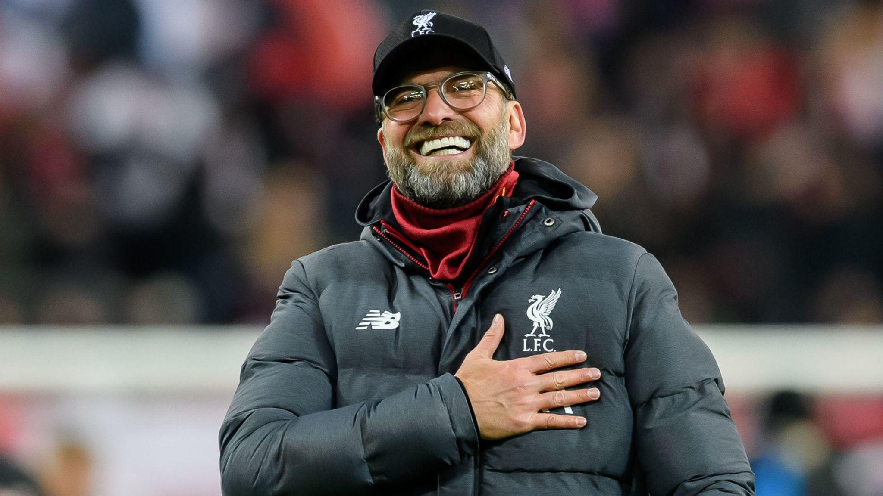
Thank you
Q&A

