Slide 1
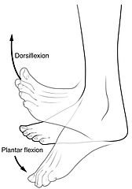
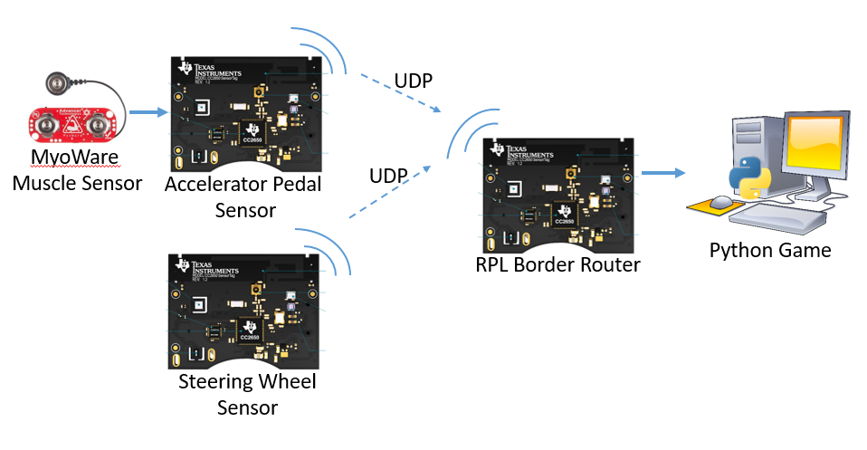
Gamification of Rehabilitation Using Muscle Sensors
Michael Redpath, Michael Garthe, Callum Sinclair, Athon Milane – Group L
PROJECT AIMS
Develop a car racing controller to assist with Human Rehabilitation
Games are a proven method to help patients rehabilitate.
When rehabilitation requires repetitive motions, keeping these motions engaging improves patient outcomes
Games have been shown to improve both physical and cognitive ability.
Interface with muscle sensors
In this project, muscle sensors have been used to measure dorsiflexion and plantarflexion rehabilitation exercises.
Figure 1: Dorsiflexion and plantarflexion exercises (Cheprasov, 2018)
The users muscle activation will be used to control the computer game.
Develop a reliable advanced embedded system
The TI Sensortag’s accelerometer and gyroscope will be used in addition to the muscle sensors. This sensor data will be combined and machine learning will be applied to produce a reliable game controller.
SYSTEM OVERVIEW
MyoWare Muscle Sensors
Detects muscle activation by measuring the electrical signals emitted by your muscles!
Provides an output from 0 to Vcc
[Possible graph of output waveform or sensor positioning]
Muscle sensors placed above each foot, one for accelerate and one for break
TI SensorTags
MPU9250 provides Accelerometer and Gyroscope measurements
[Mention on board Accelerometer and Gyro]
ADC configured to measure from 0 to Vbattery, corresponding to 0 to 4095
Sensortags placed on hands to measure “steering” and on wrists for redundancy
Wireless Communication
Each node collects either ADC or MPU data and sends it via UDP to the computer, with use of an RPL border router to link the two networks
Sensor Fusion
[Fusing Accelerometer and Gyro values?]
[Fusing Accelerometer and MYO values?]
Machine Learning
[ML on MYO Values]
Python Games
[Python program used to interface with a number of different games/ one specific game]
RESULTS
Work had to be done to improve the packet-rate of the system to achieve a desirable rate
CONCLUSIONS
Sensortag not an effective wireless platform for this application (high rate data, low-power not a major concern)
Better platform would be an nrf24l01-enabled dev board
(nrf24l01/2.4GHz used in commercial wireless controllers like mice and gamepads)
Figure 1: System Overview

