Slide 1
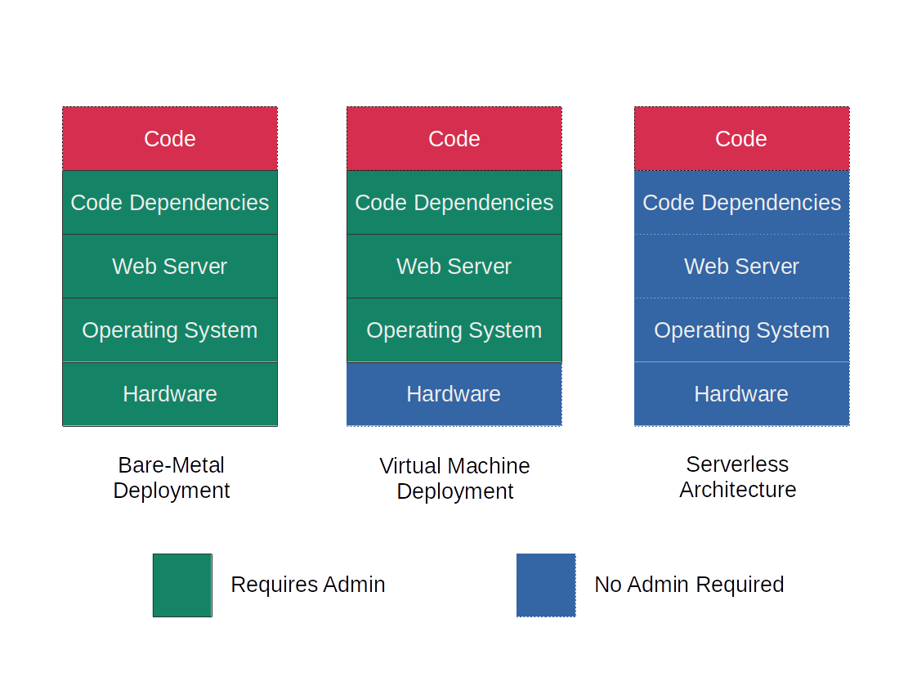
Cloud Services
Google Cloud Platform
Serverless Architecture
  Pricing model
  Availability
  Security
  Speed
REST-ful HTTP API

Slide 2
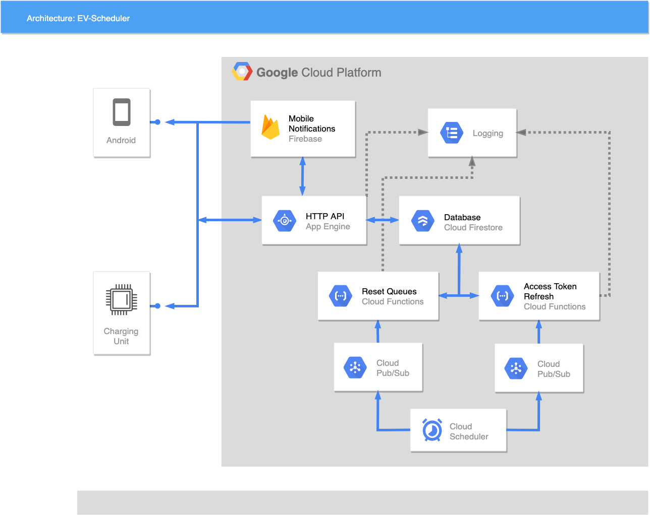

Slide 3
