Slide 1
Brain Tumor Classification Using Deep Learning
Project Sector : 3H (Health, Humanity and Hunger)
Project Code : HH19014
College : P.E.S. Modern College Of Engineering

Slide 2
Index :
Problem Statement
Target Audience
Implementation Progress
Planning
Working Model
Impact
Photos
Basic Flask Application Photos
Thank You (:

Slide 3
Problem Statement :
To Detect and Classify Brain Tumor in four classes* using CNN and ANN as an asset of Deep Learning and to examine change of tumor size.
Four Classes :
Benign (Non - Cancerous)
Malignant (Cancerous)
Pituitary Tumor.

Slide 4
Target Audience :
Product Based : The system can be hosted/maintained by-
Hospitals
Medical Institutes
User Based : The system can be accessed/utilized by-
Doctors (any)
Patients (any age group)

Slide 5
Implementation Progress - 60%
Completed Tasks
Create, clean, validate Dataset
Build primitive yes/no (two class) Model
Tumor Segmentation
Create basic website
Create basic Flask App
In progress Tasks ~(March 31)
Create ANN, CNN, Transfer Learning models for all four classes
Complete Website
Create Advance Flask App
Testing: Selenium Tool, Report Generation: TestNG
Deploy Final System
Android / ios application.

Slide 6
Planning :
A primitive system consisting of two classes is completed.
The next step is adding more classes.
Creating ANN/CNN* models and fine tuning it's parameters.
Improving tumor segmentation / predictor model.
Some miscellaneous tasks of completing interactive website, testing, provide doctors information, contacting and validating the system from a specialist will be done.
*ANN: Artificial Neural Network
*CNN: Convolution Neural Network

Slide 7
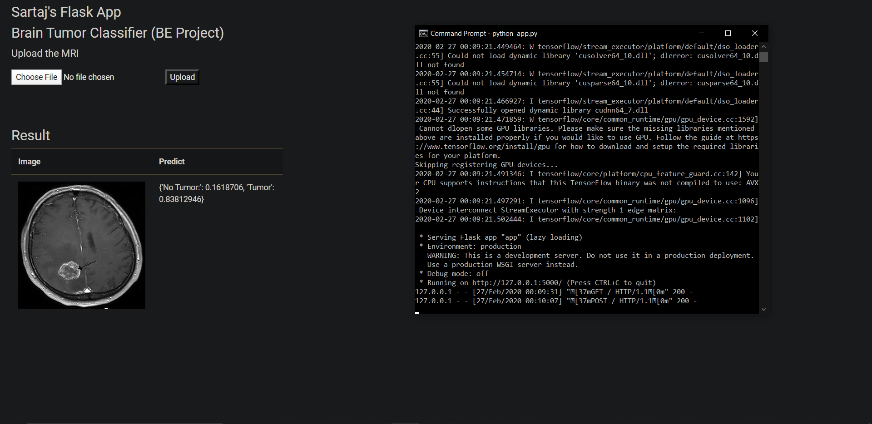
Working Model - 1
Tumor Classification Model
This is a Screenshot of the basic tumor detection.
The UI is for development phase, the final UI would be label of highest probability in prediction along with other information.
Remaining tumor types will be added in the upcoming month.

Slide 8
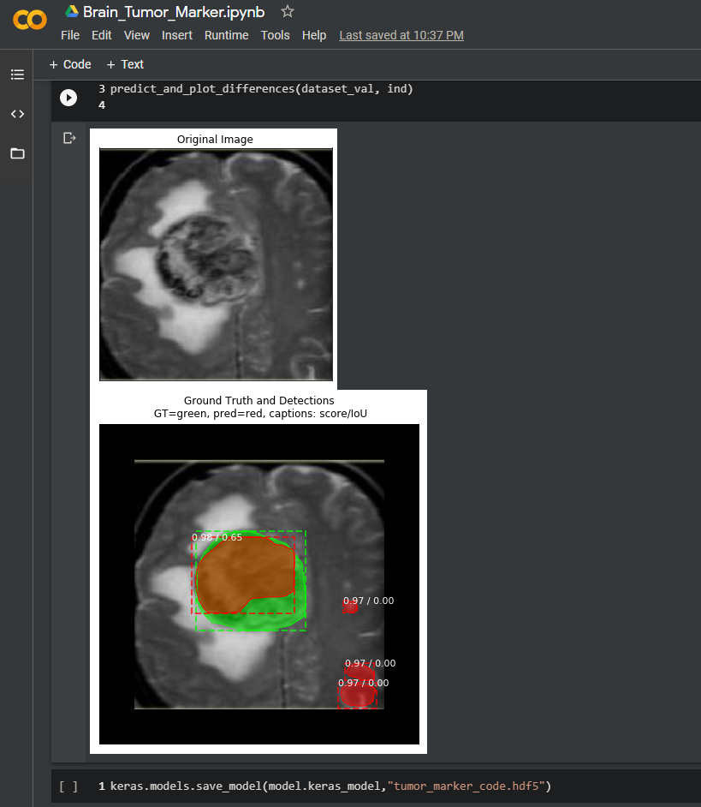
Working Model - 2
Tumor Segmentation Model
This model is to mark which part of MRI has tumor.
Brown : Actual Tumor
Green : Tumor Spread/Growth
Red : Future Prediction of regions that my turn to tumor
This model will be an extension to the “Tumor Classifier Model”.

Slide 9
Impact :
We did address few hospitals* for MRI data, but due to privacy and safety concerns we we not able to acquire any data.
Our proposition now is to establish a working system with existing data and demonstrate a working system to medical communities in hopes of getting in direct contact with professionals and get hands on more quality data.
We do not expect any monetary benefits for ourselves, our soul aspiration is to help people and spread awareness about ‘Brain Tumor’ and it’s medication.
*Yashwantrao Chavan Memorial Hospital, Chandrabhaga clinic.

Slide 10
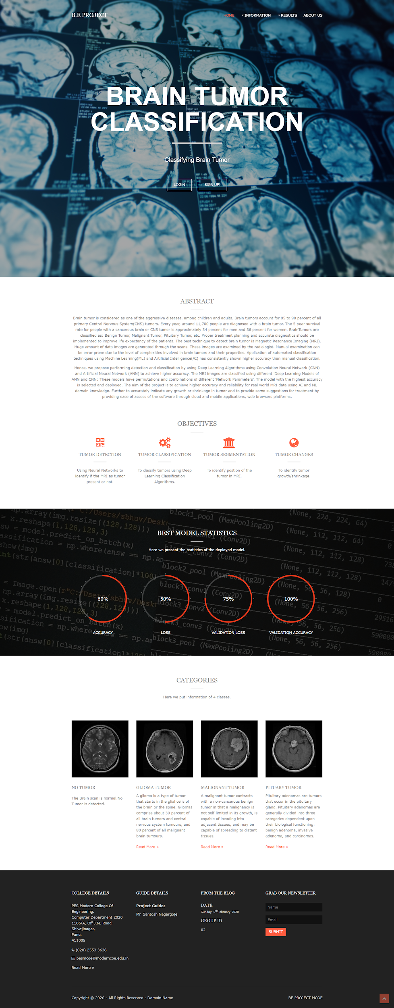
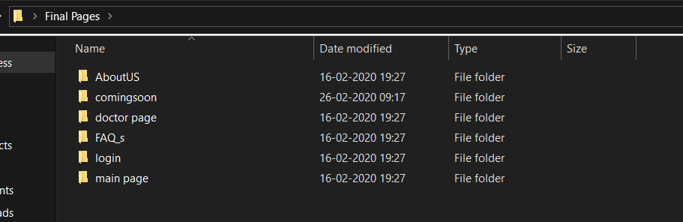
Photos :
Link of our website (in progress):
http://braintumordemoone.com
OR
http://braintumordemoone.com.preview.services/
*(The website is deployed on free domain hence it’s availability may suffer due to DNS caching.)
HTML pages created :

Slide 11
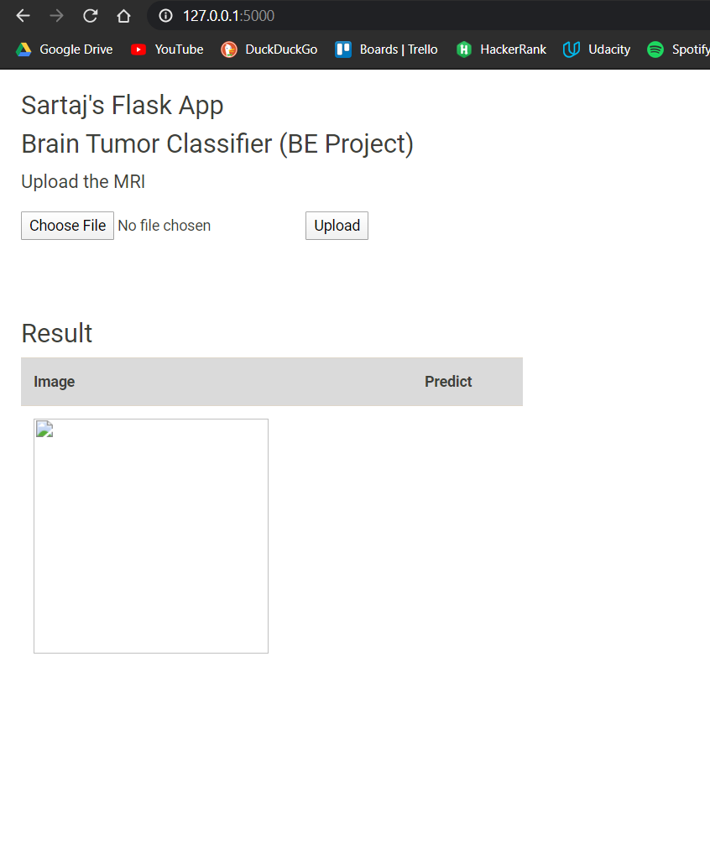
Basic Flask Application Photos
The (basic) Flask UI where user would upload the MRI.
Clicking on ‘upload’ would send the MRI to backend and the probabilities would pe displayed in prediction column.
Later, in final version of the Flask App the UI would be improved and a final result of tumor label would be displayed instead of probabilities.

Slide 12
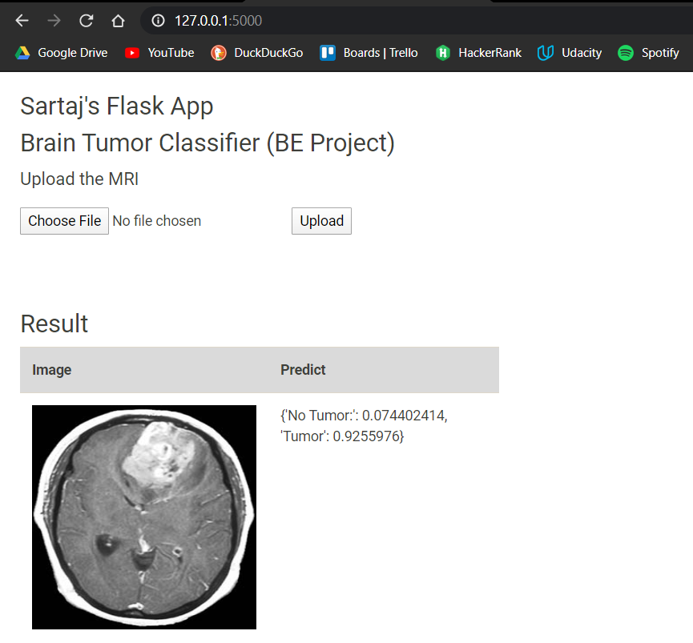
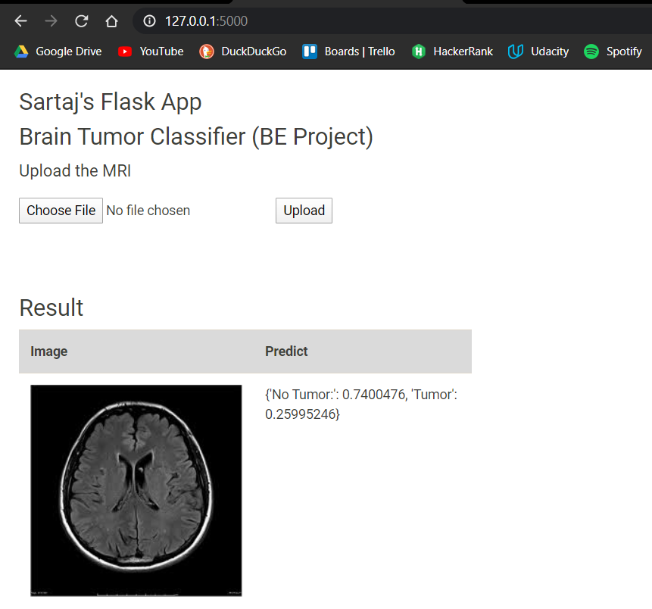
The outcome is precise! the system is able to distinguish between MRI consisting of tumor and MRI without tumor.
Next iteration would be able to classify MRI into four classes.
Now, the MRI that gets labelled confident for tumor, would be linked to 'Tumor Segmentation Model [7]' for breakdown and subsequent study.

Slide 13
Thank You :
We would like to express our gratitude towards our principal Dr. Mrs. K. R Joshi, our respected HOD.(Computer Department) Dr. Mrs. S. A. Itkar and our respected guide Mr. Santosh Nagargoje.
We would also like to thank Mr. Prashant Sahu for his support.
We would like to thank Dr. Shashikant Ubhe for validating the dataset.
We would like to thank Ms. Swati Kanchan for providing the necessary dataset.

Slide 14
Thank You :
Lastly, we would especially like to thank the i2i team for their support and encouragement.
The opportunity to showcase our project to such brilliant minds is wonderful !
Group :
Sartaj Bhuvaji
Ankita Kadam
Prajakta Bhumkar
Sameer Dedge

