Slide 1
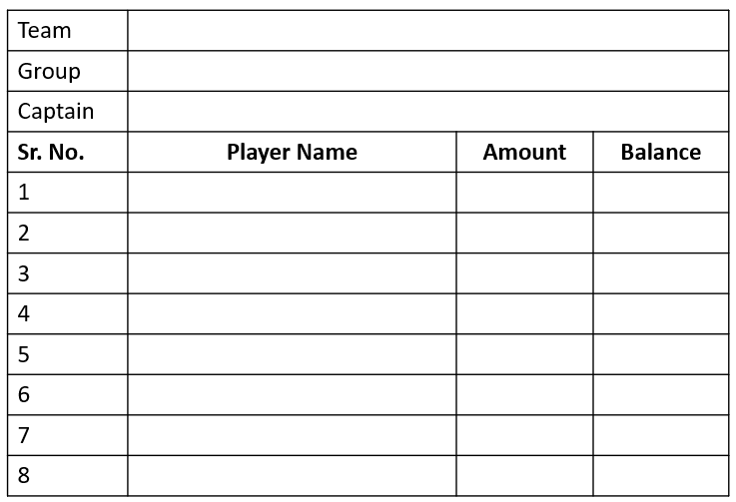
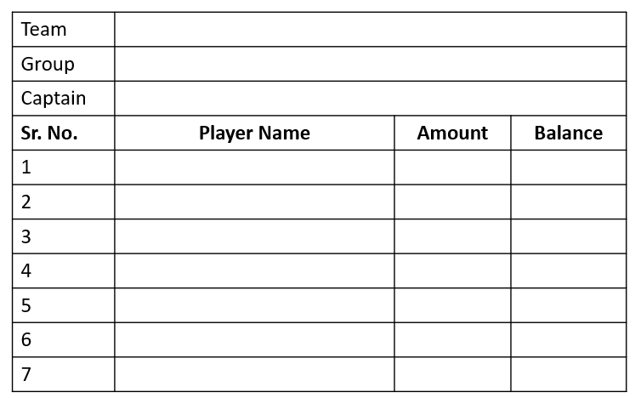
Maheshwari Royals
Aaradhya Superstars
Abhishek Lathi
Anil Chandak
Kabra Kings
Lathi Lions
Sameer Kabra
Nilesh Lathi

Slide 2
Raju Riders
Royal Challengers Dewas
Rajkumar Bhootada
Aditya Chichani
Sourabh Warriors
Sunny Spartans
Sourabh Totla
Sunny Maheswari

