Slide 1


CAPSTONE PROJECT AI-Based Legal judgment prediction system
Presented By
Student Name: Sarthak dhiman
College Name: chandigarh university
Department: AIT - cse
Email ID: ishan123dhiman@gmail.com
AICTE Student ID: AINSI_115198

Slide 2
OUTLINE
Problem Statement
Proposed Solution
System Development Approach
Algorithm & Deployment
Results
Conclusion
Future Scope
References

Slide 3

Problem Statement
With more than five crore cases pending in various courts, the Indian legal system is currently beset by a massive backlog that causes major delays in the administration of justice. In addition to being labor-intensive and time-consuming, manual legal document analysis and case outcome prediction by legal professionals are prone to human bias and inconsistency.
Effective legal strategy and resource allocation are hampered by the lack of easily accessible, data-driven tools to help litigants, judges, and attorneys predict the likely outcomes of cases.

Slide 4
Proposed Solution
The "AI Assisted Legal Judgment Prediction System" aims to harness artificial intelligence (AI) and machine learning (ML) to automate the prediction of legal case outcomes based on historical data and legal document analysis.
Key Features:
Automated Data Collection: Gathers and compiles information about court cases, including facts, statutes, arguments, and rulings, from online resources like Indian Kanoon.
Data preprocessing: Prepares unprocessed legal documents for model training by cleaning, anonymizing, and structuring them into machine-readable formats (such as JSON or Parquet).
Natural language processing (NLP) is used in NLP-Based Feature Extraction to extract pertinent features from unstructured legal texts, including named entities, cited legal provisions, and factual patterns.
Predictive Modeling: Classifies and forecasts case outcomes based on input features using sophisticated machine learning algorithms (e.g., CNN, SVM, BERT, and BiLSTM).

Slide 5
System Approach
Technology:
Programming Language: Python
Libraries & Frameworks: Pandas, NumPy, Scikit-learn, TensorFlow/PyTorch, NLTK/Spacy for NLP, Hugging Face Transformers
Data Storage: Parquet, JSON files for efficient storage and retrieval
Web Scraping: Custom scripts leveraging BeautifulSoup/Scrapy to extract data from Indian Kanoon and similar sources
Development Workflow:
Data Acquisition: Automated scripts collect and update legal datasets.
Preprocessing: Data cleaning, tokenization, stop-word removal, and entity recognition to prepare text for modeling.
Feature Engineering: Extracts key information such as legal citations, case facts, and outcomes for use in ML models.
Model Training: Selection and training of suitable algorithms, with hyperparameter tuning and cross-validation to optimize performance.
Evaluation: Uses metrics such as accuracy, precision, recall, and F1-score to assess model effectiveness.

Slide 6
Algorithm & Deployment
Choosing an Algorithm:
Using the TWO (Texas Wolf Optimization) algorithm for hyperparameter tuning, the system assesses a number of machine learning and deep learning models, such as Logistic Regression, SVM, CNN, LSTM, and BiLSTM.
Models like BERT and BiLSTM are recommended for text classification because of their exceptional ability to extract contextual and semantic information from legal documents.
Method of Training:
Subsets of the dataset are used for testing and training.
Entity recognition, vectorization, and case fact summarization are all included in feature extraction.
Supervised learning is used to train models, and in certain methods, genetic algorithms and process supervision are employed for optimization.
K-fold testing and cross-validation guard against overfitting and guarantee robustness.

Slide 7
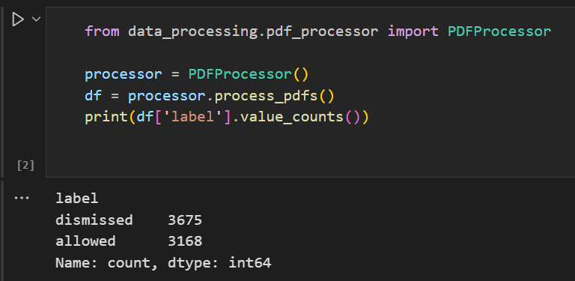
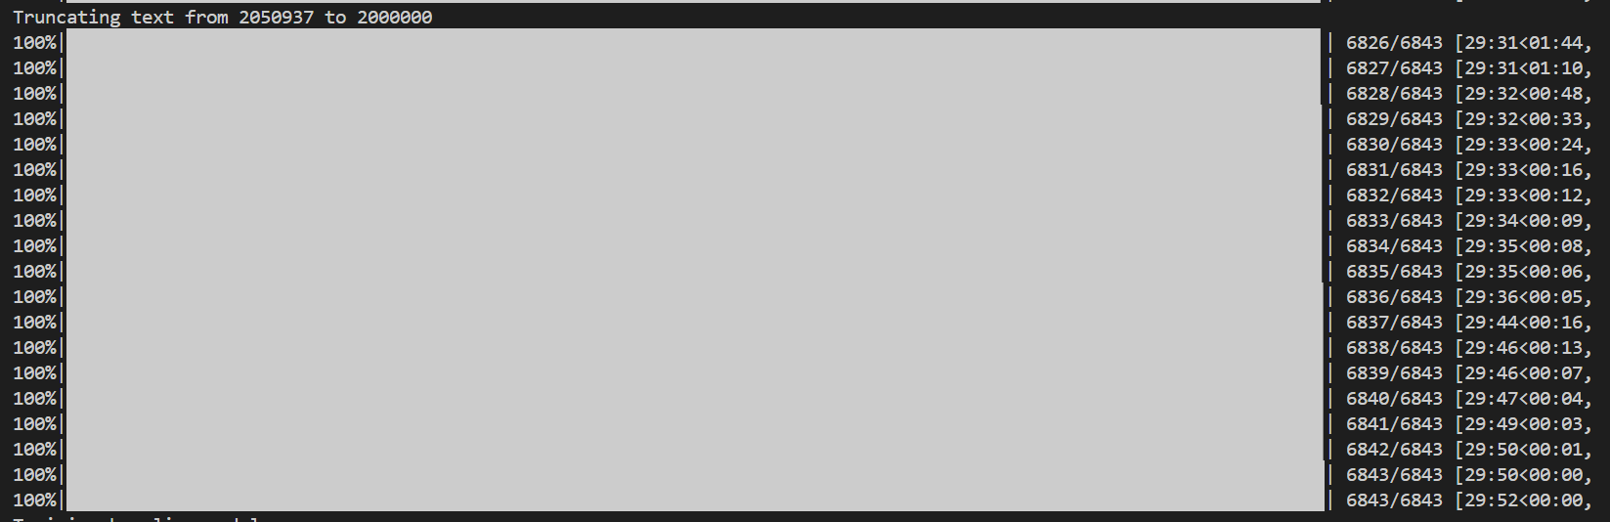
Results
The dataset used was too big to train the model in given time so I have used only 2022 cases from Indiankanoon site which consisted of 400 pdfs which gave me acceptable accuracy and model results.
First, there was PDF processing, we were able to find out there was a balance between labels so there was no imbalance and no biasness towards a particular label while training;
Then There was the process for data cleaning, if there was pdf reaching max length of spacy, then it would be truncated to max length.
1. BALANCED LABELS
2. Text Cleaning

Slide 8
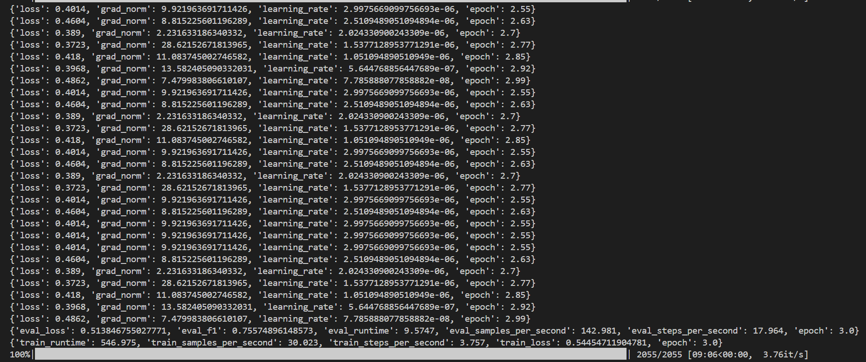
TRAINING
Bert Model was trained upto 3 epochs only to avoid the risk of overfitting and improve generalization.
Model Performance Analysis : Final F1 Score is 0.721 i.e. 72.1%
Loss decreases from 0.8 to 0.5
Generalization is steady
No signs of Overfitting
Model structure is good so it can be used to scale the dataset for training but due to system limitations here we have taken only 400 pdfs. Taking more would take days to process and train.
More epochs can improve model performance more but model can be at risk of overfitting as well.

Slide 9
Testing on sample
Testing the model on a pdf from 2023 case straight from IndianKanoon website, here we use and compare both the models i.e. Baseline model (Random Forest) and our BERT model. Baseline model is great for small datasets and sets a good baseline for our BERT model to evaluate the model performance.
Python predict.py –pdf_path “path_name” is used to test the model on testing pdf.
Here both baseline model and BERT model shows different results showing that baseline model is working fine because it was trained on a small dataset of 400 pdfs whereas BERT model lacks data where 400 pdfs was not sufficient for Bert to give a higher F1 score and accuracy as compared to Random Forest. Here the baseline model has the better F1 score of 97 percent so it is correct.

Slide 10

Conclusion
By addressing the shortcomings and inconsistencies of manual approaches, the AI Assisted Legal Judgment Prediction System offers a strong, data-driven tool for predicting legal outcomes.
The system improves the speed and accuracy of legal judgment predictions by utilizing cutting-edge NLP and ML techniques, which helps with improved case strategy and resource allocation.
The project shows how artificial intelligence (AI) has the potential to revolutionize the Indian legal system by lowering case backlogs, increasing transparency, and facilitating access to justice.
There are still issues with the quality of the data, the predictability of the results, and the requirement for constant ethical supervision and validation.

Slide 11

Future scope
Expansion to More Case Types: Extend coverage to additional legal domains, such as criminal, family, and commercial law.
Explainable AI: Integrate explainability modules to provide transparent reasoning behind predictions, aiding user trust and adoption.
Continuous Learning: Implement feedback loops for model retraining with new case data to maintain accuracy over time.
Integration with Court Systems: Collaborate with judiciary and legal tech platforms for seamless integration and real-world impact.
Ethical and Legal Compliance: Address concerns around data privacy, fairness, and accountability in AI-driven legal predictions.
Cloud-Based Deployment: Develop a scalable SaaS platform for broader accessibility to legal professionals and the public.

Slide 12
References
GitHub Repository : [https://github.com/Sarthak-Dhiman-17/AI_Assisted_Legal_Judgment_Prediction_System]
CPPR, "Predictive Justice: Using AI for Justice," ATLAS South Asia Public Policy Challenge, 2021. [https://www.cppr.in/wp-content/uploads/2021/05/PREDICTIVE-JUSTICE-USING-AI-FOR-JUSTICE-2.pdf]
S. Aletras et al., "Predicting judicial decisions of the European Court of Human Rights: a Natural Language Processing perspective," PeerJ Computer Science, 2016. [https://iacajournal.org/articles/10.36745/ijca.343]
S. Mussard et al., "Deep Learning for Prediction of Judicial Outcome – LAWBOT," ANR Project, 2020. [https://anr.fr/Project-ANR-20-CE38-0013]
Z. Zhong et al., "Iteratively Questioning and Answering for Interpretable Legal Judgment Prediction," Proceedings of the AAAI Conference on Artificial Intelligence, 2020. [https://ojs.aaai.org/index.php/AAAI/article/view/5479]
Pre/Dicta, "AI-Powered Legal Case Outcome Prediction Methods," 2025. [https://www.pre-dicta.com/ai-powered-legal-case-outcome-prediction-methods/]

Slide 13
Thank you

