Slide 1
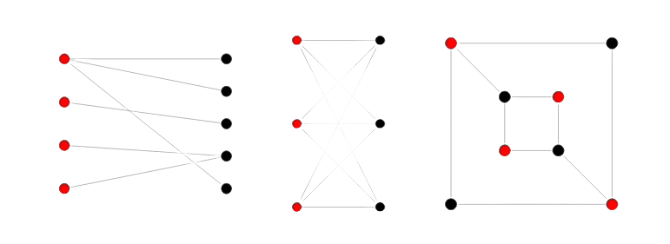
BIPARTITE GRAPH
bool dfs(int node, int c)
{
visited[node]=true,color[node]=c;
for(auto child: adj[node])
{
if(!visited[child])
{
if(dfs(child,c^1)==false) return false;
}
else if(color[node]==color[child]) return false;
}
return true;
}
bool flag=true;
for(int i=1;i<=n;i++)
{
if(visited[i]==false){ if(dfs(i,0)==false) no; }
}

Slide 2
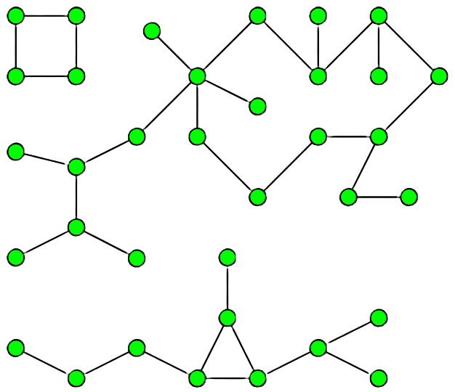
NO. OF CONNECTED COMPONENTS
You have to run dfs for all nodes and for each dfs mark all the child nodes as true. then dont run dfs if it is visited.
The total number of times you run dfs will be the number of connected components
void dfs(int node)
{
visited[node]=true;
for(auto child: adj[node])
{
if(!visited[child]) dfs(child);
}
}

Slide 3
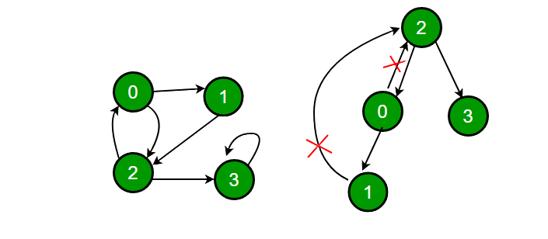
you have to run dfs for all nodes and if you run dfs and come across a case where the child != parent and still it is visited you return true. for a particular node you take the bitwise or of all the children and then return the result to the parent call.
DETECT CYLES
bool dfs(int node, int par=0)
{
visited[node] = true;
bool loop = false;
for(auto child: adj[node])
{
if(visited[child] && child==par) continue;
if(visited[child]) return true;
loop|=dfs(child,node);
}
return loop;
}

Slide 4
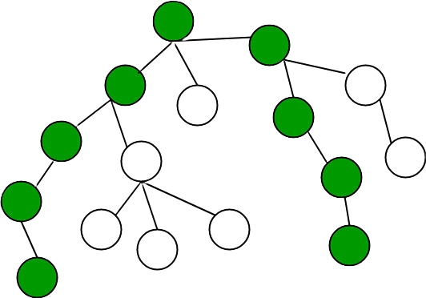
DIAMETER OF TREE/GRAPH
pair<int, int> dfs(int node)
{
visited[node] = true;
int len1 = 0, len2 = 0;
for (auto child : adj[node])
{
if (!visited[child])
{
pair<int, int> childDepths = dfs(child);
if (childDepths.first > len1)
{
len2 = len1;
len1 = childDepths.first;
}
else if (childDepths.first > len2)
{
len2 = childDepths.first;
}
}
}
diameter = max(diameter, len1 + len2);
return {1 + len1, node};
}

Slide 5
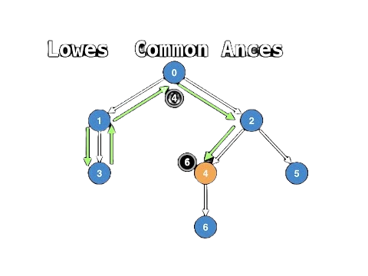
We run dfs and store the parent of every node. Then we get the paths to desired nodes from root and then we run for loop for lcao.
LCAO
void dfs(int node, int par=0)
{
visited[node]=true;
parent[node]=par;
for(auto child: adj[node])
{
if(!visited[child]) dfs(child,node);
}
} vector<int> path(int node)
{
vector<int> ans;
while(node!=0) ans.pb(parent[node]),node=parent[node];
reverse(all(ans));
return ans;
}

Slide 6
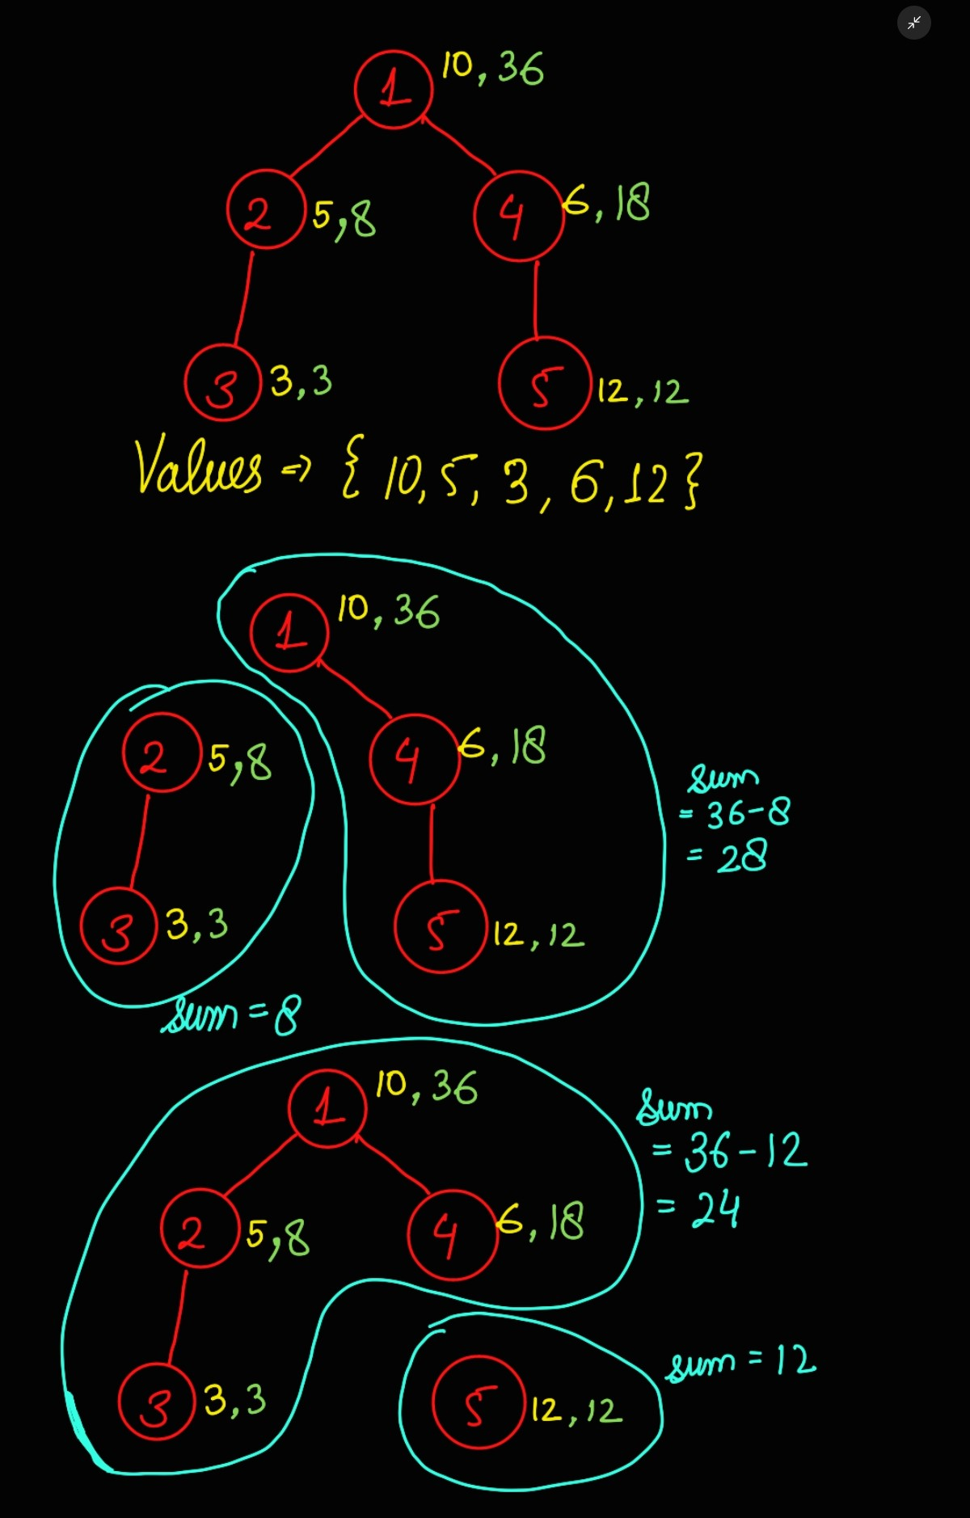
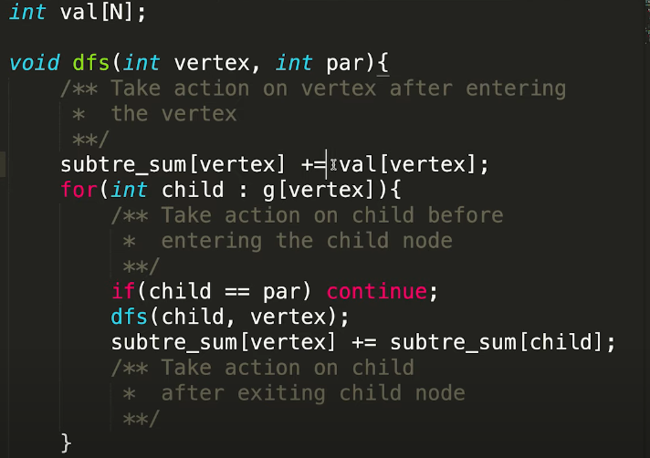
Compute the sum of subtree and go towards root node. Then sum of the two components after their edge is deleted will be sum[node] && sum[ROOT]-sum[node]
EDGE DELETION

Slide 7
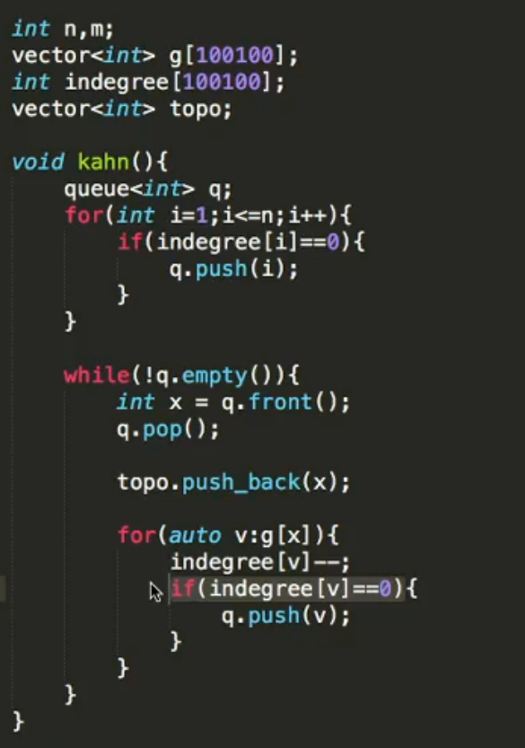

Topological Sorting
We can use Kahn’s algorithm to get the topological ordering.
Topological ordering is for a DAG where 1 is pre-requisite for 2 and so on.
However if there is a cycle in the graph then using topological sorting the indegree can never become zero.
So we can get the nodes which are involved in a cycle by simply checking for the nodes whose indegree is not zero.

Slide 8
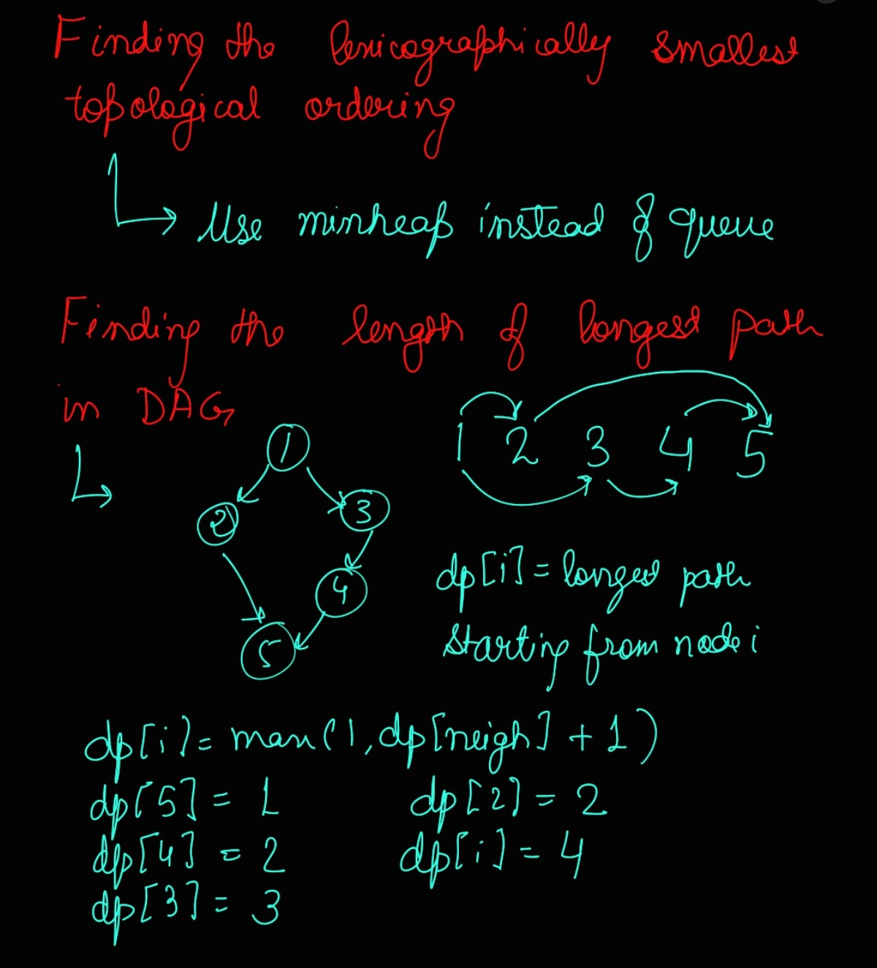
Topological Sorting

Slide 9
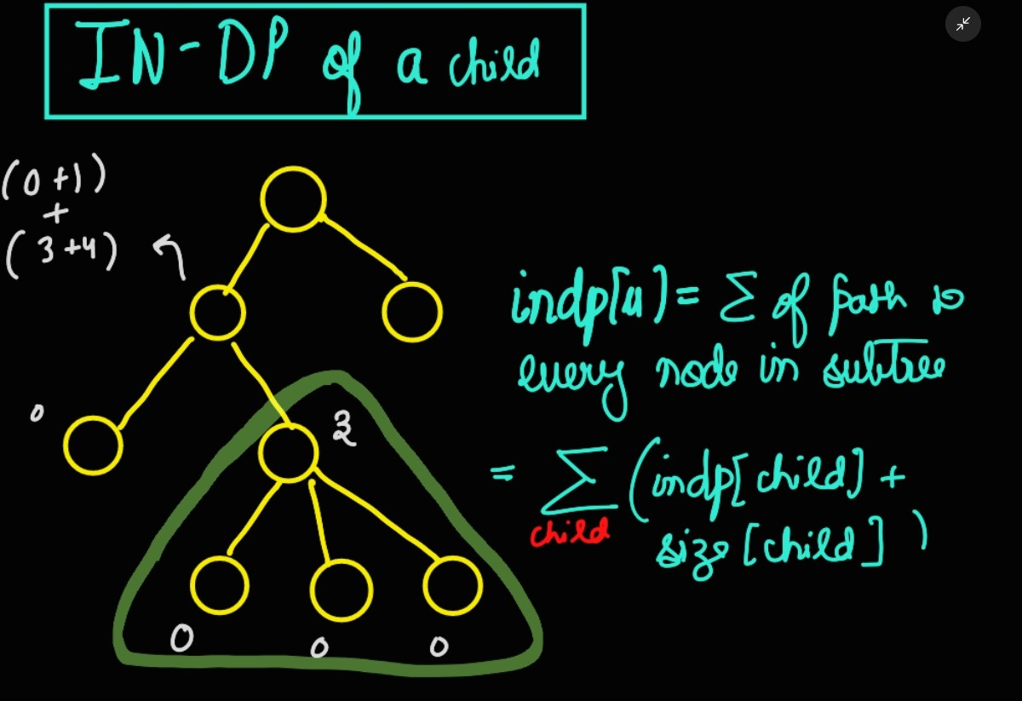
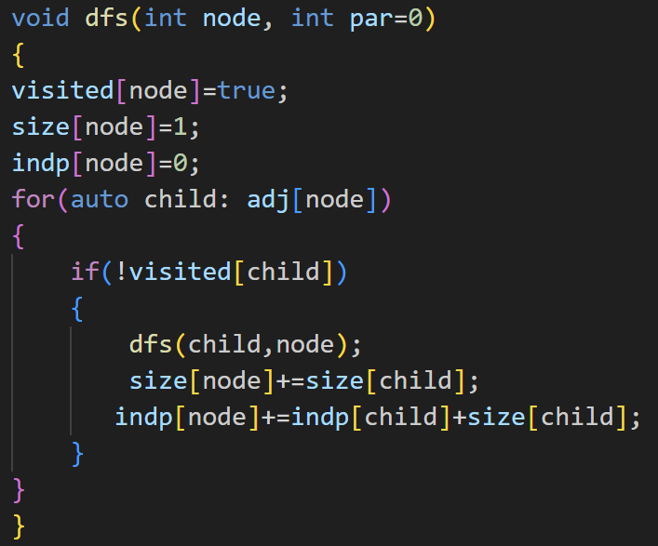
IN DP OF A NODE

Slide 10
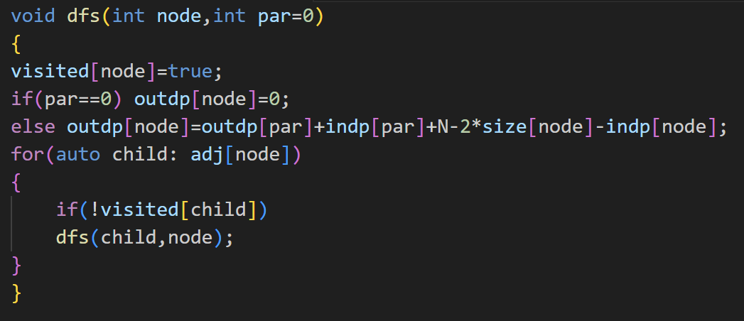
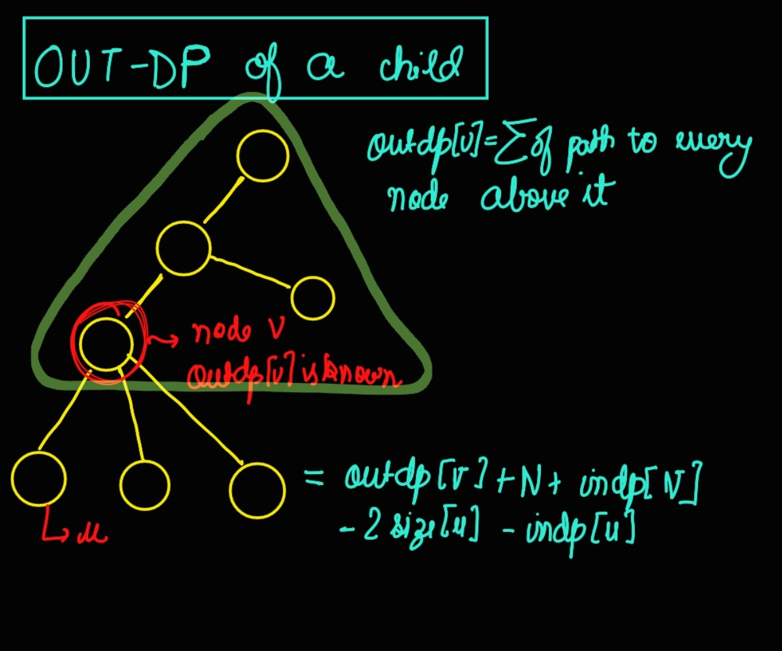
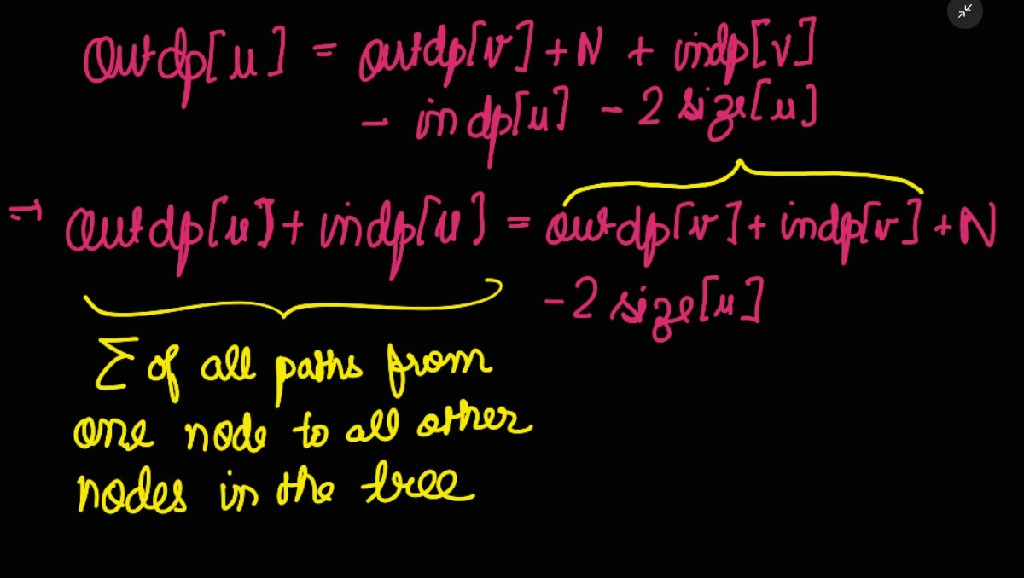
OUT DP OF A NODE

