Slide 1
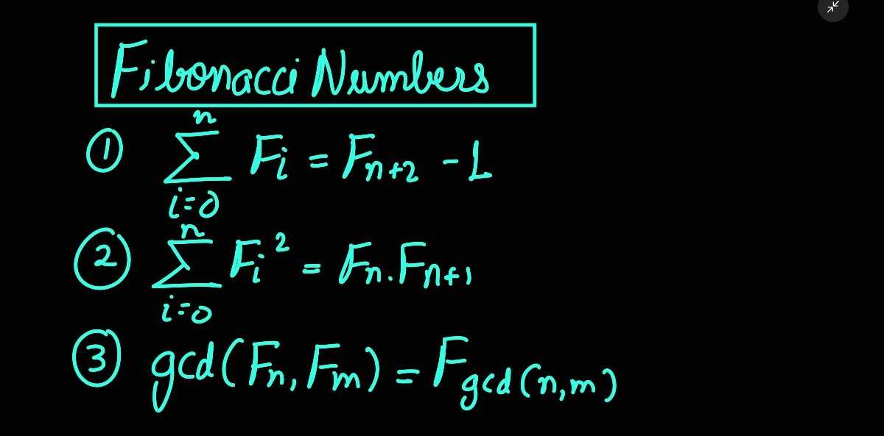

Slide 2
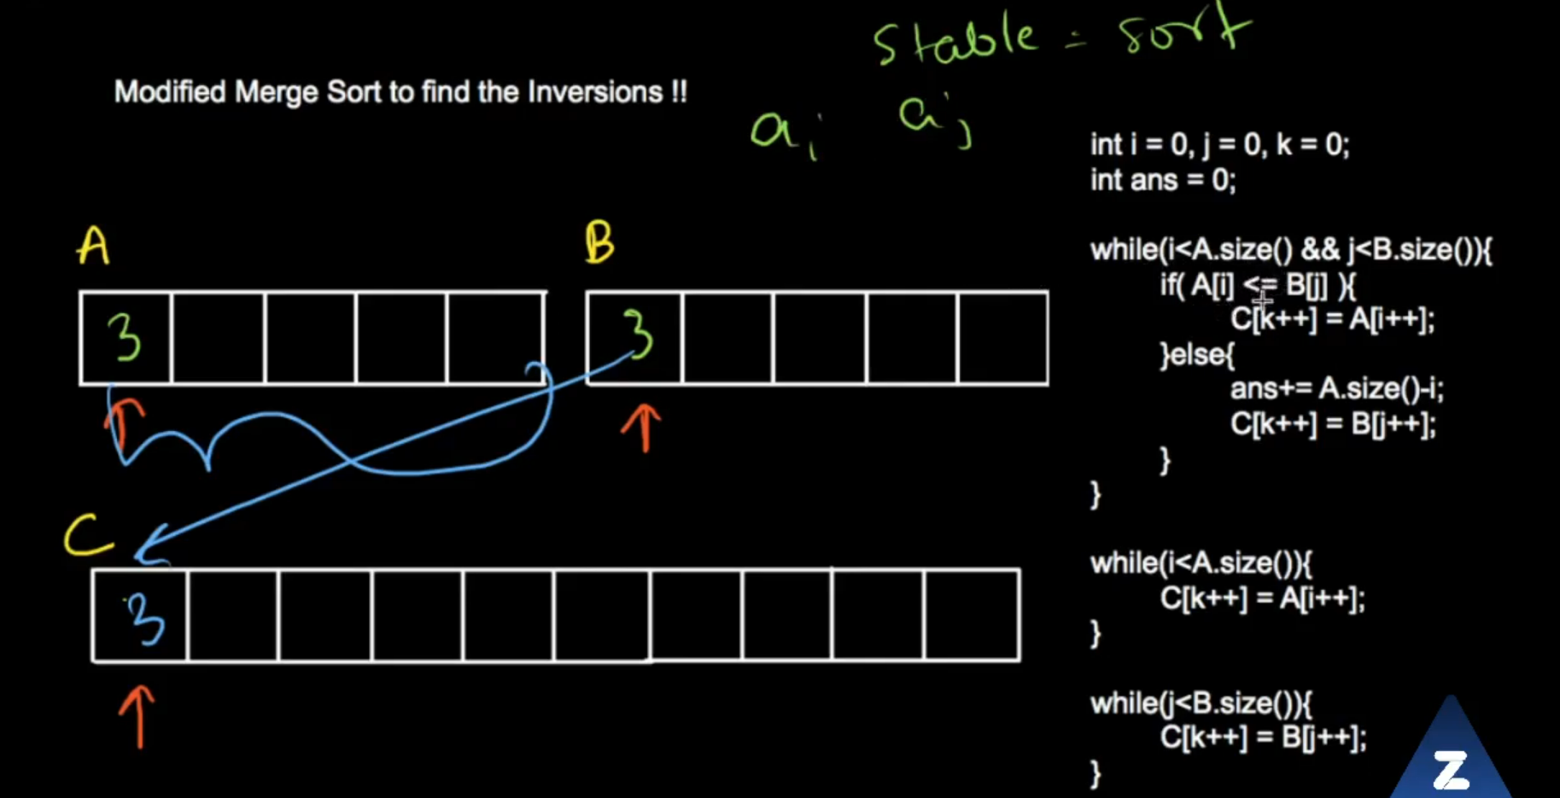
Inversions using merge sort
Code for recursive Merge Sort
https://drive.google.com/file/d/1G2eJiTZrms5XBpIO2Kcp4LM2Usc9opHO/view
Inversion:
a[i]>a[j] for i<j

Slide 3
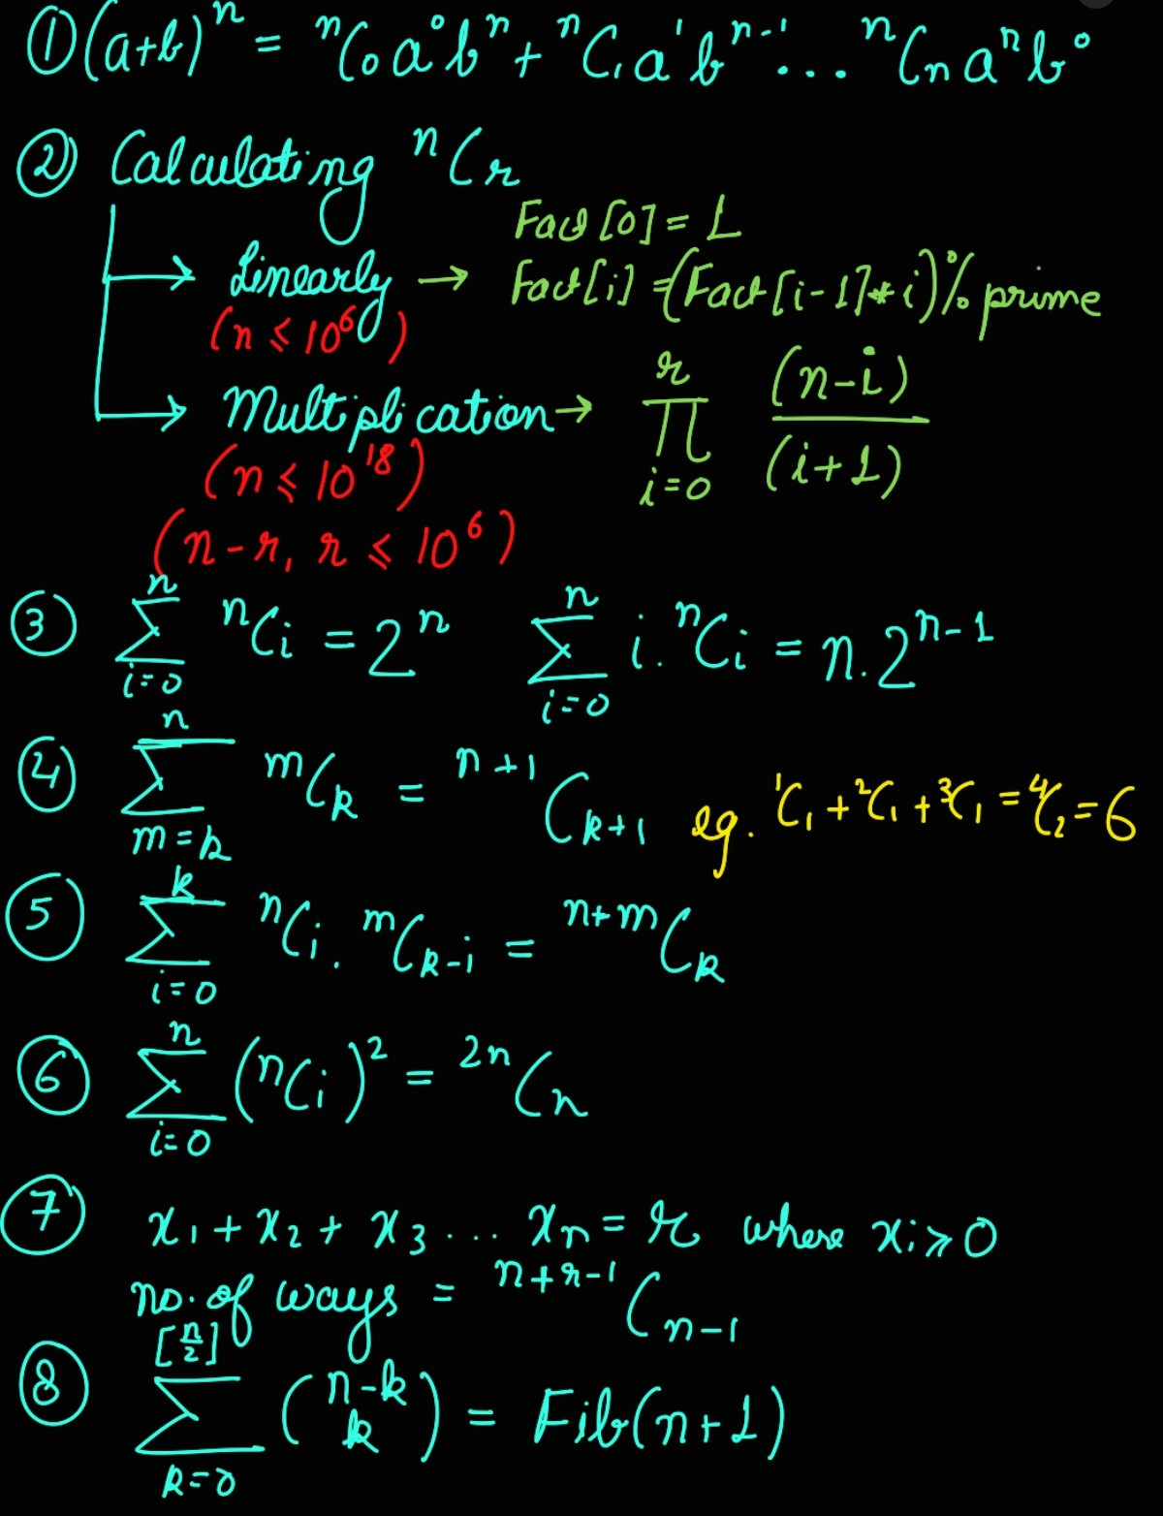
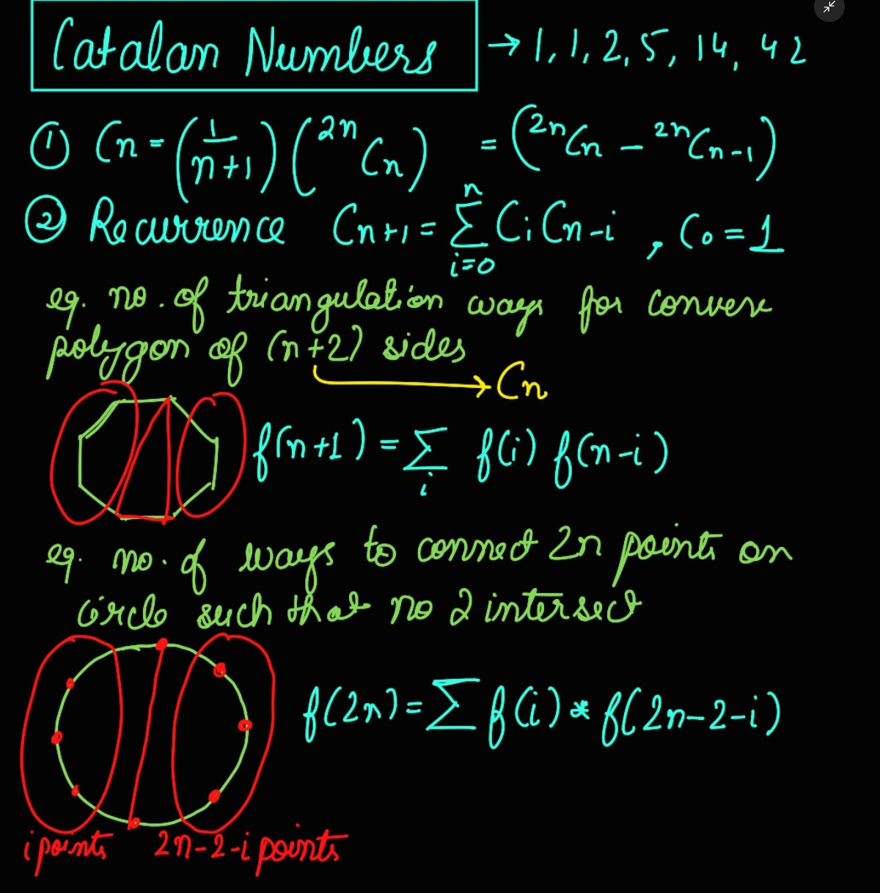

Slide 4
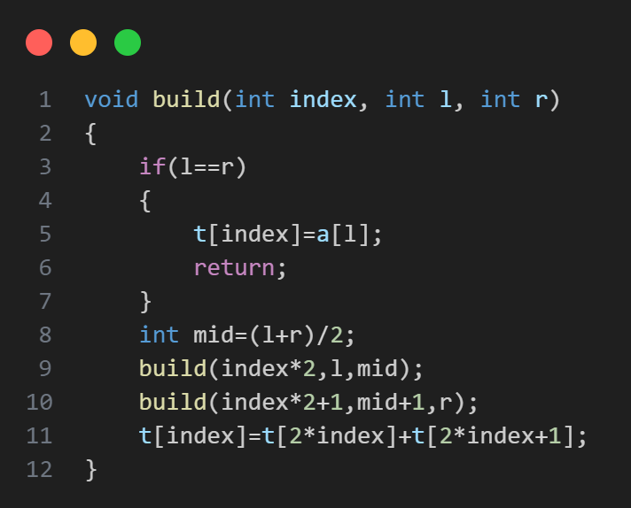
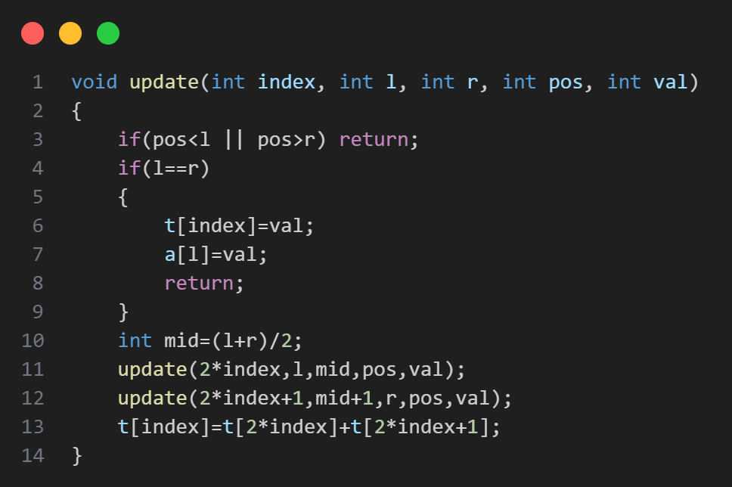
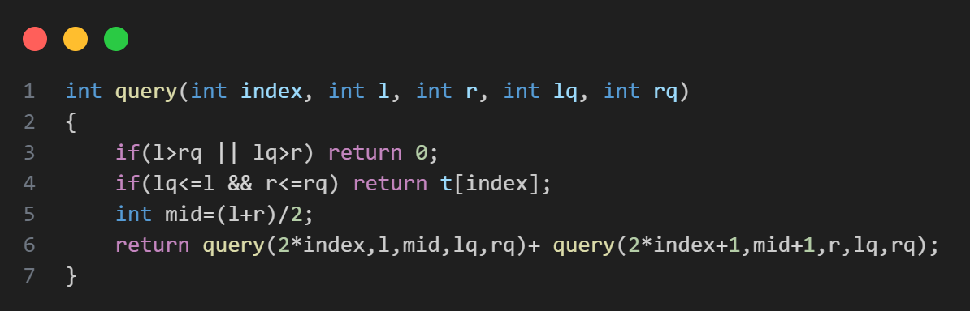
SEGMENT TREE

Slide 5
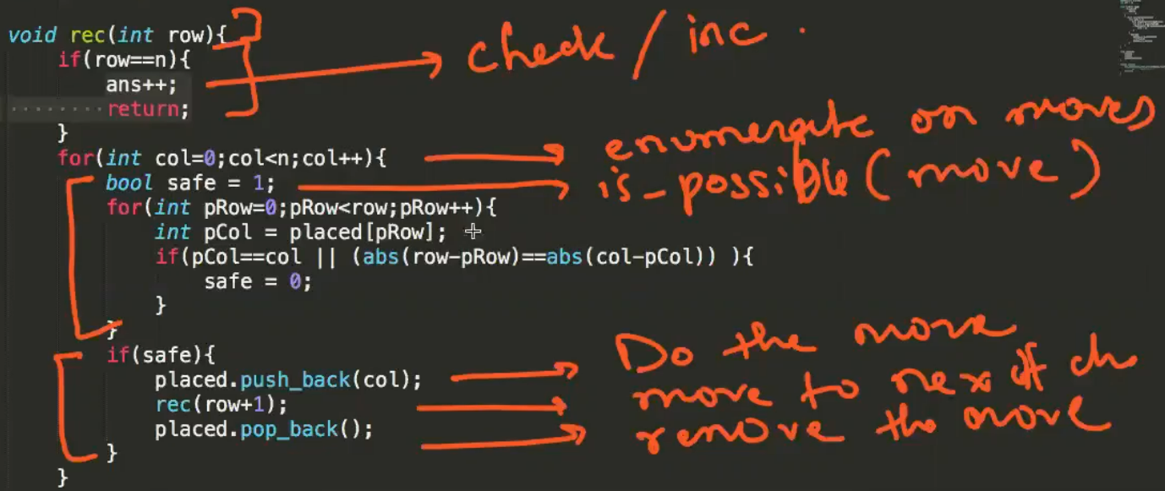
N QUEENS
We start from row 0. We try placing in each column. If we can place in that column, we store that column, call for the next row and remove that column. The number of times we reach row n will be the answer.

Slide 6
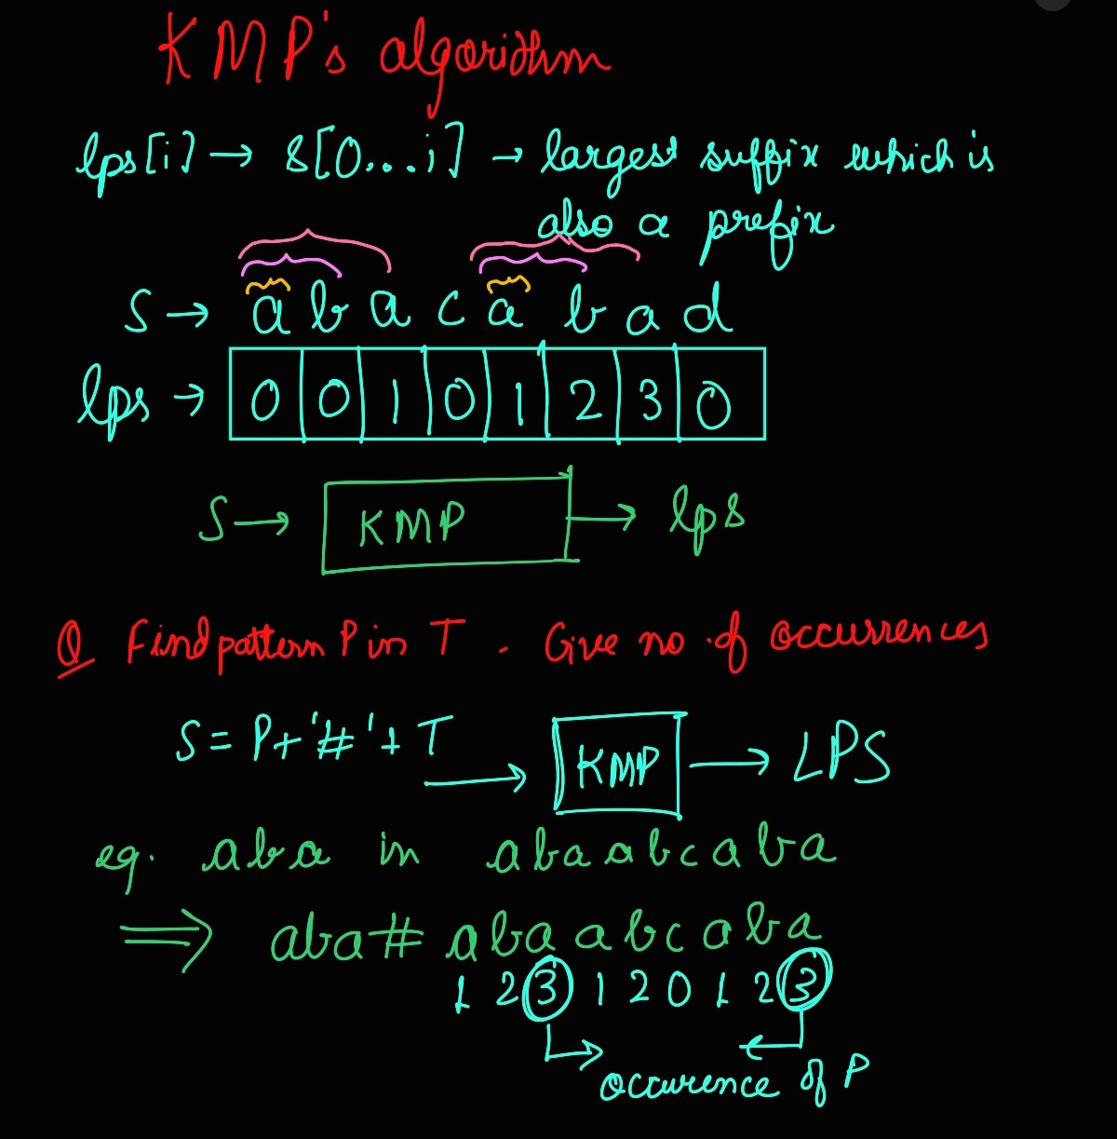
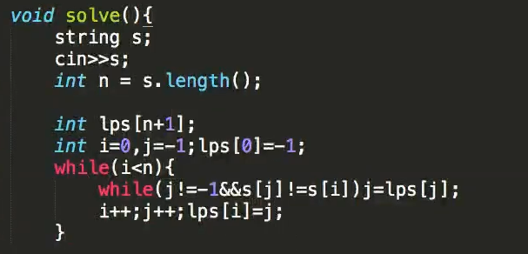
KMP Algorithm
To find the period in a string -> N-lps[N]

