Slide 1
Supervised ML classification Capstone Project Cardiovascular Risk Prediction

Slide 2
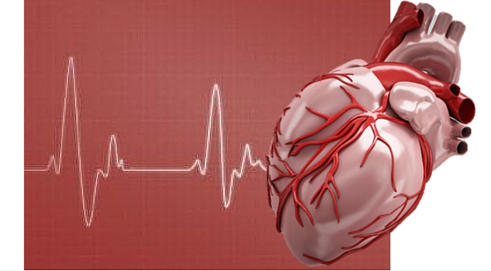
Contents
Problem Statement
Data description and Attributes
Data Inspection
EDA
Level Encoding
Feature Selection
Handling Imbalanced Data
Implementing Algorithms
Challenges
Conclusion

Slide 3
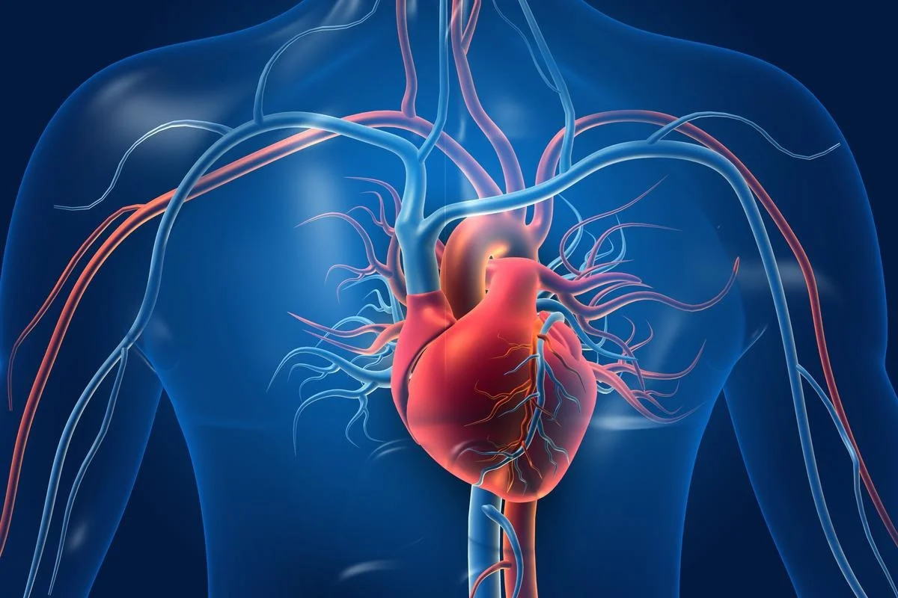
Problem Statement
The dataset is from an ongoing cardiovascular study on residents of the town of Framingham, Massachusetts.
The classification goal is to predict whether the patient has a 10-year risk of future coronary heart disease(CHD).
The dataset provides the patients’ information. It includes over 4,000 records and 15 attributes. Variable Each attribute is a potential risk factor. There are both demographic, behavioral, and medical risk factors

Slide 4
Data Description and Attributes
Demographic:
• Sex: male or female("M" or "F")
• Age: Age of the patient;(Continuous - Although the recorded ages have been truncated to
whole numbers, the concept of age is continuous)
Behavioral
• is_smoking: whether or not the patient is a current smoker ("YES" or "NO")
• Cigs Per Day: the number of cigarettes that the person smoked on average in one day.(can be
considered continuous as one can have any number of cigarettes, even half a cigarette.)

Slide 5
Data Description and Attributes
Medical( history)
• BP Meds: whether or not the patient was on blood pressure medication (Nominal)
• Prevalent Stroke: whether or not the patient had previously had a stroke (Nominal)
• Prevalent Hyp: whether or not the patient was hypertensive (Nominal)
• Diabetes: whether or not the patient had diabetes (Nominal)
Medical(current)
• Tot Chol: total cholesterol level (Continuous)
• Sys BP: systolic blood pressure (Continuous)
• Dia BP: diastolic blood pressure (Continuous)
• BMI: Body Mass Index (Continuous)
• Heart Rate: heart rate (Continuous - In medical research, variables such as heart rate though in
fact discrete, yet are considered continuous because of large number of possible values.)
• Glucose: glucose level (Continuous)
Predict variable (desired target)

Slide 6
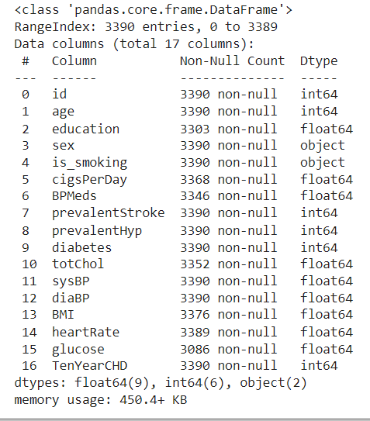
Data Inspection:
This Dataset has contains 3390 rows and 16 columns.
Six categorical features i.e sex and is_smoking,BPMeds,prevalentStroke,prevalent Hyp,diabetes.
This Dataset also contain missing values around 510 of seven features.

Slide 7
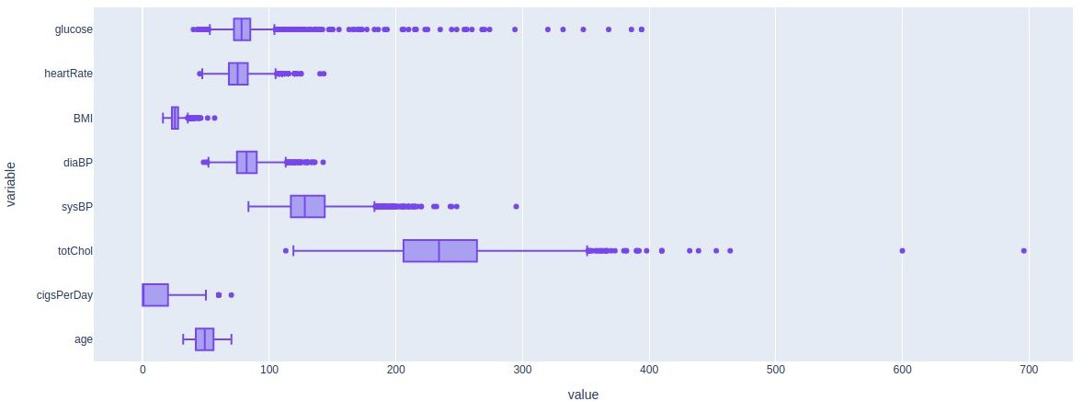
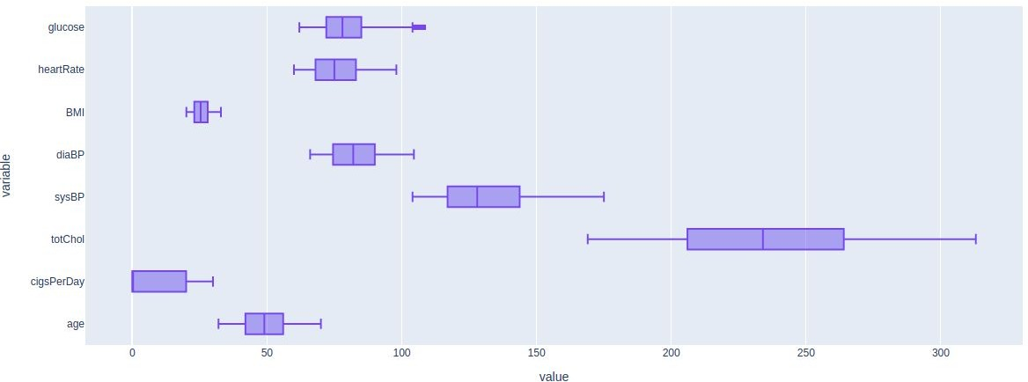
Analysis Of Outliers:
Age has no outlier.
Capping the outlier rows with Percentile.

Slide 8
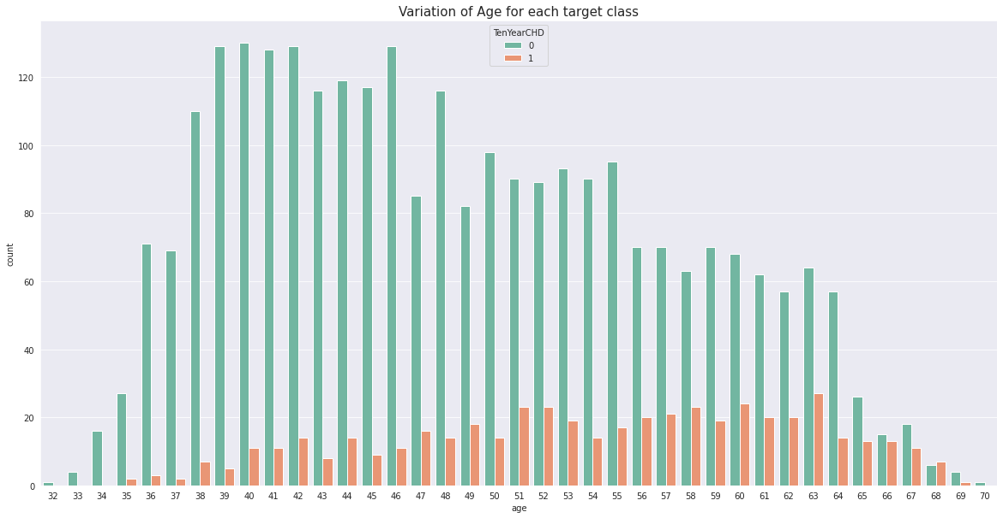
Analysis Of Age for each Target class:
EDA
Coronary heart disease(CHD) increases after age 51.
Age group (34 < Age < 51) are at lower risk of cardiovascular disease.

Slide 9
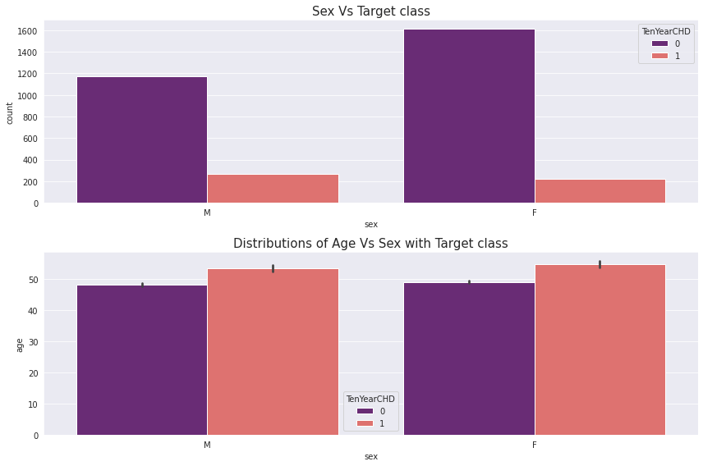
Analysis Of Age vs Sex with Target class :
We can see from the countplot that no. of male heart patient more than female.
We can see from the barplot that male get early CHD as compared to female.

Slide 10
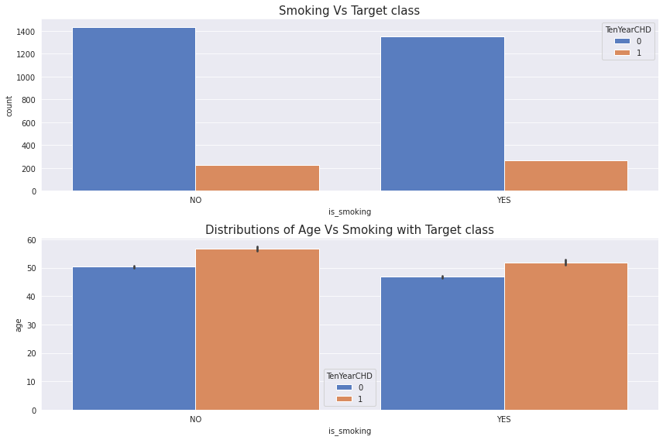
Analysis Of Age vs Smoking with Target class :
We can see from the countplot that no. of patient those who smoke more than as compared to those who won’t.
We can see from the barplot that those who smoke get early heart disease as compared to those who don’t.

Slide 11
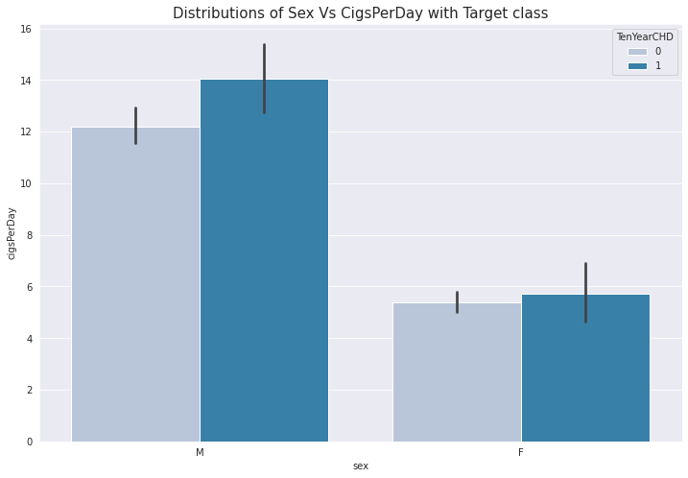
Analysis Of Cigs per day vs Sex with Target class :
As we can see the barplot we can say that no. of cigsperday taken by male is more than female.
So, male heart patient is more as compared to female.
In case of male CHD = 1 when he take cigsperday > 12.1 and in case of female CHD = 1 when she take cigsperday > 4.8.

Slide 12
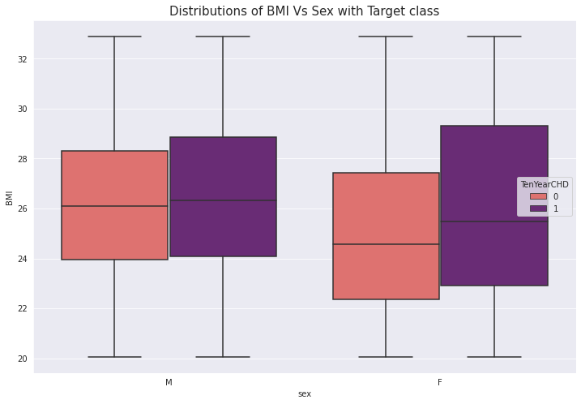
Analysis Of BMI vs Sex with Target class :
As we can see the boxplot we can say
that female BMI is more than male BMI. that’s leads to OVERWEIGHT.
So,female CHD patient more than male CHD patient.
If your BMI is:
below 18.5 – you're in the underweight range
between 18.5 and 24.9 – you're in the healthy weight range
between 25 and 29.9 – you're in the overweight range
between 30 and 39.9 – you're in the obese range

Slide 13
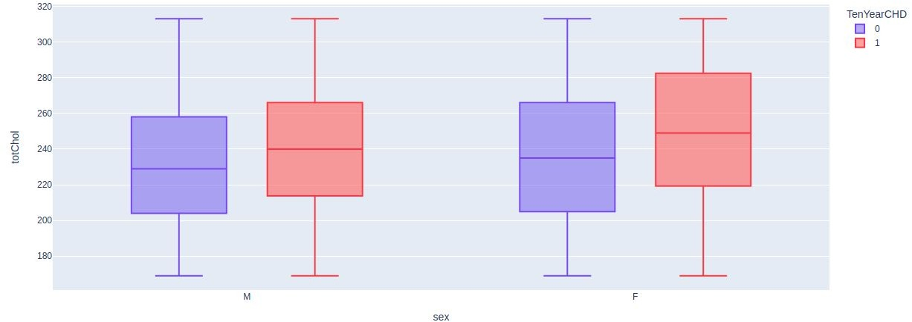
Analysis Of Cholesterol vs Sex withTarget class :
As we can see the boxplot we can say that female cholesterol is more than male cholesterol that’s leads to OVERWEIGHT.
So, In female heart disease is more due to cholesterol.

Slide 14
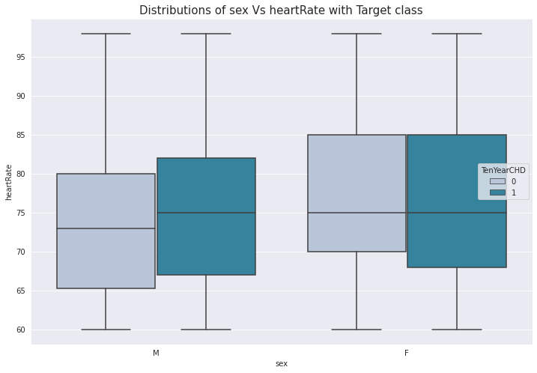
Analysis Of Heart Rate vs Sex with Target class :
As we can see the box plot we can say that for Female heart disease patients has more Heart Rate as compared to male heart disease patients.

Slide 15
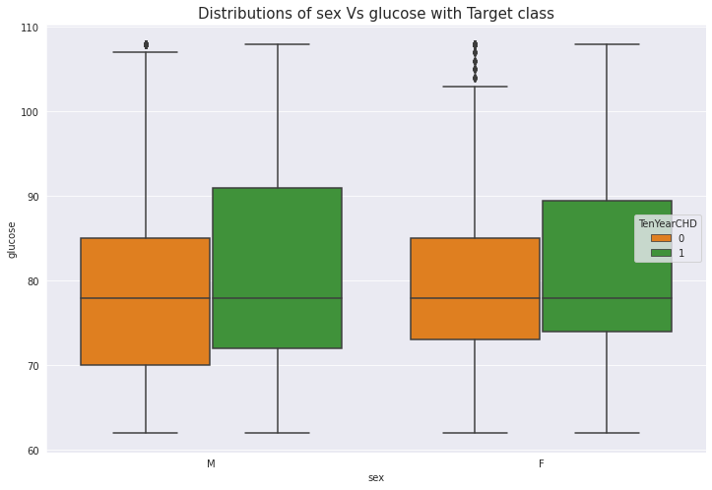
Analysis Of Glucose vs Sex with Target class :
As we can see the box plot we can say that for male heart disease patients has more glucose level as compared to female heart disease patients.

Slide 16
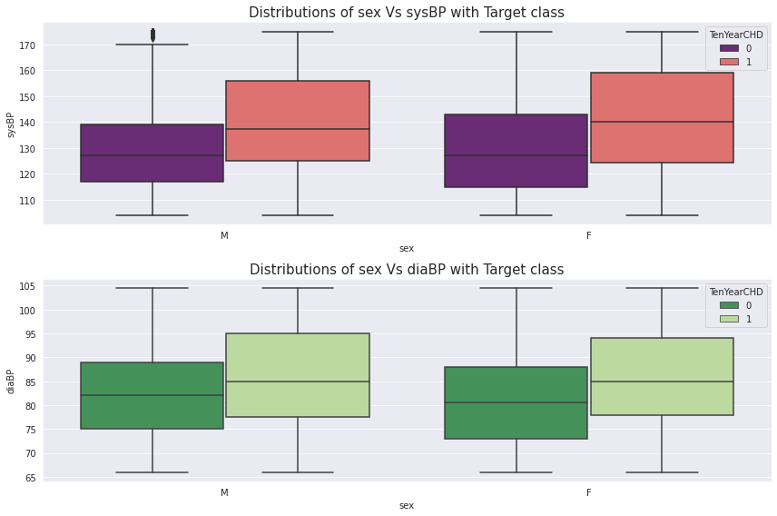
Analysis Of Systolic and Diastolic vs Sex with Target class :
As we can see the box plot we can say that for female heart disease patients has more Systolic BP level as compared to male heart disease patients.
Normal < 120 mmHg.
As we can see the box plot we can say that for male heart disease patients has more Diastolic BP level as compared to female heart disease patients.
Normal < 80 mmHg.

Slide 17
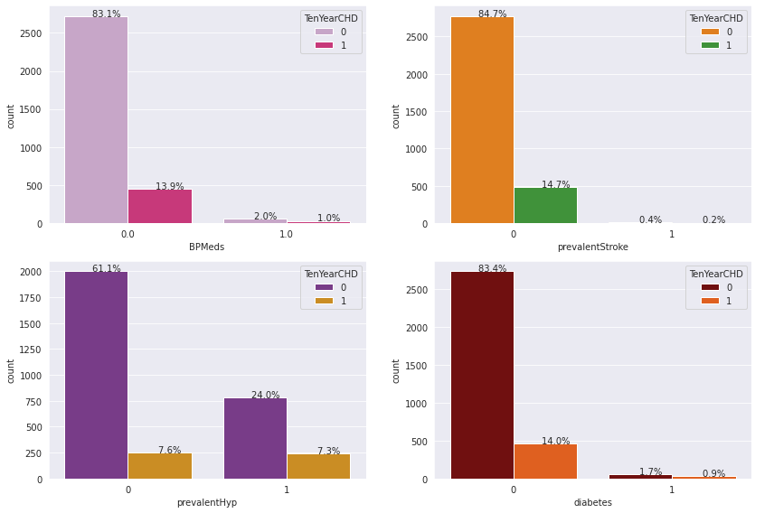
Analysis Of BP Meds | PrevalentStroke | PrevalentHyp | Diabetes vs Sex with Target class :
BPMeds means whether or not the patient was on blood pressure medication i.e if the patients is take medication then it reduces the risk of heart disease, as compared to who won't take medication.

Slide 18
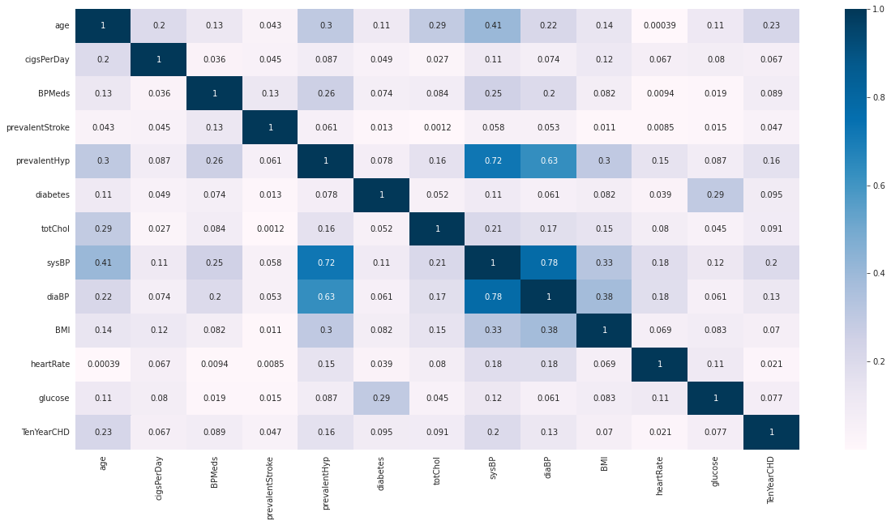
Correlation matrix:
sysBP is moderately correlated with prevalenthyp, i.e. prevalent hypertension.
diaBP and sysBP are somewhat moderately correlated.
glucose level are also moderately correlated to whether patient is diabetic.

Slide 19
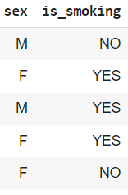
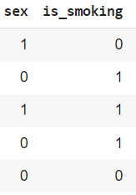
Label Encoding:
We have two categorical columns i.e sex and is_smoking.
After applying label encoding we converted into 0’s and 1’s.

Slide 20
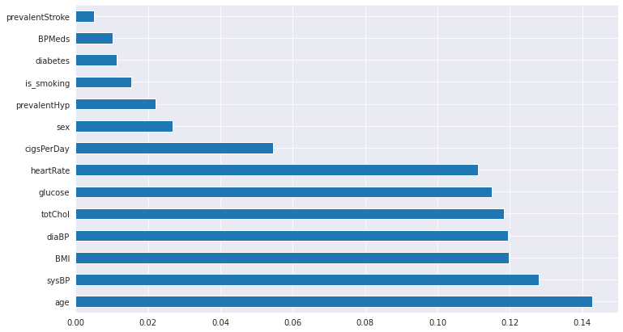
Feature Selection:
For feature selection we used ExtraTreeClassifiers.
We found that every feature is important.

Slide 21
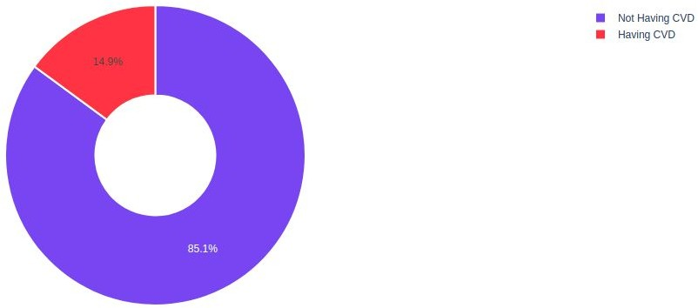

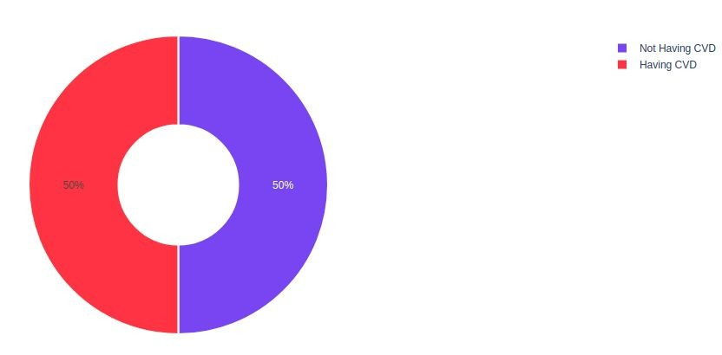

Handling Imbalanced Data:
SMOTE
SMOTE (Synthetic Minority Oversampling Technique) works by randomly picking a point from the minority class and computing the k-nearest neighbors for this point. The synthetic points are added between the chosen point and its neighbors.

Slide 22

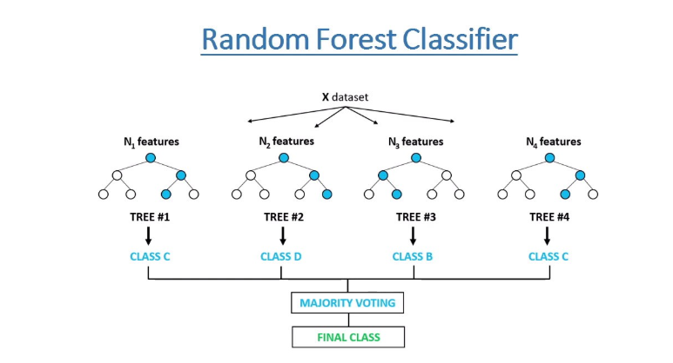
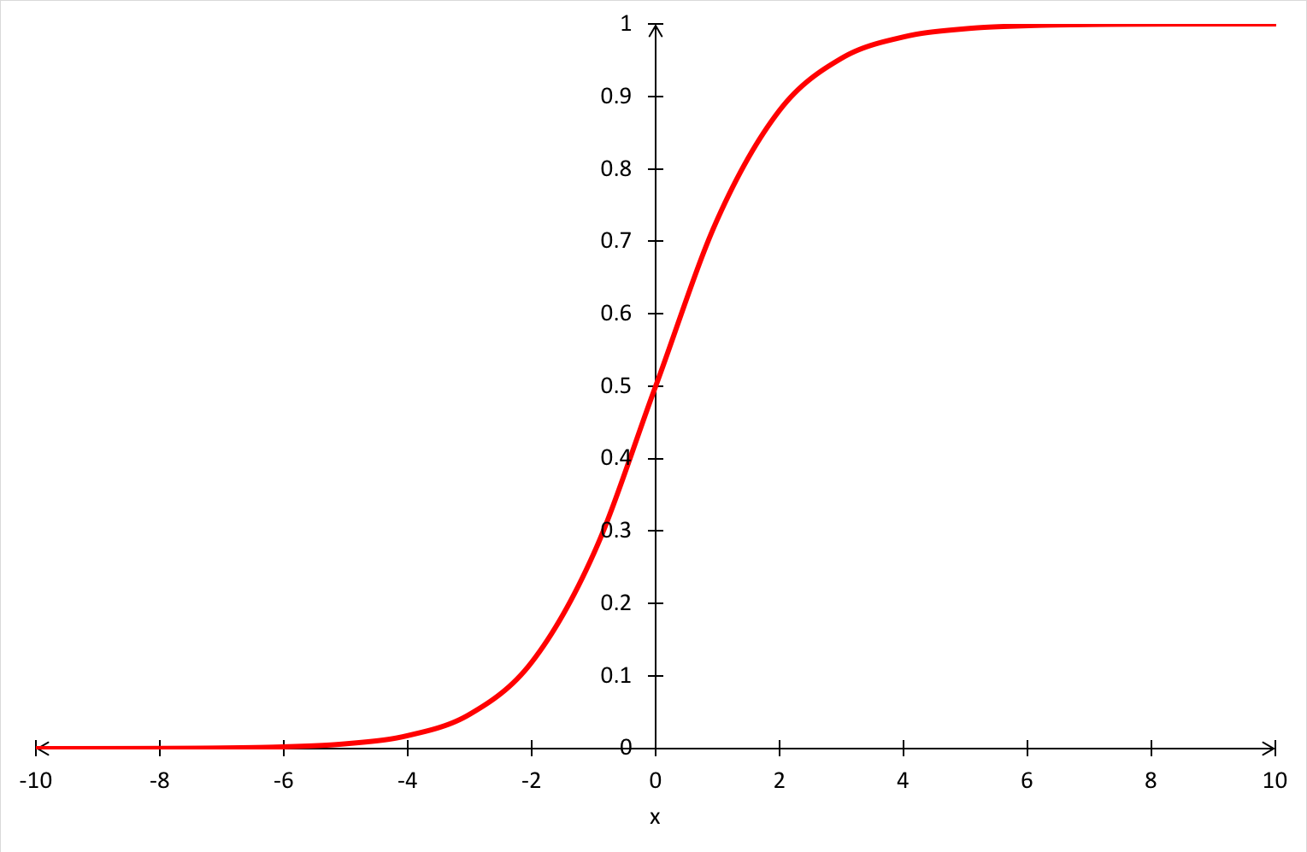
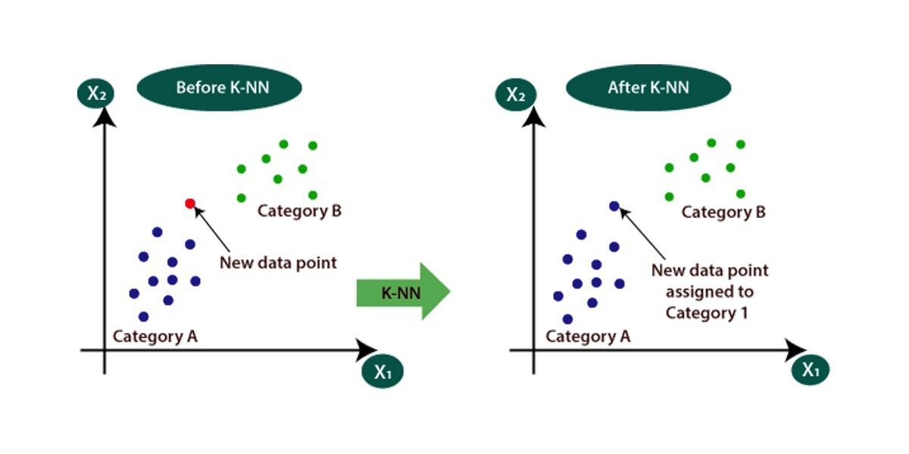
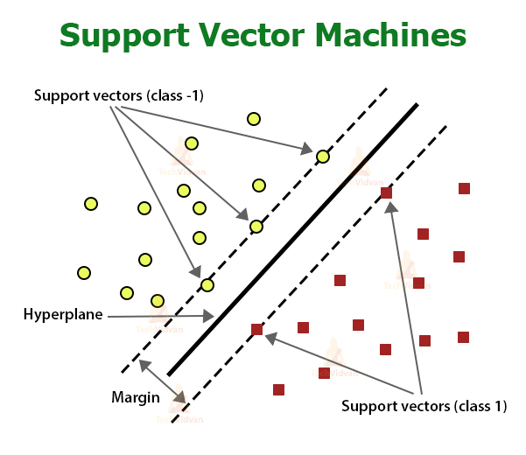
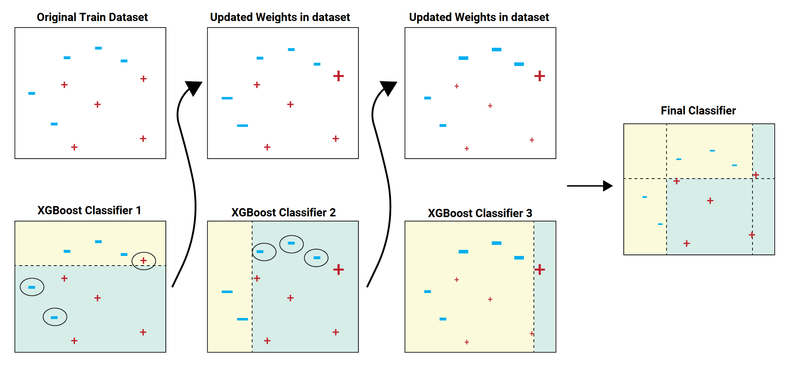
Model Building:
1] Logistic Regression 2] Decision Tree Classifier 3] Random Forest Classifier
4] XGB Classifier 5] KNN Classifier 6] Support Vector Machines

Slide 23
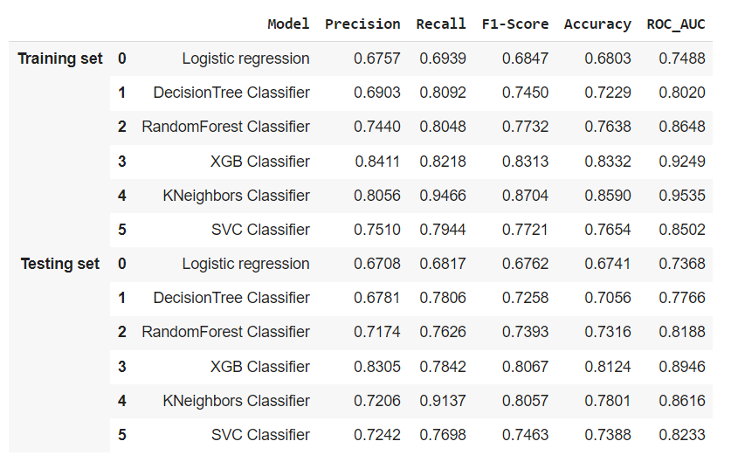
Evaluating models:

Slide 24
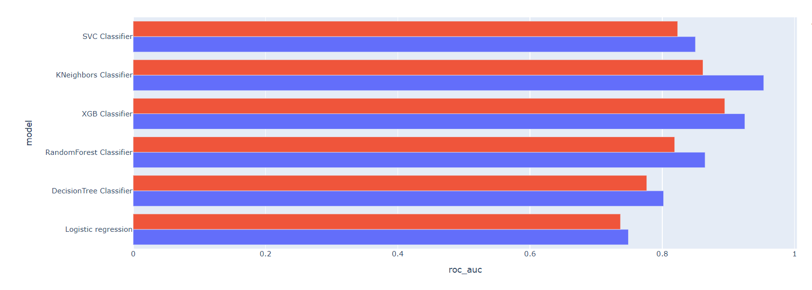
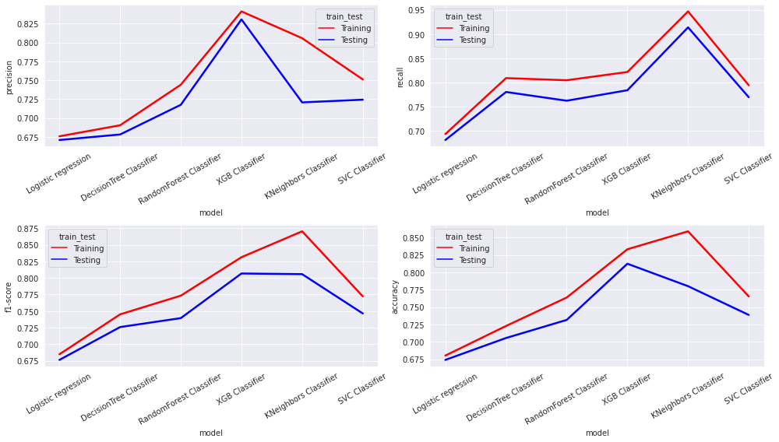
Comparing different ML Models:
In the above Models Evaluation Table(Testing set) our auc-roc score is more than 0.80 except Logistic regression and Decision Tree.So we can say that our model predicted the classes in a good manner.
XGB Classifier is performing well which has best Recall,Precision,F1-Score and Accuracy Score.

Slide 25
Challenges:
Large Dataset to handle
Needs to plot lot of Graphs to analyse
Handling Null values
Feature selection
Optimising the model
Carefully tuned Hyperparameters

Slide 26
Conclusion:
In the given dataset we observe that Coronary heart disease increases from age 51 to 67 then decreases.
We draw the countplot and observe that no. of male heart patients is more than female and also notice that male get early age heart diseases as compared to females.
We observe no. of heart patients who smoke more than as compared to those who won’t and also notice that those who smoke get early heart disease as compared to those who won’t.
We draw the barplot and observe that no. of cigsperday taken by male is more than female.So, male heart patients is more as compared to females.
We draw the boxplot and observe that female BMI(The BMI is defined as the body mass divided by the square of the body height, and is expressed in units of kg/m²) is more than male BMI. that’s leads to OVERWEIGHT and So,female CHD patients is more than male CHD patients.

Slide 27
We draw the boxplot and observe that female Cholesterol is more than male Cholesterol. that’s leads to OVERWEIGHT and So, in that case also female CHD patients is more than male CHD patients.
We Observe that Female heart disease patients has more Heart Rate as compared to male heart disease patients.
We also observe that male heart disease patients has more glucose level as compared to female heart disease patients.
In the Models Evaluation Table(Testing set) our auc-roc score is more 0.80 except Logistic regression and Decision Tree.So we can say that our model predicted the classes in a good manner.
XGBClassifier are performing well which has the best Recall,Precision,F1-Score and Accuracy Score.

Slide 28


