Slide 1


Team Details
  Team name: [add team name]
  Team leader name: [add team leader name]
  Problem Statement: Retail & Commerce: customers can’t see or trust the kitchens behind food delivery, and there will never be enough inspectors

Slide 2




Brief about the idea
THE PROBLEM
3,000+
FDA raids in Maharashtra since May 2026 found cockroaches, rats and rotting food
2,000
food safety officers one state would need; inspections alone can’t keep up
0
kitchens a customer can actually see before ordering food online
OUR IDEA: KITCHENPROOF
Surprise request
Live phone walk-through
Gemini verifies
Trust made public
Platform or a customer asks at a random time
Random checks one by one + a hand-gesture test
Pass / fail per check with timestamped video evidence
Kitchen Score for customers, risk list for inspectors
Faking one video is easy. Faking it every day, at random times, while real orders cook, is harder than just keeping the kitchen clean.

Slide 3


Opportunities
HOW IS IT DIFFERENT?
HOW WILL IT SOLVE THE PROBLEM?
 | FSSAI hygiene rating | Platform hygiene audits | CCTV AI (chains) | KitchenProof
Unannounced, random | ✗ | ✗ | ✓ | ✓
No extra hardware | ✓ | ✓ | ✗ | ✓
AI-verified evidence | ✗ | ✗ | ✓ | ✓
Visible when ordering | ~ | ✓ | ✗ | ✓
Affordable for every kitchen | ✗ | ✗ | ✗ | ✓
Every phone becomes an inspector
scales to lakhs of kitchens
Customers choose with evidence
not just star ratings
Inspectors visit the riskiest first
ranked with plain reasons
USP
Unannounced, randomized, AI-verified and public: a kitchen check that is hard to fake and cheap enough for every kitchen.
✓ yes ✗ no ~ rarely

Slide 4




List of features offered by the solution
Surprise audits
Random live checks
Liveness challenge
Gemini auditor
Random timing. 10 min to start, 4 to finish, or it shows as a missed check.
16 FSSAI-style checks, revealed one at a time by the server.
“Hold up 3 fingers at the stove” defeats pre-recorded video.
Pass / fail / not verified per check, with an MM:SS timestamp.
Integrity check
Kitchen Score + tiers
Customer spot check
Inspector ranking
Spots cuts, a different kitchen, or “too perfect” for the order volume.
Bronze → Silver → Gold evidence tiers; fades without fresh checks.
Ask for a live check during your own order and see the result.
Kitchens ranked by risk, with reasons and a review queue.
Also: owner disputes → human review · fix list in English / हिन्दी / ଓଡ଼ିଆ · spoken prompts · works on any phone (PWA)

Slide 5


Process flow diagram or Use-case diagram
① Trigger surprise check
Missed window → public “missed check”
Suspicious or disputed → inspector decides
⑥ Risk ranking + review queue
Inspector /
platform
② Alert + 10-min countdown
③ Live video: random checks + hand gesture
Restaurant
owner
④ Gemini auditor ∥ integrity check
⑤ Score · tier · fix list
KitchenProof
AI (Gemini)
① Request check during my order
⑥ Verified badge on order + listing
Customer

Slide 6


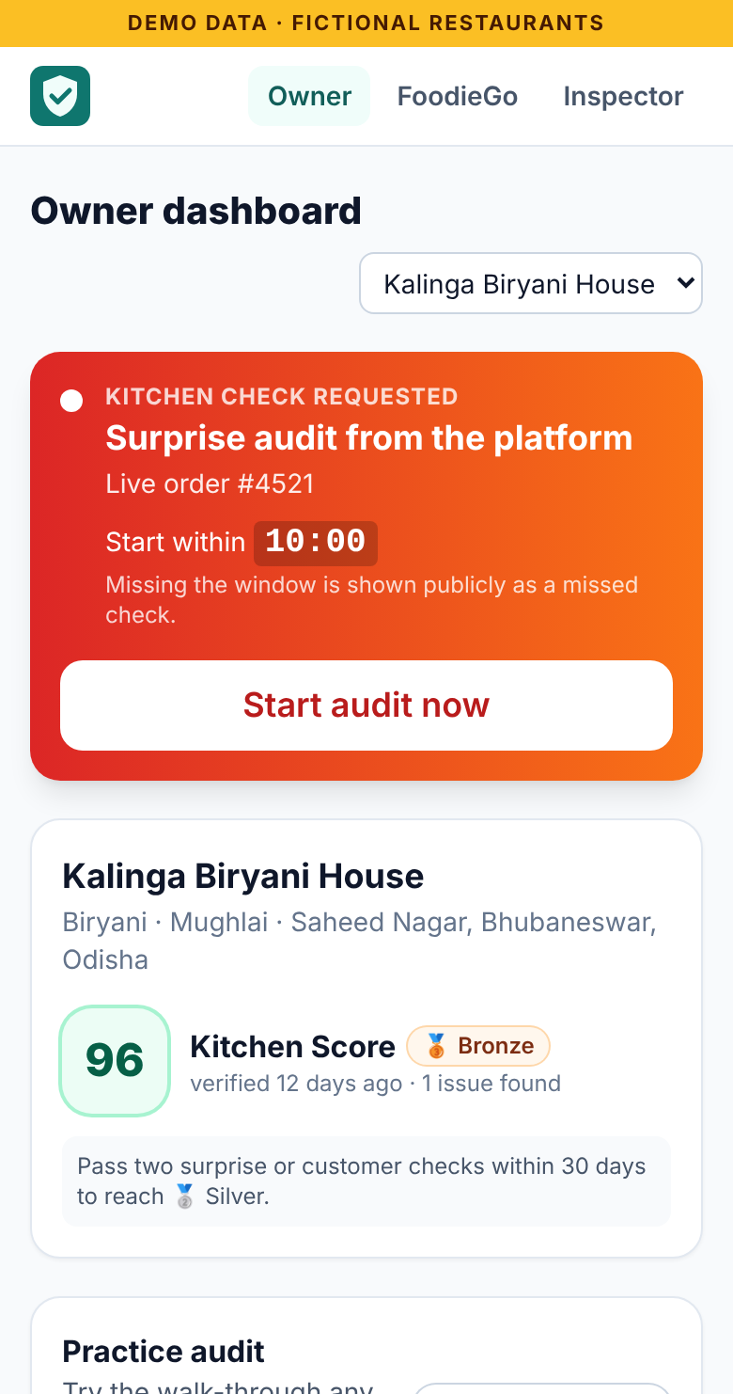
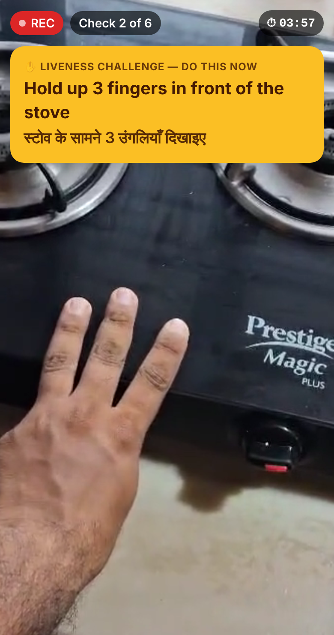
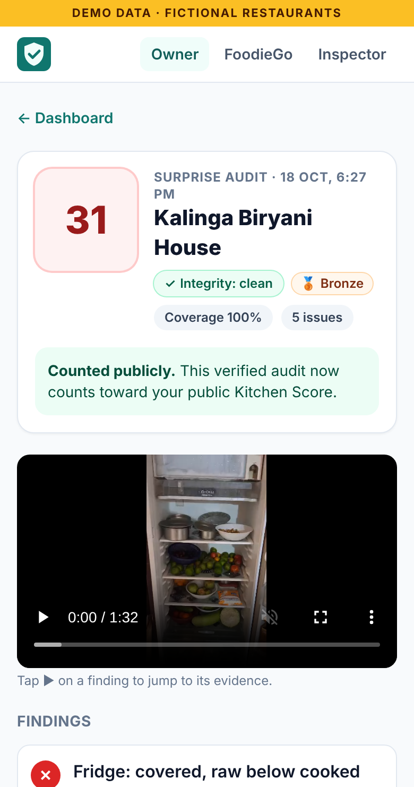
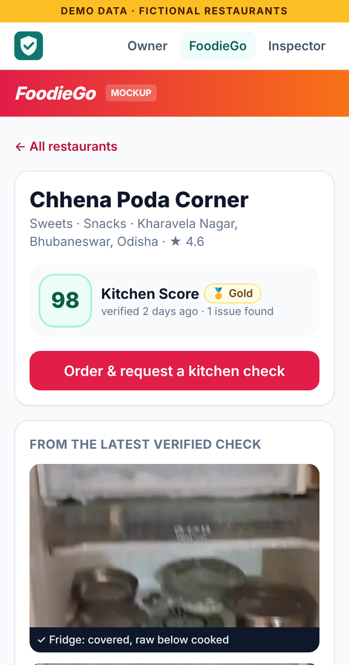
Wireframes/Mock diagrams of the proposed solution (optional)
Owner gets a surprise request with a countdown
Live audit: one check at a time + hand gesture
Gemini report with timestamped evidence
Customer sees the verified Kitchen Score

Slide 7

Architecture diagram of the proposed solution
Web app (PWA)
React · any phone
Firebase Hosting
website + /api route
Cloud Run
Python FastAPI · AI agents
Owner
camera audit
2×
Gemini 3.8 Flash
on Vertex AI
video → JSON
Orchestrator
Firebase Auth
anonymous sign-in
Planner
Auditor
Customer
FoodieGo
Integrity
Scorer
Per audit
Gemini reads the video straight from Cloud Storage (gs://). Auditor and integrity run in parallel → score → fix list → Firestore → badge updates live.
Cloud Firestore
live data & listeners
Coach (EN/HI/OR)
Risk ranking
Inspector
dashboard
Cloud Storage
audit videos
Cloud Scheduler
surprise audits
Secret Manager
+ Cloud Build

Slide 8



Technologies to be used in the solution
AI
Google Cloud
Firebase
App
Gemini 3.8 Flash
Cloud Run
Firebase Hosting
React + Vite + TypeScript
Vertex AI
Cloud Storage
Firebase Authentication
Tailwind CSS · PWA
Google Gen AI SDK
Cloud Scheduler
Cloud Firestore
Camera: getUserMedia
Video understanding
Secret Manager
Security rules
Python 3.12 + FastAPI
Structured JSON output
Cloud Build + Artifact Registry
Emulator Suite (tests)
Speech: EN / हिन्दी

Slide 9
Estimated implementation cost (optional)
≈ $0.02
≈ ₹60
₹0
per AI-verified audit
2 Gemini Flash calls on a 1–2 min video
per kitchen per month
with one surprise audit every day
extra hardware
any smartphone; no CCTV install
Scale | Kitchens | Audits / month | Est. monthly cost | Per kitchen
Pilot (one city zone) | 100 | 3,000 | ≈ $75 (₹6k) | $0.75
City | 1,000 | 30,000 | ≈ $700 (₹58k) | $0.70
State | 10,000 | 300,000 | ≈ $6,500 (₹5.4 lakh) | $0.65
Estimates: Gemini Flash list pricing on Vertex AI (~50k video tokens per audit) plus Cloud Run, Firestore, Storage and Hosting. Cloud Run scales to zero when idle. $1 ≈ ₹83.

Slide 10
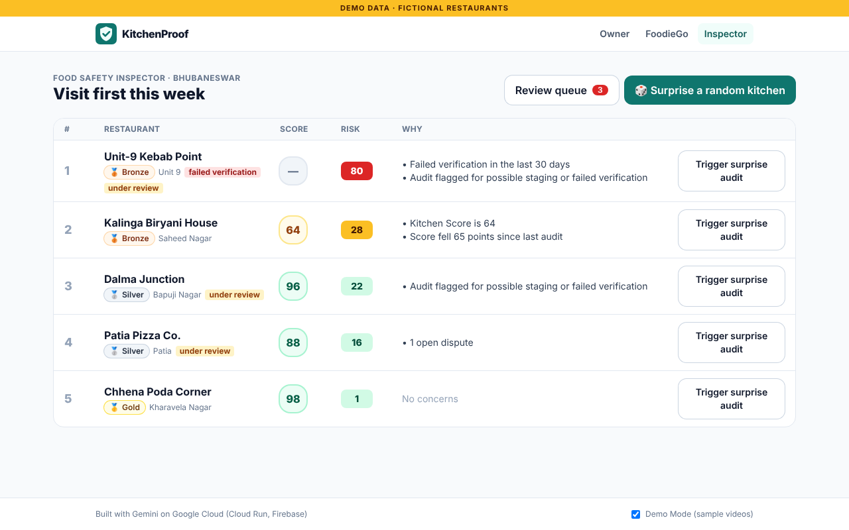
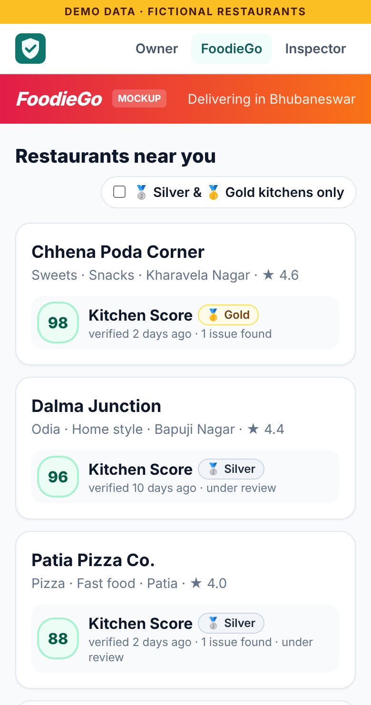
Snapshots of the prototype
Inspector: kitchens ranked by risk, with reasons
AI report + evidence
FoodieGo badges

Slide 11
Prototype Performance report/Benchmarking
Kitchen Score by Gemini 3.8 Flash on our real videos
5 / 5
43–46 s
issues caught in the messy kitchen
incl. expired ghee read off the label
live analysis per video
Cloud Run + Vertex AI, 2 parallel calls
1 / 1
2 / 2
real video edit detected
a cut at 1:01 in a re-shot clip
staged kitchens flagged
“too perfect” at a busy hour, 95% sure
Tested: 23 backend tests · end-to-end browser tests of the tour and camera audit · security rules on Firebase emulators

Slide 12




Additional Details/Future Development (if any)
NOW
0–3 MONTHS
3–6 MONTHS
6–12 MONTHS
Prototype live
Pilot
Integrate
Scale
Gemini on Vertex AI
50 cloud kitchens
Delivery-app badge API
School mid-day meal kitchens
Cloud Run + Firebase
Gemini Live voice guide
FSSAI inspector dashboard
Hostel messes
Real kitchen videos
ADK agent orchestration
Rider pickup photo checks
Other states & countries

Slide 13


Provide links to your:
GitHub Public Repository: github.com/Sarthak115/KitchenProof
Demo Video Link (3 Minutes): [add YouTube / Drive link]
Final Product Link: kitchenproof.web.app
Try it live
Source code
kitchenproof.web.app/tour
github.com/Sarthak115/KitchenProof

Slide 14




Why it is hard to fake, and fair to owners
Stops owners staging a clean kitchen
Protects owners from AI mistakes
Unannounced random time, 10 min to start, 4 min to finish
“Not verified” ≠ fail
lowers coverage, never the score
One check at a time the owner never sees the list in advance
Low confidence → human
never shown publicly
Hand-gesture liveness a replayed video can’t follow it
Live order on camera “show order #4521 being made right now”
Evidence for every finding
MM:SS timestamp in the video
Gemini integrity check cuts, a different kitchen, “too perfect”
Dispute any finding
an inspector decides
Evidence tiers one staged video never gets past Bronze

Slide 15


