Slide 1



RAIN PREDICTION IN AUSTRALIA: A MACHINE LEARNING
APPROACH
CS – 513 A
Group No. 7
Sarthak Achyut Vaidya
20016184
Piyush Devendra Kataktalware
20022156
Sai Venkata Subbaraya Akhil Pulipaka
20012406

Slide 2
CONTENTS
Problem Statement
Brief idea of the “Rain prediction in Australia” classification Model
About our data
Data pre-processing
Exploratory Data Analysis
Various Classification models used
Conclusion

Slide 3
PROBLEM STATEMENT
Australia's vast and varied climatic conditions present a significant challenge in predicting rainfall accurately.
The unpredictability of rain patterns affects agriculture, urban planning, and environmental sustainability.
Our goal is to leverage machine learning models to improve the accuracy of rain predictions, aiding in effective planning and resource management across different Australian regions.

Slide 4
BRIEF IDEA OF “RAIN PREDICTION” CLASSIFICATION MODEL
This classification model, uses various features to provide accurate and timely forecasts to inform decision-making in agriculture, urban planning, and disaster management.
This information can be used to help in crop planning and irrigation scheduling to optimize agricultural output.
Rain prediction models aids in designing effective drainage systems, flood mitigation strategies, and water conservation measures. It enables early warnings for floods and storms, allowing for evacuation and strategic deployment of resources. It also supports the preservation of ecosystems by anticipating and managing changes in water availability.

Slide 5
ABOUT OUR DATA
Date
Location
Min Temp
Max Temp
Rainfall
Evaporation
Sunshine
Wind Gust Dir
Wind Gust Speed
WindDir9am
WindDir3pm
WindSpeed9am
WindSpeed3pm
Humidity9am
Humidity3pm
Pressure9am
Pressure3pm
Cloud9am
Cloud3pm
Temp9am
Temp3pm
Rain Today
Rain Tomorrow
Raw data was taken from:
https://www.kaggle.com/datasets/jsphyg/weather-dataset-rattle-package/data

Slide 6
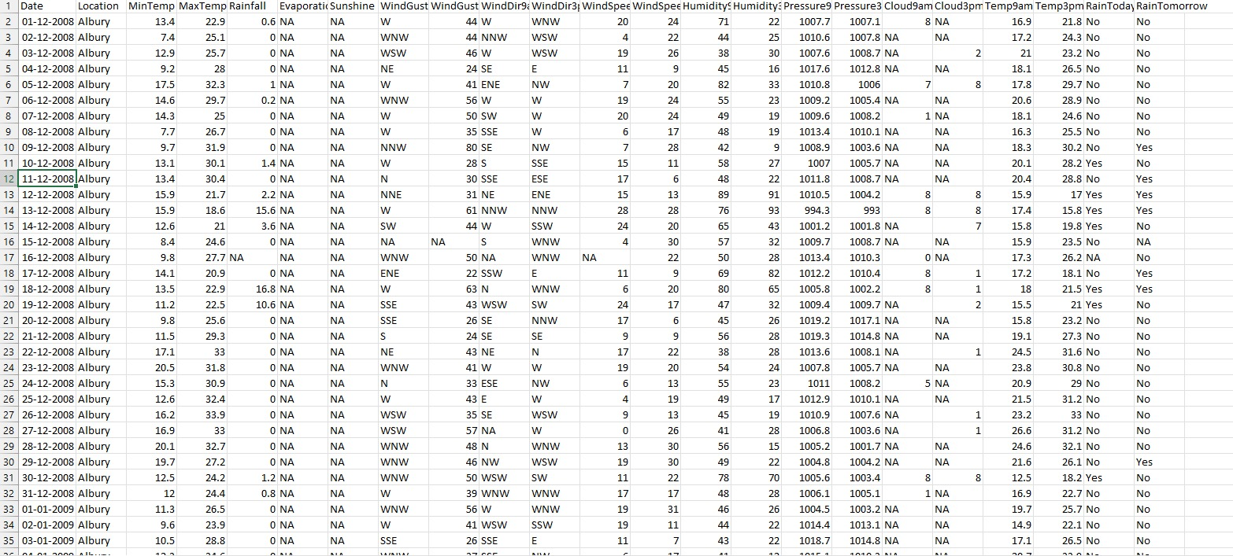
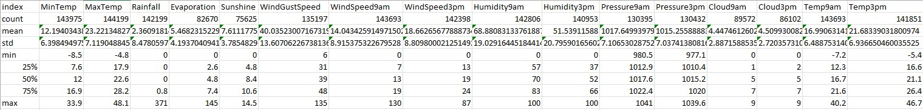
Sample of the used dataset
Summary of the dataset

Slide 7
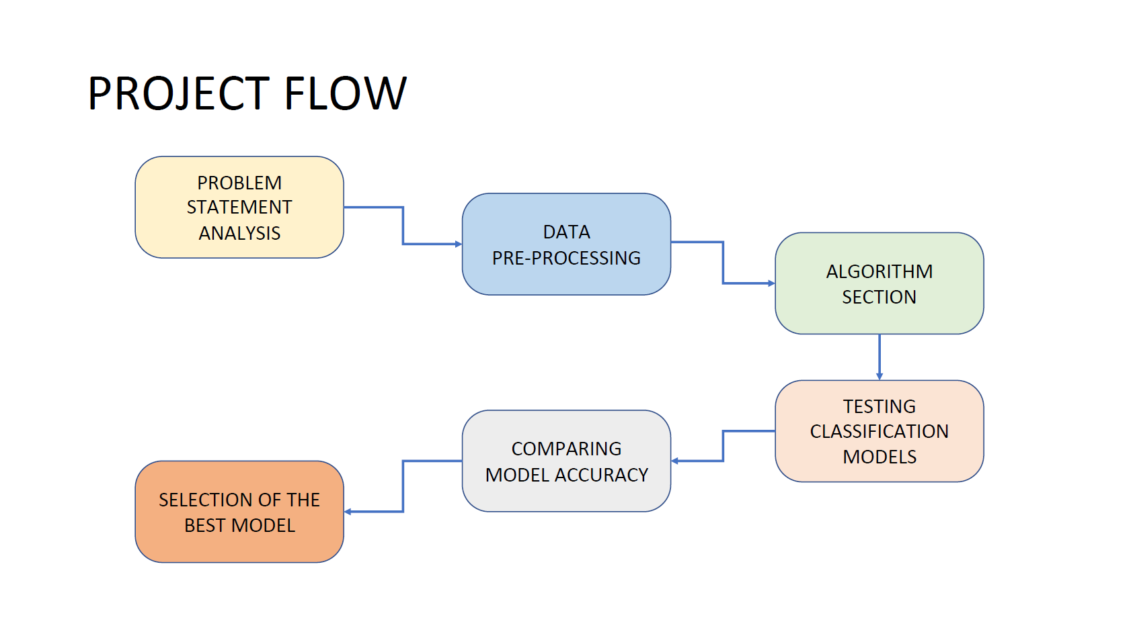

Slide 8
EXPLORATORY DATA ANALYSIS
We removed the date column from the dataset as it was not going to be a useful feature.
We converted the Rain Today, Rain Tomorrow features into binary form, where we denoted rain being there as 1 and rain not being there as 0.
We have removed all the unknown values(NA’s) for ease of data analysis.
We have added one hot encoding for the following columns
Location, WindGustDir, WindDir9am, WindDir3pm

Slide 9
HANDLING THE IMBALANCED DATA
The dataset had sparse occurrences of significant rainfall compared to periods of little to no rain, leading to an imbalanced dataset. To address this imbalance, we utilized the Python package Imbalanced-learn.
To equalize the distribution of data representing different rainfall intensities, we created additional samples of the underrepresented class — in this case, significant rainfall events.
This was achieved by employing the ‘RandomOverSampler’ function from the imbalanced-learn library, thus enhancing our model's ability to predict rain by learning from a more balanced dataset.

Slide 10
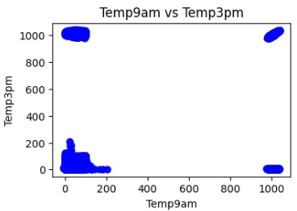
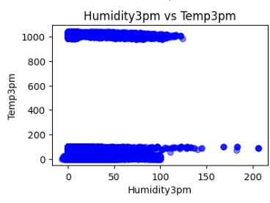
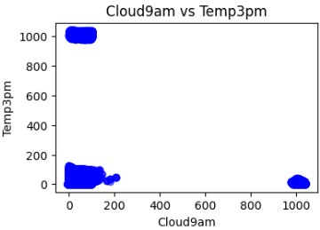

Slide 11
CLASSIFICATION MODELS
Logistic Regression
xgBoost
Decision Tree
KNN
Random Forest
Naive Bayes

Slide 12
LOGISTIC REGRESSION
Logistic Regression is a statistical method used for binary classification. In rain prediction, it helps in determining the probability of rain occurrence on a specific day, based on historical weather data. This model is valued for its simplicity and effectiveness in binary outcome predictions.
LR Accuracy: 0.8089555631321741

Slide 13
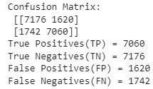
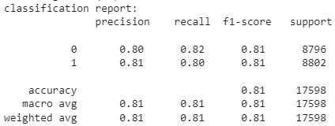
LOGISTIC REGRESSION

Slide 14
K-NEAREST NEIGHBORS (KNN)
KNN is a non-parametric method used for classification and regression. In rain prediction, it involves analyzing weather patterns by considering the 'k' nearest data points to predict rainfall. KNN is appreciated for its adaptability and ease of implementation.
k = 3 Accuracy: 0.8446414365268781
k = 5 Accuracy: 0.8063984543698147
k = 10 Accuracy: 0.7824184566428003

Slide 15
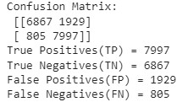
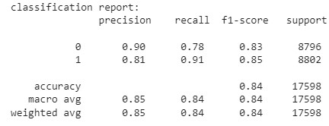
K NEAREST NEIGHBOR

Slide 16
NAÏVE BAYES
Naive Bayes is a probabilistic classifier that applies Bayes' theorem with strong independence assumptions between the features. It is particularly effective in rain prediction when dealing with large datasets, offering fast and efficient predictions.
NB Accuracy: 0.721502443459484

Slide 17
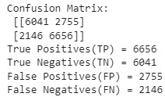
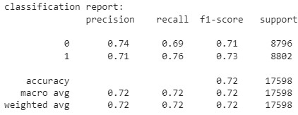
NAÏVE BAYES

Slide 18
RANDOM FOREST
The Random Forest model is a powerful ensemble learning technique that builds multiple decision trees during training and predicts the outcome based on the mode of the results from individual trees.
This approach enhances robustness and accuracy, outperforming single decision trees, particularly with complex datasets. It's well-suited for rain prediction as it effectively handles large datasets with multiple variables and captures complex, nonlinear relationships within weather data.
Random Forests also mitigate overfitting risks, providing reliable and generalizable predictions for varied meteorological conditions.
RF Accuracy: 0.7923059438572565

Slide 19
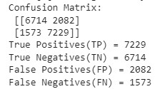
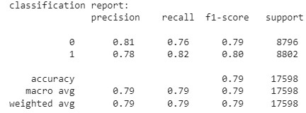
RANDOM FOREST

Slide 20
DECISION TREE
The Decision Tree model uses a tree-like graph of decisions and their possible consequences. It is intuitive and easy to understand, making it a popular choice for rain prediction. Decision Trees are particularly useful for visualizing the decision-making process.
Decision Tree Accuracy: 0.7287759972724174

Slide 21
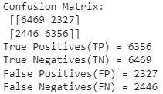
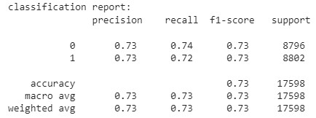
DECISION TREE

Slide 22
xgBoost
Classifier
The xgboostClassifier is a classification algorithm based on the decision tree model. It is an implementation of the XGBoost algorithm, which is an optimized and scalable gradient boosting library that uses decision trees as base learners.
xgBoost Accuracy: 0.8031026252983293

Slide 23
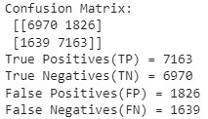
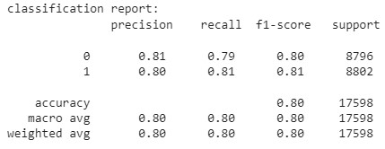
xgBoost Classifier

Slide 24
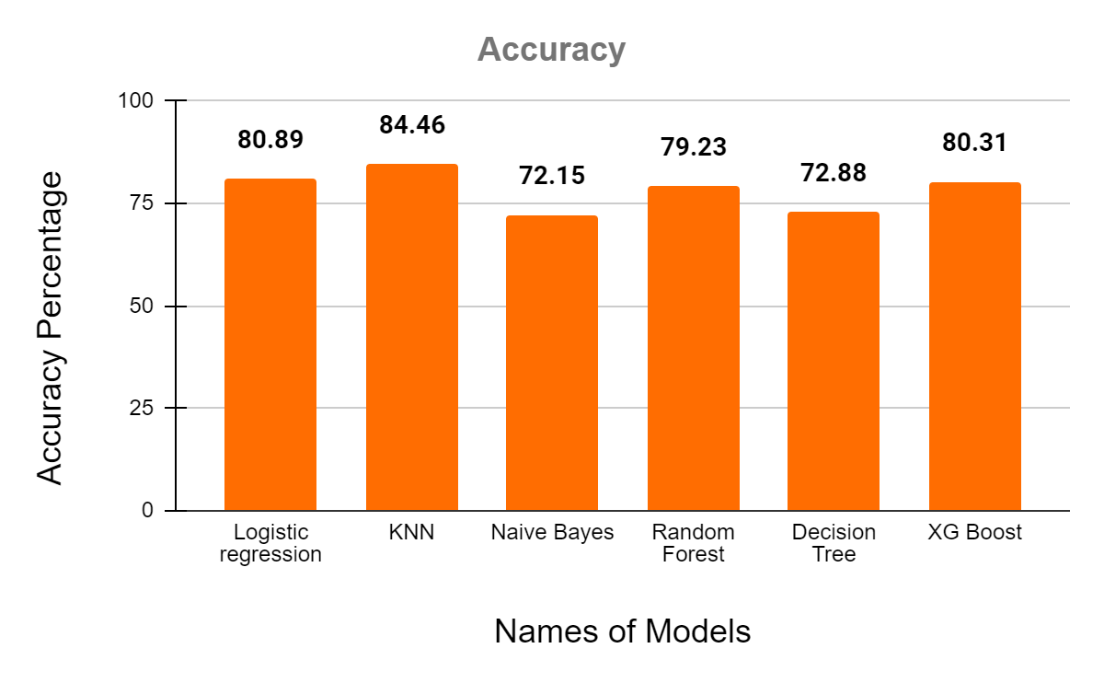
CONCLUSION
As per the classification models used and considering the accuracy of each and every model, the best classification model is K-Nearest Neighbor (k=3) with 84.46% accuracy.
The following graph compares the accuracy of the models used

Slide 25

THANK YOU

