Slide 1
Face Mask Detection using Deep Learning
Submitted By: Group 8

Slide 2
Agenda
Problem Statement
Project Overview
Dataset
Data Preprocessing
CNN Workflow
Application

Slide 3
Problem Statement
Many of the establishments are finding it hard to detect protocol violations as the time and labour spent for the same is incurring high cost and is highly inefficient.
The main aim of this project is to detect violations such as not wearing a mask in a workplace and notify the officials.
PANDEMIC
COVID-19

Slide 4
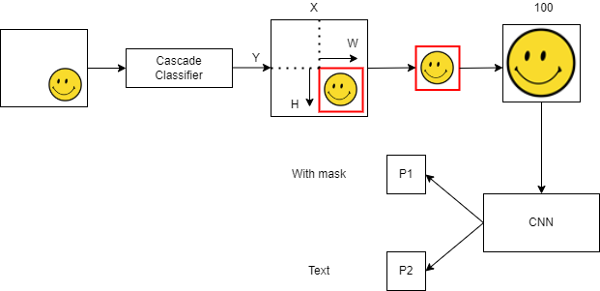
Project Overview

Slide 5
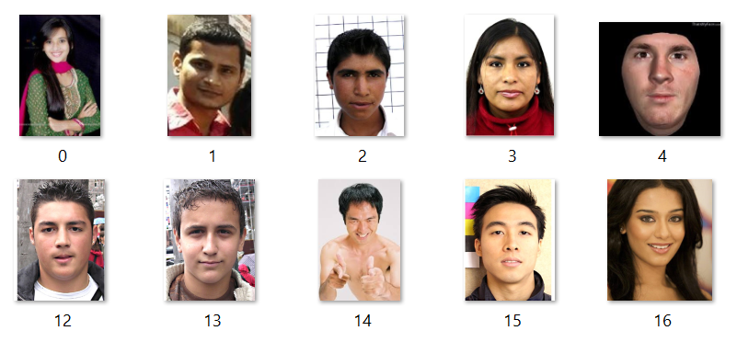
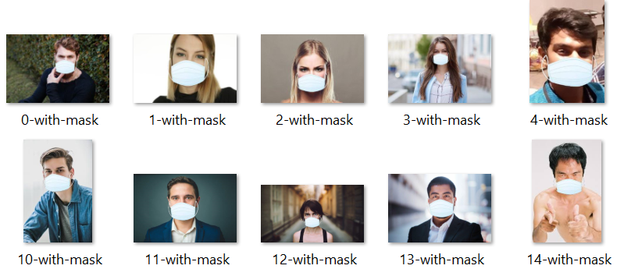
Dataset
The dataset consisted of 1376 images, 690 face images with masks and 686 without masks.
The original dataset is prepared by Prajna Bhandary and available at Github.

Slide 6

Data Preprocessing
Convert to grayscale image
Resize to 100x100
Make 2 categories – with mask, without mask
Reshape to 4D array

Slide 7
CNN Workflow
Architecture and Code Logic

Slide 8
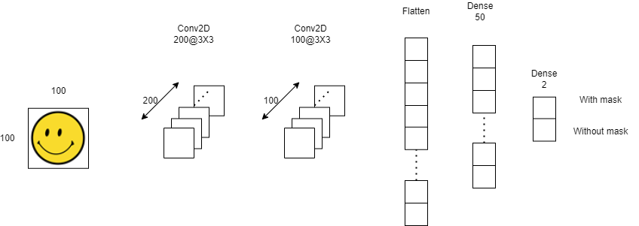
CNN Architecture

Slide 9
Training and Validation - Loss & Accuracy Plots

Slide 10



Applications
The Face Mask Detection System can be used at airports to detect travelers without masks. If a traveler is found to be without a face mask, their picture is sent to the airport authorities so that they could take quick action.
Airports
Using Face Mask Detection System, Hospitals can monitor if their staff is wearing masks during their shift or not.
Can be used to monitor quarantine people as well
Hospitals
The Face Mask Detection System can be used at office premises to detect if employees are maintaining safety standards at work.
It monitors employees without masks and sends them a reminder to wear a mask. The reports can be downloaded or sent an email at the end of the day to capture people who are not complying with the regulations or the requirements.
Offices

Slide 11
THANK YOU

