Slide 1
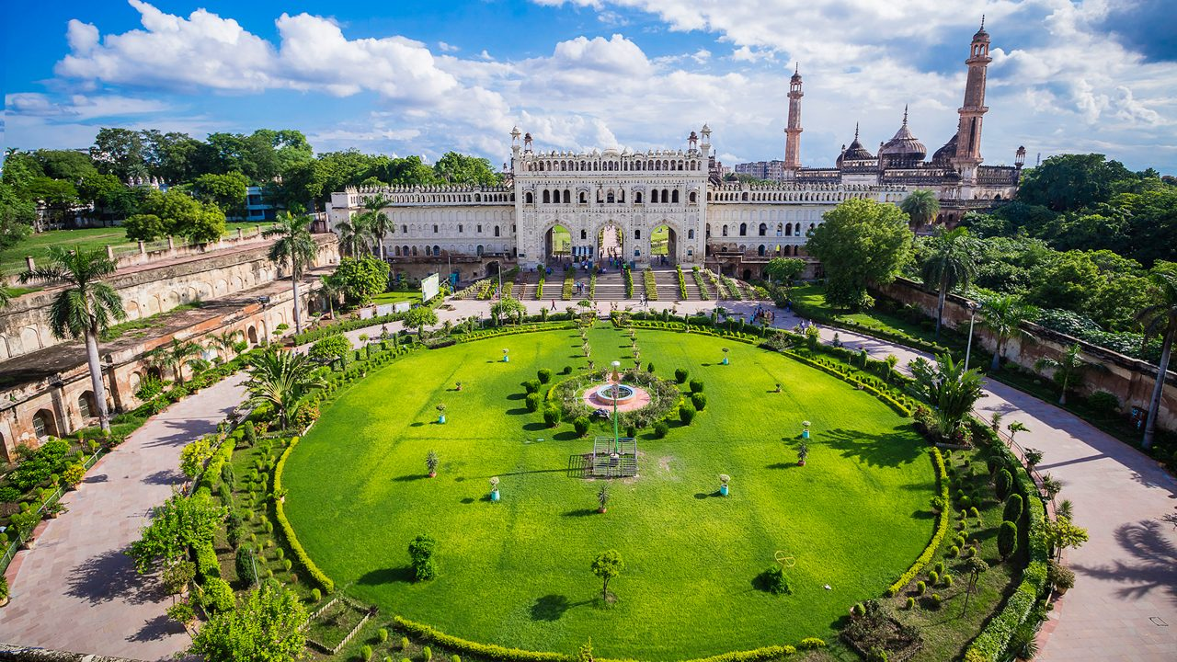
The Majestic Bara Imambara
A Historic Marvel of Lucknow
Presented by: [Your Name]
Date: 2025

Slide 2
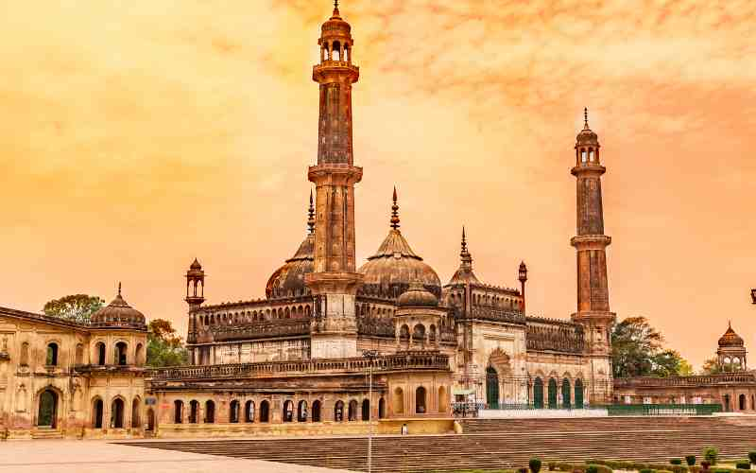
Introduction
• Bara Imambara is one of the world's most iconic architectural wonders
• Located in Lucknow, Uttar Pradesh, India
• Built between 1784-1791 under Nawab Asaf-ud-Daula
• Originally constructed as a famine relief project
• Features the world's largest unsupported vaulted roof
• Home to the mysterious Bhool Bhulaiya labyrinth
• A perfect blend of Mughal, Persian, and Awadhi architecture

Slide 3
Historical Background
• Construction began in 1784 during a severe famine
• Built by Nawab Asaf-ud-Daula to provide employment
• Completed in 1791 after 7 years of construction
• Served as a symbol of royal generosity and humanitarian spirit
• Witnessed the Revolt of 1857 against British rule
• Major restorations in 1900 and 1980
• Now a protected monument under Archaeological Survey of India

Slide 4
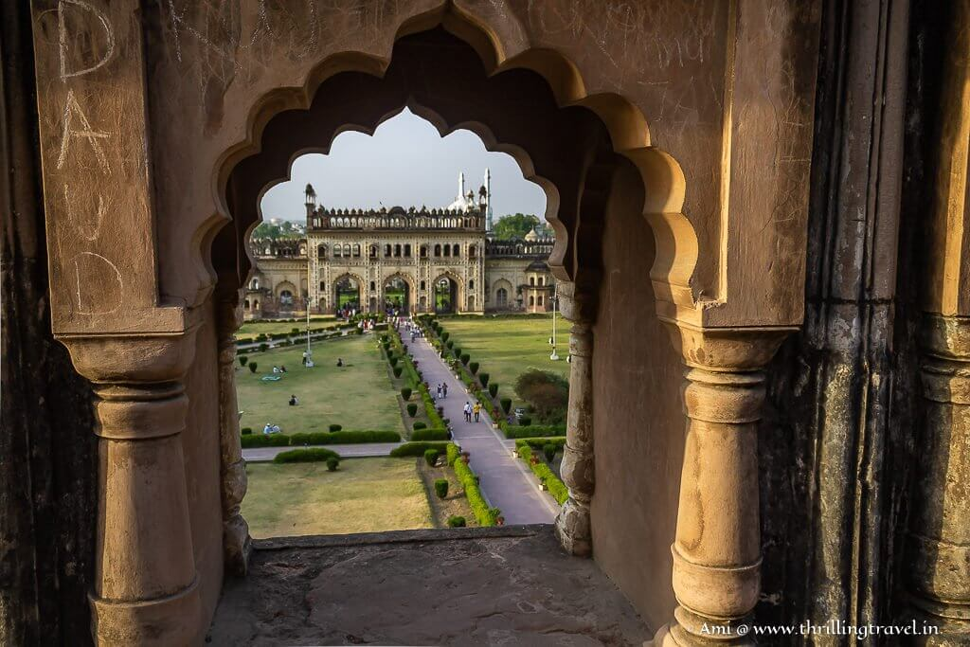
Architectural Marvel
• World's largest unsupported vaulted roof
• Built without any wooden beams or iron supports
• Uses lime plaster and bricks for construction
• Features intricate calligraphic carvings
• Grand arched gateways and courtyards
• Central dome with no supporting pillars
• Unique blend of Mughal, Persian, and Awadhi styles

Slide 5
Key Architectural Features
• Central Dome: Towering dome without supporting beams
• Bhool Bhulaiya: Complex labyrinth with 1000+ passageways
• Asfi Mosque: Elegant Mughal-style mosque within complex
• Shahi Baoli: Ingenious stepwell and water management system
• Grand Courtyards: Vast open spaces with green lawns
• Arched Gateways: Majestic entrances with intricate details
• Calligraphic Ornamentation: Beautiful Islamic inscriptions

Slide 6
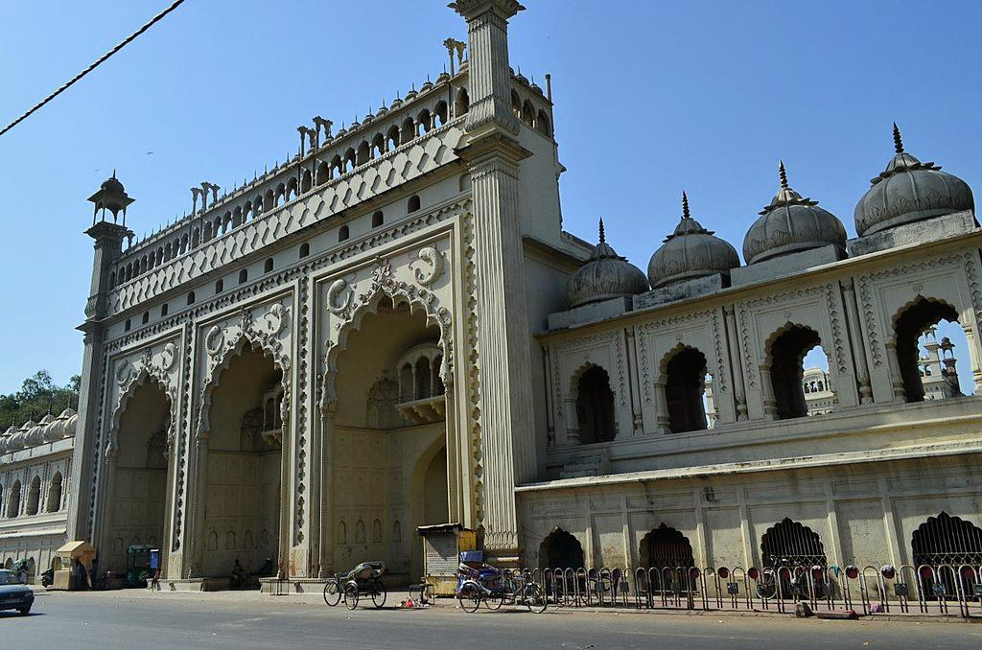
Visitor Information
• Opening Hours: 6:00 AM to 5:00 PM (Closed Mondays)
• Location: Chowk, Lucknow, Uttar Pradesh 226003
• Ticket Prices: ₹50 (Adults), ₹25 (Children), ₹500 (Foreigners)
• Photography: ₹10 (Digital), ₹25 (Video)
• Accessibility: Wheelchair ramps and accessible facilities
• Best Time to Visit: October to March (pleasant weather)
• Nearby Metro: Chowk Metro Station (5-minute walk)

Slide 7
Cultural Significance
• Active site of worship and religious ceremonies
• Major tourist attraction drawing millions annually
• Symbol of Lucknow's rich cultural heritage
• Represents Awadhi architecture and craftsmanship
• Important landmark in Indian history
• UNESCO World Heritage Site candidate
• Preserves traditional Islamic architectural techniques
• Showcases humanitarian values through famine relief origins

Slide 8
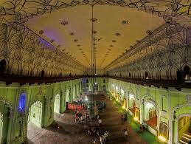
Engineering Achievements
• Constructed without modern machinery
• Advanced techniques: interlocking stones, lime mortar
• Precision-cut stone blocks and dry stone masonry
• Innovative vaulted roof construction
• Strategic labyrinth design for defense
• Sophisticated water management system
• Earthquake-resistant construction methods
• Enduring structural integrity for over 230 years

Slide 9
Tourism and Economic Impact
• Major contributor to Lucknow's tourism economy
• Generates employment for local guides and vendors
• Promotes cultural exchange and understanding
• Supports local handicraft and souvenir industries
• Educational destination for architecture students
• Photography and film location opportunities
• Cultural events and festivals venue
• Heritage conservation and restoration projects

Slide 10
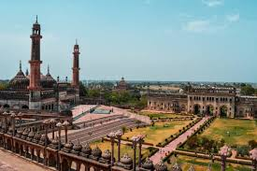
Conclusion
• Bara Imambara stands as a testament to human ingenuity
• Perfect blend of architectural beauty and engineering excellence
• Rich historical significance and cultural heritage
• Continues to inspire and amaze visitors worldwide
• Symbol of resilience, humanitarian values, and artistic achievement
• Must-visit destination for anyone interested in Indian heritage
• Preserves the legacy of Awadhi culture and craftsmanship
• A living monument that bridges past and present

Slide 11
Thank You
Questions & Discussion
Contact: [Your Contact Information]
Email: [Your Email]
Visit Bara Imambara to experience its majesty firsthand!

