Slide 1
CAPSTONE PROJECT PRESENTATION
Made by Sarthak

Slide 2
Introduction/Business Requirements
London and Paris are quite the popular tourist and vacation destinations for people all around the world. They are diverse and multicultural and offer a wide variety of experiences that is widely sought after. We try to group the neighbourhoods of London and Paris respectively and draw insights to what they look like now. These cities are majestic to say the least. They have been the hub of several great civilisations.
The aim is to help tourists choose their destinations depending on the experiences that the neighbourhoods have to offer and what they would want to have. This also helps people make decisions if they are thinking about migrating to London or Paris or even if they want to relocate neighbourhoods within the city. Our findings will help stakeholders make informed decisions and address any concerns they have including the different kinds of cuisines, provision stores and what the city has to offer. By this analysis, we provide the power of informed decision making to the viewer. We want to enable them to make informed decision and save both money and time,not to mention a lot of effort as well.
What it’s about…

Slide 3
Data Description
We require geographical location data for both London and Paris. Postal codes in each city serve as a starting point. Using Postal codes we use can find out the neighborhoods, boroughs, venues and their most popular venue categories.
For London Data, We scrape our data from https://en.wikipedia.org/wiki/List_of_areas_of_London This wikipedia page has information about all the neighbourhoods, we limit it to London.
borough : Name of Neighbourhood
town : Name of borough
post_code : Postal codes for London.
For Paris Data, We leverage JSON data available at https://www.data.gouv.fr/fr/datasets/r/e88c6fda-1d09-42a0-a069-606d3259114e The JSON file has data about all the neighbourhoods in France, we limit it to Paris.
postal_code : Postal codes for France
nom_comm : Name of Neighbourhoods in France
nom_dept : Name of the boroughs, equivalent to towns in France
geo_point_2d : Tuple containing the latitude and longitude of the Neighbourhoods.
Defining the data…

Slide 4
Data Description
We can further leverage Foursquare API to gain additional data, The data retrieved from Foursquare contained information of venues within a specified distance of the longitude and latitude of the postcodes. We set the radius to 500m. The information obtained per venue as follows:
Neighbourhood : Name of the Neighbourhood
Neighbourhood Latitude : Latitude of the Neighbourhood
Neighbourhood Longitude : Longitude of the Neighbourhood
Venue : Name of the Venue
Venue Latitude : Latitude of Venue
Venue Longitude : Longitude of Venue
Venue Category : Category of Venue
This data should suffice and could very well provide us with enough resources to make a detailed report
Defining the data…

Slide 5
Methodology
To compare the similarities of two cities, we decided to explore neighborhoods, segment them, and group them into clusters to find similar neighborhoods in big cities like London and Paris. To be able to do that, we need to cluster data which is a form of unsupervised machine learning: k-means clustering algorithm.
Using credentials of Foursquare API features of near-by places of the neighborhoods would be mined. Due to http request limitations the number of places per neighborhood parameter would reasonably be set to 100 and the radius parameter would be set to 500.
Describing the methods…

Slide 6
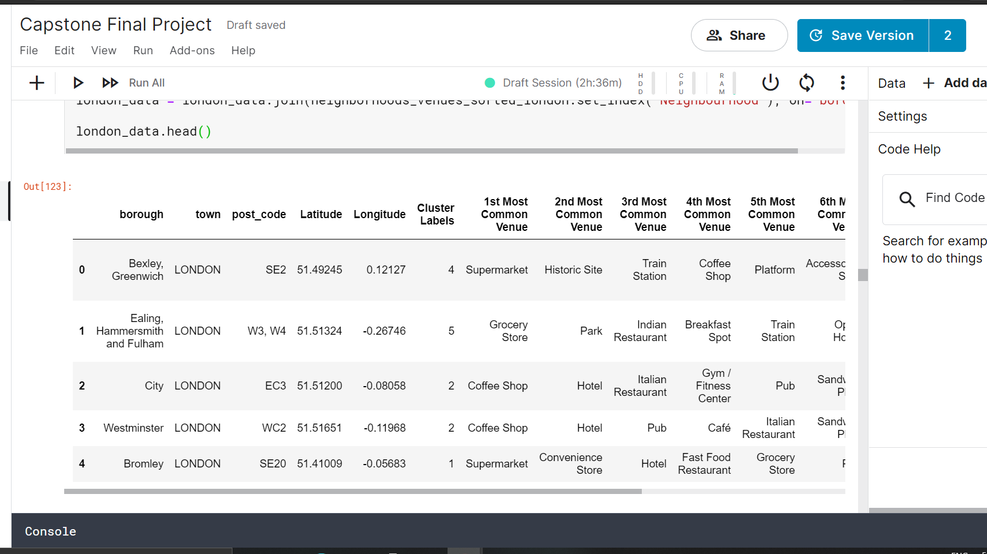
Clustering the London data
Clustered data looks like

Slide 7
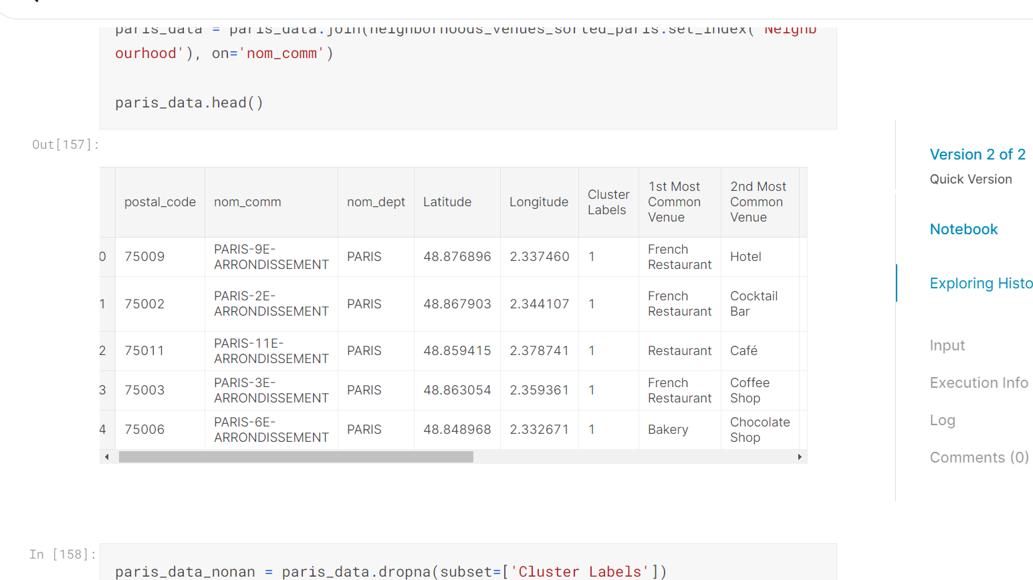
Clustering the Paris data
Clustered data looks like

Slide 8
Result/Discussion
The neighbourhoods of London are very mulitcultural. There are a lot of different cusines including Indian, Italian, Turkish and Chinese. London seems to take a step further in this direction by having a lot of Restaurants, bars, juice bars, coffee shops, Fish and Chips shop and Breakfast spots. It has a lot of shopping options too with that of the Flea markets, flower shops, fish markets, Fishing stores, clothing stores. The main modes of transport seem to be Buses and trains. For leisure, the neighbourhoods are set up to have lots of parks, golf courses, zoo, gyms and Historic sites.
The final results for London…

Slide 9
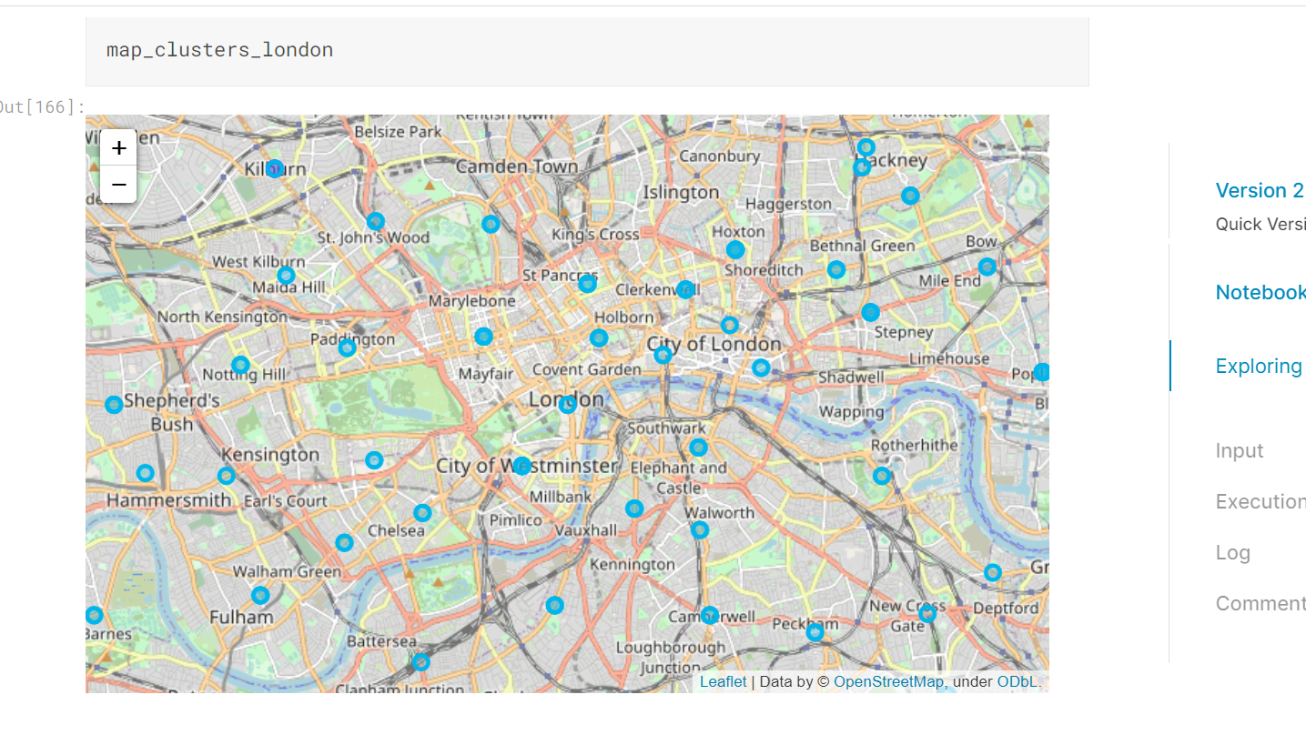
Visualizing Clustering for London Data
Visualized using Folium module

Slide 10
Result/Discussion
Paris is relatively small in size geographically. It has a wide variety of cusines and eateries including French, Thai, Cambodian, Asian, Chinese etc. There are a lot of hangout spots including many Restaurants and Bars. Paris has a lot of Bistro's. Different means of public transport in Paris which includes buses, bikes, boats or ferries. For leisure and sight seeing, there are a lot of Plazas, Trails, Parks, Historic sites, clothing shops, Art galleries and Museums.
Paris seems to be more vibrant and 'happier' than London and seems to be more desirable tourist destination among the two.
The final results for Paris…

Slide 11
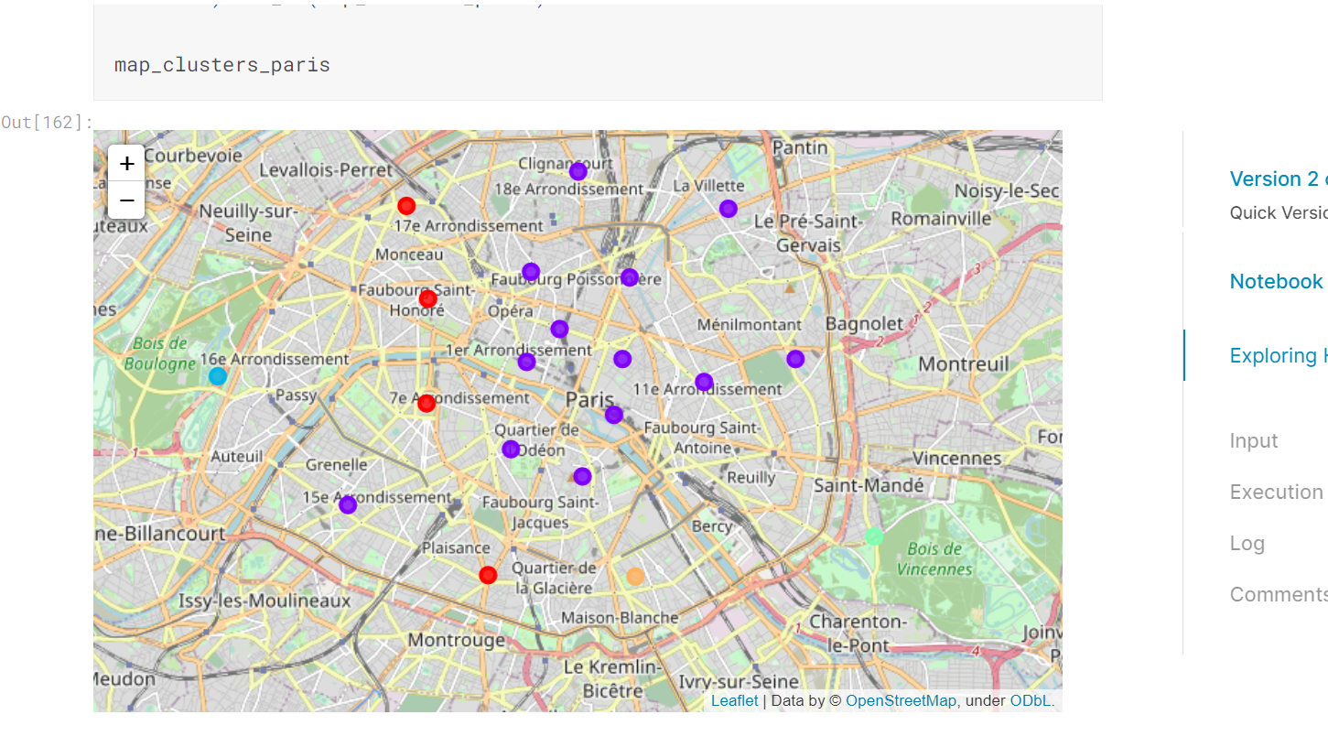
Visualizing Clustering for Paris Data
Visualized using Folium module

Slide 12
Conclusion
The purpose of this project was to explore the cities of London and Paris and see how attractive it is to potential tourists and migrants. We explored both the cities based on their postal codes and then extrapolated the common venues present in each of the neighbourhoods finally concluding with clustering similar neighbourhoods together.
We could see that each of the neighbourhoods in both the cities have a wide variety of experiences to offer which is unique in it's own way.It's upto the stakeholders to decide which experience they would prefer more.
The Notebook along with the code is available on my Github.
Final thoughts…

Slide 13
Thank You

