Slide 1
UNIVERSITY RECOMENDATION SYSTEM
RAJATH MAHESH
SARTHAK GUPTA
SUJAY UMESH

Slide 2
INTRODUCTION
The project is about recommending the students various universities in US.
The students look for various universities but fails to find or tend to ignore some university and our system will give them recommendations based on their search by looking at the various advertisements of the universities they were looking for.
These recommendations are based on the tweets given by user
Using Classifier on data to recommend the tweets to the user

Slide 3
Twitter Dataset
Tweets selected using specific Hashtags
#University #application
#grad #student #application
Libraries and Packages used:
Numpy,Panda,sklearn

Slide 4
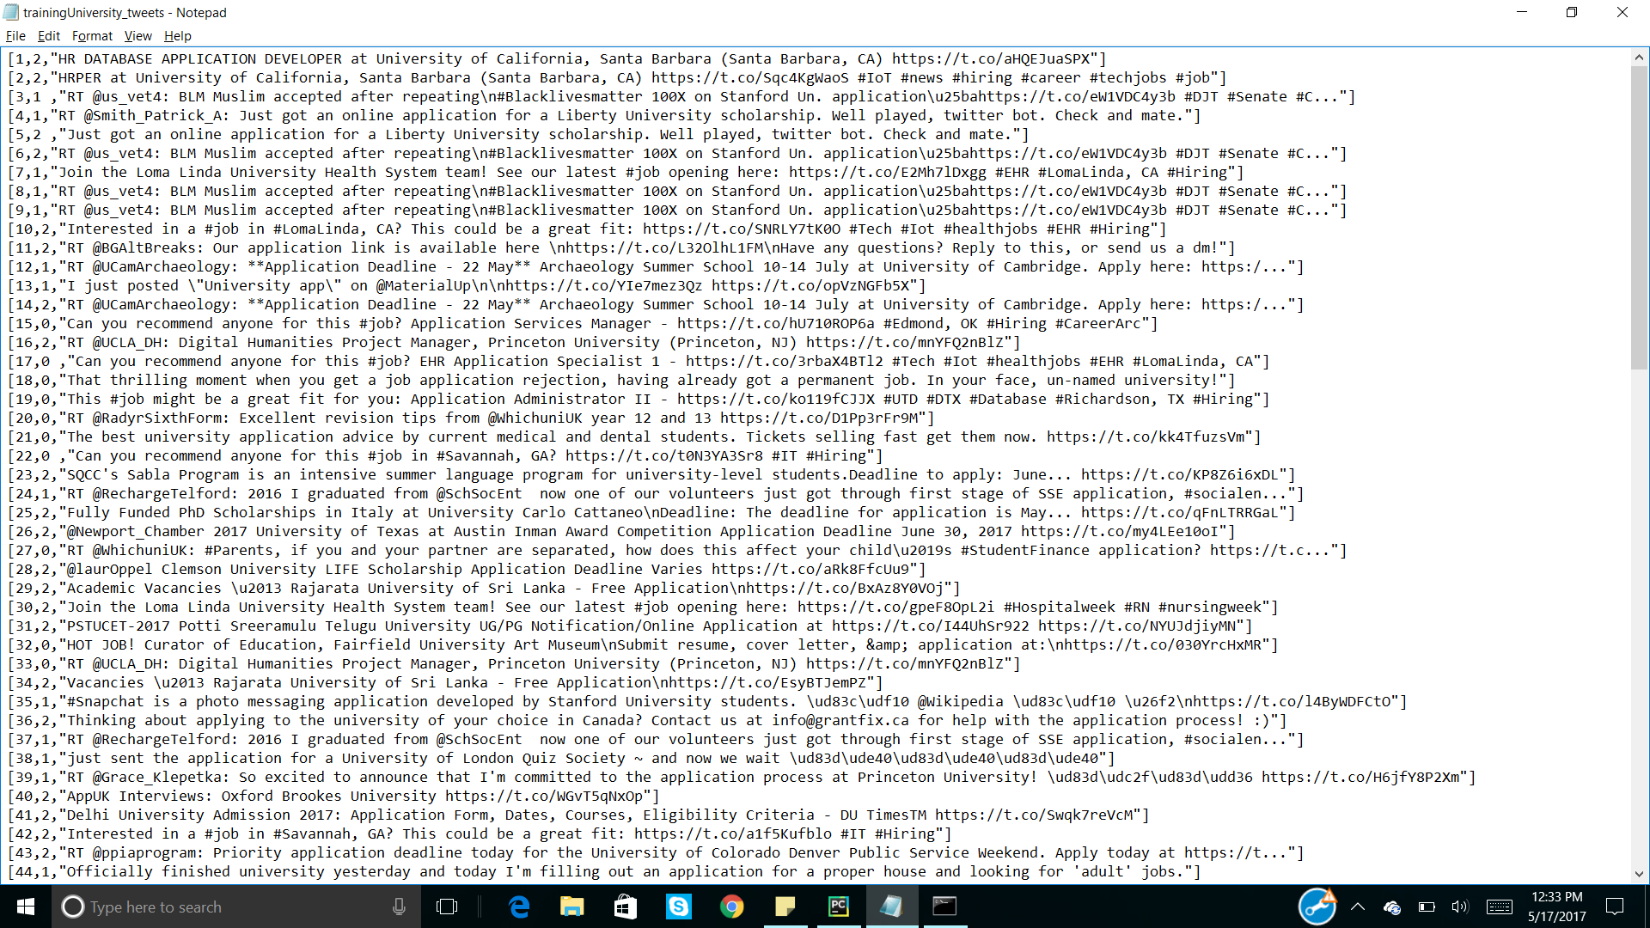
PROCESSED DATA COLLECTION

Slide 5
Data Preprocessing
The Tweets collected were then preprocessed for cleaning the data
The Tweets from a language other than English were Removed
All the tweets were then saved in a particular Format like removing the colons, semi colons and other special characters.
Used Stop word removal like before ,above ,after etc

Slide 6
DATASETS
TRAINING SET
We designed the query to extract tweets with relevant hashtags
100 Tweets with relevant hashtags
TEST SET
More tweets with the relevant hashtags were extracted
70 Tweets
The trained classifier was used on this test dataset

Slide 7
Labelling of Training Dataset
The Tweets collected were manually labelled
For Every Tweet The Annotators had to Choose from the below mentioned options
Positive
Negative
Irrelevant
The following annotation was made to every tweet in the training dataset
Relevant Tweets: 1
Irrelevant Tweets: 0
Advertisement: 2

Slide 8
TEST DATASET
The dataset consisted of 70 Tweets
The trained Classifier was then applied on this test Dataset
Predictions made:
Relevant: 1
Advertisement: 2
Irrelevant Tweets: 0

Slide 9
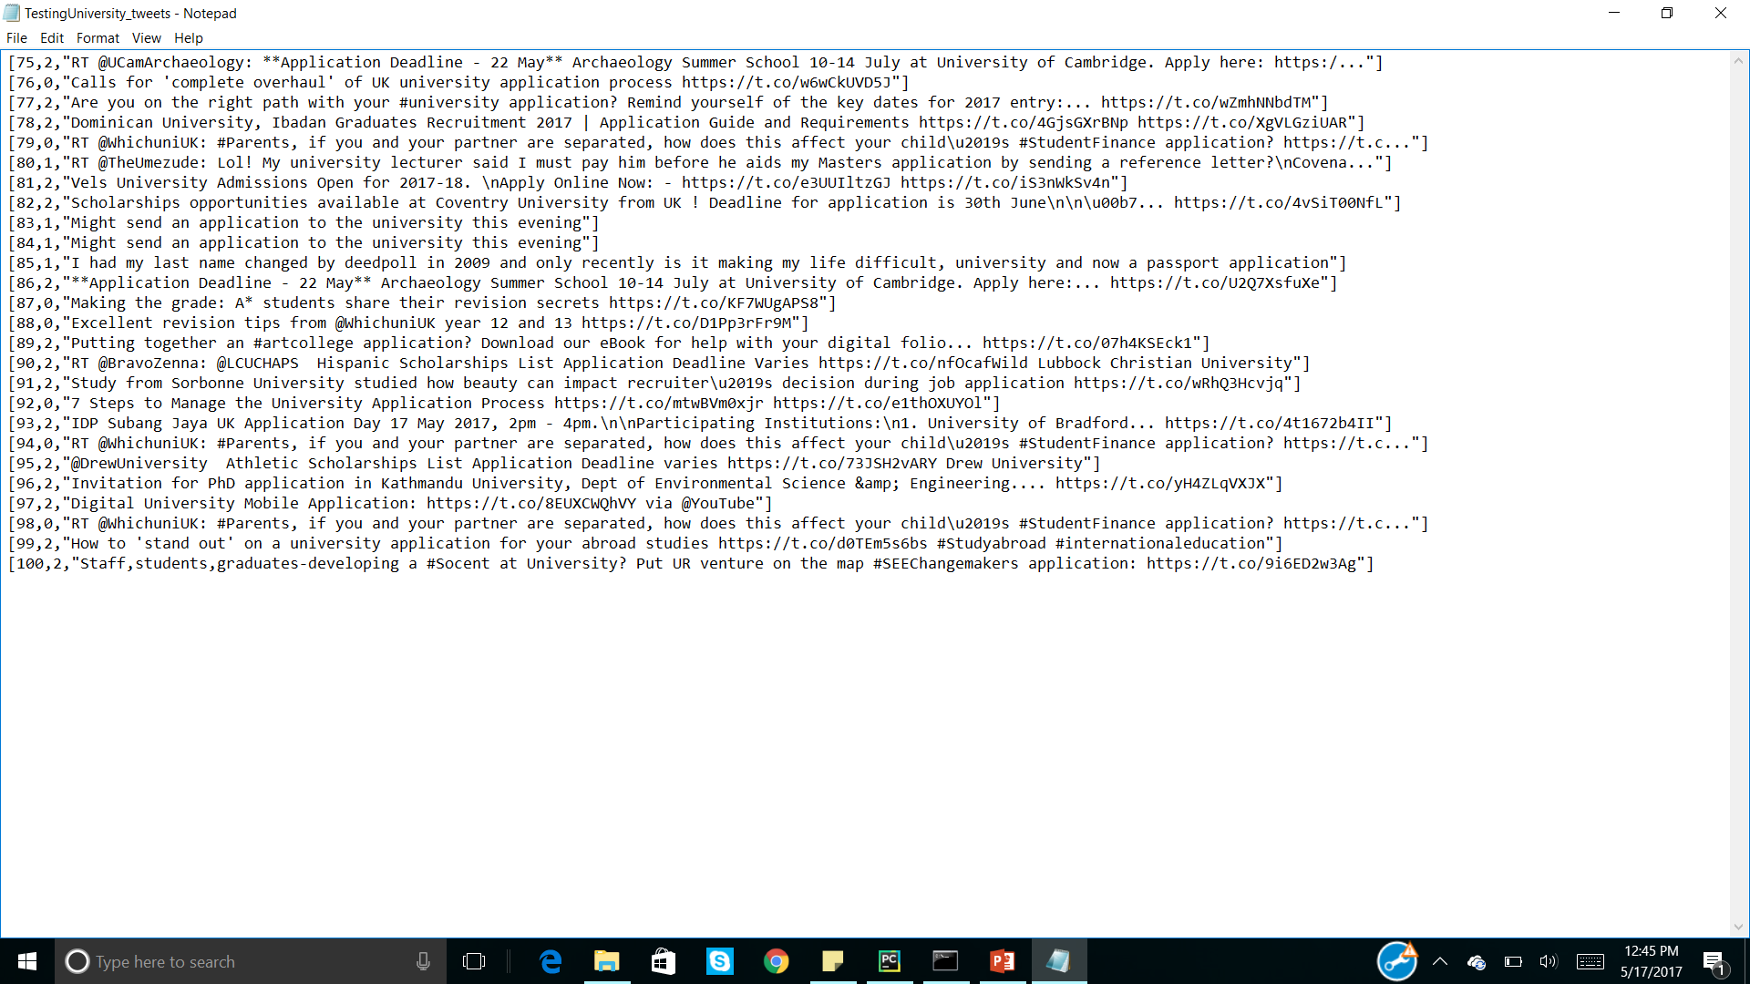
TEST DATASET: SCREENSHOT

Slide 10
CLASSIFIER USED
We have used LOGISTIC REGRESSION
Also implemented the same with SVM
We trained the Training data using the above mentioned classifier
Then the classifier was applied to the Test Dataset
Thus predictions were made to the test dataset by classifier based on the training done on the training dataset.

Slide 11
Recommendations
We used the trained classifier to classify the data
Then we find the similarity between the positive tweet and the advertisement tweets.
Based on this similarity
The system will recommend the user with relevant advertisement regarding university and their application.

Slide 12
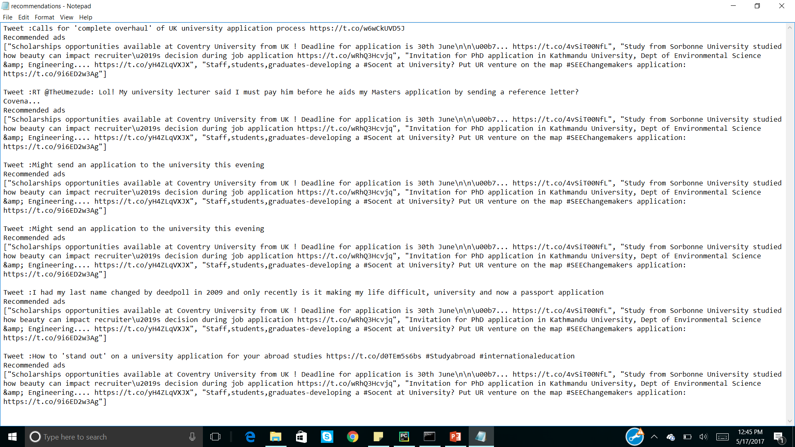
Recommendations

Slide 13
Compare data models
SVM
Logistic regression
Not good for large dataset
Give not so better results
Good for large dataset
Give better results

Slide 14
ADVANTAGES
Using three parameters as 0,1,2 we avoid bad data or unused data.
This system will help the students in faster filtering of their application and recommendation.
The use of different models like logistic regression and SVM also gives us the time complexity between them.

Slide 15
DISADVANTAGE
Use of larger data will give us better accuracy.
Comparing both the data mining models gives us better understanding and also gives us the advantage of one over another.

Slide 16
Thank You

