Slide 1

A Project Report on “Cricket Score Management System” SUBMITTED BY: Sarthak Darandale
SUBJECT
C++
PROGRAMMING
Under the Guidance of
Ms. Ishawari Tirse
Ma’am
Department of
Computer Science and Engineering
Sanjivani Rural Education Society’s
SANJIVANI UNIVERSITY
KOPARGAON – 423603,
DIST : AHMEDNAGAR 2024-2025

Slide 2
INDEX
.
SR. NO. | CONTENT | PAGE NO.
1. | INTRODUCTION | 3
2. | CODE | 4
3. | OUTPUT | 6
4. | CONCLUSION | 7

Slide 3
INTRODUCTION
Cricket is a popular sport, and keeping track of the scores manually can be a tedious task. To simplify this, I have developed a Cricket Score Management System using C++. This system allows the user to input and manage scores of two teams and displays the total runs, wickets, and overs. This project will help in automating the scorekeeping process, making it easier and faster to manage.

Slide 4
CODE
#include<iostream>
using namespace std;
class Cricket
{
public:
int total_runs;
int total_wickets;
int overs;
Cricket()
{
total_runs = 0;
total_wickets = 0;
overs = 0;
}
void addRuns(int runs)
{ total_runs += runs; }
void addWicket()
{ total_wickets += 1; }
void addOver()
{ overs += 1; }
void displayScore()
{
cout << "Total Runs: " << total_runs << endl;
cout << "Total Wickets: " << total_wickets << endl;
cout << "Overs: " << overs << endl;
}
};

Slide 5
int main()
{
Cricket match;
int choice, runs;
do { cout << "1. Add Runs" << endl;
cout << "2. Add Wicket" << endl;
cout << "3. Add Over" << endl;
cout << "4. Display Score" << endl;
cout << "5. Exit" << endl;
cout << "Enter your choice: ";
cin >> choice;
switch (choice)
{
case 1:
cout << "Enter runs to add: ";
cin >> runs;
match.addRuns(runs);
break;
case 2:
match.addWicket();
break;
case 3:
match.addOver();
break;
case 4:
match.displayScore();
break;
case 5:
cout << "Exiting..." << endl;
break;
default:
cout << "Invalid choice!" << endl;
}
}
while (choice != 5);
return 0;
}

Slide 6
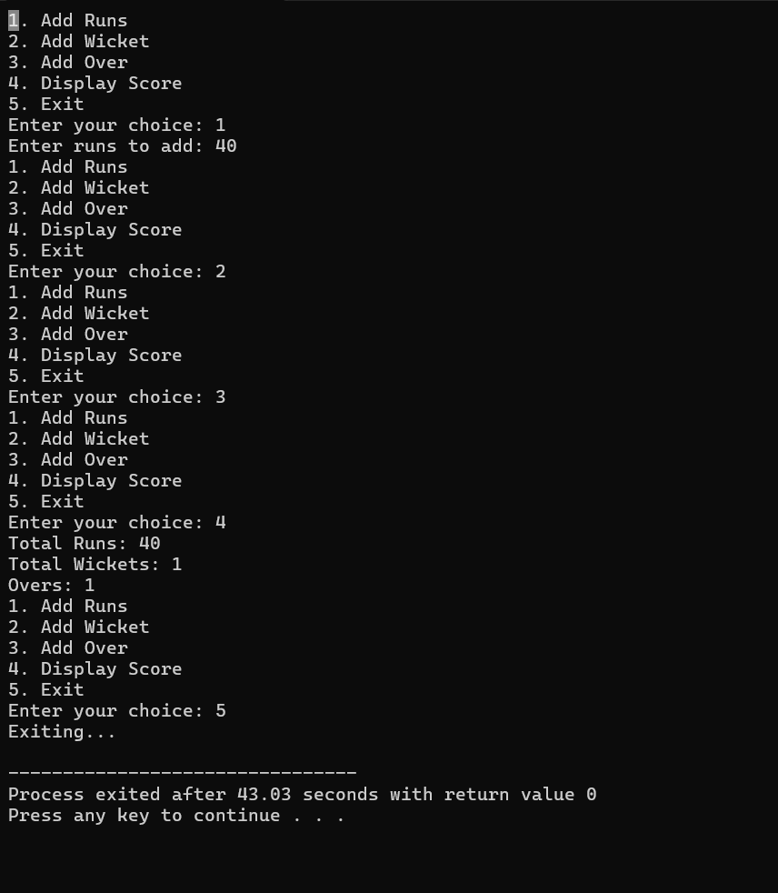
OUTPUT

Slide 7
CONCLUSION
This Cricket Score Management System simplifies the process of tracking and managing cricket scores. The system can handle adding runs, wickets, and overs, providing real-time updates on the game's status. As I learn more in C++,
I can enhance this system by adding more features, such as player names and individual scores.

