Slide 2
Project Title
COMPUTATION OF EIGENVALUES AND EIGEN VECTOR FOR LARGE MATRICES USING
CLOUD OUTSOURCING
Project Guide
DR. RAJEEV TIWARI

Slide 3
Team Members & Role
ROLL NO. | BRANCH | NAME | ROLE
R110216050 | CSE-CCVT | AYUSH RAJ CHAUHAN | Literature Review Design of Algorithm Implementation of Algorithm Comparison
R103216034 | CSE-BAO | DIPIN MADAAN
R100216072 | CSE-OSS | SARTHAK SRIVASTAVA

Slide 4
Introduction
Cloud computing possess a majority of advantages, such as flexibility, location independent, robust, economical, easy access, faster response time, easy to maintain and is vendor specific.
Cloud computing enables clients with limited computational resources to economically outsource their large-scale computations. It reduces computational workload and storage limitation problems by its high computational power and on demand network services.
Eigenvalue problem is one of the basic problems of this domain which has a vast number of applications. It is used in information retrieval and even Google uses the eigenvector of the maximal eigenvalue of Google matrix to determine the rank of a page during search.
Eigenvectors are fundamental to principal components for analysis which is commonly used for dimensionality reduction in face recognition and other machine learning applications.

Slide 5
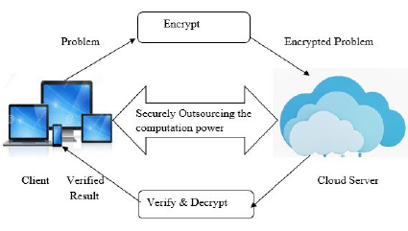
Despite having prodigious benefits of cloud, the direct control of customer over the computation of its data is deprived, which brings in new challenges.
Security: The data first needs to be encrypted before outsourcing it to cloud. The result after computation also needs to be protected
Verifiability: For highly intensive computational tasks there is a huge encouragement for the cloud to be lazy and give back random incorrect results.
Efficiency: There should be a substantial reduction in the computational performance of the workload on cloud as compared to the problem done on its own.

Slide 6
Problem Statement
Eigenvalue computation is one of the basic problems which has a vast number of applications. Eigenvectors are fundamental to principal components for analysis. Its direct computation method is computationally very expensive for large dimensionality. Using cloud outsourcing for this computation is the task which is to be aimed that too securely, effectively and accurately.

Slide 7
Objectives
Designing of an optimized algorithm for encrypting user’s matrix, performing Eigen Decomposition, verifying result received from cloud, and decrypting the verified result.
Implementation of proposed algorithm.
Comparison of complexities of algorithm with and without cloud.

Slide 8
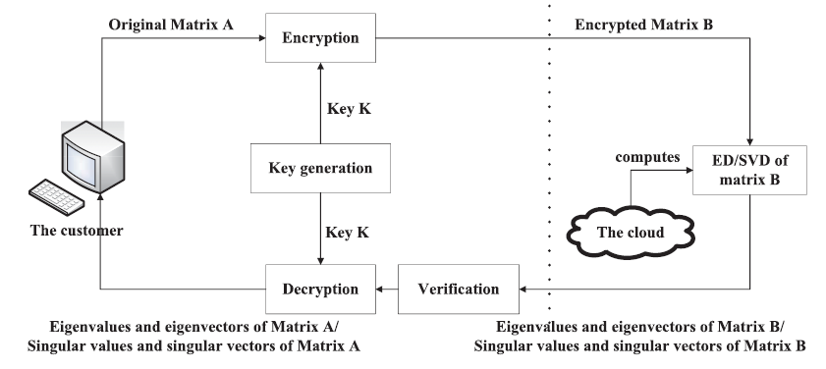
Literature Review
Matrices are extremely confounded articles that are hard to utilize, and in practical problems enormous. Eigenvalues/Eigenvectors enable one to catch some fundamental highlights of your framework in only one value and one vector. This is more straightforward than a NxN grid. Eigenvalues and the relating Eigenvectors are arguably the most imperative property in computer vision as well as image processing.

Slide 9
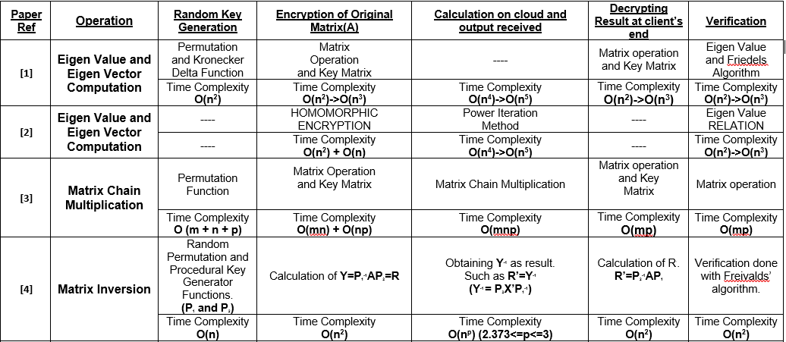

Slide 10
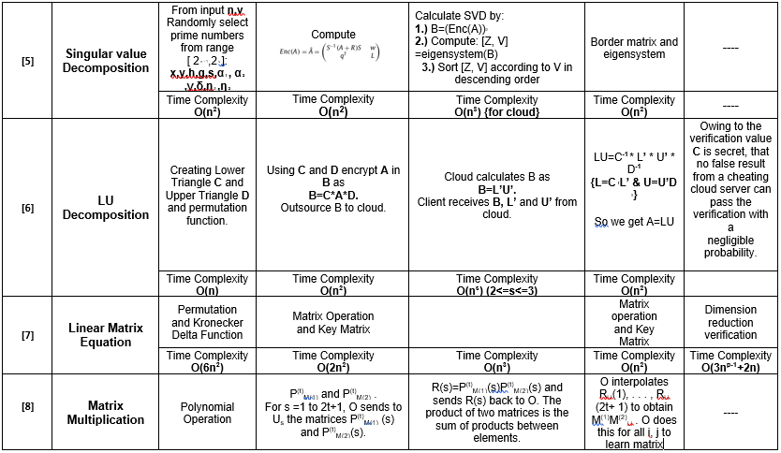

Slide 11
Method of direct computation of Eigen vectors has a time complexity of O(n⁴) which is very expensive for matrices of large dimensions. Despite having prodigious benefits of cloud, the direct control of customer over the computation of its data is deprived, which brings in new challenges.
Security, Verifiability and Efficiency are the factors that need to be taken into consideration while outsourcing to a public cloud.
In our work, we are using multiple matrix operations for securing the original matrix and then outsourcing the matrix to the cloud for calculation of eigen values and eigen vectors.
Our next algorithm will verify the result obtained from the cloud subsequent to which we will decrypt the result.

Slide 12
PERT Chart
LITERATURE REVIEW
DURATION: 8 WEEK(S)
DATE: 24.08.18 - 17.10.18
ASSIGNED TO: AYUSH, DIPIN, SARTHAK
DESIGNING OF ALGORITHM
DURATION: 7 WEEK(S)
DATE: 08.09.18 - 30.10.18
ASSIGNED TO: AYUSH, DIPIN, SARTHAK
PSUEDO CODE
DURATION: 1 WEEK(S)
DATE: 07.10.18 - 14.10.18
ASSIGNED TO: AYUSH, DIPIN, SARTHAK
OUTSOURCING ON CLOUD
DURATION: 2 WEEK(S)
DATE: 08.11.18 - 20.11.18
ASSIGNED TO: AYUSH, DIPIN, SARTHAK
TESTING & DEBUGGING
DURATION: 1 WEEK(S)
DATE: 05.11.18 - 12.11.18
ASSIGNED TO: AYUSH, DIPIN, SARTHAK
IMPLEMENTATION
DURATION: 3 WEEK(S)
DATE: 15.10.18 - 04.11.18
ASSIGNED TO: AYUSH, DIPIN, SARTHAK
COMPARISON
DURATION: 1 WEEK(S)
DATE: 21.11.18 - 25.11.18
ASSIGNED TO: AYUSH, DIPIN, SARTHAK
PUBLISH REPORT
DURATION: 1 WEEK(S)
DATE: 04.11.18 - 01.12.18
ASSIGNED TO: AYUSH, DIPIN, SARTHAK

Slide 13
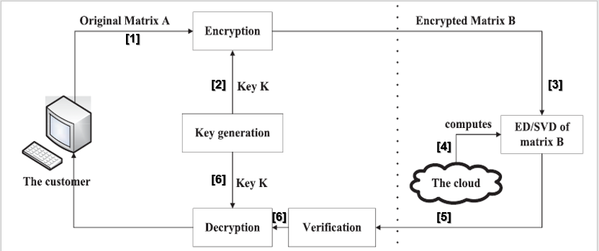
FLOW DIAGRAM
[1] Encryption of matrix
[2] Key Generation
[3] Transfer of Encrypted matrix for computation
[4] Computation over encrypted matrix with cloud
[5] Verification of the output generated
[6] Decryption to get the desired eigen vector and Value

Slide 14
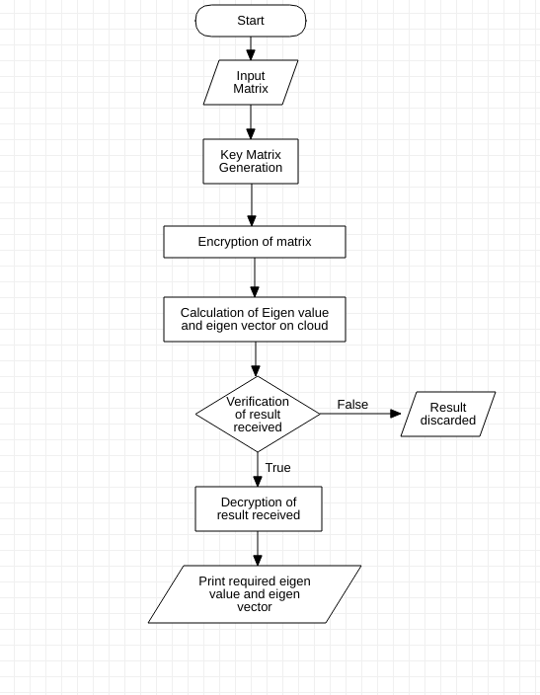
Flow Chart

Slide 15
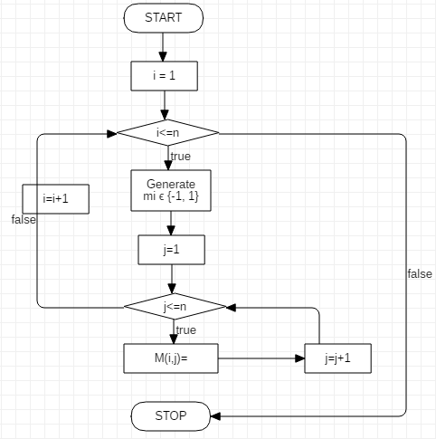
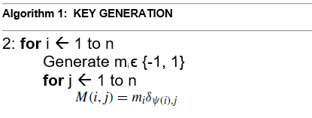
ALGORITHM

Slide 16
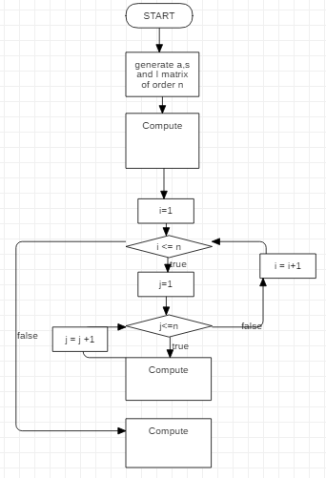
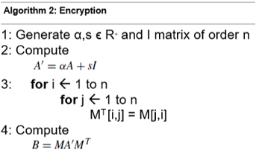

Slide 17
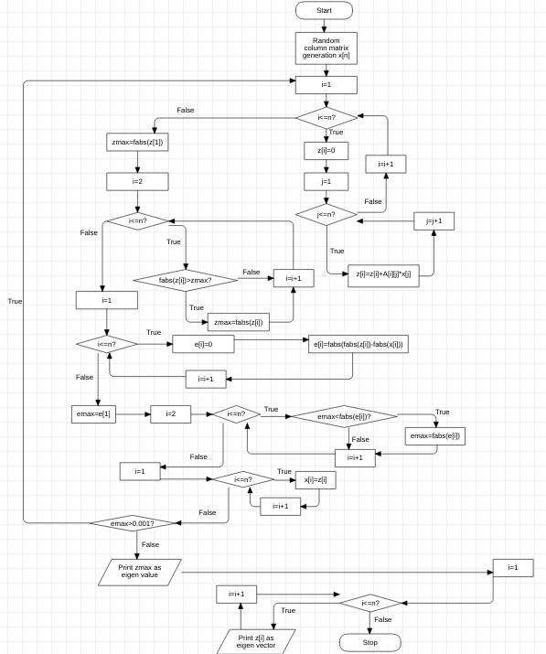
CALCULATION ALGORITHM

Slide 18
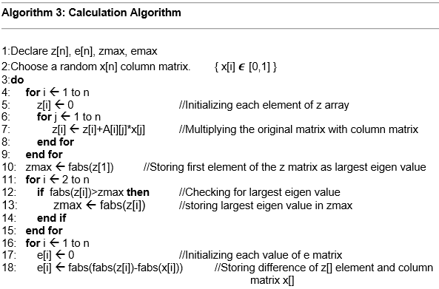
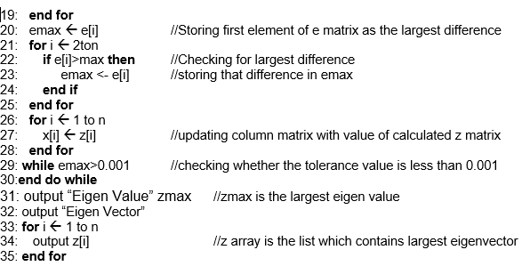

Slide 19
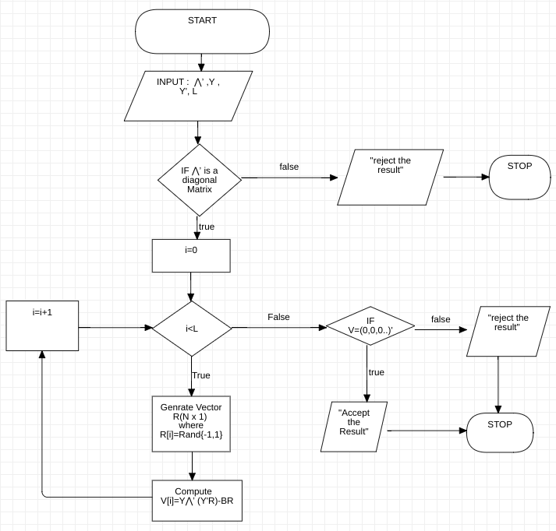
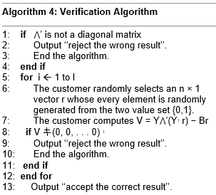

Slide 20
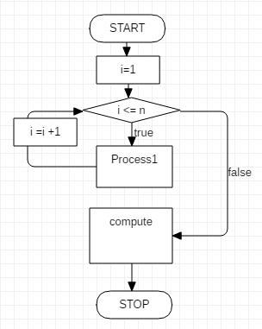
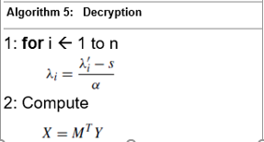


Slide 21
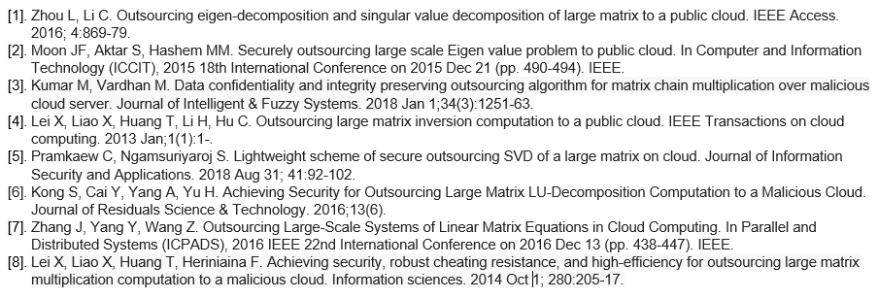
References

