Slide 1


Slide 2
Topics for Today
Support Vector machines
Dimensionality Reduction
Notes:
In London

Slide 3
Support Vector Machine
Notes:
In London

Slide 4
Intuition
Think of machine learning algorithms as an armory packed with axes, sword, blades, bow, dagger etc.
You have various tools, but you ought to learn to use them at the right time
As an analogy, think of ‘Regression’ as a sword capable of slicing and dicing data efficiently, but incapable of dealing with highly complex data
On the contrary, ‘Support Vector Machines’ is like a sharp knife – it works on smaller datasets, but on them, it can be much more stronger and powerful in building models.
Notes:
In London

Slide 5
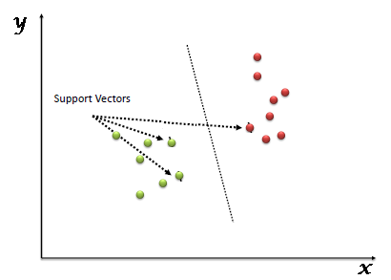
What is SVM
“Support Vector Machine” (SVM) is a supervised machine learning algorithm, it is mostly used in classification problems
In this algorithm, we plot each data item as a point in n-dimensional space (where n is number of features you have) with the value of each feature being the value of a particular coordinate
Then, we perform classification by finding the hyper-plane that differentiate the two classes very well (look at the below snapshot).
Support Vectors are simply the co-ordinates of individual observation
Support Vector Machine is a frontier which best segregates the two classes (hyper-plane/ line).
Notes:
In London

Slide 6
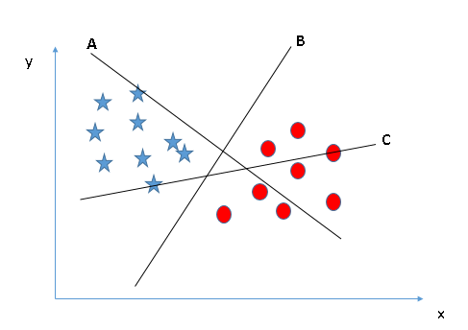
Which is the right Hyperplane
Notes:
In London

Slide 7
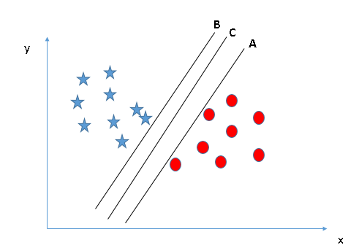
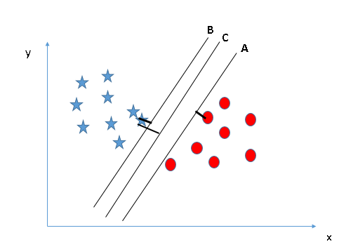
Here, maximizing the distances between nearest data point (either class) and hyper-plane will help us to decide the right hyper-plane. This distance is called as Margin
If we select a hyper-plane having low margin then there is high chance of miss-classification.
Notes:
In London

Slide 8
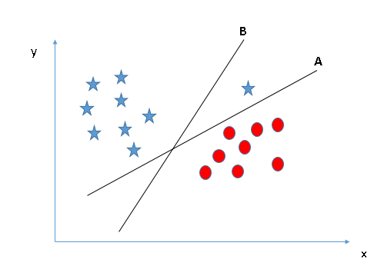
Which is the right Hyperplane
Notes:
In London

Slide 9
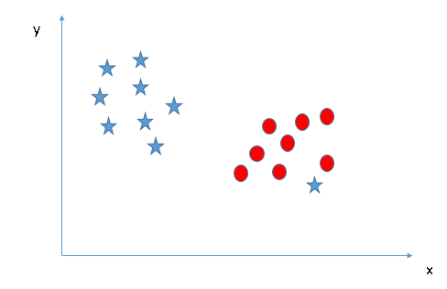
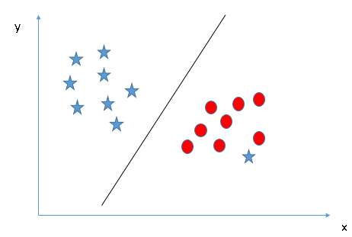
SVM has a feature to ignore outliers and find the hyper-plane that has maximum margin. Hence, we can say, SVM is robust to outliers.
Notes:
In London

Slide 10
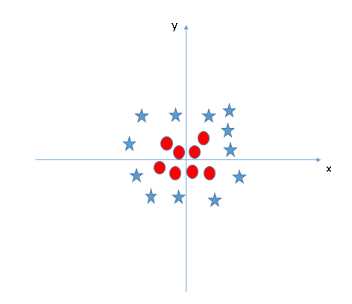
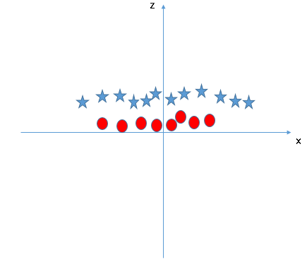
Can we have a linear line/hyperplane
SVM can solve this problem. Easily! It solves this problem by introducing additional feature. Here, we will add a new feature z=x^2+y^2. Now, let’s plot the data points on axis x and z:
We will not add the feature manually to have a hyper-plane. SVM has a technique called the kernel trick. It is mostly useful in non-linear separation problem
Notes:
In London

Slide 11
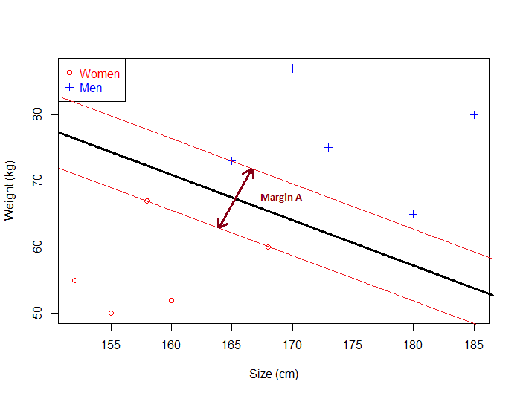
What is Margin and how does it give optimal hyperplane
Given a particular hyperplane, we can compute the distance between the hyperplane and the closest data point. Once we have this value, if we double it we will get what is called the margin
Basically the margin is a no man's land. There will never be any data point inside the margin
Notes:
In London

Slide 12
Let’s jump to code!
Notes:
In London

Slide 13
Dimensionality Reduction
Notes:
In London

Slide 14
Dilemma
  From a theoretical point of view, increasing the number of features should lead to better performance.
  In practice, the inclusion of more features leads to worse performance (i.e., curse of dimensionality).
  The number of training examples required increases exponentially with dimensionality.

Slide 15
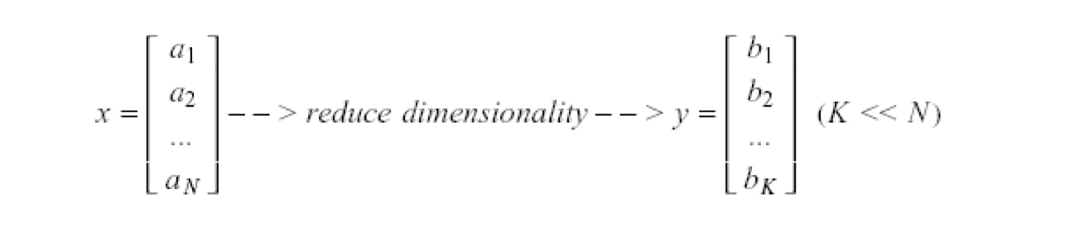
Dimensionality Reduction
Significant improvements can be achieved by first mapping the data into a lower-dimensional space.
Dimensionality can be reduced by:
  Combining features using a linear or non-linear transformations.
  Selecting a subset of features (i.e., feature selection).

Slide 16
Dimensionality Reduction (cont’d)
Classical approaches for finding an optimal linear transformation:
  Principal Components Analysis (PCA): Seeks a projection that preserves as much information in the data as possible (in a least-squares sense).
  Linear Discriminant Analysis (LDA): Seeks a projection that best separates the data (in a least-squares sense).

Slide 17
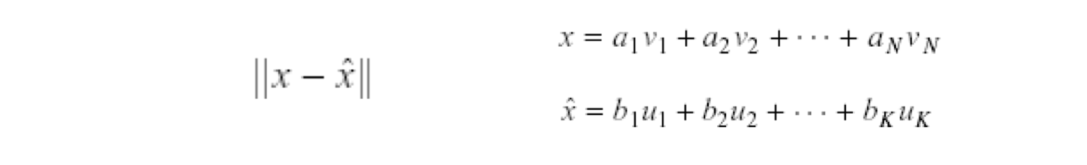
Principal Component Analysis (PCA)
Dimensionality reduction implies information loss; PCA preserves as much information as possible by minimizing the reconstruction error:
How should we determine the “best” lower dimensional space?
The “best” low-dimensional space can be determined by the “best” eigenvectors of the covariance matrix of the data (i.e., the eigenvectors corresponding to the “largest” eigenvalues – also called “principal components”).

Slide 18
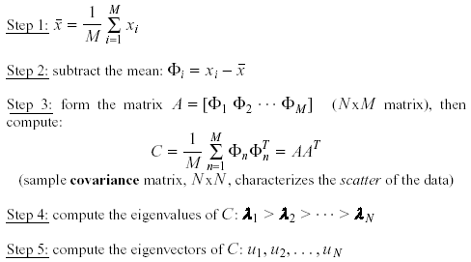
PCA Algorithm
  Suppose x₁, x₂, ..., x_{M} are N x 1 vectors

Slide 19
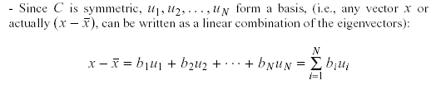
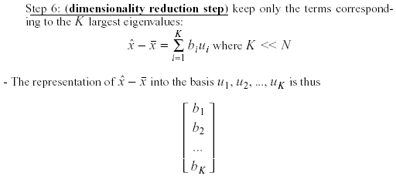
where

Slide 20
Let’s jump to code!
Notes:
In London

