Slide 1


SAATHI
One app for everyday independence
Team: git set go Leader: Lokita Varma
Team member: Sarthak Bhan
Problem: essential services are hard to access for people with low digital confidence.

Slide 2
Brief about the idea
Everyday services, through one conversation
Saathi helps older adults and people with limited digital literacy request rides, meals and medicines through one accessible interface.
The app remembers preferences, asks for missing details and keeps each request visible in Activity.
Societal focus: digital inclusion and greater independence in daily life.

Slide 3
Opportunities and USP
One app. Shared preferences. Less to learn.
A common entry point
Help at the moment of need
Ride, food and medicine requests share the same conversation and history.
Saathi turns a natural request into details, choices and a clear next action.
Personal by default
Support with permission
Saved places, dietary choices and budgets travel with each request.
Care Circle members receive only the access the user chooses.

Slide 4
Features offered by the solution
Conversational requests
Everyday services
English and Hindi requests, follow-up questions and preference-aware choices.
Ride, food and medicine request flows with quote review and booking history.
Accessible controls
Care Circle
Large text, high contrast, simplified view and expandable settings.
Invitations, spending approvals and trusted contacts in one place.
Prototype booking and payment flows use simulated providers.

Slide 5
Process flow diagram
Example: “A mild vegetarian meal under ₹150”
User request
Gemini drafts
the request
Check details
and preferences
Show suitable
options
Missing details
Booking status
in Activity
Ask for details
and retry
Confirm with
approval checks
The user stays informed through confirmation, status and cancellation.

Slide 6
Interface structure
Five clear destinations
Saathi
Home
Activity
Services
Family
Profile
Start a request
Track requests
Choose services
Manage support
Set preferences
Categories expand only when needed, keeping the next action easy to find.

Slide 7
Architecture of the proposed solution
React app
Firebase Hosting
FastAPI
Cloud Run
Gemini
Structured requests
Shared conversation
and booking workflow
Firestore
Profile and activity
Care Circle
Approval rules
Service adapters
Prototype actions
Notes:
Cloud deployment design, supported by firebase.json, backend/Dockerfile and backend/app/hub_store.py. Local demonstrations use SQLite. Gemini interprets intent; deterministic backend workflows control booking and permissions.

Slide 8
Technologies used in the solution
Firebase Hosting
Serves the web app and routes API requests.
Cloud Run
Runs the Python FastAPI backend.
Firestore
Stores profiles, bookings and shared activity.
Gemini
Interprets natural-language requests and preferences.
React + TypeScript
Provides the responsive, accessible app interface.

Slide 9
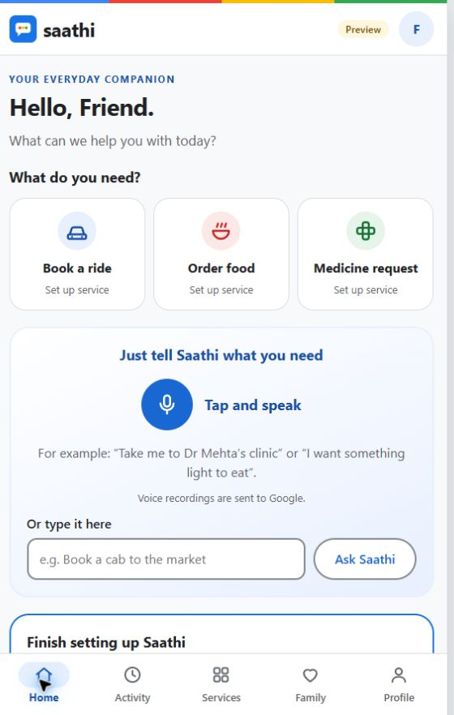
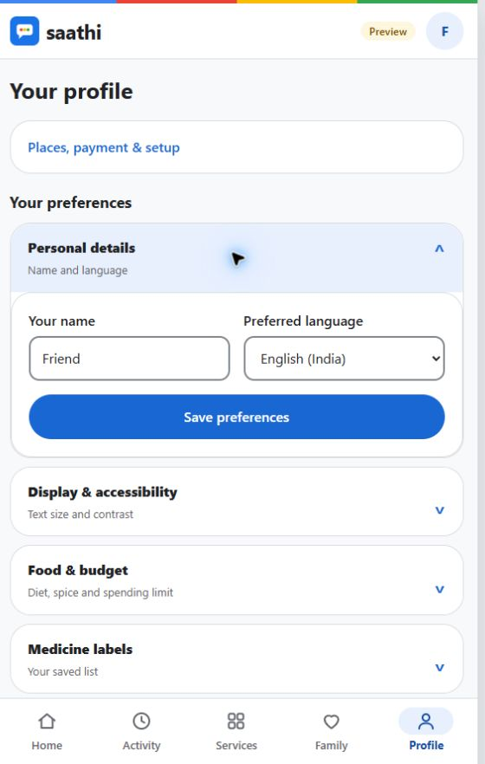
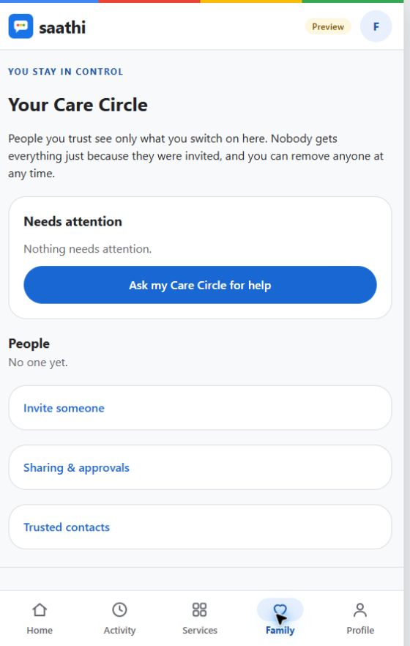
Snapshots of the prototype
Everyday requests
Expandable preferences
Care Circle
Notes:
Actual local application screenshots captured 18 October 2026. The app uses simulated service providers for prototype transactions.

Slide 10
Prototype performance and verification
246
442
frontend tests passed
backend tests passed
Verified workflows
Request clarification, booking confirmation, cancellation,
Care Circle permissions and preference persistence.
Recorded local test runs, 17–18 October 2026. Automated coverage uses mocked external services.
Notes:
Evidence: docs/local-verification-2026-10-17.md records 442 passing backend tests (5 emulator tests skipped); .local/categories-final.txt records 246 passing frontend tests on 18 October. Final dropdown UI subset: 71 passing tests, build and lint passed. Counts are automated regression coverage, not live production benchmarks or model accuracy.

Slide 11
Additional details: accessibility and independence
For the person using Saathi
For family and caregivers
Speak or type a familiar request. Reuse preferences instead of repeating them.
Offer help through explicit permissions and approval settings.
The intended impact
Make essential digital services easier to understand and use independently.

Slide 12
Submission links
GitHub public repository
[Add public GitHub URL]
Demo video
[Add 3–4 minute video URL]
Working prototype
[Add deployed prototype URL]
Notes:
Replace all three link placeholders before submission. Links must be publicly accessible throughout evaluation.

Slide 13


