Slide 1


Email/SMS Spam Detector
Presented by
Sarthak Jaiswal
MCA

Slide 2


Table of content
Introduction
Problem statement
Methodology
Snapshot of the projects
conclusion

Slide 3
INTRODUCTION
Prediction of SMS spam has been an important area of research for a long time. The goal is to apply different machine learning algorithms to SMS spam classification problem, compare their performance to gain insight and further explore the problem, and design an application based on one of these algorithms that can filter SMS spams with high accuracy.

Slide 4
PROBLEM STATEMENT
A number of major differences exist between spam-filtering in text messages and emails. Unlike emails, which have a variety of large datasets available, real databases for SMS spams are very limited. Additionally, due to the small length of text messages, the number of features that can be used for their classification is far smaller than the corresponding number in emails. Here, no header exists as well. Additionally, text messages are full of abbreviations and have much less formal language that what one would expect from emails. All of these factors may result in serious degradation in performance of major email spam filtering algorithms applied to short text messages.

Slide 5
METHODOLOGY
We use SMS/Email classification data set from the UCI machine learning repository. Then we load that dataset into our program. After that we remove the unwanted almost null column. Since we have only two columns i.e., target and text therefore we create three more column which determine the number of words, sentences and characters in the given message for better understanding of the data. Next, we perform pre-processing to clean, remove unwanted text, characters out of the message. After the preprocessing we split our data into training and testing and we train our classifier by fitting the train data to the classifier, there after prediction of results over unseen test data set is made which there after provides us with the accuracy with which the classifier had predicted the outcomes. There after we present our results in a pictorial manner which is the best way to showcase results because of its easiness to understand information out of it.

Slide 6
.
The following are the pre-processing techniques we perform on our messages
Converting text to lower case
Tokenization of text (breaking sentences into words)
Removing of special words or symbols
Removing stop words
Stemming and Lemmatization

Slide 7
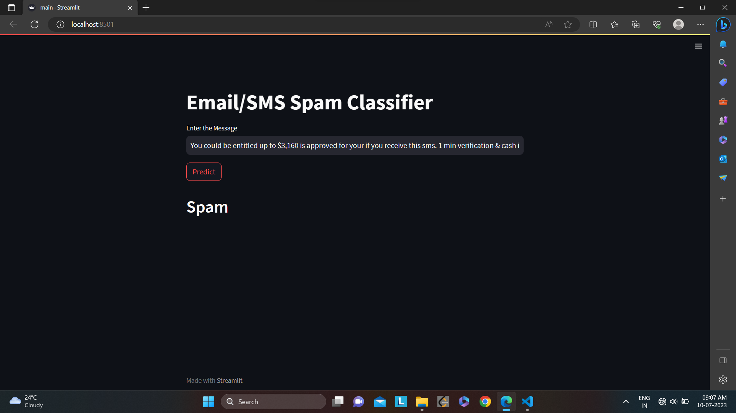
SNAP SHOTS

Slide 8
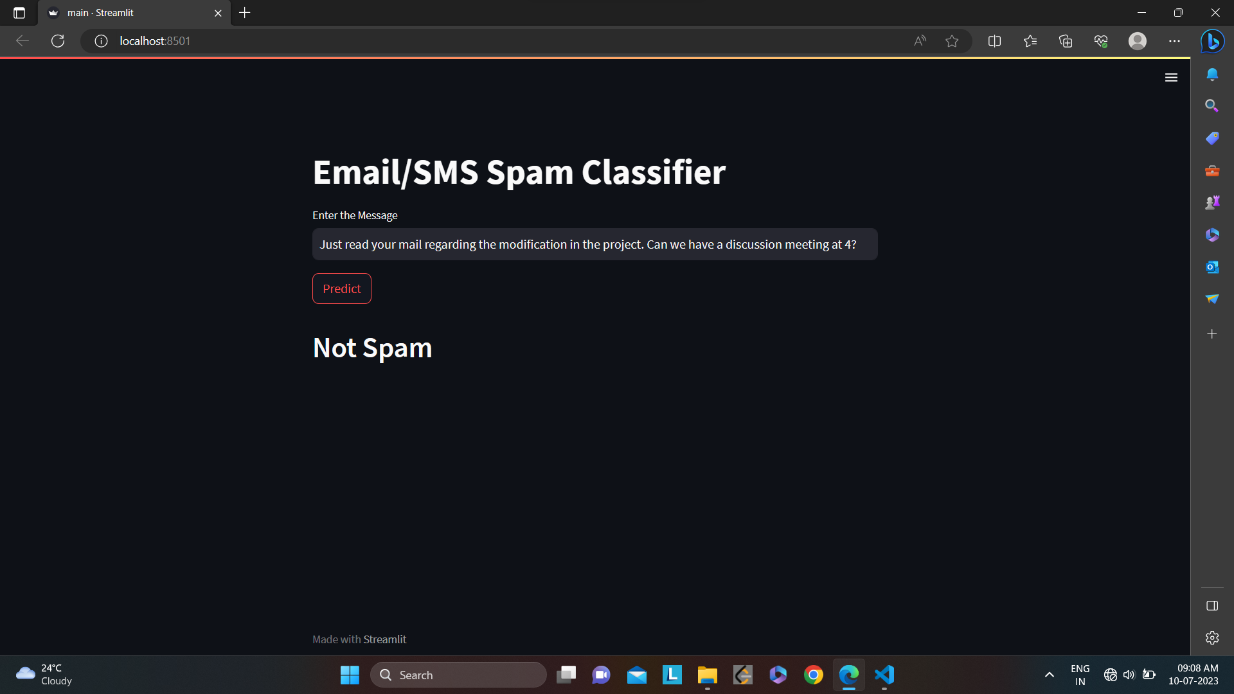
.

Slide 9
CONSLUSION
Email classification is a technique used to classify emails into different categories such as spam or ham. Naive Bayes classifier technique has become a very popular method in mail filtering Email. Every word has certain probability of occurring in spam or ham email in its database. However, it is not enough to evaluate the performance based on the accuracy alone since the dataset is imbalanced. After some examinations, NB algorithm still manages to provide good precision and f measure with 0.98 of precision while 0.97 for f-measure. Different algorithms will provide different performances and results based on the features used. For future works, adding more features such as message lengths might help the classifiers to train data better and give better performance.

Slide 10
THANK YOU

