Slide 1
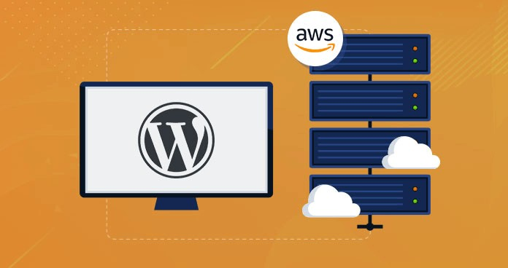
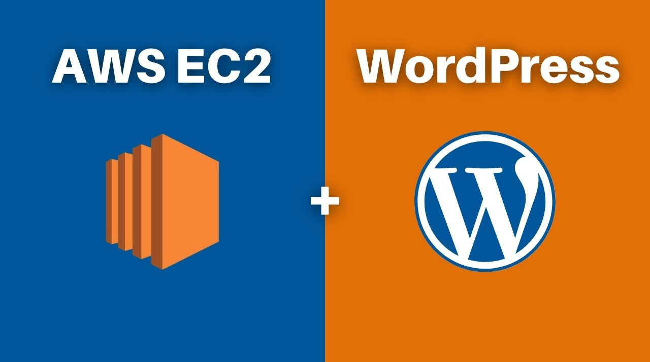
CLOUDWP : THE FAST AND EASY WAY TO DEPLOY YOUR
WORDPRESS SITE ON THE CLOUD
BCA - CTIS SEMESTER VI

Slide 2
OUTLINE
- INTRODUCTION
- IMPORTANCE OF CLOUD DEPLOYMENT FOR WORDPRESS SITES
- CLOUD HOSTING & ITS ADVANTAGES
- OBJECTIVE OF THE PROJECT
- MOTIVATION
- SOFTWARE & HARDWARE REQUIREMENTS
- PROPOSED WORK
- IMPLEMENTATION
- RESULT
- CHALLENGES
- CONCLUSION
- REFERENCES

Slide 3
INTRODUCTION
This presentation covers WordPress site setup in the cloud. Having a website is essential for both individuals and businesses in the modern digital age. However, setting up a website can be diﬃcult, especially for those who are unfamiliar with web hosting and website management. This is where cloud deployment steps in, providing a quick and scalable ﬁx for website hosting.
We will go through the advantages of cloud deployment for WordPress sites in this presentation, as well as how to set up and install WordPress on Amazon Web Services (AWS) Elastic Compute Cloud (EC2) instances.
This presentation will provide you with the information and abilities needed to deploy your WordPress site on the cloud with simplicity, whether you're a business owner trying to build a website for your ﬁrm or an individual looking to promote your portfolio. Therefore, let's get started right away!

Slide 4
IMPORTANCE OF CLOUD DEPLOYMENT FOR WORDPRESS SITES
Scalability
Security
Cost-effectiveness
Flexibility
Reliability

Slide 5
CLOUD HOSTING AND ITS ADVANTAGES
Cloud hosting is a type of web hosting that makes use of the capabilities of numerous servers to deliver a scalable and dependable hosting solution. The website is hosted on a network of servers that collaborate to provide the necessary computer resources such as processing power, memory, and storage.
It is the practice of hosting websites, programs, and other services on virtual servers accessible over the internet. Cloud hosting, rather than depending on a single physical server, makes use of a network of interconnected computers spread across different data centers. These servers collaborate to create a scalable and dependable hosting environment.

Slide 6
CONTD....
Advantages:
As your website traﬃc and needs change, cloud hosting makes it simple to scale your resources up or down.
Because your website is hosted on a network of servers rather than a single server, cloud hosting offers a high level of dependability and uptime.
With cloud hosting, you may select the level of resources you want and only pay for what you really use.
To safeguard your website and data from threats, cloud hosting providers use strong security features including ﬁrewalls, intrusion detection and prevention systems, and data encryption.
- The market has a number of cloud hosting providers, including Amazon Web Services (AWS), Google Cloud Platform (GCP), Microsoft Azure, and Digital Ocean, each of which provides a variety of features and price options.

Slide 7
OBJECTIVE OF THE PROJECT
To introduce the concept of cloud hosting and its advantages over traditional web hosting methods.
To provide an overview of Amazon Web Services (AWS) Elastic Compute Cloud (EC2) instances and their role in cloud hosting.
To guide through the process of setting up and conﬁguring WordPress on an EC2 instance.
To equip with the knowledge and skills needed to deploy a WordPress site on the cloud using AWS services.
To emphasize the importance of cloud deployment for WordPress sites in terms of scalability, security, and cost-effectiveness.
To provide resources and recommendations for further learning and support in WordPress site deployment and cloud hosting.

Slide 8
MOTIVATION
For businesses that host their websites using WordPress, a dependable, secure, and scalable hosting solution is necessary to guarantee that the website is always available. Cloud hosting is the best hosting option for WordPress websites since it has so many advantages, including scalability, security, and affordability.
Individuals or developers that run their own WordPress sites may ﬁnd that cloud hosting allows them to optimize site performance while also lowering hosting expenses. In addition, cloud hosting can help ensure that the site remains secure and accessible even during high traﬃc or demand periods.
Cloud hosting is growing more popular as businesses and people seek the beneﬁts of cloud computing, such as on-demand resource allocation, ﬂexibility, and scalability.
Organizations may ensure that their websites remain operational and accessible in the case of an outage or other disaster by hosting their WordPress sites in the cloud.

Slide 9
SOFTWARE & HARDWARE REQUIREMENTS
Software Requirements:
- Web server software: Apache
- PHP runtime environment: PHP 7.0 or higher
- MySQL database: MySQL 5.6 or higher
- WordPress: The latest version of WordPress
- SSH client: MobaXterm
Hardware Requirements:
- Computer with an internet connection
- Suﬃcient storage capacity to store website data and ﬁles
- Suﬃcient RAM and processing power to handle website traﬃc
- Depending on the cloud hosting provider, you may also need to consider the size and type of virtual machine or instance that you choose.

Slide 10
PROPOSED WORK
Select a cloud hosting provider: Choose a cloud hosting company depending on your budget and requirements.
Create a virtual machine or instance: Create a virtual machine or instance using the cloud hosting provider of your choice.
Install and conﬁgure web server software: On the virtual machine or instance, install and conﬁgure Apache web server software.
Install and conﬁgure the PHP runtime environment: On the virtual machine or instance, install and conﬁgure the PHP runtime environment version 7.0 or above.
Install and setup MySQL database: On the virtual machine or instance, install and conﬁgure the MySQL 5.6 or above database.
Download and install WordPress: Download and install the most recent version of WordPress on the virtual machine or instance.

Slide 11
PROPOSED WORK
Conﬁgure WordPress settings, such as the site title, admin login, and password.
Install and conﬁgure plugins and themes: To customize the appearance and functionality of the WordPress site, install and conﬁgure plugins and themes.
Implement security measures such as HTTPS, strong passwords, and limiting login attempts to secure the WordPress site.
Test and launch the WordPress site: Check that the WordPress site is working properly before making it public.

Slide 12
IMPLEMENTATION
1. Choose a cloud hosting provider: We will select a cloud service provider and in this project, we chose Amazon Web Services (AWS) based on cost, features, and support.
2. Create a virtual machine or instance: Once we've decided on a cloud hosting provider, we'll set up a virtual machine or instance on AWS using EC2.
EC2 Instances: EC2 (Elastic Computing Cloud) is a web service provided by Amazon Web Services (AWS) that provides resizable computing capability in the cloud. EC2 instances are virtual machines (VMs) that may be deployed in the cloud to offer computational resources for a variety of applications. EC2 instances are offered in a variety of conﬁgurations, or instance types, that are optimized for certain workloads. CPU, memory, storage, and networking specs vary per instance type.

Slide 13
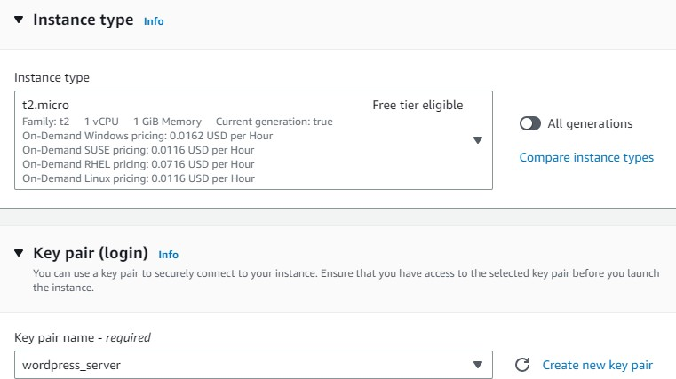
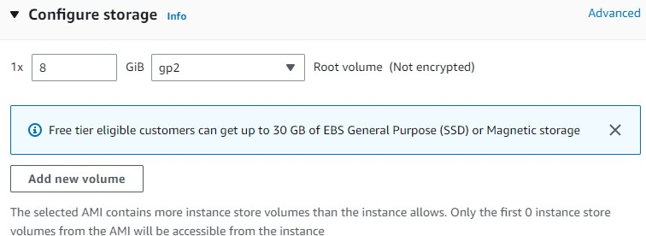
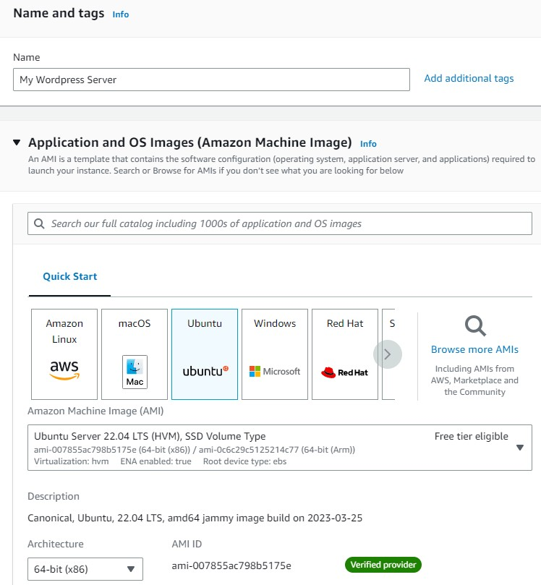
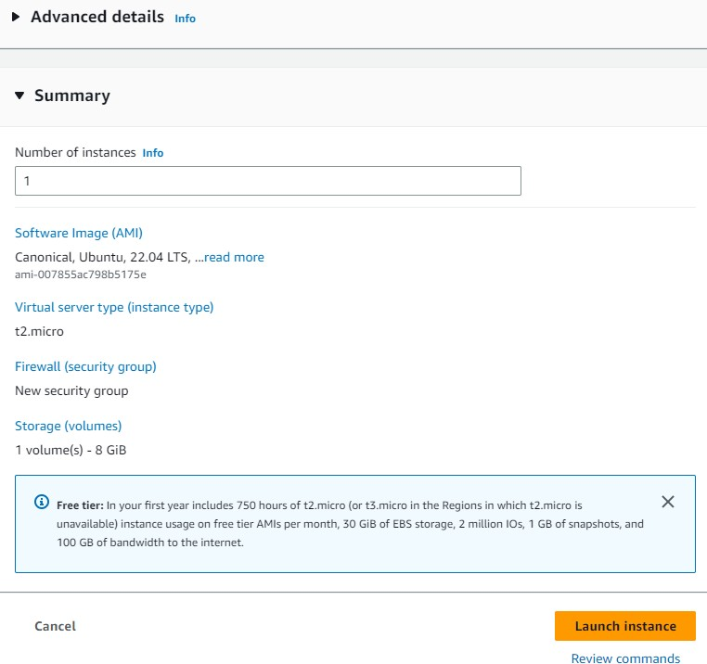
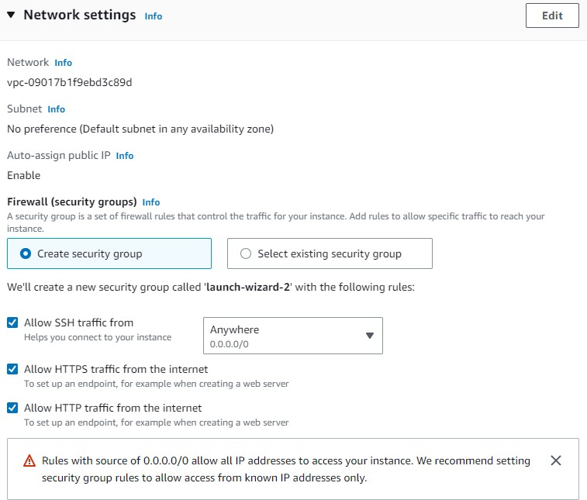
IMPLEMENTATION
To Launch an Instance -

Slide 14
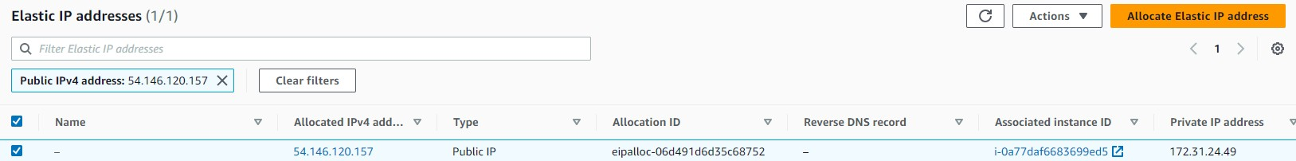
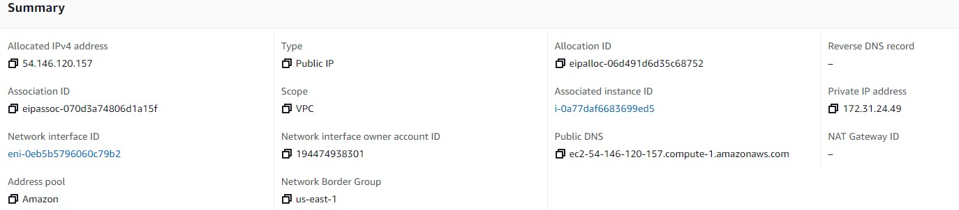
CONTD....
3. Assigning Elastic IP to our instance:

Slide 15
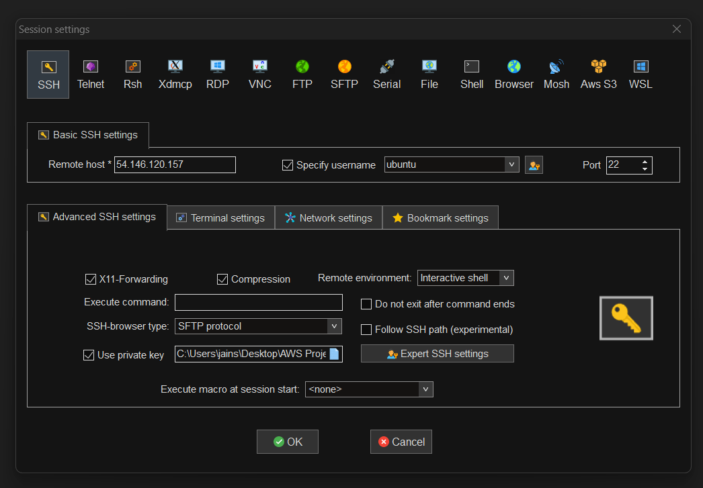
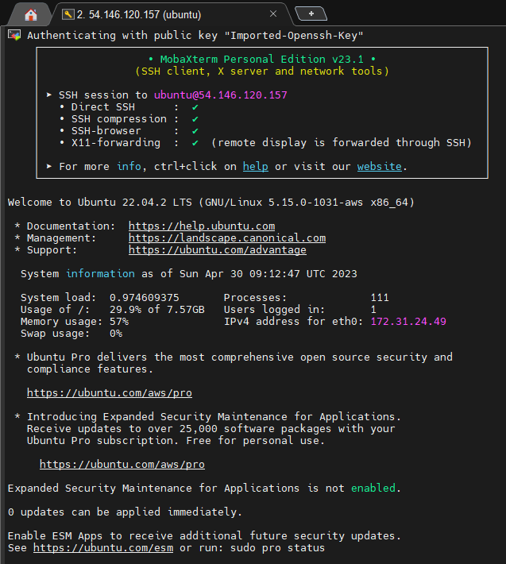
4. Connect the Instance to SSH using MobaXterm ( SSH Client ):
CONTD….

Slide 16
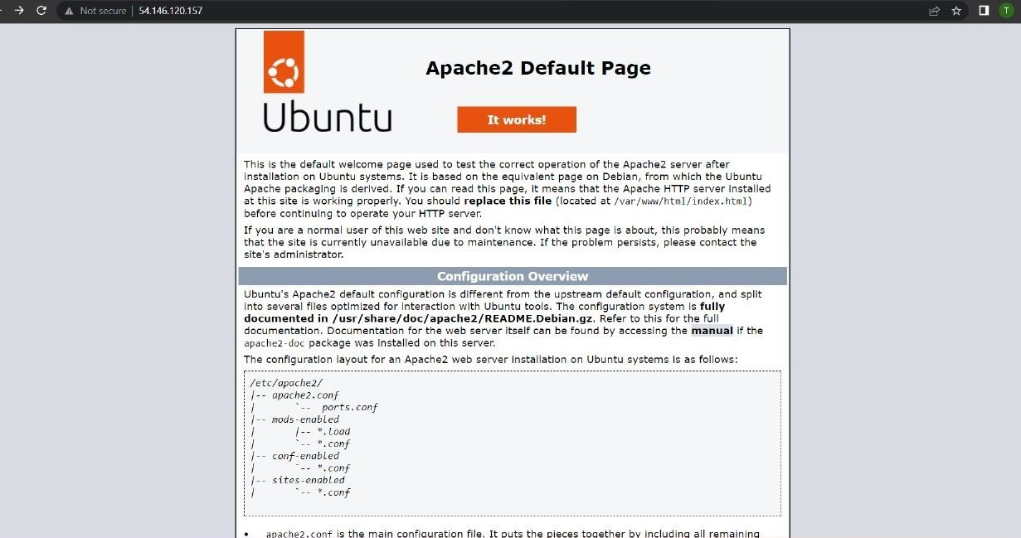
CONTD….
5. Install and conﬁgure web server software
sudo apt install apache2

Slide 17
CONTD….
6. Install and conﬁgure PHP runtime environment:
sudo apt install php libapache2-mod-php php-mysql
7. Install and conﬁgure MySQL database:
sudo apt install mysql-server
8. log in to the MySQL server:
sudo mysql -u root
9. Change authentication plugin to mysql_native_password:
ALTER USER 'root'@'localhost' IDENTIFIED WITH mysql_native_password by 'Test@123' ;
* sudo - superuser do or substitute user do (eﬃcient method for temporarily granting users or user groups privileged access to system resources so that they may perform commands that their normal accounts cannot run)

Slide 18
CONTD….
10. Create a new database user for WordPress:
CREATE USER ''wp_user'@localhost IDENTIFIED BY 'Test@123' ;
11. Create a database for WordPress:
CREATE DATABASE wp ;
12. Grant all privileges on the database ''wp'' tot the newly created user
GRANT ALL PRIVILEGES ON wp.* TO 'wp_user'@localhost ;
13. Download and install WordPress:
- cd /tmp
- wget https://WordPress.org/latest.tar.gz
- ls
You will ﬁnd " latest.tar.gz "

Slide 19
CONTD….
14. Unzip " latest.tar.gz " :
- tar -xvf latest.tar.gz
- ls
You will ﬁnd " WordPress " folder
15. Move WordPress folder to Apache document root :
- sudo mv WordPress/ /var/www/html/
- cd /var/www/html/
- ls
You will ﬁnd " WordPress " in the path

Slide 20
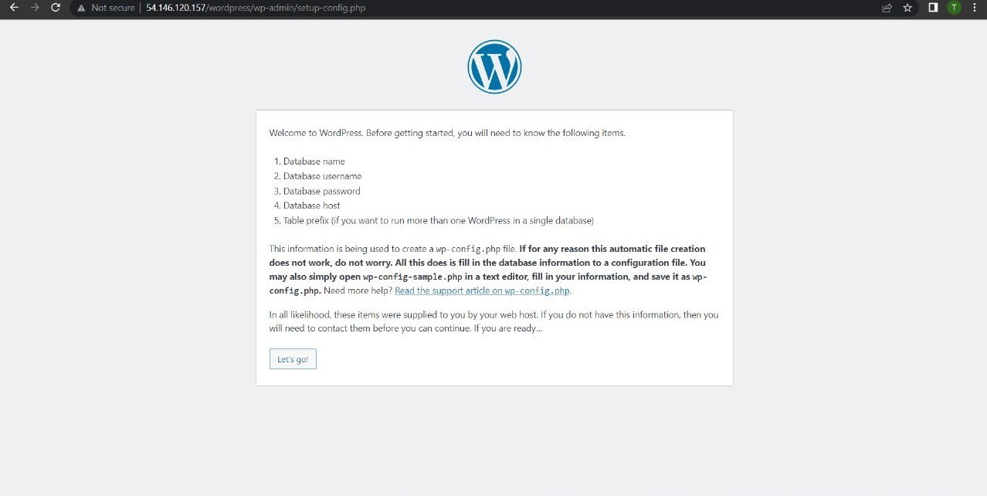
CONTD….

Slide 21
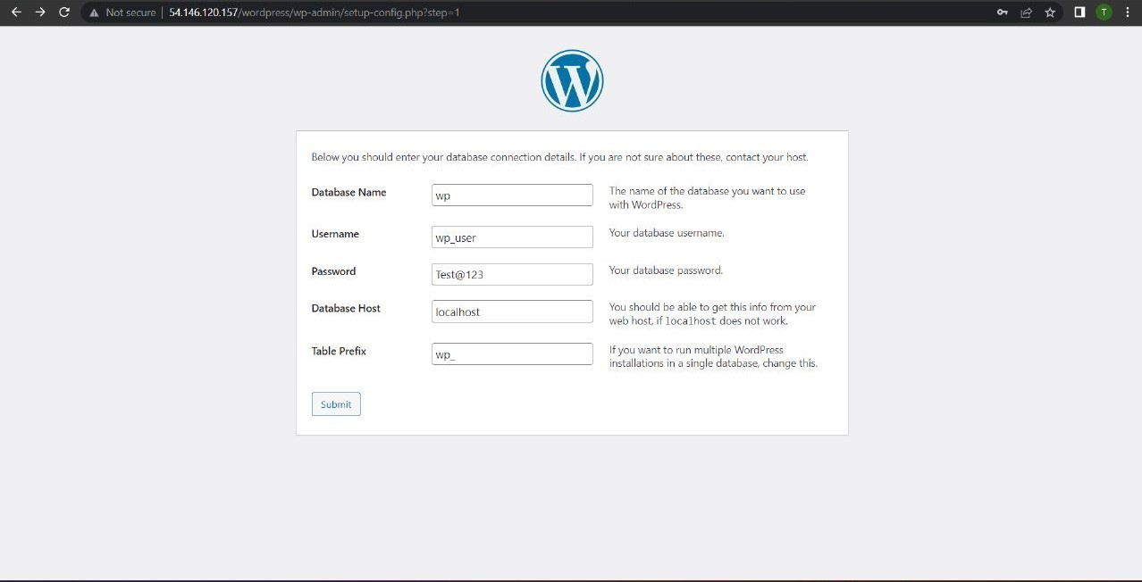
CONTD….

Slide 22
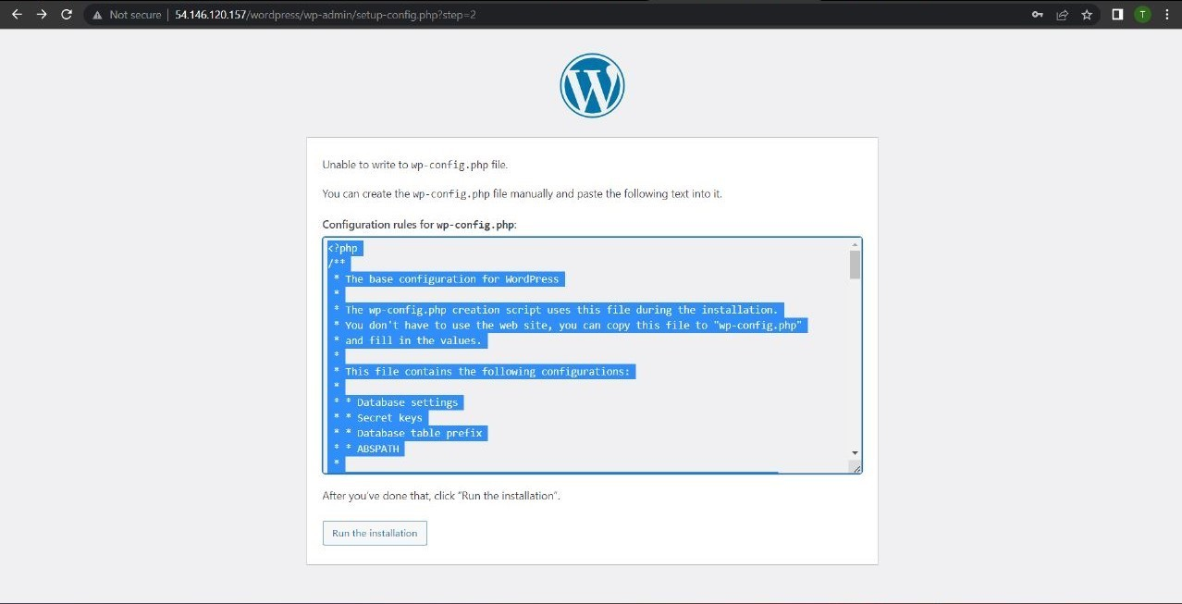
CONTD….

Slide 23
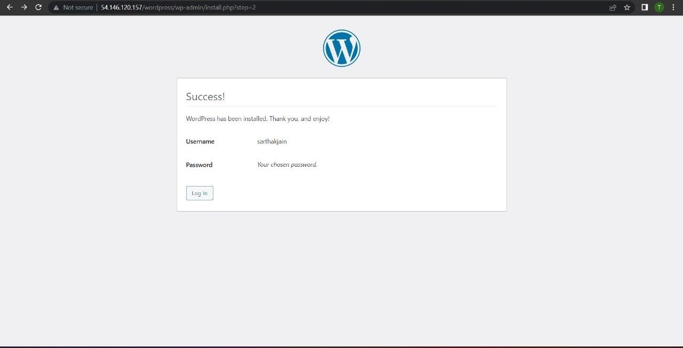
CONTD….
16. Go to WordPress director, create a new ﬁle and paste the copied code to ﬁx the error:
- cd WordPress/
- nano wp-conﬁg.php (paste the code inside the ﬁle)
* Wordpress is installed

Slide 24
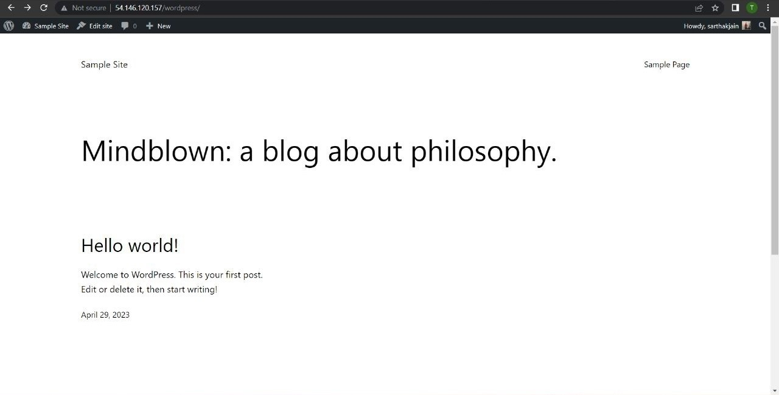
CONTD….

Slide 25
CONTD….
17. To serve the WordPress site on the rroot directory ( Modify Apache conﬁguration ) :
- cd /etc/apache2/sites-available/
You will ﬁnd " 000-default.conf default-ssl.conf "
Edit - 000-default.conf
- sudo nano 000-default.conf ( opening ﬁle with nano editor )
Change - DocumentRoot /var/www/html to DocumentRoot /var/www/html/WordPress
18. To restart Apache:
sudo systemclt restart apache2

Slide 26
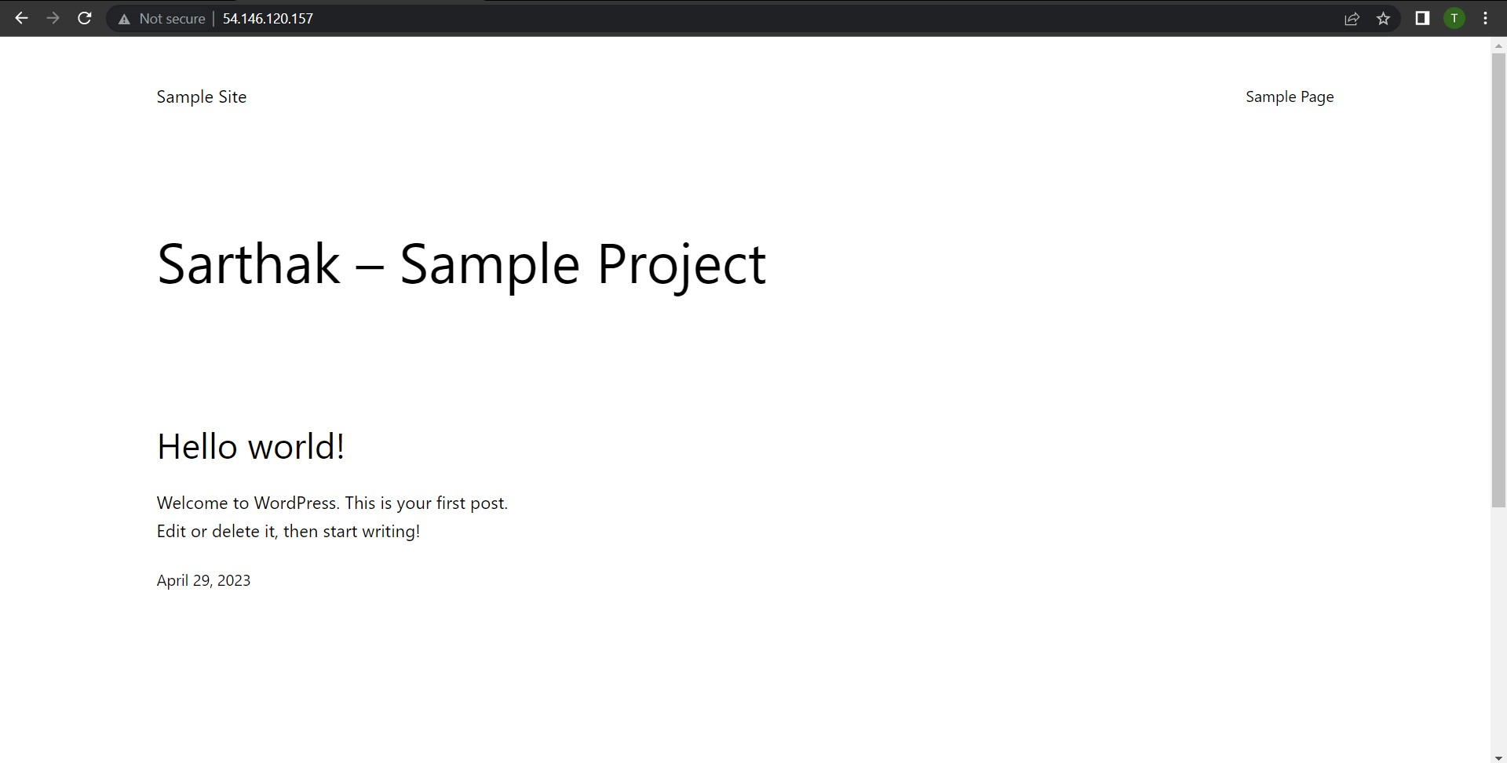
RESULT
Wordpress site on Root Directory :

Slide 27
CHALLENGES
Conﬁguring and administering various cloud services necessary for WordPress site deployment may be complicated and time-consuming.
Cloud hosting offers possible security threats such as unauthorized access and data breaches, which must be mitigated with appropriate methods.
While cloud hosting can improve performance, proper optimization is also required to ensure the site runs smoothly and loads quickly..
The cloud installation of a WordPress site necessitates technical expertise as well as an understanding of cloud computing and WordPress administration.
To achieve maximum performance and reduce downtime, the cloud infrastructure must be constantly monitored and maintained.
The WordPress site may necessitate the use of particular software versions that are incompatible with the cloud infrastructure, requiring additional actions to assure compatibility.

Slide 28
CONCLUSION
At last, hosting a WordPress site in the cloud provides numerous beneﬁts such as increased scalability, performance, and cost-effectiveness. Cloud hosting companies such as AWS give a wide range of capabilities and tools to help with the deployment and maintenance of WordPress sites.
The suggested work in this project included establishing a WordPress site on an AWS EC2 instance and optimizing its speed and scalability with different cloud services and tools. The implementation procedure included conﬁguring the EC2 instance, installing WordPress, and so forth.
The project's outcomes illustrated both the feasibility and beneﬁts of setting up a WordPress website in the cloud as well as its possible drawbacks and restrictions. The project offered knowledge and suggestions for enhancing the WordPress site's' eﬃciency, scalability, and cost-effectiveness.
Overall, this project emphasizes the value of cloud hosting for WordPress websites and offers a road map for further deployments and improvements. With the rising acceptance of cloud computing, it is critical for organizations and individuals to make use of the beneﬁts of cloud hosting for their WordPress websites in order to remain competitive in the current digital environment.

Slide 29
REFERENCES
Amazon Web Services. (n.d.). Amazon Elastic Compute Cloud (Amazon EC2). Retrieved from https://aws.amazon.com/ec2/
WordPress. (n.d.). Requirements. Retrieved from https://WordPress.org/about/requirements/
WordPress. (n.d.). How to Install WordPress. Retrieved from https://WordPress.org/support/article/how-to- install-WordPress/
Apache Software Foundation. (n.d.). Apache HTTP Server Documentation. Retrieved from https://httpd.apache.org/docs/
MobaXterm User Guide: SSH sessions: https://mobaxterm.mobatek.net/documentation.html#3_1
GitHub. (n.d.). GitHub Help: Adding a ﬁle to a repository.. Retrieved from
https://help.github.com/en/github/managing-ﬁles-in-a-repository/adding-a-ﬁle-to-a-repository

Slide 30
THANK YOU

