Slide 1
Introduction
We are designing a quiz module with a proper interface. When the user starts attempting quiz, he will have choice about the questions category like which level of question he wants to attempt (Easy, Medium, Tough) . We will also keep record of user name, registration number and section. After completing all these required credential and level of question , he has to click on submit button to process further. After submission of required information, he has to attempt 10 questions either of easy, medium or tough, it depend what he selected on homepage.

Slide 2
Objective:
Aiding in language development with the questions based in the language alone
Aiding in the team building process
Being fun to participate in but with a competitive element
Provoking discussion and healthy debate amongst participating players / teams
Aiding to relieve the tension of the daily work routine
Promoting group harmony, whether in organisations, schools or just a group of friends
Making new friends, from different cultures at times
Likewise spelling bees improve the student’s spellings and vocabulary
Quiz competitions even help build the student’s soft skills
The questions in the quiz will be regarding python programming and same general questions related to computer science and technology with given four options.
To increase the efficiency of and knowledge of the user related to computer science and programming.
To provide a good and Knowledge full interface to the users to sharp their skills.

Slide 3
Quiz Modules
Home Page:- This page is the first page of our online quiz questions module. In this page the users will have to fill their name, registration number, section and difficulty level of question. This page has a submit button to move further for attempting questions.
Questions Page:- This page have the question according to the user’s choice of difficulty level. The questions have four options to select a correct one. There are 20 question of each difficulty level (easy,medium and high).
Result Page:- This page will have the result of the quiz attempted by the user with their name, registration number. This page also describes that how many questions you have attempted are correct and wrong. Overall it will show you about your performance in the quiz game.

Slide 4
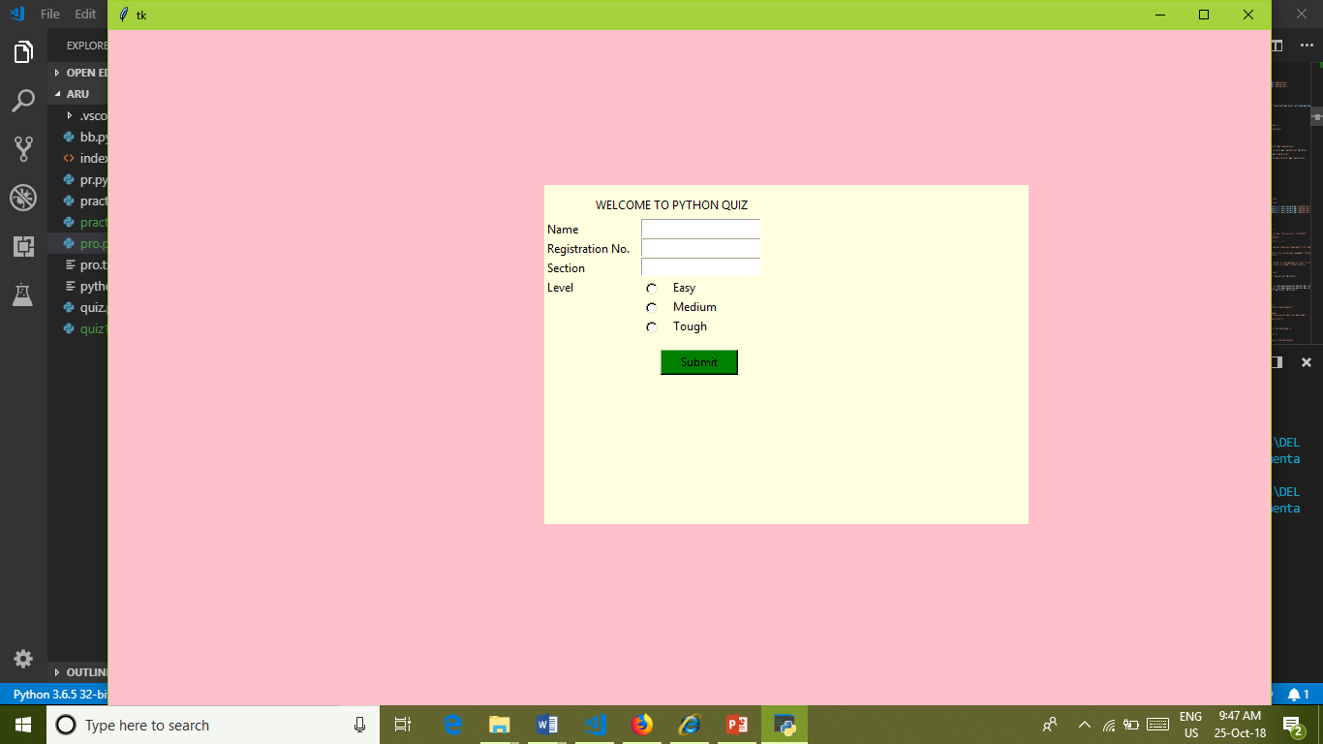
Home page

Slide 5
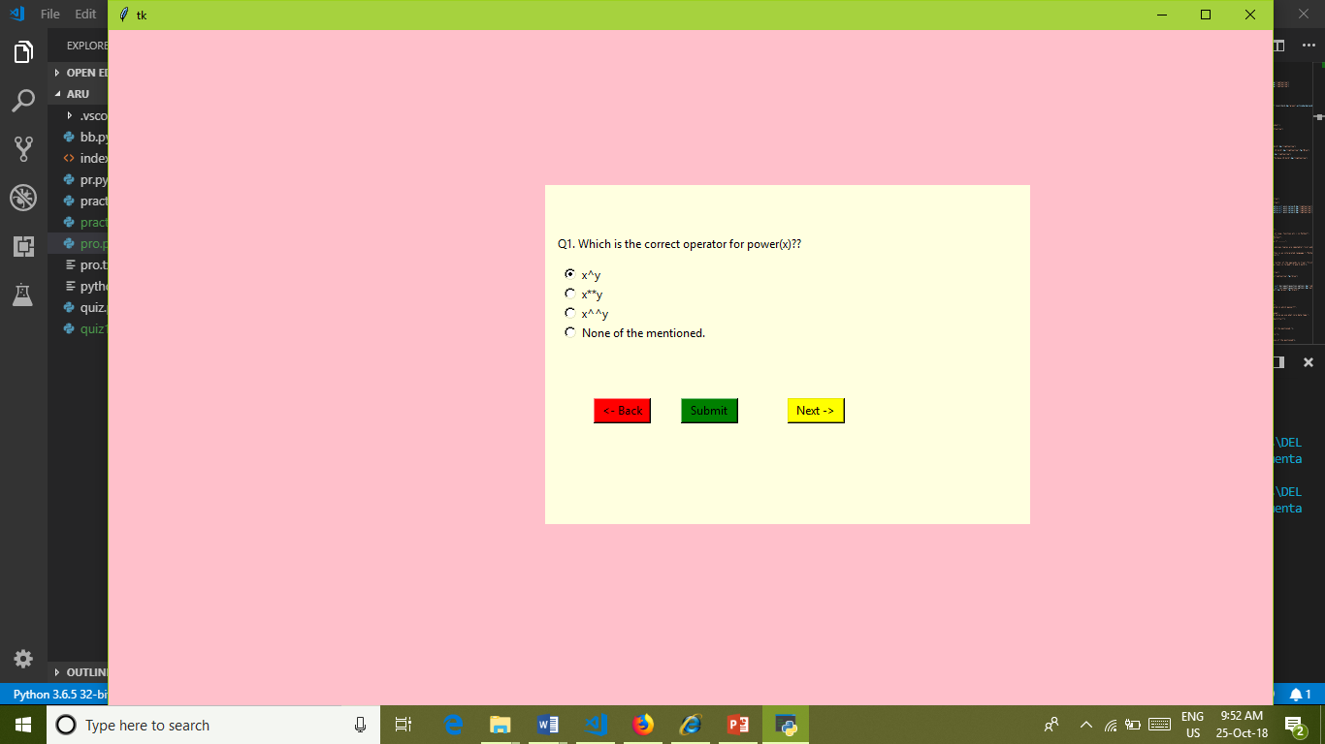
Question Page

Slide 6
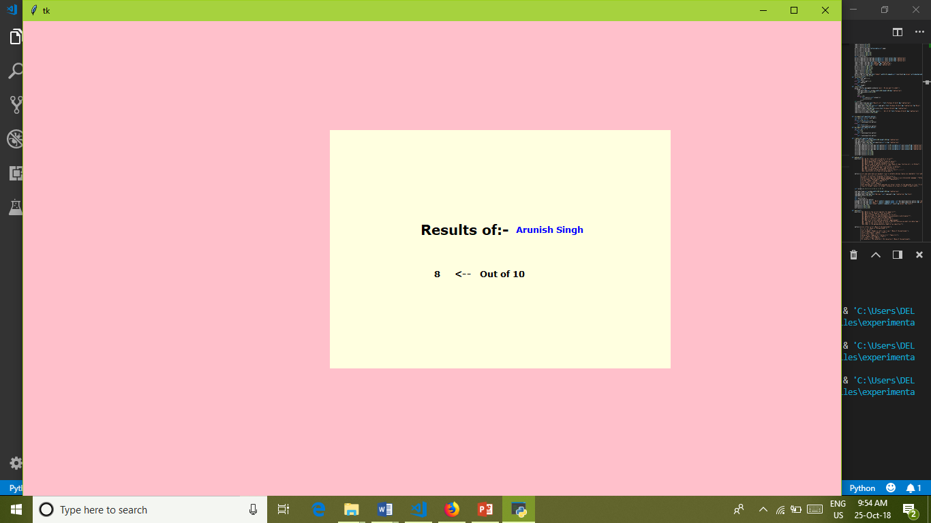
Result page

Slide 7
Conclusion
This quiz system module provides the service of attempting the quiz having different difficulty levels.
The project is user friendly. It is very handy to use.
The backend coding which is in python is easy to read and understandable.
It displays the questions effectively and performs the function very effectively in the backend.

