Slide 1

Breast Cancer Prediction

Slide 2
Introduction
Everyone's life depends on their health. Breast cancer can develop in either a man or female when the breast's cells start to proliferate uncontrollably. These cells typically develop into tumours, which can be felt as a bump or seen on an x-ray. It is possible to distinguish between benign and malignant forms of cancer.
I used the dataset from the UCI repository to research breast cancer. I'll utilise the logistic regression approach from machine learning to help determine if a patient has malignant or benign cancer.

Slide 3
Problem statement & Dataset
Problem statement-
To create a website that can determine whether a patient has malignant or benign cancer.
Link to the Breast Cancer Wisconsin Datase-http://archive.ics.uci.edu/

Slide 4
Data Sharing Agreement
Sample File Name: data.csv
Cleaned Data File Name: VIEH_BCP_DATASET.csv
Number of Columns: 30
Number of Rows: 569
Columns Datatype: float64

Slide 5
Architecture
Start
Data preprocessing
Data cleaning
Model training
Feature selection
EDA
Cross validation
Metrics evaluation
Data validation
End
Deployment

Slide 6
Step 1: Data preprocessing & EDA
Raw dataset contains 32 columns & 569 rows.
For EDA, I utilised the Seaborn module.
I omitted columns like id, unnamed: 32 and just picked the crucial information.
Since id and Unnamed:32 are independent of cancer kind, we eliminated them.
Data labelling done to diagnosis column which is categorical.
Then I only chose 10 characteristics for the model training after removing strongly associated features from the dataset using correlation.

Slide 7
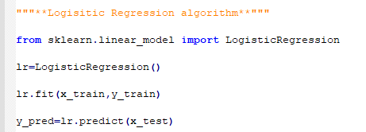
Step 2: Logistic Regression Model
An algorithm for classifying data is logistic regression. When the response variable is categorical, it is often utilised. The goal is to establish a link between traits and the likelihood of a result. I utilised the logistic regression technique for my research to determine if a patient had malignant or benign cancer.

Slide 8
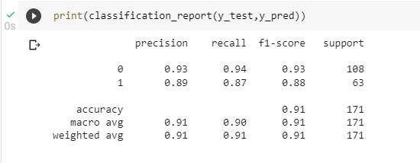

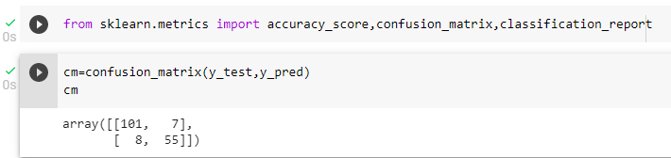
Step 3: Model Evaluation
Classification report
Accuracy: 92%
Confusion matrix

Slide 9
Step 3: Model Evaluation…
So here we printed the predictions. The first data shows the actual result of which patient had cancer and the second data is the one predicted by the model.
The accuracy of the model is 92% so we can see a few wrong predictions but mostly this model is successful in predicting a tumor Malignant (M) (harmful) or Benign (B) (not harmful) based upon the features provided in the data and the training given.

Slide 10
Deployment
To construct a web application, I utilised HTML, CSS as the front end, and a flask module.
With the aid of the PaaS provider Heroku, I have deployed a web application.
Project link: https://breast-cancer-predictor-ml.herokuapp.com/
Github link: https://github.com/Sarthak88-tech/Breast-Cancer-Prediction-ML

Slide 11
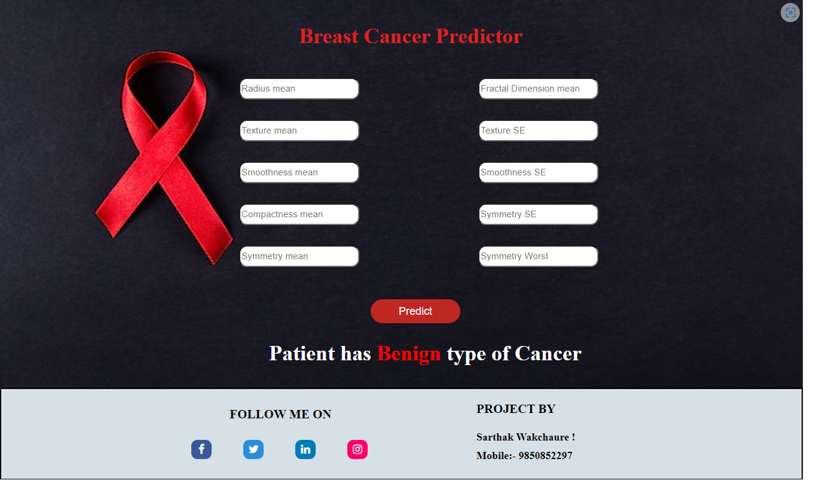
Screenshot with output

Slide 12
Conclusion & future scope
In this Python project, I developed graphs and results for the same breast cancer tumour predictor that we learnt to build using the Wisconsin dataset. A solid dataset has been shown to offer greater accuracy. The creation of prediction systems will result from the selection of appropriate algorithms with a strong home dataset. When a patient has been diagnosed with breast cancer, these systems can help determine the best course of therapy. Based on the stage of a patient's breast cancer, there are a variety of therapies available; data mining and machine learning may be a big help in selecting the course of therapy to be taken by extracting knowledge from such appropriate databases.

Slide 13
References
https://ieeexplore.ieee.org/document/9544687
https://www.mayoclinic.org/diseases-conditions/breast-cancer/symptoms-causes/syc-20352470
https://www.geeksforgeeks.org/understanding-logistic-regression/
https://internship.viehgroup.com/courses/breast-cancer-prediction/
https://www.researchgate.net/publication/319688741_Breast_Cancer_Prediction_Using_Data_Mining_Method

Slide 14
Thank you !!!

