Slide 1
CHALLENGE 02
Network Anomaly Root-Cause Assistant
Build a Network Anomaly Root-Cause Assistant that ingests telemetry, logs, alerts, topology data, and configuration changes to detect anomalies and generate explainable root-cause hypotheses. The solution must distinguish correlation from likely causation, rank probable causes, and provide supporting evidence.
Problem statement reproduced verbatim from ProblemStatement.md
1

Slide 2
Five sources become one auditable investigation
PROTOTYPE SOURCES
FASTAPI ANALYSIS
REACT DASHBOARD
Prometheus-style metrics Syslog / application logs Alertmanager alerts Configuration audit Topology / CMDB fixture
Ingest + validate → anomaly detection Incident manager + typed topology Catalogue candidates + deterministic ranker Evidence + playbooks + explanation Human review + append-only audit
Operations overview Incident investigation • Timeline • Topology impact • Evidence and actions
2

Slide 3
Distinct source schemas prove multi-source ingestion
01
simulator.prometheus
labels + value + unit
ONE CONTRACT
02
simulator.syslog
facility + level + message
CanonicalEvent
03
simulator.alertmanager
labels + startsAt + status
UTC timestamp entity + modality source record identity trace / session ID severity + quality flags redacted raw payload
04
simulator.config_audit
actor + key + old/new value
05
fixture.cmdb_topology
typed edges + fixture version
Validation, quarantine, duplicate collapse, and provenance occur before analysis.
3

Slide 4
The pipeline turns signals into testable hypotheses
01
02
03
04
Detect
Form incident
Rank RCA
Explain + review
Metric windows, log rules, alert severity, config context
Lookback, typed-hop attachment, exclusions with reasons
Three catalogue candidates, eight frozen factors, conflicts
Four evidence tiers, safe playbooks, human decision, audit
Same ordered canonical input → byte-equivalent AnalysisResult
Scores, ranks, and evidence are deterministic; narration cannot modify them.
4

Slide 5
Conflicting evidence is the guardrail against easy blame
VERIFIED OBSERVED
CORRELATED
A record and value were directly seen. Observed does not mean causal.
A relevant association supports investigation, without being presented as proof.
CONFLICTING
MISSING
Stable raw ingress weakens external DoS. Normal DB utilization weakens DB exhaustion.
A concrete catalogue request states exactly what evidence the operator should collect.
5

Slide 6
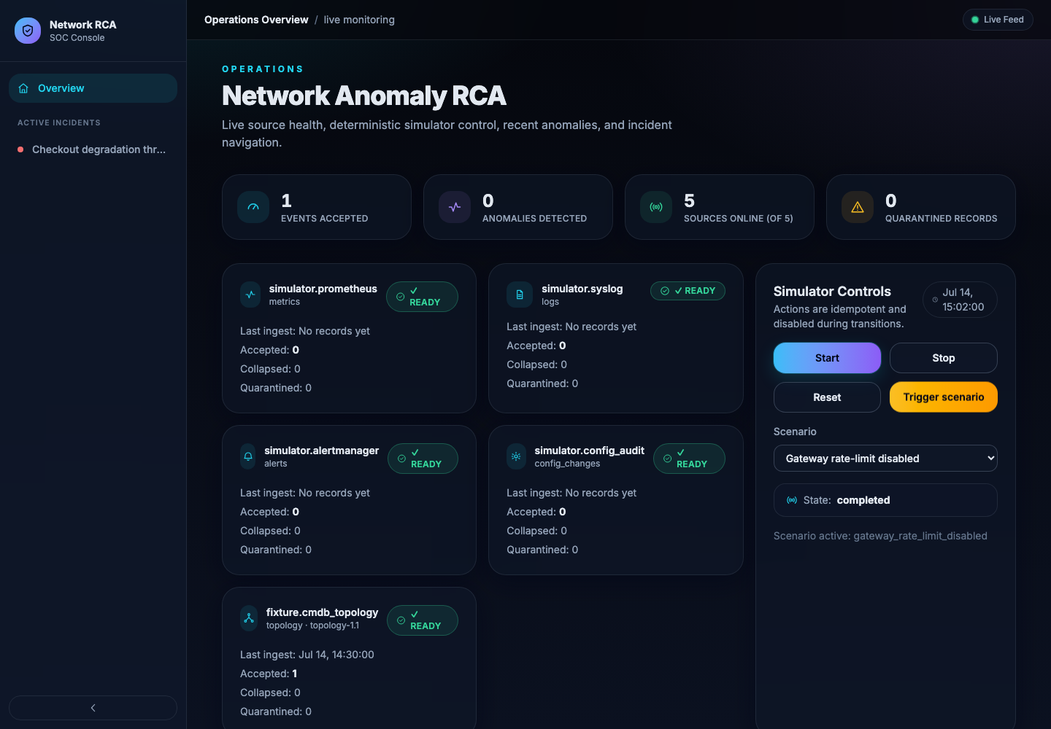
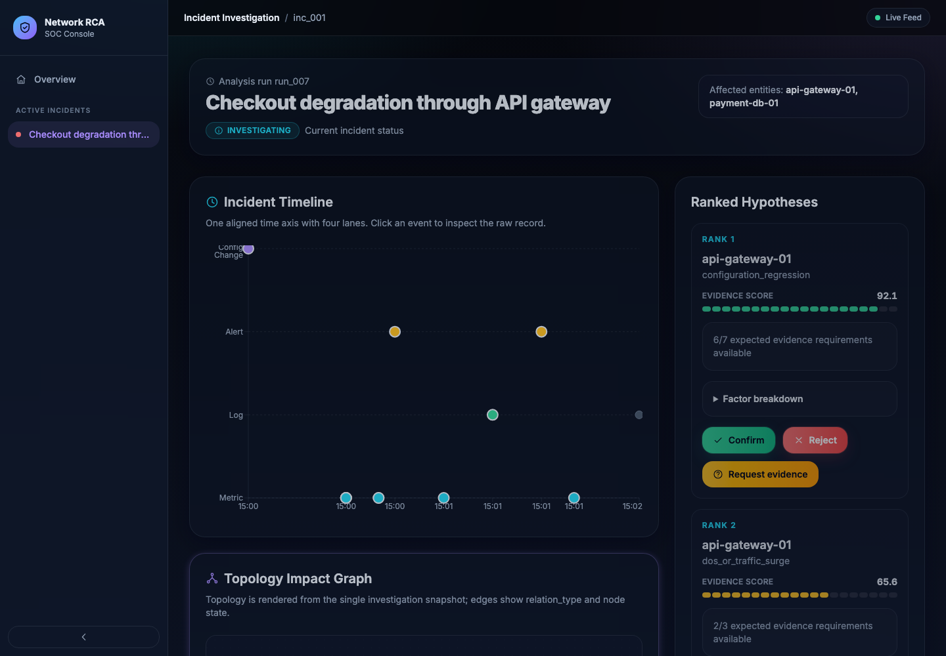
The operator sees one consistent analysis snapshot
OPERATIONS OVERVIEW
INCIDENT INVESTIGATION
Five source-health cards, simulator state, anomalies, incidents
Timeline, typed topology, ranked hypotheses, evidence, review
6

Slide 7
Eight transparent factors produce the frozen 92.1
Factor | Weight | Input | Contribution
Symptom compatibility | 25% | 1.00 | 25.0
Topology relevance | 20% | 1.00 | 20.0
Direct logs + alerts | 15% | 0.60 | 9.0
Propagation consistency | 15% | 1.00 | 15.0
Metric anomaly | 10% | 0.91 | 9.1
Change causal fit | 10% | 1.00 | 10.0
Temporal proximity | 3% | 1.00 | 3.0
Historical similarity | 2% | 0.50 | 1.0
EVIDENCE SCORE
92.1
Rank 1 configuration_regression api-gateway-01
Next: DoS / traffic surge 65.6 Then: DB exhaustion 41.5
100 × Σ(weight × factor), rounded half-up to one decimal
7

Slide 8
P0 is complete; future scope stays clearly labelled
IMPLEMENTED — P0
DOCUMENTED FUTURE — P2
✓ Five typed source adapters ✓ Deterministic simulator + reset ✓ Detection, incident grouping, typed topology ✓ Three catalogue-backed ranked hypotheses ✓ Four evidence tiers + safe playbooks ✓ Human review, explanation, append-only audit
• Production connectors • Kafka / WebSocket transport • Dynamic topology discovery • Adaptive ranking weights • Authentication and tenancy • Automated remediation execution
No future capability is presented as part of the working prototype.
8

Slide 9
Reference datasets inform realism; the simulator owns runtime truth
REFERENCE-ONLY
RUNTIME SOURCE
NSL-KDD + UNSW-NB15 Network vocabulary and plausible ranges LogHub HDFS / BGL Operational log structure and templates GAIA + trace samples Topology, injection, and trace schema ideas
Fixed seed 20260714 Four distinct raw event emitters Topology fixture loaded at startup Scenario-relative timestamps, entity IDs, traces, config changes, alerts, and propagation
Ground-truth firewall: runtime modules never import expected/, ground_truth, or golden test outputs.
9

Slide 10
Q&A
What would you investigate next?
CAUSE
EVIDENCE
ACTION
Which ranked hypothesis should be challenged?
What missing record would change the ranking?
Which diagnostic step is safe to run first?
Network Anomaly Root-Cause Assistant
10

