Slide 1

Note: The data and information in this document is reflective of a hypothetical situation and client. This document is to be used for KPMG Virtual Internship purposes only.
Sprocket Central Pty Ltd
Data analytics approach
Sarthak Chitre

Slide 2
Note: The data and information in this document is reflective of a hypothetical situation and client. This document is to be used for KPMG Virtual Internship purposes only.
Agenda
Introduction
Data Exploration
Model Development
Interpretation

Slide 3
Note: The data and information in this document is reflective of a hypothetical situation and client. This document is to be used for KPMG Virtual Internship purposes only.
Introduction
Identify and Recommend Top 1000 Customer to Target from Datasets
Outline of Problem
Sprocket Central is a company that specializes in high quality bikes and cycling accessories.
Their marketing team is looking to boost business sales by analyzing provided datasets.
Using the 3 datasets provided the aim is to analyze and recommend 1000 customers that Sprocket should target to boast their growth.
.
Contents of Data Analysis
This will be done with three phases of:
Data exploration
Model Development
Interpretation
Conclusions will be made by getting insights from the datasets provided by client.

Slide 4
Data Exploration
Data Quality Assessment and Clean Up
The datasets provided by the client should be cleaned of underlying errors.
The data should be made accurate, values should be up to date, records should not be duplicate.
The data should contain allowable values.
The blank columns should also be removed if it is not going to impact interpretations.
Provide recommendation to client to mitigate the errors in the given datasets.

Slide 5
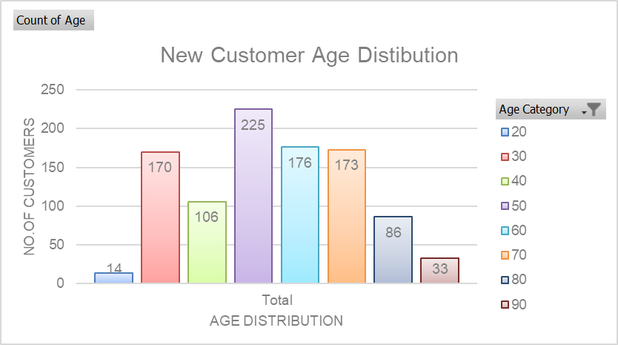
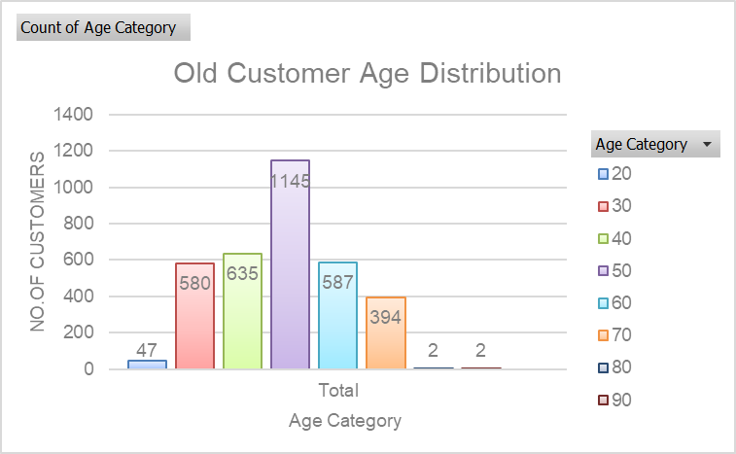
Data Exploration
New and Old Customer Age Distribution
Most customers belong to the age category of 50 that means most of the customers are in the age range of 40-49
The lowest age groups are under 20 and 80+ for both New and Old customer lists
The New customer list suggests that age groups 20-29 and 40-69 are most populated.
The Old customer list suggests 20-69
Place any supporting images, graphs, data or extra text here.

Slide 6
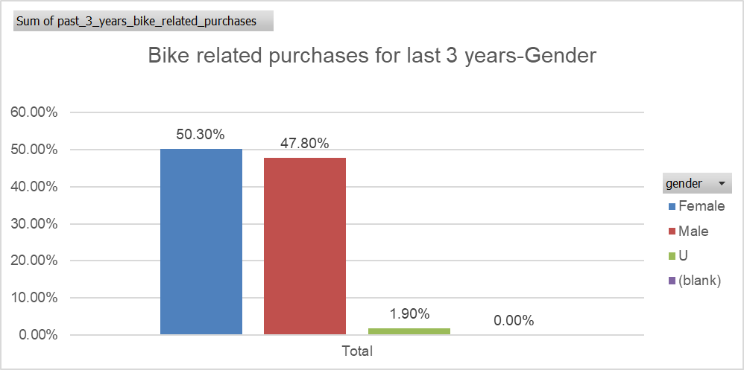
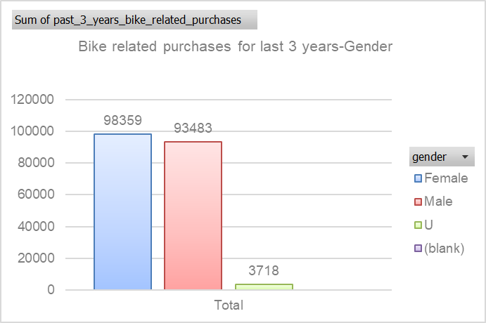
Note: The data and information in this document is reflective of a hypothetical situation and client. This document is to be used for KPMG Virtual Internship purposes only.
Data Exploration
Data Quality Assessment and Clean Up
Over the last 3 years in bike related purchases, 50% of the purchases where by females, 48% of the purchases where by males
Females purchases where 1000 more than the rest of the groups.
.

Slide 7
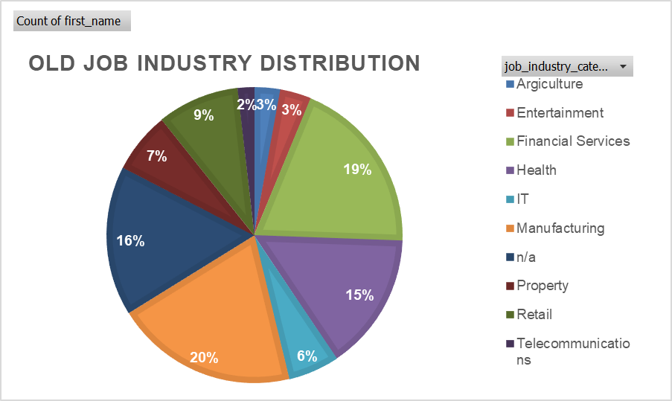
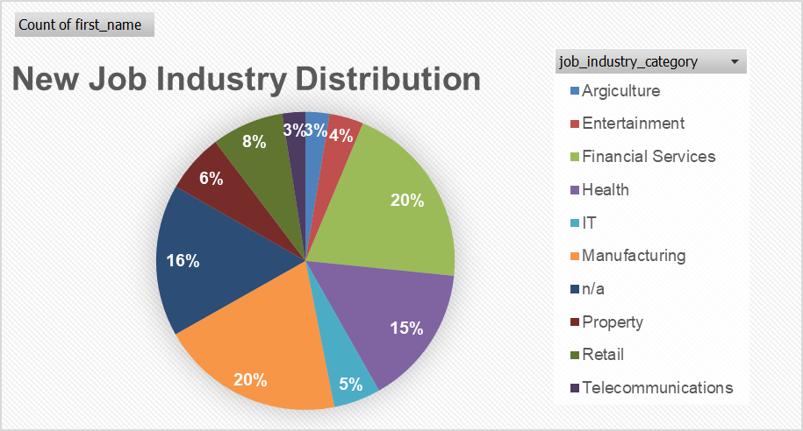
Data Exploration
Job Industry Distribution
20% of New customers are in Manufacturing and Financial Services respectively.
The smaller number of customers are in Agriculture and Telecommunications at 3%
Similar pattern was observed in Old Customers
Job industry of 16% of the customers is not mentioned in both the lists.

Slide 8
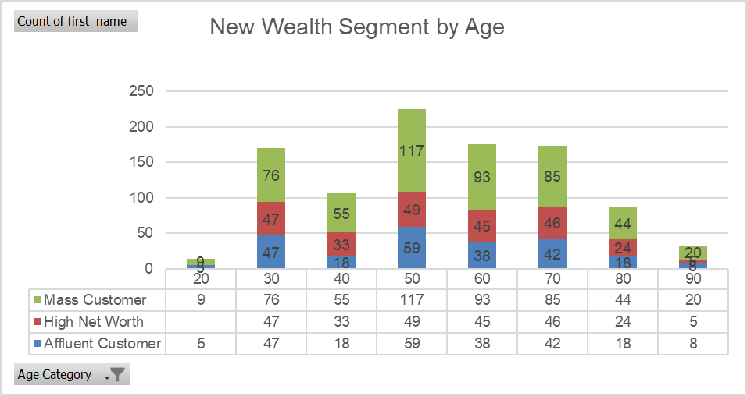
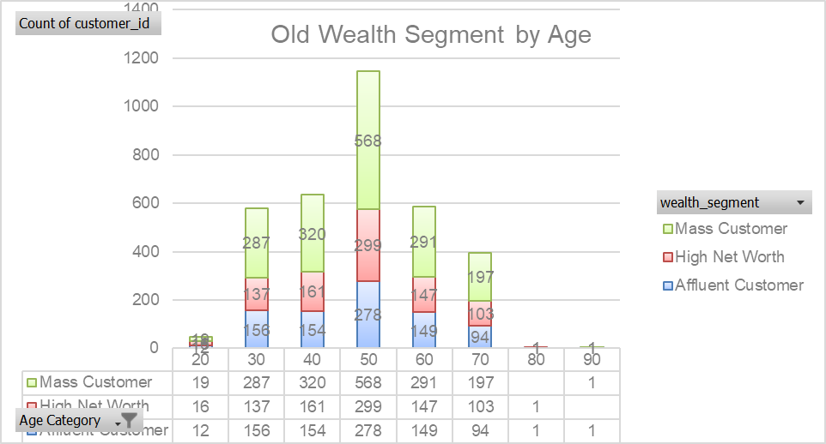
Data Exploration
Wealth Segmentation by age category
In all the age categories the largest number of customers are classified as “Mass Customers”
Even significant number of high net worth customers owe the bikes and cycling accessories.
There isn’t huge difference number of affluent customers and high net worth customers.

Slide 9
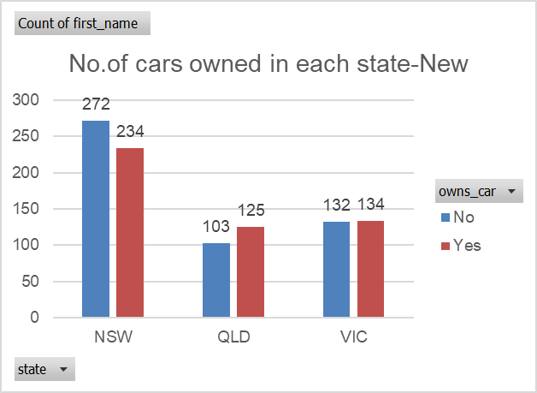
Data Exploration
Number of cars owned by the state
NSW has the largest amount of people that do and do not own a car. It seems that the data collected from NSW was more or/ and the number of customers are higher in NSW compared to other states.
Victoria is also split quite evenly. But both numbers are significantly lower than those of NSW.
QLD has a relatively high number of customers that own a car.

Slide 10
Model Devlopment
RFM Analysis
RFM analysis is used which customers the company should target to increase its revenue.
Customers who purchased more recently have generated more revenue, than customer who visited while ago
Customers who visited more than 200 days ago generate low revenue

Slide 11
Interpretation
Summary Table of the Top 1000 Customers to Target
Rank | Customer Title | Description | RFM Value | No.of Customers | Cumulative
1 | Platinum | Most recent buys, buys often,most spent | 444 | 176 | 176
2 | Very Loyal | Most recent buys, buys often,huge spent | 433 | 184 | 360
3 | Loyal | Recent,buy more than once, large spent | 421 | 344 | 704
4 | Recent | Recent,not often buy,more than avg money spent | 344 | 368 | 1072
5 | Potential | Recent,not often buy,avg money spent | 323 | 355 | 1427
6 | Late | No purchases recently,RFM value large than avg | 311 | 333 | 1760
7 | Losing | No purchases recently,RFM value lower than avg | 224 | 356 | 2116
8 | High risk | Purchase long time ago,avg buy,avg spent | 212 | 360 | 2476
9 | Almost Lost | Purchase long time ago,low buy,avg spent | 124 | 326 | 2802
10 | Inactive | Purchase long time ago,low buy,low spent | 112 | 401 | 3203
11 | Lost | Lowest RFM | 111 | 290 | 3497
The Platinum, Very Loyal, Loyal, Recent consist of the Top 1000 customers.
The 1000 customers discovered would have brought recently, they have bought very frequently in the past and tend to spend more than other customers.

Slide 12
Note: The data and information in this document is reflective of a hypothetical situation and client. This document is to be used for KPMG Virtual Internship purposes only.
Appendix

Slide 13
Note: The data and information in this document is reflective of a hypothetical situation and client. This document is to be used for KPMG Virtual Internship purposes only.
Appendix
This is an optional slide where you may place any supporting items.

