Slide 1


Walchand College Of Engineering, Sangli
(Academic year 2022-23)
Department Of Information Technology
Web-based project management system for IT department

Slide 2

Mini Project
Under the guidance of
Prof. M.B.Narnaware
Name of the student: PRN:
Mayuresh Shedmekhe 2020BTEIT00015
Ayush Wadalkar 2020BTEIT00018
Adwait Samak 2020BTEIT00021
Mohit Khairnar 2020BTEIT00038
Sarthak Deshmukh 2020BTEIT00060
Abhishek Deokar 2020BTEIT00061
Anand Kadale 21620003

Slide 3
Agenda
Introduction
Problem Statement
Project Objective
Technology
Model Diagram
References

Slide 4
Introduction:
This website is based on publishing projects of various users on a centralized platform so that anyone can access them and can take advantage of it.
There are various platforms where the source code of any project can be deployed but the complexity of the user interface makes it difficult to get relevant information.
This website will be providing a simplified way of getting projects of any tech stack or of any topic.

Slide 5
Objective :
The project management software allows the student to upload their project.
To deploy the project management system for the IT department which will help students to search and refer to the repositories for the previous projects.
The website will also provide the tags with which the user will be able to search the projects more efficiently.
Teachers will be able to verify the projects which are completed under their group.
Sorting different projects with the help of ‘Upvote’ feature.

Slide 6
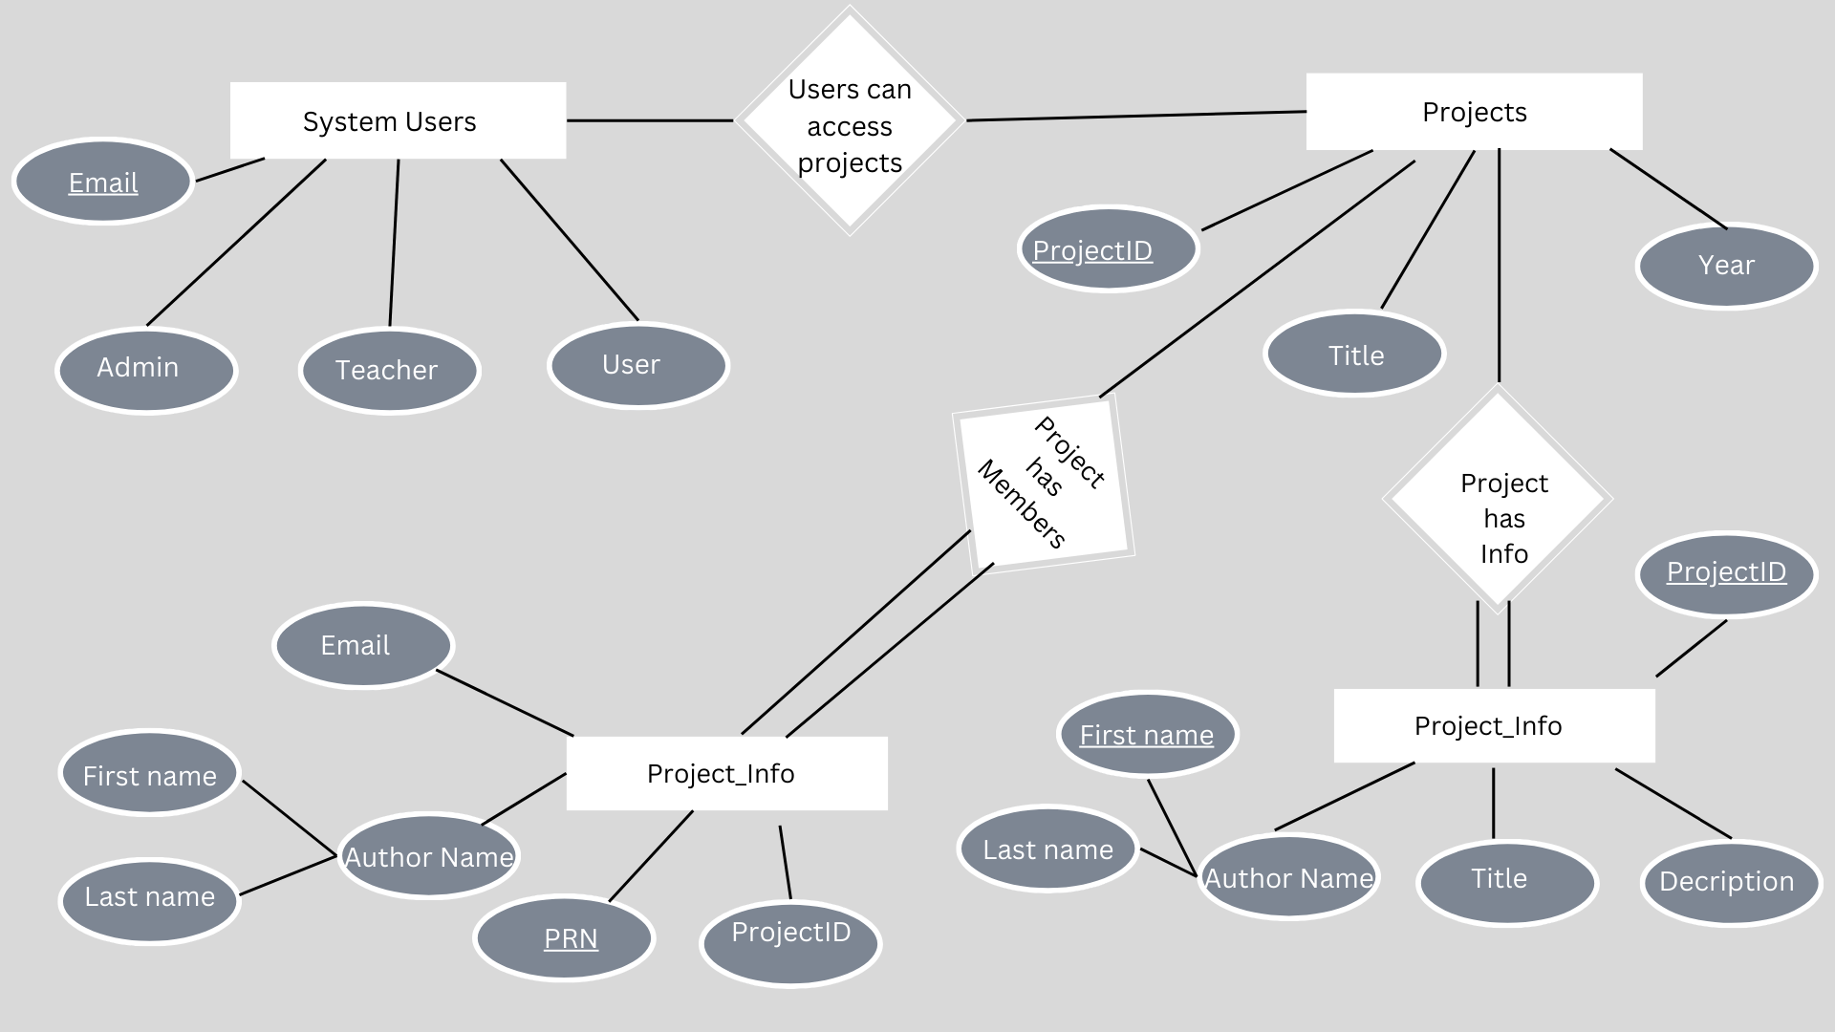
ER Diagram:

Slide 7






Technologies used :
HTML
CSS
Javascript
React
NodeJS
MongoDB

Slide 8
References
1] Documentation for most of the web technologies : - https://devdocs.io/
2] Official Documentation :-
React : https://reactjs.org/docs/getting-started.html
NodeJS : https://nodejs.org/en/docs/
MongoDB: https://www.mongodb.com/docs/

Slide 9
THANK YOU !!!

