Slide 1
Date: 30 October, 2020
Impact of U.S. Financial Crisis on the European Union
NAME: Sarthak Dalmia
ID: 2018B3A70290G Supervisor: Mr. Sukumar Vellakkal

Slide 2
Overview
Basics of International financial markets
Some problems in international finance
US financial crisis effect on the European union countries with special reflection on Greece.
The case of Northern Rock Bank of UK.

Slide 3
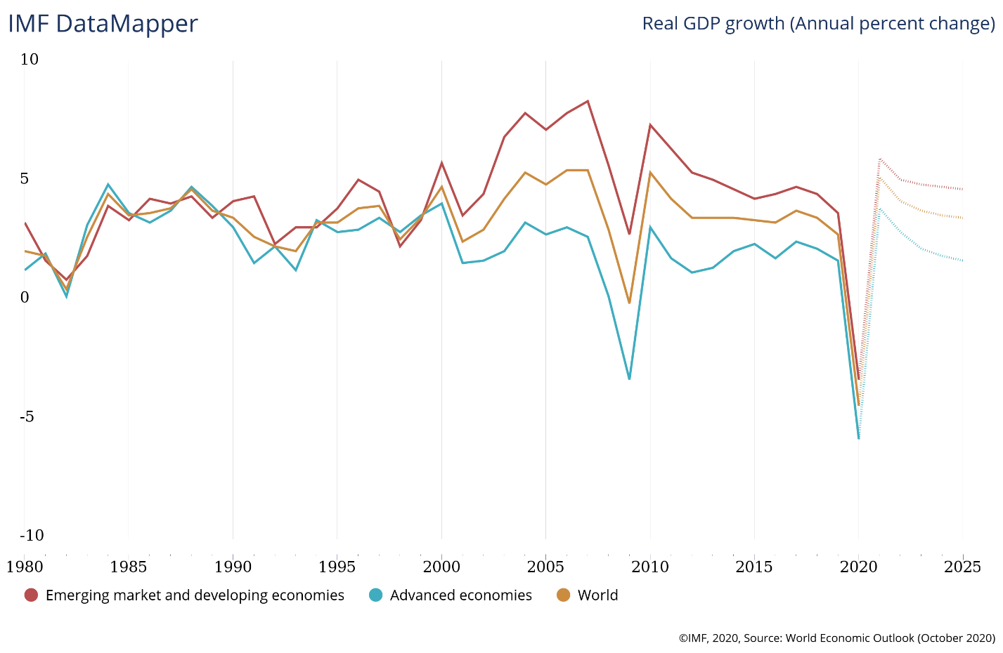
Introduction
Global financial Crisis is considered the worst economic downturn after the Great Depression of 1929.
Originating in US, it affected countries all around the world.
According to Moody’s Analytics the world lost 4% economic growth due to the crisis between mid-2008 and early-2009.
The high integration of the finance markets all across the world were a major factor in global effect of the crisis.

Slide 4

International(Int’l) Finance Markets
An international bank (for e.g.: JPMorgan Chase) is a bank which offers international financial services such as loans, lending opportunities and payment account to foreign clients.
These are large scale banks with majority of funding backed by international money market instruments which includes:
Foreign Exchange
International Securities – International bonds (Eurobonds, foreign, global, brady), internationally traded equities, treasury bills, etc.
International Loans – Interbank Loans etc.

Slide 5
Problems in Int’l Finance Markets
Foreign currency value declines
Banks asset holdings in that currency depreciates
Deterioration of bank’s balance sheets
Exchange Rate
High dependence on International debt
Economics and financial problems in lender countries and banks
Credit shortage and liquidity crisis
International debt (interbank loans, etc.)

Slide 6
Problems in Int’l Finance Markets
Moral Hazard
Increase in Risky Investment
Asset-price bubbles
Easy availability of credit
Asymmetric Information
Lack of coordination

Slide 7
Effect on Europe
The major banks like Northern Rock and Deustche Industriebank AG faced heavy losses due to now worthless asset-backed securities and CDOs. This deteriorated balance sheet of the banks and thus made it even harder to arrange funds.
Spain had an extra problem: lack of standard accounting practices made it easier for banks to hide losses. Asymmetric Information increased.
Ireland saw rapid economic growth between mid-1990s and mid-2000s. The growth was mainly funded by FDI. This boom led to a housing bubble and subsequent severe economic downturn with the crisis.

Slide 8
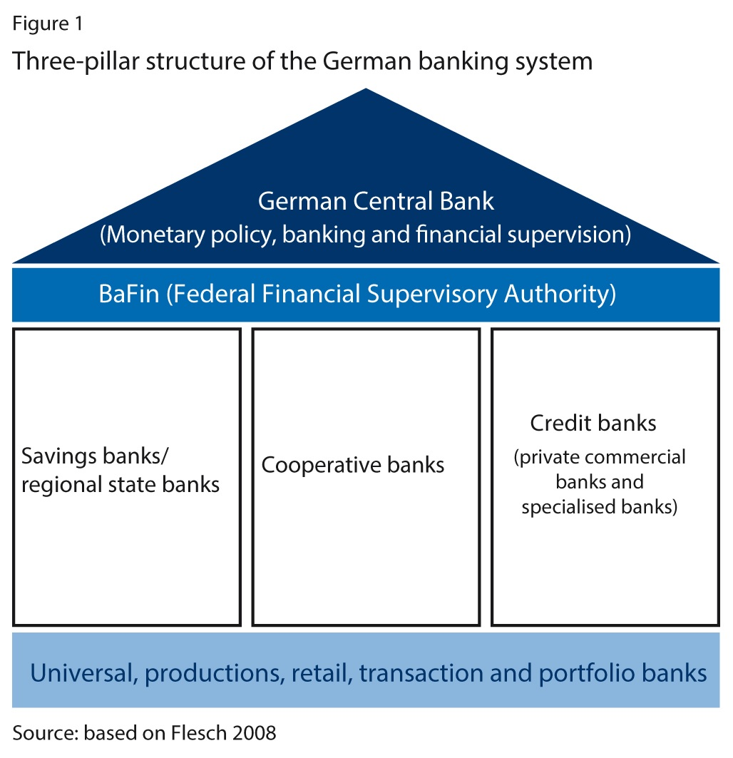
Effect on Europe
Germany had a relatively robust banking structure (the three pillar structure) and a stable housing market. Allowing it to experience though a deep but relatively short spanned recession.
Private commercial banks like Deutsche Postbank AG, and
Regional banks like Saxony Bank which was involved in subprime crisis through an Irish subsidy faced huge losses.

Slide 9
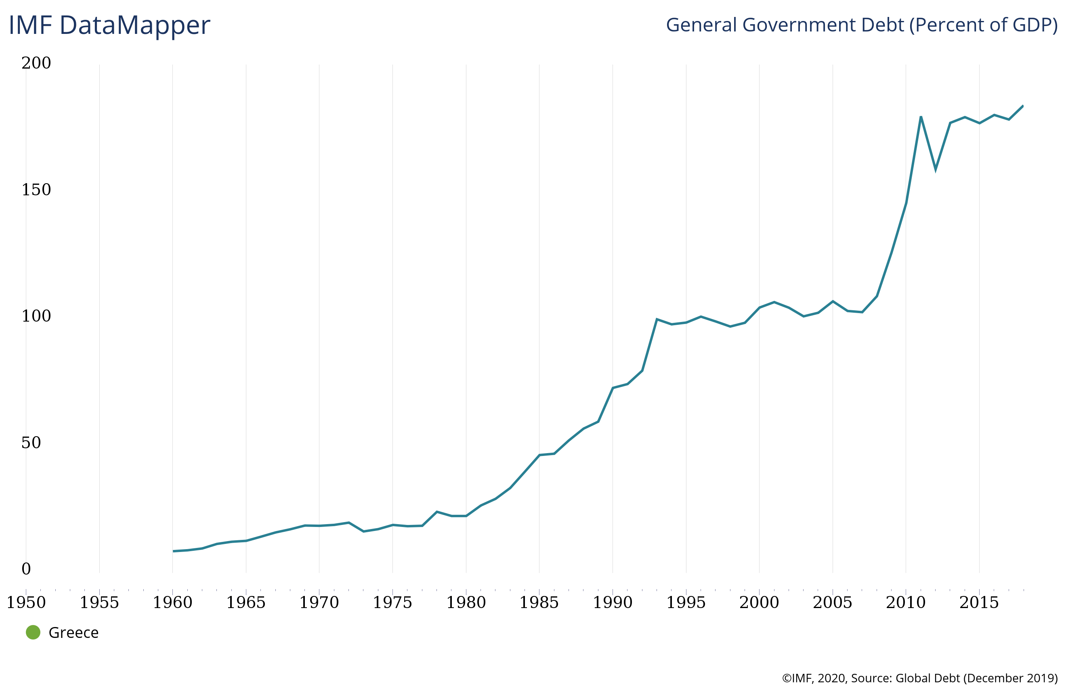
Effect on Europe
Birth of European Sovereign Debt Crisis
Greece Systemic tax evasion
Increased govt. expenditure
Entry into EU
Increased Sovereign debt
Greek bonds rated “junk” in 2010
European Sovereign Debt Crisis

Slide 10
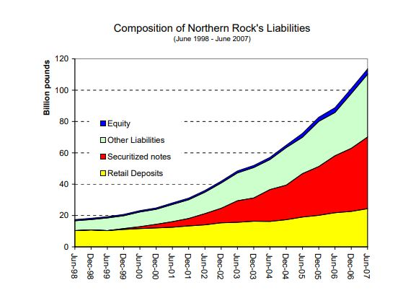
The fall of Northern Rock Bank
Northern Rock was among the first bank to announce liquidity crisis in the EU.
The bank had grown aggressively over the last years, relying on international money market instruments such as asset-backed securities.
The bank, being over-exposed to housing market, was among the first to loose the line of credit.
This deteriorated the balance sheet faster than the bank could cope with.
Source: http://citeseerx.ist.psu.edu/viewdoc/download?doi=10.1.1.637.8526&rep=rep1&type=pdf

Slide 11
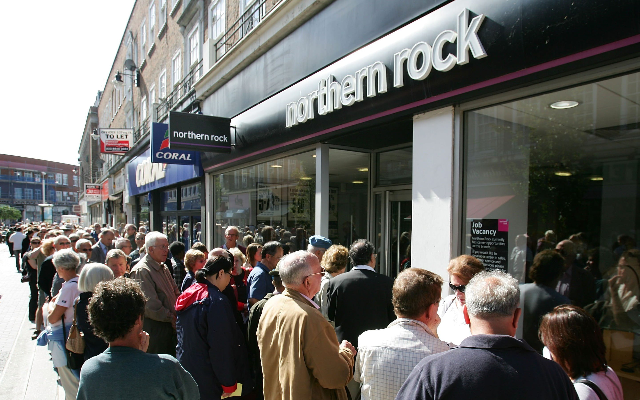
The fall of Northern Rock Bank
The bank turned to Bank of England, as a lender of last resort which gave about £28bn for a bailout.
On September 14, 2007, the issues were made public.
This triggered the first bank run in UK in over 150 years.
Contributing to the problem, government safety net in case of bank failure was bad in the UK.
Maximum reimbursement of £2000.
In case of in insolvency, all deposits were frozen and not even partial reimbursement was available.

Slide 12

This further aggravated the bank run.
In February, 2008, the bank was nationalized by the Bank of England.
Though Northern Rock repaid most of it’s dues, in 2012, Virgin Money acquired Northern Rock from the Bank of England.
Loan re-payments along with sale of the bank netted UK Government a surplus of £8bn to £11bn.
Source: http://www.n-ram.co.uk/~/media/Files/N/NRAM-PLC/results-presentations/halfyearresults080801.pdf

Slide 13
Conclusion
International finance markets are both a boon and a bane.
Though it provides great opportunities for growth, it also makes banks vulnerable to a number of economic and financial factors.
Low level of regulation results in more asymmetric information among the institutions.
Stricter rules and regulations regarding liquidity management are required.
Well structured rules by an international institution for a firm’s investment are required so as to limit risky behavior.

Slide 14
Thank You

Slide 15
References
^{[2]}https://www.washingtonpost.com/business/economy/a-guide-to-the-financial-crisis--10-years-later/2018/09/10/114b76ba-af10-11e8-a20b-5f4f84429666_story.html
^{[3]} https://money.howstuffworks.com/personal-finance/banking/international-banking.htm#:~:text=An%20international%20bank%20is%20a,lending%20opportunities%2C%20to%20foreign%20clients.&text=Companies%20do%20business%20with%20international,which%20can%20be%20quite%20costly.
^{[4]} https://www.investopedia.com/terms/i/internationalbond.asp
^{[5]}Bleuel, Hans-H. (2009) : The German banking system and the global financial crisis: Causes, developments and policy responses, Düsseldorf Working Papers in Applied Management and Economics, No. 8, Fachhochschule Düsseldorf, Fachbereich Wirtschaft, Düsseldorf, http://nbn-resolving.de/urn:nbn:de:hbz:due62-opus-5116
^{[6]} https://spark.adobe.com/page/DAlRb7HdWiHqA/
^{[7]} https://www.chroniclelive.co.uk/business/business-news/northern-rock-anniversary-how-crisis-13614085

