Slide 1
9
International Financial Markets
Copyright © 2012 Pearson Education, Inc. publishing as Prentice Hall

Slide 2


Capital Market
System that allocates financial resources
according to their most efficient uses
  Debt: Repay principal plus interest
  Bond has timed principal & interest payments
  Equity: Part ownership of a company
    Stock shares in financial gains or losses
Copyright © 2012 Pearson Education, Inc. publishing as Prentice Hall
9 - <number>
Notes:
A capital market allocates financial resources according to their most efficient uses and provides a way to borrow or invest money efficiently.
Debt is a loan in which the borrower repays the borrowed amount, called principal, plus interest.
Companies can raise money by issuing bonds—debt instruments that specify the timing of principal and interest payments.
Equity is part ownership of a company in which the equity holder participates with other owners in the company’s financial gains and losses.
Companies can also raise money by issuing stock—shares of ownership in a company’s assets that give shareholders a claim on the company’s future cash flows.

Slide 3


International Capital Market
Network of people, firms, financial institutions, and governments borrowing and investing internationally
Borrowers
Expands money supply
Reduces cost of money
Lenders
Spread / reduce risk
Offset gains / losses
Copyright © 2012 Pearson Education, Inc. publishing as Prentice Hall
9 - <number>
Notes:
The international capital market affects money markets in at least four ways:
It expands the money supply for borrowers by providing access to international sources of capital.
It reduces the cost of money for borrowers by increasing its supply and forcing down borrowing costs.
It reduces risk for lenders by expanding the set of available lending opportunities.
And it allows investors to offset gains in some economies with losses in others.

Slide 4

International Capital
Market Drivers
Information technology
Deregulation
Financial instruments
Copyright © 2012 Pearson Education, Inc. publishing as Prentice Hall
9 - <number>
Notes:
Three main forces are expanding the international capital market.
Information technology reduces the time and money needed to communicate globally and allows for 24-hour electronic trading.
Little regulation relative to other financial markets increases competition, lowers transaction costs, and opens up national financial markets.
And growth has resulted from securitization—the repackaging of hard-to-trade financial assets into more liquid, negotiable, and marketable securities.

Slide 5

Offshore Financial Centers
Operational center
Extensive financial activity
and currency trading
Country or territory
whose financial sector
features few regulations
and few, if any, taxes
Booking center
Mostly for bookkeeping
and tax purposes
Copyright © 2012 Pearson Education, Inc. publishing as Prentice Hall
9 - <number>
Notes:
An offshore financial center tends to feature few regulations, few (if any) taxes, economic and political stability, and an advanced telecommunications infrastructure.
Offshore financial centers fall into two categories.
Operational Centers see a great deal of financial activity, such as London in currencies and Switzerland in investment capital.
Booking Centers are usually located on small island nations or territories with favorable tax and/or secrecy laws. Funds simply pass through these centers on their way to large operational centers.

Slide 6
International Bond Market
Market of bonds sold by issuing companies, governments, and others outside their own countries
Eurobond
Foreign bond
Interest rates
Bond that is issued outside the country in whose currency the bond is denominated
Bond sold outside a borrower’s country and denominated in the currency of the country in which it is sold
Driving growth are differential interest rates between developed and developing nations
Copyright © 2012 Pearson Education, Inc. publishing as Prentice Hall
9 - <number>
Notes:
A Eurobond is issued outside the country in whose currency it is denominated. For example, a bond issued in Venezuela in U.S. dollars and sold in Britain, France, and Germany is called a Eurobond.
A foreign bond is sold outside the borrower’s country and denominated in the currency of the country in which it is sold. For example, a yen-denominated bond issued by German carmaker BMW in Japan’s bond market is called a foreign bond.
Interest rates are driving growth in the international bond market. Borrowers in emerging economies seek to borrow money in developed nations where interest rates are lower, and investors in developed nations seek to buy bonds of companies in emerging economies to earn higher rates of return.

Slide 7
International Equity Market
Market of stocks bought and sold outside
the issuer’s home country
Privatization
Emerging markets
Investment banks
Electronic markets
Copyright © 2012 Pearson Education, Inc. publishing as Prentice Hall
9 - <number>
Notes:
Four factors lie behind the growth in the international equity market.
A single privatization often places billions of dollars of new equity on stock markets.
Some companies in emerging markets seek funding abroad to overcome domestic capital shortages.
Investment banks facilitate the sale of equity worldwide by bringing together sellers and potential buyers.
And electronic markets now allow online global trading activities 24 hours a day.

Slide 8

Eurocurrency Market
Unregulated market of currencies banked outside their countries of origin
Governments
Commercial banks
International companies
Wealthy individuals
Copyright © 2012 Pearson Education, Inc. publishing as Prentice Hall
9 - <number>
Notes:
All the world’s currencies banked outside their countries of origin are called Eurocurrency and trade on the Eurocurrency market.
Sources of Eurocurrency deposits include governments, commercial banks, international companies, and extremely wealthy individuals.
The appeal of the Eurocurrency market is its complete absence of regulation and low transaction costs.
The downside of this market is its greater risk due to a lack of government regulation.

Slide 9
Foreign Exchange Market
Market in which currencies are bought and sold and their prices are determined
  Conversion: To facilitate transactions, invest directly abroad, or repatriate profits
  Hedging: Insure against potential losses from adverse exchange-rate changes
  Arbitrage: Instantaneous purchase and sale of a currency in different markets for profit
  Speculation: Sequential purchase and sale (or vice-versa) of a currency for profit
Copyright © 2012 Pearson Education, Inc. publishing as Prentice Hall
9 - <number>
Notes:
The foreign exchange market serves four main functions.
Currency conversion helps facilitate international transactions, investments abroad, and the repatriation of profits back to the home country.
Currency hedging helps insure against potential losses from adverse changes in exchange rates.
Currency arbitrage lets investors seek profits by conducting an instantaneous purchase and sale of a currency in different markets.
And currency speculation lets traders purchase or sell a currency with the expectation that its value will change over time and generate a profit.

Slide 10
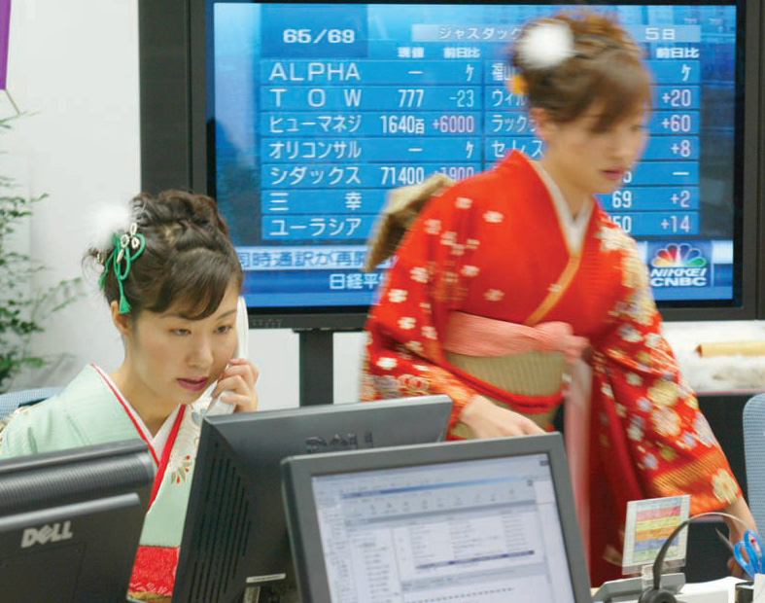
Largest Currency Markets
USA: $3.20 trillion
UK: $1.33 trillion
Japan: $0.24 trillion
Copyright © 2012 Pearson Education, Inc. publishing as Prentice Hall
9 - <number>
Notes:
Currency exchange workers in Tokyo, Japan, wear traditional kimonos on the first trading day of the year.
The world’s three largest markets for currencies are the United States, the United Kingdom, and Japan.

Slide 11
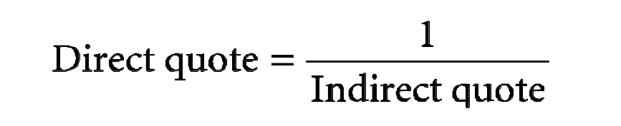
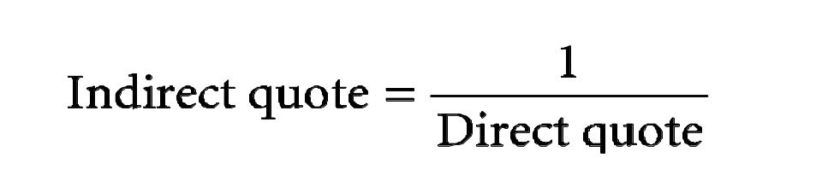
Quoting Currencies
Quoted currency = numerator
Base currency = denominator
(¥/$) = Japanese yen needed to buy one U.S. dollar
Yen is quoted currency, dollar is base currency
Copyright © 2012 Pearson Education, Inc. publishing as Prentice Hall
9 - <number>
Notes:
Two components of every exchange rate are the quoted currency and the base currency.
In the exchange rate of ¥90/$ (read as “90 yen to the dollar”), the yen is the quoted currency because it is the numerator, and the dollar is the base currency because it is the denominator. We also call this a direct quote on the yen and an indirect quote on the dollar.
To derive a direct quote from an indirect quote, simply divide the indirect quote into 1.
And, to derive an indirect quote from a direct quote, divide the direct quote into 1.

Slide 12
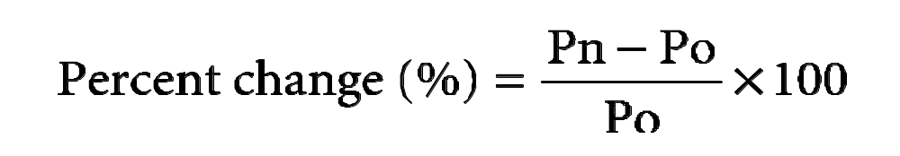
Currency Values
Change in U.S. dollar against Norwegian krone
February 1: NOK 5/$
March 1: NOK 4/$
%change = [(4-5)/5] x 100 = -20%
U.S. dollar fell 20%
Change in Norwegian krone against U.S. dollar
Make krone base currency (1÷ NOK/$)
February 1: $.20/NOK
March 1: $.25/NOK
%change = [(.25-.20)/.20] x 100 = 25%
Norwegian krone rose 25%
Copyright © 2012 Pearson Education, Inc. publishing as Prentice Hall
9 - <number>
Notes:
Exchange-rate risk is important to international companies because it can jeopardize profits from current and future international transactions.
In the formula above, Pn is the exchange rate at the end of a period (a currency’s new price), and Po is the exchange rate at the beginning of that period (a currency’s old price).
Suppose on February 1, the exchange rate between the Norwegian krone (NOK) and the U.S. dollar was NOK 5/$ (read as “5 Norwegian Krone to the dollar”). On March 1, suppose the exchange rate stood at NOK 4/$ (read as “4 Norwegian Krone to the dollar”).
The left-hand portion of this slide shows that the value of the base currency, the dollar, fell by 20%.

Slide 13
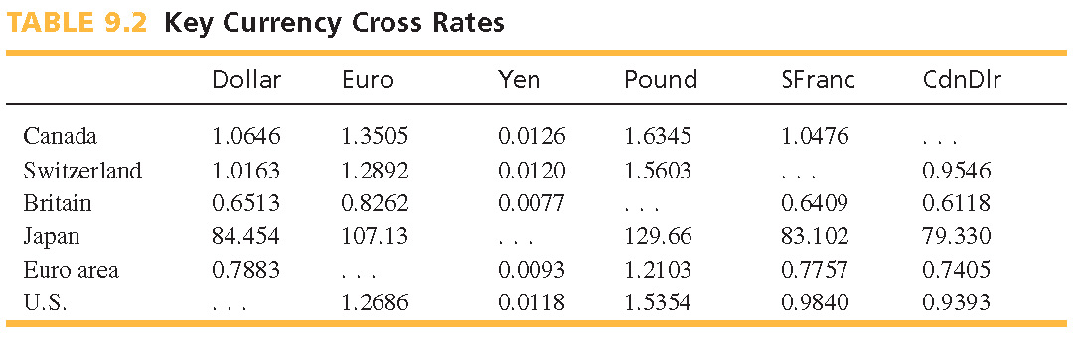
Cross Rate
Exchange rate calculated using two other exchange rates
Use direct or indirect exchange rates against a third currency
Copyright © 2012 Pearson Education, Inc. publishing as Prentice Hall
9 - <number>
Notes:
A cross rate is calculated using two currencies’ exchange rates against a third currency.
This slide shows cross rates for several major world currencies.

Slide 14
Cross Rate Example
Direct quote method
Quote on euro = € 0.7883/$
Quote on yen = ¥ 84.3770/$
€ 0.7883/$ ÷ ¥ 84.3770/$ = € 0.0093/¥
Costs 0.0093 euros to buy 1 yen
Copyright © 2012 Pearson Education, Inc. publishing as Prentice Hall
9 - <number>
Notes:
This slide demonstrates how to find the cross rate between the euro and the yen from their exchange rates with the U.S. dollar.

Slide 15
Spot Rate
Exchange rate requiring delivery
of traded currency within two business days
Repatriate income
from sales abroad
Pay supplier in
its own currency
Invest in another
national market
Copyright © 2012 Pearson Education, Inc. publishing as Prentice Hall
9 - <number>
Notes:
Businesses exchanging currencies at their local bank receive a buy rate (the rate at which a bank will buy a currency) and an ask rate (the rate at which a bank will sell a currency).
The spot market helps companies to:
Convert income from sales abroad into the home-country currency.
Convert funds into the currency of an international supplier.
And convert funds into the currency of a country in which it will invest.

Slide 16
Forward Rate
Rate at which two parties will exchange
currencies on a specified future date
    Forward Contracts
    Reduce exchange-rate risk
    30, 90, 180 days or custom lengths
Copyright © 2012 Pearson Education, Inc. publishing as Prentice Hall
9 - <number>
Notes:
A forward rate is a rate at which two parties agree to exchange currencies on a specified future date.
A forward contract requires exchange of an agreed-upon amount of a currency on an agreed-upon date at a specific exchange rate.
It is used to insure against unfavorable changes in exchange rates.
Forward contracts are commonly created for 30, 90, and 180 days into the future, but customized contracts are also possible.

Slide 17
Swaps, Options, and Futures
Currency swap
Simultaneous purchase and sale of foreign exchange
for two different dates
Currency option
Option to exchange a specific amount of a currency on a
specific date at a specific rate
Currency futures contract
Contract requiring the exchange of a specific amount of a currency
on a specific date at a specific rate, with all conditions
fixed and not adjustable
Copyright © 2012 Pearson Education, Inc. publishing as Prentice Hall
9 - <number>
Notes:
The forward market has produced three additional types of currency instruments.
A currency swap is used to reduce exchange-rate risk and lock in a future exchange rate.
A currency option is used to hedge against exchange-rate risk and obtain foreign currency at a favorable rate.
And a currency futures contract is similar to a currency option but is an enforceable contract and all conditions are fixed.

Slide 18
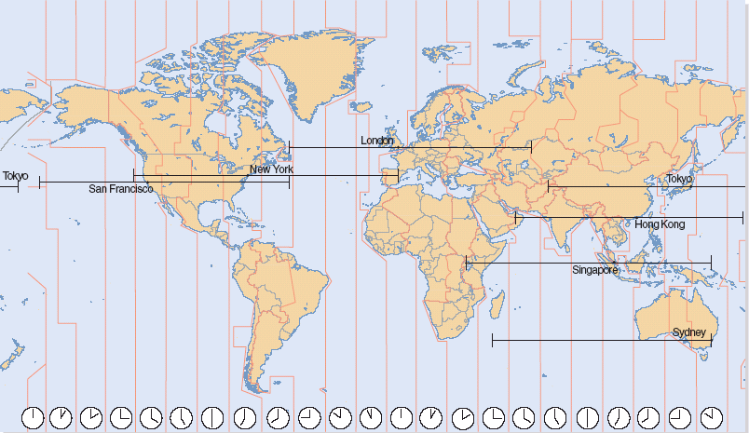
24-Hour Trading
Copyright © 2012 Pearson Education, Inc. publishing as Prentice Hall
9 - <number>
Notes:
The foreign exchange market today is a collection of physical locations and an electronic network of traders, banks, and investment firms.
Major trading centers are the United Kingdom, the United States, and Japan. London dominates the foreign exchange market for historic and geographic reasons.
A vehicle currency is used as an intermediary to convert funds between two other currencies.
The most popular vehicle currencies include the U.S. dollar, British pound, Japanese yen, and the European Union euro.

Slide 19
Key Market Institutions
Interbank
market
Securities
exchange
Over-the-Counter
(OTC) market
Market in which
the world’s largest
banks exchange
currencies at spot
and forward rates
Exchange that
specializes in
currency futures
and options
transactions
Global computer
network of foreign
exchange traders
and other market
participants
Copyright © 2012 Pearson Education, Inc. publishing as Prentice Hall
9 - <number>
Notes:
Three key institutions comprise the foreign exchange market.
The interbank market is where the world’s largest banks exchange currencies at spot and forward rates for clients.
Securities exchanges specialize in currency futures and options transactions that are smaller than those in the interbank market.
The over-the-counter market is a global computer network of traders and other participants with no central trading location. This market offers greater opportunities for designing customized transactions.

Slide 20




Managing Foreign Exchange
1. Match Needs to Providers
2. Work with the Major Banks
3. Consolidate Multiple Transactions
4. Get the Best Rate Possible
5. Embrace Information Technology
Copyright © 2012 Pearson Education, Inc. publishing as Prentice Hall
9 - <number>
Notes:
Global managers should observe several points to get the best deals on foreign exchange transactions.
1. Match the company’s foreign currency needs with the best provider the company can afford.
2. Major banks located in financial centers often have cost and service advantages over local banks.
3. Consolidate individual money exchanges into larger ones to reduce fees.
4. Get the best rate possible by developing relationships with big banks and monitoring fees charged.
5. Technology can help reduce errors, speed execution, and reduce time needed to exchange currencies.

Slide 21



Goals of Currency Restriction
Preserve hard currency
to repay debts owed
to other nations
Preserve hard currency
to pay for imports and
finance trade deficits
Protect a currency
from speculators
Constrain individuals
and companies from
investing abroad
Copyright © 2012 Pearson Education, Inc. publishing as Prentice Hall
9 - <number>
Notes:
A convertible (hard) currency is one that trades freely in the foreign exchange market, with its price determined by the forces of supply and demand.
Countries that restrict the convertibility of their currencies may be trying to:
Preserve the nation’s hard currencies to repay debts owed to other nations.
Preserve hard currencies to pay for imports and finance trade deficits.
Protect its currency from speculators.
And keep individuals and businesses from investing in other nations.

Slide 22
Currency Restriction Policies
Central bank approval
Import licenses
Multiple exchange rate system
Import deposit requirements
Quantity restrictions
What’s a firm to do?
Countertrade
Copyright © 2012 Pearson Education, Inc. publishing as Prentice Hall
9 - <number>
Notes:
Policies for restricting currency convertibility include:
Demanding central bank approval of all foreign exchange transactions.
Requiring import licenses to control the amount of currency leaving the country in transactions.
Implementing multiple exchange rates that impose less favorable rates on the imports of certain goods or certain nations.
Issuing import deposit requirements that require businesses to place a portion of their foreign exchange holdings in special accounts before receiving import licenses.
Issuing quantity restrictions that limit the amount of foreign currency that individuals can take out of the country when traveling abroad.
Companies thwarted by currency restrictions may engage in countertrade—exchanging goods or services without using money. Countertrade is covered fully in Chapter 13.

