Slide 1

HinglishFinSent
A Benchmark Dataset and Architecture Comparison
for Hinglish Financial Sentiment Analysis
Project Based Learning-4 · VI Semester · Jan–May 2026
Sarthak Gupta · 23FE10CSE00432
Guide: Dr. Bali Devi
Dept. of CSE, Manipal University Jaipur

Slide 2
Motivation
PROBLEM STATEMENT
📈
🗣️
🔍
150M+ Demat Accounts
Code-Mixed Language
No Existing Benchmark
India's retail investor boom drives massive Hinglish financial discourse on Reddit, YouTube & Telegram.
"Nifty ka breakout confirm ho gaya, accumulate karo" — English NLP models fail on Hindi morphology.
Zero labelled datasets exist for Hinglish financial sentiment, blocking progress in this application area.
"yeh stock toh gaya bhai, kab tak hold karein?" — typical Hinglish financial post; zero standard NLP tool handles this correctly

Slide 3
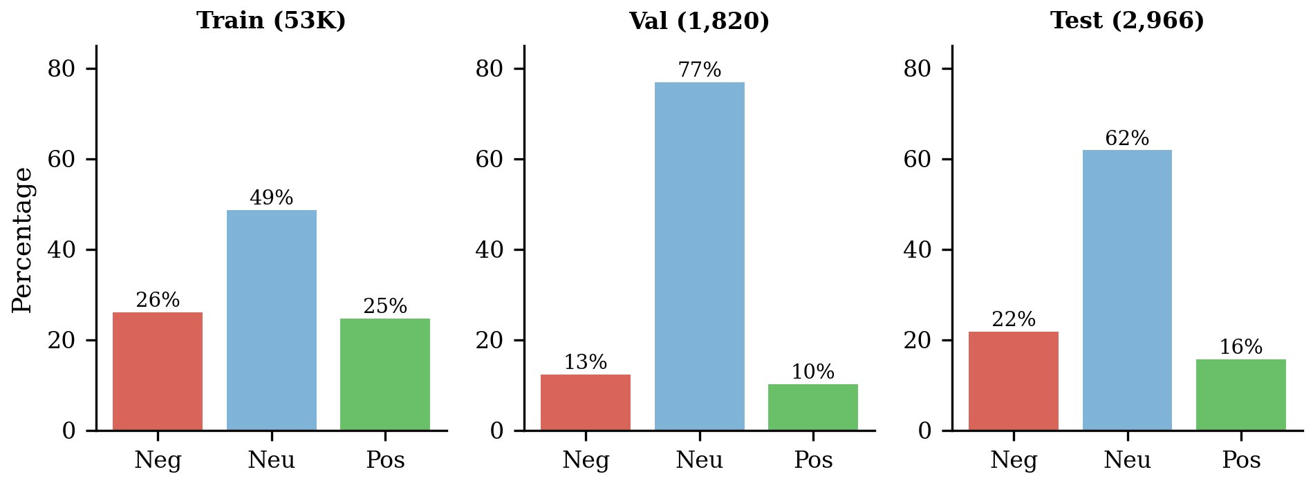
HinglishFinSent Dataset
DATA CONSTRUCTION
1
Collection
72,944 raw records from Reddit, YouTube, Telegram
2
Preprocessing
7-step pipeline → 19,235 records retained
3
Annotation
Weak supervision + MuRIL + human gold labels
4
Augmentation
Synonym replacement + Gemini 2.0 Flash paraphrases
2,966
53,433
3
~$0.53
Gold Test Samples
Train (augmented)
Classes
LLM Augm. Cost

Slide 4
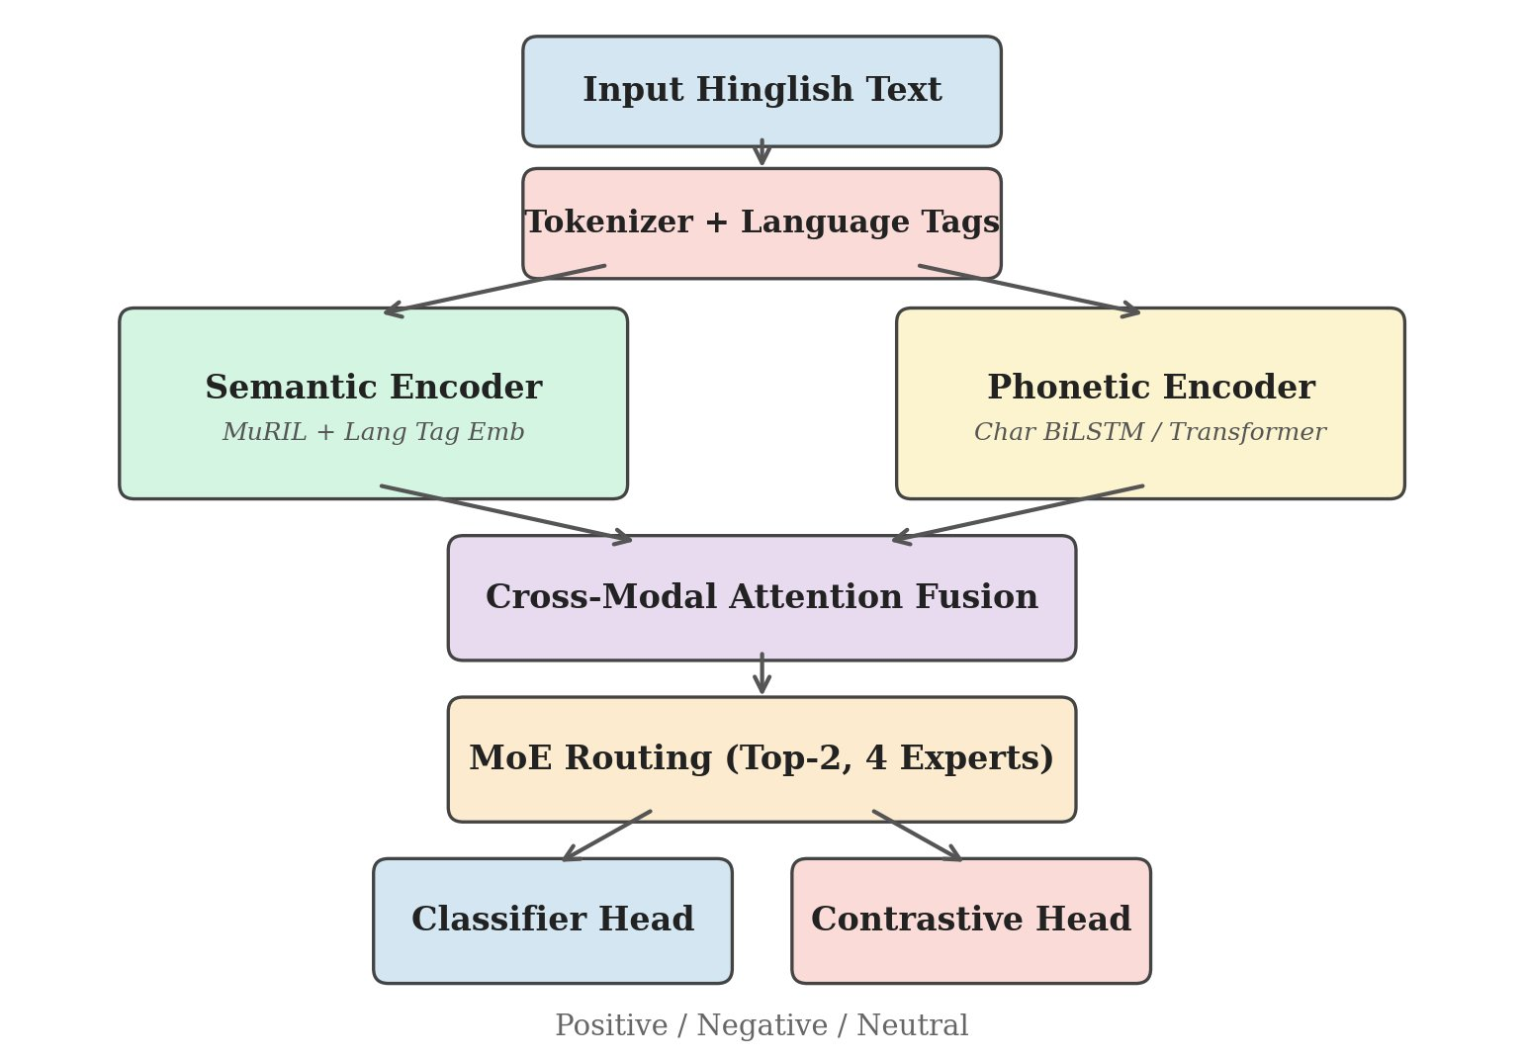
Four Custom Architectures
METHODOLOGY
BiLSTM + Attention
SACL
FACT
PRC-MoE
6.1M params
8.4M params
9.7M params
~50M params
Two-layer BiLSTM with scaled dot-product attention pooling. Bahdanau-style baseline.
Language-stream separation routing tokens to Hindi/English BiLSTMs with FinancialLexiconGate.
Custom Transformer with LanguageAwarePositional Encoding, FinancialContextAttention & CodeSwitch Pooling.
MuRIL semantic encoder + phonetic BiLSTM + top-2 sparse MoE routing with contrastive learning head.
All models trained with AdamW · Label Smoothing ε=0.1 · Class-weighted CE Loss · Early stopping on val macro F₁

Slide 5
PRC-MoE Architecture
METHODOLOGY
Semantic (MuRIL + Lang Tags) + Phonetic (Char BiLSTM) → Cross-Modal Attention Fusion → Top-2 MoE → Classifier + Contrastive Head

Slide 6
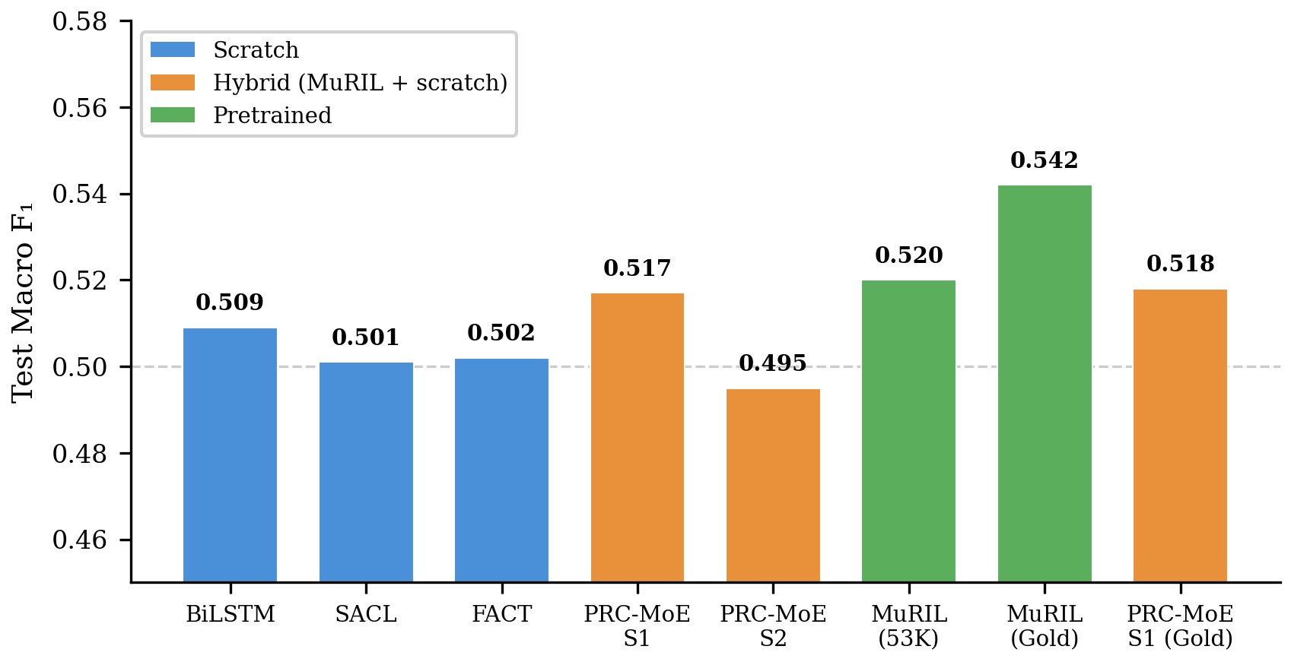
Main Results
RESULTS
Model | Training | Val F₁ | Test F₁
BiLSTM + Attn | 53K | 0.87 | 0.509
SACL | 53K | 0.82 | 0.501
FACT | 53K | 0.86 | 0.502
PRC-MoE S1 | 53K | 0.92 | 0.517
MuRIL | 53K | 0.53 | 0.520
MuRIL (Gold) ★ | Gold | 0.54 | 0.542
Key Finding: All models plateau at ~0.50–0.52 F₁ when trained on 53K augmented data. MuRIL on gold-only data achieves 0.542 — the highest score across all configurations.
Evaluation on 2,966-sample gold test set · Primary metric: Macro F₁ · 62% neutral class in test set

Slide 7
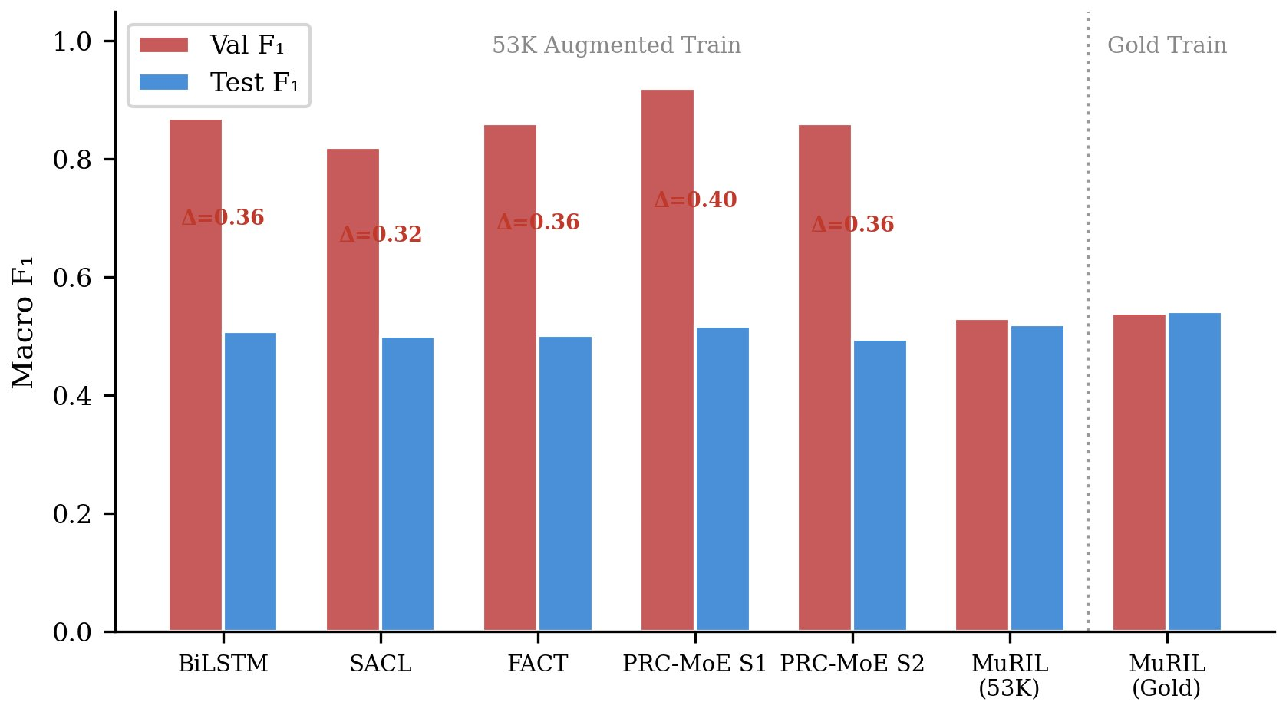
The Central Finding
KEY INSIGHT
~0.35 Val/Test Gap
All models trained on 53K augmented data show a massive gap. High val F₁ (0.82–0.92) masks poor test performance (0.50–0.52).
<0.05 Gap on Gold
MuRIL trained only on real annotated data: val 0.54 → test 0.542. The gap nearly vanishes.
Root Cause
Gemini-generated Hinglish is too clean. Real posts have irregular transliteration, abbreviations & non-standard code-switching.
Conclusion: The bottleneck is data distribution, not model capacity. LLM augmentation creates distributional shift.

Slide 8
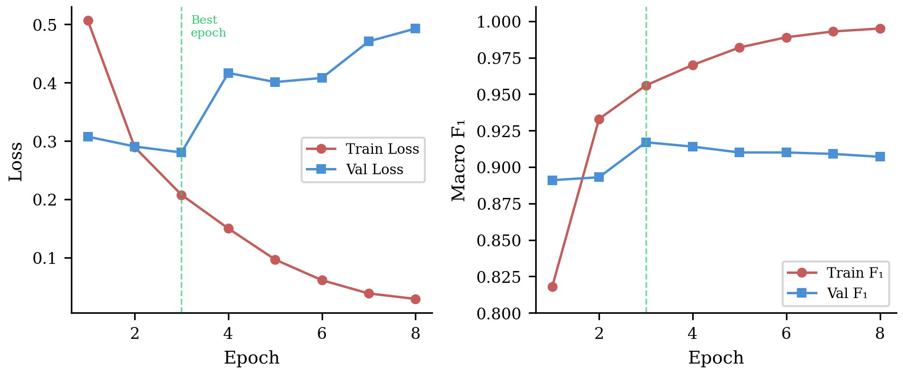
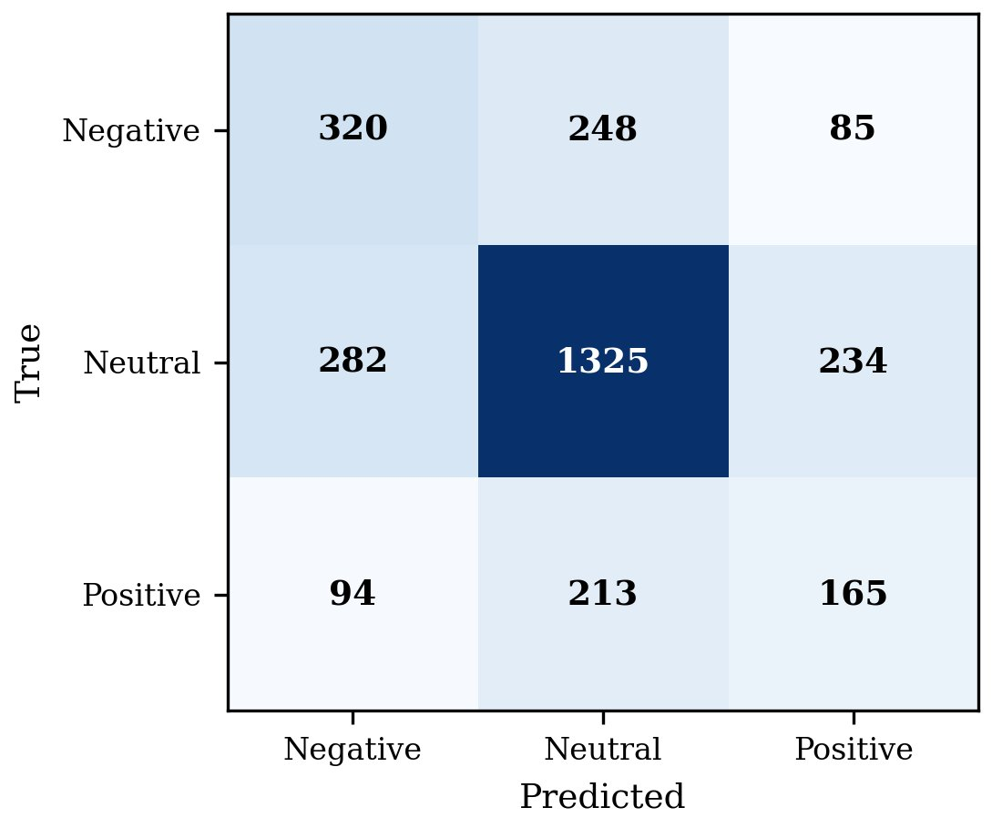
Training Dynamics & Error Analysis
ANALYSIS
Training Curves (PRC-MoE Stage 1)
Confusion Matrix — MuRIL (Gold)
📊 Training loss diverges after best epoch — classic overfitting to augmented distribution | ⚠️ Positive class most confused with Neutral (213/472 positive samples misclassified)
Model | Neg F₁ | Neu F₁ | Pos F₁ | Macro
BiLSTM | 0.43 | 0.75 | 0.35 | 0.509
MuRIL (53K) | 0.47 | 0.75 | 0.35 | 0.520
MuRIL (Gold) ★ | 0.50 | 0.76 | 0.42 | 0.542

Slide 9
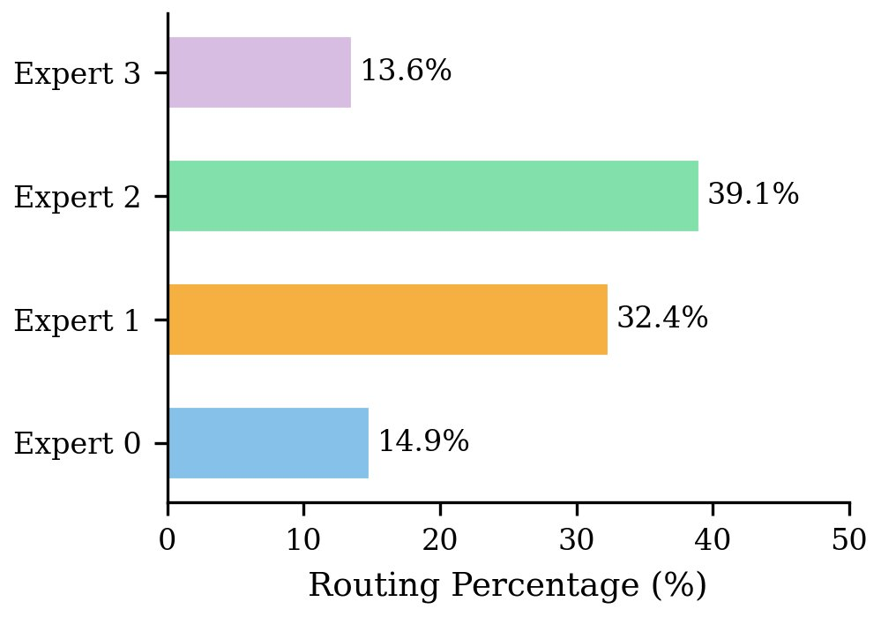
PRC-MoE Expert Routing & Dataset Analysis
DEEP DIVE
Expert Routing Distribution
Class Distribution Across Splits
▸ Expert 2 (39.1%) & Expert 1 (32.4%) dominate — routing learns to specialise by sentiment expression style
▸ Experts 0 & 3 handle minority patterns (~14% each) — natural specialisation without explicit supervision
▸ Val set is 77% neutral vs 62% in test → partial explanation for val/test distribution gap

Slide 10
Conclusion & Future Work
Contributions
Future Work
HinglishFinSent — first labelled Hinglish financial sentiment benchmark (2,966 gold samples)
Expand gold annotations — target Cohen's κ ≥ 0.70 with a second annotator pass
Four novel architectures — BiLSTM, SACL, FACT, PRC-MoE for code-mixed financial text
Replace LLM augmentation with real scraped annotated data to eliminate distribution shift
LLM augmentation analysis — distributional shift is primary bottleneck, not model capacity
Twitter/X data — pursue API access for this major source of Indian financial discourse
PRC-MoE interpretability — MoE routing specialises by sentiment expression style without supervision
Downstream utility — correlate Hinglish sentiment with NSE stock price movements
Outcome: HinglishFinSent dataset released publicly · IEEE-format paper in preparation · Novel empirical findings on LLM augmentation quality in low-resource NLP
github.com/SarthakGupta · Manipal University Jaipur · Guide: Dr. Bali Devi

