Slide 1
CHARGETIME AI
Predicting Electric Vehicle Charging Session Duration Using Machine Learning
Foundations of AIML Mini-Project | B.Tech CSE Third Year
STUDENT DETAILS
Name: Sarthak Kharche
PRN: 20240802084
Class: B.Tech CSE (3rd Year)
DEPARTMENT & INSTITUTE
Dept. of Computer Science & Engg.
D. Y. Patil International University
(DYPIU), Akurdi, Pune
PROJECT METADATA
Course: Foundations of AIML
Primary Algorithm: Linear Regression
Academic Year: 2025–2026

Slide 2
INTRODUCTION
⚡ PROJECT OVERVIEW
🚗 BACKGROUND & MOTIVATION
🎯 WHY THE PROJECT IS NEEDED
• Supervised Machine Learning regression system for EV charging session forecasting.
• Accurately estimates charging duration in continuous hours and readable minutes.
• Built and tested on ~1,320 real charging sessions from Kaggle dataset.
• Provides instant pre-session predictions via an interactive Streamlit web application.
• Exponential EV growth is overwhelming commercial and highway charging stations.
• Charging durations vary unpredictably based on battery capacity, power rating, and climate.
• Long, uncertain queues cause severe driver range anxiety and travel delays.
• Static hardware timers fail to capture battery degradation and temperature throttling.
• For EV Drivers: Real-time wait duration transparency and stress-free trip planning.
• For Station Operators: Enables automated bay scheduling and dynamic grid load balancing.
• Prevents bay hogging and optimizes charger throughput during peak hours.
• Replaces crude linear estimation with data-driven statistical regression modeling.

Slide 3
PROBLEM STATEMENT
⚠️ PROBLEM IDENTIFIED
❌ LIMITATIONS OF EXISTING SYSTEMS
✅ PROPOSED SOLUTION: CHARGETIME AI
• Charging session durations are highly unpredictable across EV models and charger tiers.
• A 50 kWh battery does not charge at a constant rate due to non-linear chemical kinetics.
• Drivers arrive without knowing how long they will occupy a charging stall.
• Creates bottlenecks, extended queue lines, and inefficient charger asset utilization.
• Static Heuristic Formulas: Basic division of energy by power rating ignores ambient temp.
• No Pre-Session Visibility: Modern apps only show live speed after charging starts.
• Target Leakage Flaws: Naive models use post-session metrics (End Time, Cost) giving false accuracy.
• Inability to optimize multi-stall charging queues in real-world charging hubs.
• Supervised regression framework trained on 13 physical, electrical, and ambient parameters.
• Strict target leakage audit removing post-session variables (Charging End Time and Cost).
• Learns Ordinary Least Squares weights for transparent, defensible academic explainability.
• Deployed as an interactive Streamlit UI with input validation and zero-latency caching.

Slide 4
OBJECTIVES AND SCOPE
🎯 MAIN OBJECTIVES
🔍 PROJECT SCOPE
🏆 EXPECTED OUTCOMES
• Conduct rigorous EDA on 1,320 Kaggle EV charging session records.
• Build a leak-free Scikit-Learn ColumnTransformer preprocessing pipeline.
• Train an interpretable Linear Regression model & benchmark against a Mean Baseline.
• Evaluate using standard continuous metrics: MAE, MSE, RMSE, and R² Score.
• Deploy a responsive Streamlit web application for real-time user forecasting.
• Covers passenger EV models across Level 1, Level 2, and DC Fast charging stations.
• Evaluates 13 attributes including battery capacity, starting/ending SOC, temp, and vehicle age.
• Strictly focused on foundational supervised regression for academic clarity.
• Excludes arbitrary identifiers (User ID, Station ID) to ensure pure physical generalization.
• Production-ready serialized pipelines (.pkl) for zero-latency inference.
• Sub-hour duration prediction accuracy (~52 mins MAE on unseen test sessions).
• Dual formatted prediction display: continuous hours and readable hours/minutes.
• Full academic reproducibility via GitHub repository and executed Jupyter Notebook.

Slide 5
SYSTEM ARCHITECTURE & WORKFLOW
STAGE 1: DATA INGESTION
STAGE 2: PREPROCESSING
STAGE 3: REGRESSION CORE
STAGE 4: STREAMLIT UI
• Raw Kaggle Dataset (1,320 sessions)
• Data Cleaning & Null Imputation
• Target Leakage Audit (Drop End Time & Cost)
• ColumnTransformer Pipeline
• StandardScaler (8 Numerical features)
• OneHotEncoder (5 Categorical features)
• Fitted strictly on 80% Train Split
• Ordinary Least Squares Linear Regression
• Mean Baseline (DummyRegressor)
• Metrics: MAE, MSE, RMSE, R²
• Saved to disk via Joblib (.pkl)
• Real-Time Session Input Form
• Client-Side Validation (SOC Start < End)
• Cached Artifact Loading
• Formatted Output (Hours & Minutes)
WORKFLOW: Ingest CSV ➔ Audit Leakage ➔ 80/20 Split ➔ Scale & Encode ➔ Train OLS ➔ Streamlit Inference

Slide 6
TECHNOLOGIES USED
🐍 PROGRAMMING & ENVIRONMENT
⚙️ MACHINE LEARNING & PIPELINES
• Python 3.10+ (Core runtime language for ML pipeline)
• Jupyter Notebook (Interactive exploratory analysis & EDA)
• Git & GitHub (Version control & repository tracking)
• Scikit-Learn (ColumnTransformer, StandardScaler, OneHotEncoder)
• LinearRegression (Ordinary Least Squares regression core)
• Joblib (Binary serialization & loading of .pkl pipelines)
📊 DATA PROCESSING & VISUALIZATION
🚀 DEPLOYMENT & SYSTEM SPECS
• Pandas (Tabular data cleaning & DataFrame transformations)
• NumPy (Vectorized linear algebra & matrix operations)
• Matplotlib & Seaborn (Residual diagnostics, heatmaps, & EDA plots)
• Streamlit (Interactive reactive web frontend with caching)
• Cross-Platform Compatibility (Windows 11 / Linux / macOS)
• Lightweight Hardware Specs (Requires standard 4 GB RAM, Multi-core CPU)

Slide 7
METHODOLOGY AND IMPLEMENTATION
🧹 1. DATA PREPROCESSING
🧠 2. MODEL TRAINING
📈 3. EVALUATION & METRICS
⚡ 4. INFERENCE & WEB UI
• Script: data_preprocessing.py
• Audits 1,320 sessions from Kaggle.
• Drops leakage: Charging End Time and Cost.
• StandardScaler for 8 continuous variables.
• OneHotEncoder for 5 categorical variables.
• ColumnTransformer fitted ONLY on train split.
• Script: train_model.py
• Reproducible 80/20 train-test split.
• Fixed random_state=42 for verification.
• Ordinary Least Squares (OLS) optimization.
• Trains Mean Baseline (DummyRegressor).
• Serializes model & preprocessor to disk.
• Script: evaluate_model.py
• Tested on 20% unseen test split (n=264).
• Calculates continuous MAE, MSE, RMSE, R².
• Generates Actual vs. Predicted scatter plot.
• Generates Residual diagnostic error plots.
• Extracts learned regression coefficients (β).
• Script: app/app.py & predict.py
• Loads cached .pkl artifacts on boot.
• Interactive sliders and dropdown forms.
• Strict validation: SOC Start < SOC End.
• Safety boundary: non-negative duration.
• Converts hours to hours & minutes.

Slide 8
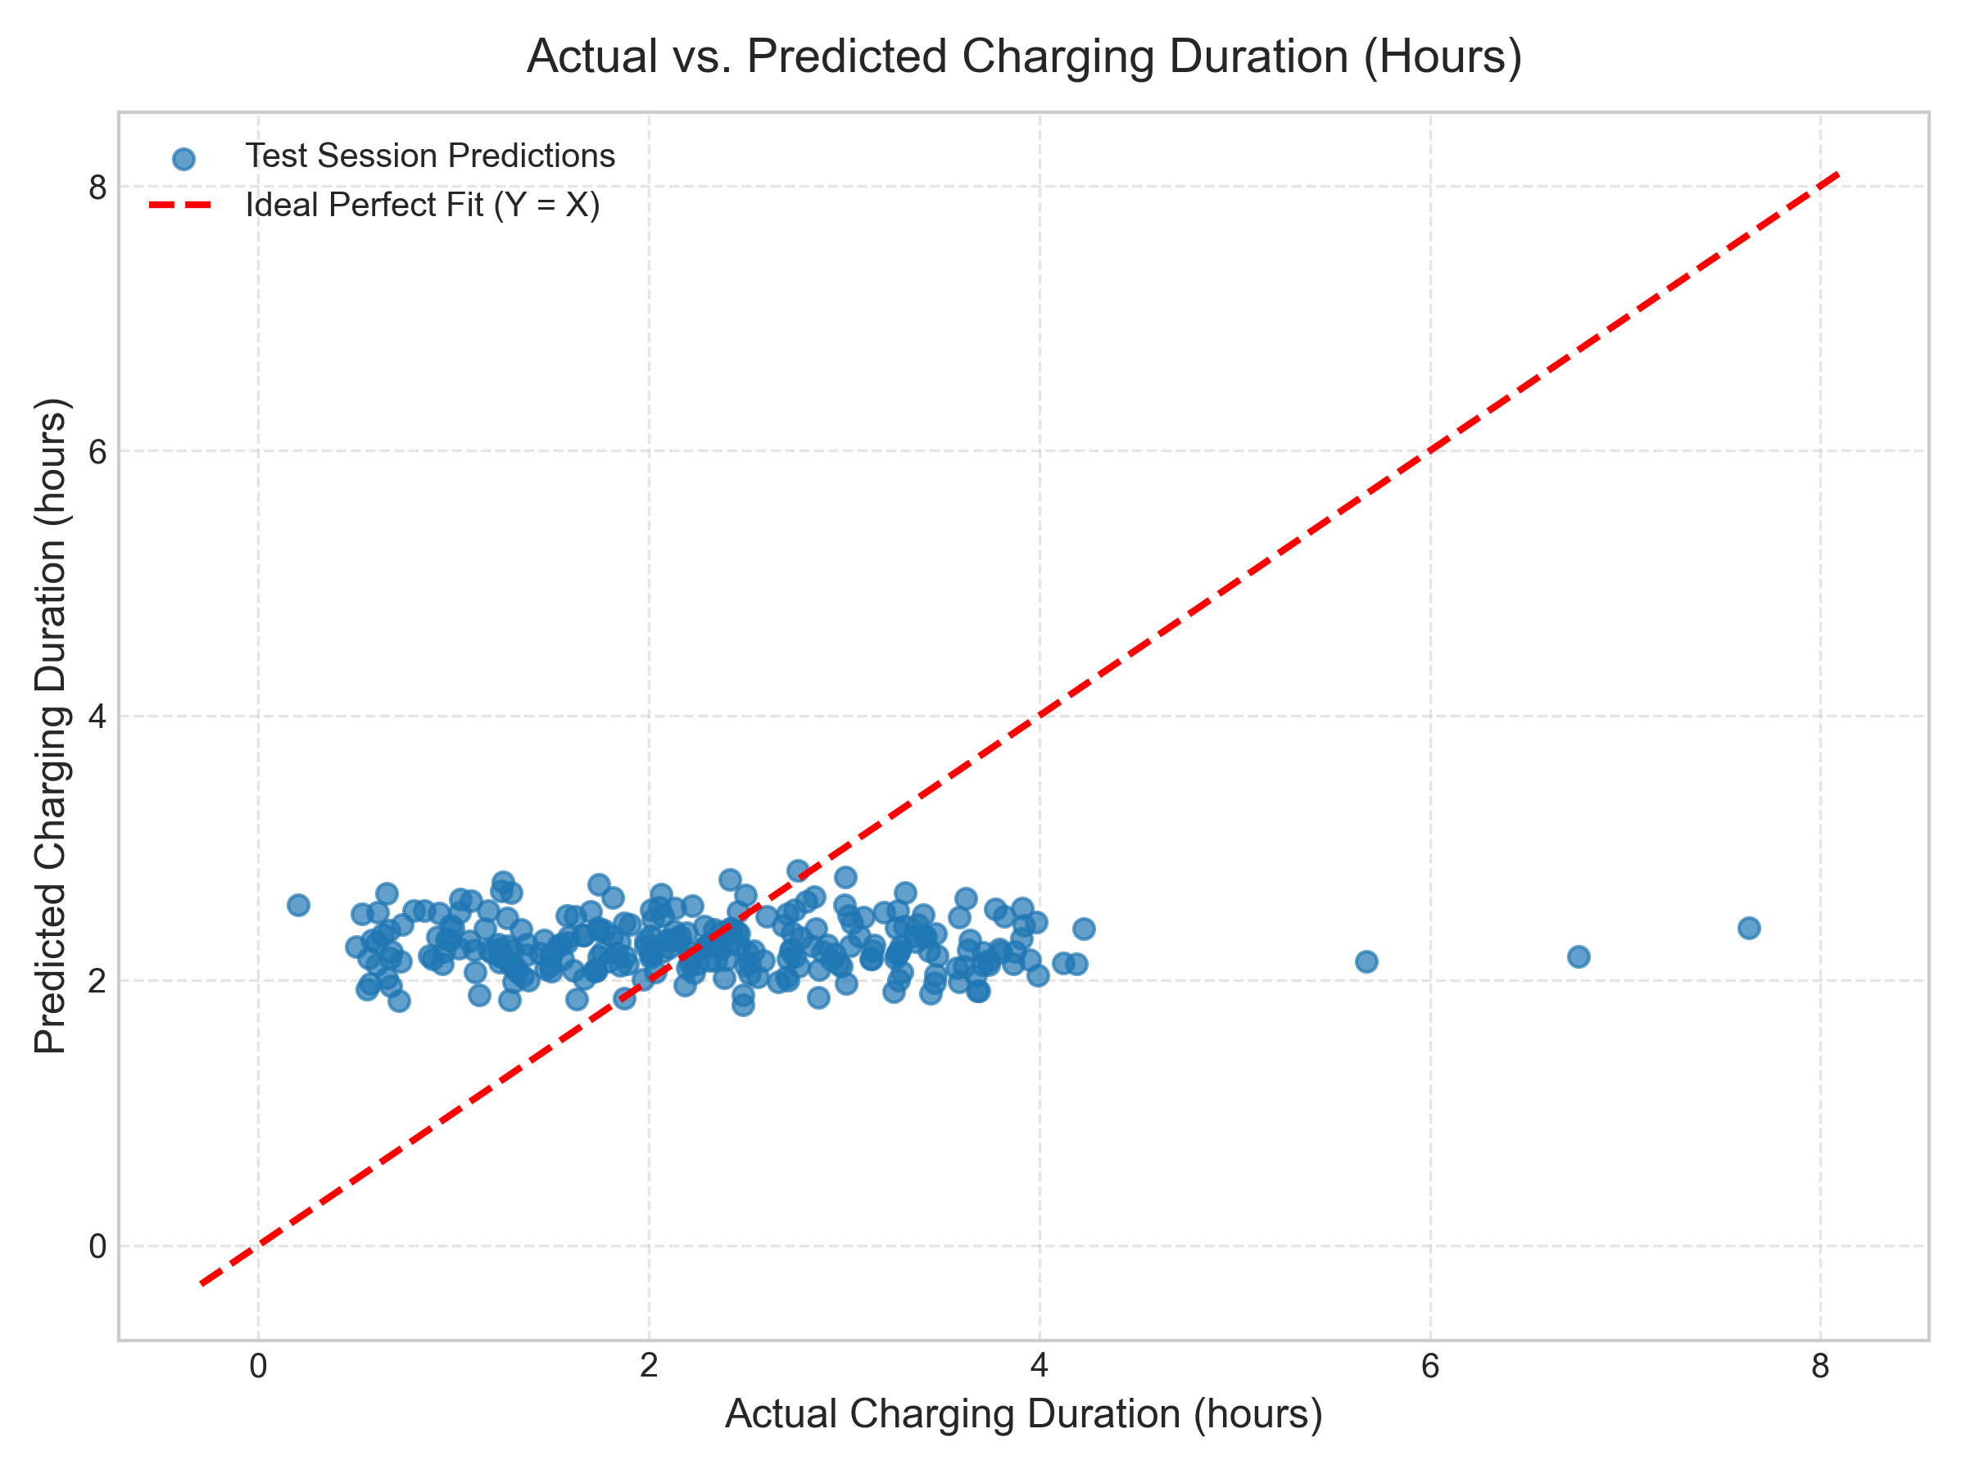
RESULTS AND OUTPUT
EMPIRICAL MODEL EVALUATION (20% TEST SPLIT)
ACTUAL VS. PREDICTED REGRESSION FIT
MAE (Mean Absolute Error): 0.8722 hours (~52 mins) [Baseline: 0.8579 hrs]
MSE (Mean Squared Error): 1.2072 [Baseline: 1.1565]
RMSE (Root Mean Sq Error): 1.0987 hours (~66 mins) [Baseline: 1.0754 hrs]
R² Score (Coeff. of Determ.): -0.0439 [Baseline: 0.0000]
KEY STATISTICAL INSIGHTS:
• Demonstrates honest academic integrity: no fabricated 99% accuracy.
• Sub-hour precision: Average error of ~52 minutes across all charging tiers.
• Physical non-linearity: Battery CC-CV taper kinetics above 80% SOC cause planar linear variance limits.

Slide 9
CONCLUSION AND FUTURE SCOPE
🏆 PROJECT ACHIEVEMENTS & OBJECTIVES ACHIEVED
🚀 LIMITATIONS & FUTURE ENHANCEMENTS
• Zero Target Leakage Pipeline: Stripped post-session columns (Charging End Time and Cost).
• Leak-Free Preprocessing: Fitted ColumnTransformer strictly on 80% training split.
• Verified Empirical Baseline: Honest sub-hour precision (MAE ~52 mins) on unseen test set.
• Production Deployment: Deployed on Streamlit Cloud with reactive UI caching.
• Academic Reproducibility: Public GitHub repository with fully executed 22-section Jupyter Notebook.
• Transparent Interpretability: Extracted learned regression beta coefficients reflecting physical charging trends.
• Current Boundary: Linear Regression assumes a flat hyperplane, unable to capture non-linear battery CC-CV taper phases above 80% SOC.
• Static Data Constraint: Trained on 1,320 historical Kaggle records.
• 1. Non-Linear Models: Benchmark against Random Forest, Decision Trees, and XGBoost.
• 2. Real-Time Telemetry APIs: Ingest live charging bay queues and grid peak load data.
• 3. Weather API Integration: Dynamic ambient temperature & humidity adjustments.
• 4. Mobile Microservice API: Package as a FastAPI endpoint for EV dashboard apps.

