Slide 1


Sound Detection and Classification
Group No. 16
223327 Sarthak Kshirsagar
223352 Shraddha Chougule
Mr. Prashant Karhale Mr. Akshay Tilekar
Centre Coordinator Project Guide

Slide 2
Contents - Sound Detection and Classification
Introduction
Dataset
Workflow
Exploratory Data Analysis
Data Pre-Processing
Models
Feature Selection Models
Results
User Interface
Requirement Specification
Summary
Future Scope
References

Slide 3
Introduction
Sound classification is one of the most widely used applications in audio deep learning.
It involves learning to classify sounds and predicting the category of that sound.
This type of problem can be applied to many practical scenarios, e.g., classifying music clips to identify the genre of the music, or classifying short utterances by a set of speakers to identify the speaker based on the voice.
Our project involves a comparison of some deep learning models.
This project will be helpful to deaf people know their surroundings.
Here people can load the audio files (.wav) and, once they submit them, the audio sound is printed as the outcome for each model, thus achieving our goal for the project.

Slide 4
Dataset
Dataset taken from -[https://urbansounddataset.weebly.com/urbansound8k.html]
This dataset contains 8732 labelled sound excerpts (=4s) of urban sounds from ten categories: air conditioner, car horn, children playing, dog bark, drilling, engine idling, gun shot, jackhammer, siren, and street music.
The classes are based on the taxonomy of urban sounds. All excerpts are from field recordings.
The files are pre-sorted into ten folds (folders named fold1-fold10) to aid in reproducing and comparing the results of the automatic classification.
Audio files included 8732 WAV audio files of urban sounds as described above.
This dataset also contains UrbanSound8k.csv that contains meta-data for each audio file in the dataset

Slide 5
Dataset - Features
slice_file_name : (fsID)-(classID)-(occurrenceID)-(sliceID).wav
fsID : The Freesound ID of the recording from which this excerpt (slice) is taken
start :The start time of the slice in the original Freesound recording
end :The end time of slice in the original Freesound recording
salience :A (subjective) salience rating of the sound. 1 = foreground, 2 = background.
fold : The fold number (1-10) to which this file has been allocated.
classID : A numeric identifier of the sound class.
class :The class name: air_conditioner, car_horn, children_playing, dog_bark, drilling, engine_idling, gun_shot, jackhammer, siren, street_music.

Slide 6
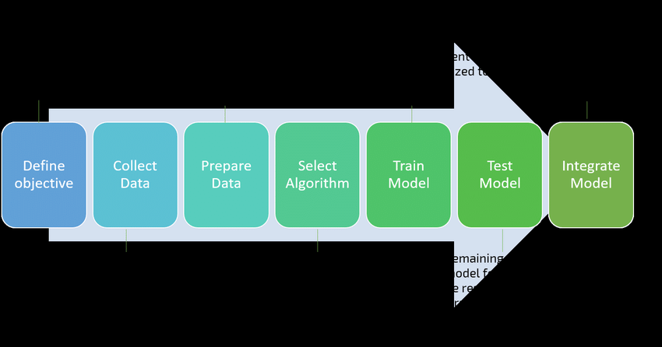
Workflow

Slide 7
Data Preprocessing and Feature Extraction
We use the data we obtained by using librosa because we require data in numeric format.
We use Mel-Frequency Cepstral Coefficients (MFCC) to extract independent data, which summarizes the frequency distribution across the window size, allowing us to analyze both the frequency and time characteristics of the sound. We can identify features for classification using these audio representations.
We defined the features extractor function and passed in the path to the audio file as a parameter, after which we will extract the audio features using librosa.
The feature_extractor function is applied to all rows, and the results are stored in a dataframe with features and class columns for further calculations.

Slide 8
MFCC :
MFCC stands for Mel-frequency cepstrum coefficients is a mathematical coefficients for sound modeling.
The MFCC uses the MEL scale to divide the frequency band to sub-bands and then extracts the Cepstral Coefficents using Discrete Cosine Transform (DCT). MEL scale is based on the way humans distinguish between frequencies which makes it very convenient to process sounds.
Below is code for MFCC visualizations. We have created visualizations for each class.

Slide 9
Feature Extraction:
We obtained the dataset from UrbanSound8K, which contains over 8500 data files containing various audios such as a baby crying, birds sound, dog bark, and many others in the form of.wav files.
It is divided into ten folders, indicating that the dataset has ten classes as described in the dataset section.
Libraries that are required are added, as well as Librosa for feature extraction.

Slide 10
Models
Convolutional Neural Network (CNN)
CNN1D
CNN2D

Slide 11
CNN1D
A modified form of 2D CNNs known as 1D Convolutional Neural Networks (1D CNNs) has recently been developed as an alternative.
In dealing with 1D signals, these research have proven that 1D CNNs are beneficial and consequently preferable to their 2D counterparts in some situations.
1D CNN, kernel moves in 1 direction. Input and output data of 1D CNN is 2 dimensional.
Mostly used on Time-Series data. 1D CNN can perform activity recognition task from accelerometer data, such as if the person is standing, walking, jumping etc.
This data has 2 dimensions.
The first dimension is time-steps and other is the values of the acceleration in 3 axes.
Similarly, 1D CNNs are also used on audio and text data since we can also represent the sound and texts as a time series data.
Conv1D is widely applied on sensory data, and accelerometer data is one of it.

Slide 12
CNN2D
The traditional deep CNNs are only designed to work with 2D data like photos and movies.
This is why they're referred to as "2D CNNs" so frequently. 2D CNN, kernel moves in 2 directions.
Input and output data of 2D CNN is 3 dimensional. Mostly used on Image data.
This is the conventional Convolution Neural Network, which was introduced in the Lenet-5 architecture for the first time. On Image data, Conv2D is commonly used.
Because the kernel slides along two dimensions on the data, it is called 2 dimensional CNN.
The main benefit of employing CNN is that it can extract spatial properties from data using its kernel, which is something that other networks can't achieve.
CNN, for example, can detect edges, colour distribution, and other spatial aspects in an image, making these networks particularly robust in image classification and other data with spatial qualities.

Slide 13
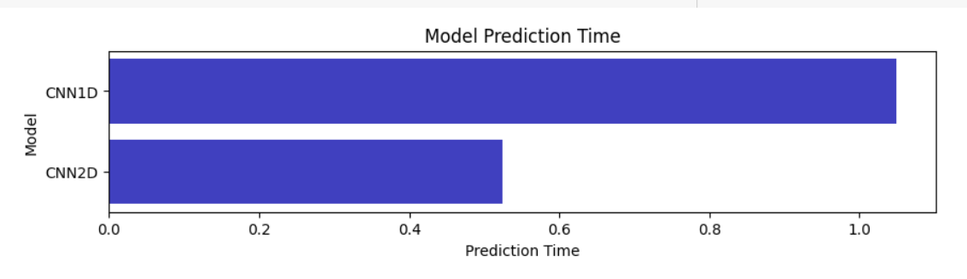
Prediction time of models:
CNN1D requires more time compared to CNN2D

Slide 14
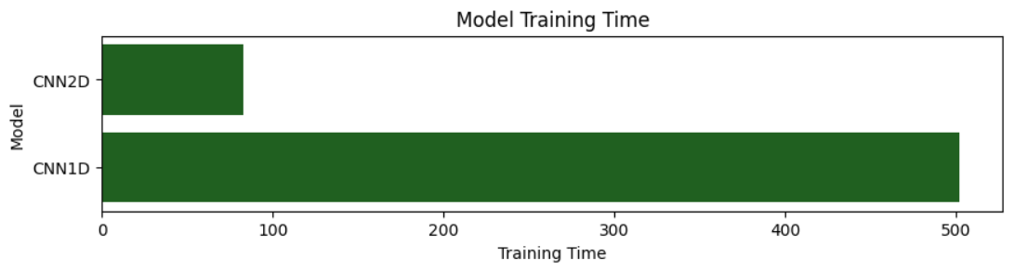
Prediction time of models:

Slide 15
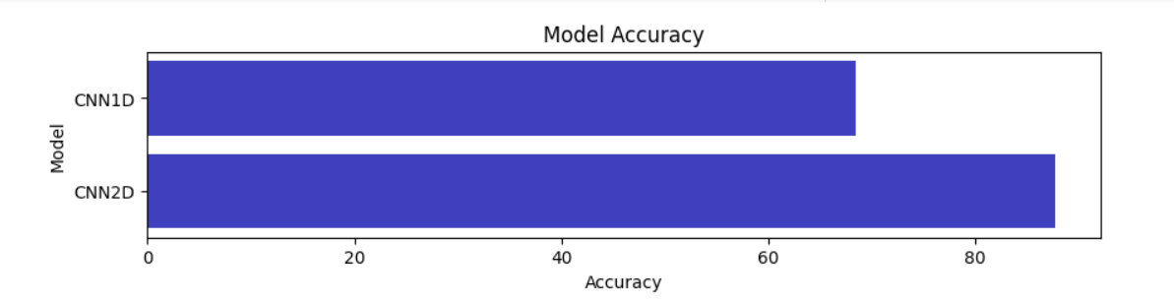
Accuracy of Models:
CNN2D has more accuracy that is 89.93% accuracy rate compared to CNN1D

Slide 16
Requirement Specification
Hardware Requirement:
250 GB HDD.
8 GB RAM
PC x64-bit CPU.
Software Requirement:
Windows/Mac/Linux
Python-3.9.12VS Code/Anaconda/Spyder
Python Extension for VS Code
Browser :Any Modern Web Browser like Google Chrome, Mozilla Firefox.

Slide 17
Libraries :
Pandas
Numpy
Matplotlib
Sklearn
Seaborn
tqdm
matplotlib
scikit-learn
tensorflow

Slide 18
Conclusion
There are so many research papers that tells us how an algorithm works and how to predict any model or algorithm.
Those references helped us a lot in achieving our project goal.
As a result, we have successfully done a comparative analysis for accuracy rate, training time and prediction time.
In future work; we can also do comparative analysis on many models to get a better understanding of any model. We can also develop User Interface for this project.
Also, we can deploy an updated model that allows users to record their surroundings using a mic and get the desired output as well as we can deploy this project on cloud.
This way, users can easily use the model deployment anywhere without any restrictions like file format not supported or large file size and so on.

Slide 19
Reference
R. Kohavi and F. Provost, "Glossary of Terms", Machine Learning, vol. 30, no. 2-3, pp. 271- 274, 1998.
J. Mueller and L. Massaron, Machine Learning For Dummies, 1st ed. 2016, pp. 40-43.
M. Mohri, A. Rostamizadeh and A. Talwalkar, Foundations of Machine Learning, 2nd ed. The MIT Press, 2012, pp. 101-105.
S. Geman, E. Bienenstock and R. Doursat, "Neural Networks and the Bias/Variance Dilemma", Neural Computation, vol. 4, no. 1, pp. 1-58, 1992

Slide 20
THANK YOU

