Slide 1
FIFA World Cup Analysis
Name :- Sarthak Rangrao Mogane

Slide 2
introduction
The FIFA World Cup is a global football competition contested by the various football-playing nations of the world.
It is contested every four years and is the most prestigious and important trophy in the sport of football.
The World Cups dataset shows all information about all the World Cups in history.
while the World Cup Matches dataset shows all the results from the matches contested as part of thecups.

Slide 3
Details in DaTASET
WorldCups:
Year ,Country , Runner-up, Third , Fourth, Goal Scored, QualifiedTeams ,
MatchesPlayed , Attendance, Teams , Title
WorldCup Players :
Round ID , Match ID , Team initialize, Coach Name , Lin-up ,Shirt Number
Player Name , Position, Event.
WorldCup Matches :
Year, Datetime ,stage , Stadium , City , Home Team Name , Home Team Goals
Away Team Name , Away Team Goals , Win conditions , Attendence ,Half time Home Goals
Half time away Goals ,referee ,Assistant 1, Assistant 2, Round Id ,Match Id,
Home Team Initials , Away Team Initials

Slide 4
Report Case
Home team Vs Away team
Most titles by team
Total attendance by year
Total Goal Scored by year
Host Country
Total Matches Played
Total Goals scored
Total Players

Slide 5
TECHNIQUES USED
▪ Power bi
Data selection
Data cleaning
Splitting data
Transforming data
Data visulaization

Slide 6
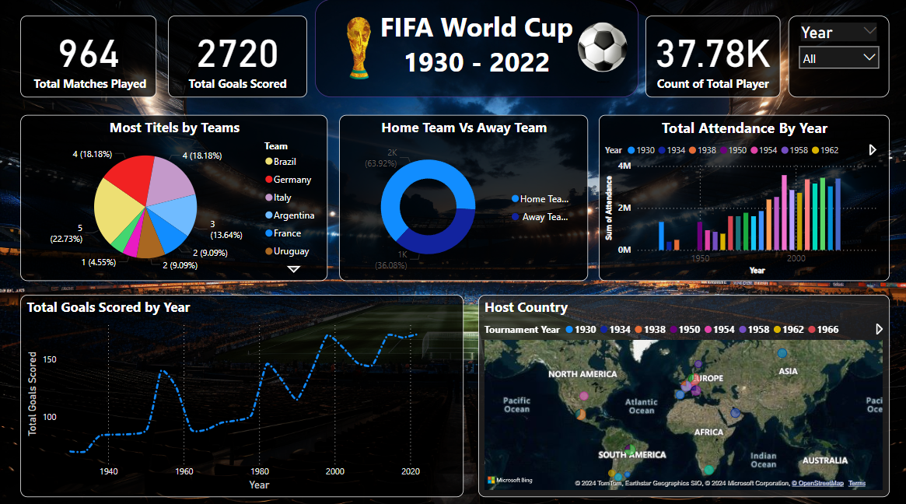
My Report Design

Slide 7
Thank YOU

