Slide 1

Dysarthric Speech Detection Using CNN & Hybrid Models
TEAM 13
Team Members | Registration Number
SAKILAM ABHIMAN | CH.EN.U4AIE20055
SARTHAK YADAV | CH.EN.U4AIE20058
SHAIK HUZAIFA FAZIL | CH.EN.U4AIE20060
B SIVA JYOTHI NATHA REDDY | CH.EN.U4AIE20063
VEMIREDDY ANVITHA | CH.EN.U4AIE20076
01

Slide 2

Abstract
Dysarthria is a motor speech disorder that affects the muscles used for speech
It can result in difficulty pronouncing words, slurred speech, a slow or fast rate of speech
Dysarthria can be caused by a variety of factors, including neurological conditions
Machine learning models such as CNN ,CNN-LSTM and CNN-GRU will be developed to detect dysarthric speech.
The performance of the model will be evaluated using metrics such as accuracy, precision, recall, and F1-score.
02

Slide 3
Objective
In this project, machine learning models will be developed to detect dysarthric speech, models such as
CNN (Convolutional Neural Network) CNN-LSTM (Convolutional Neural Network-Long Short-Term Memory) CNN-GRU (Convolutional Neural Network-Gated Recurrent Unit)
The ultimate goal of this project is to develop a reliable and accurate tool for detecting dysarthric individuals that can be used in clinical settings and assistive technology development.
03

Slide 4

Problem Statement
Dysarthria is a motor speech disorder that affects a person's ability to communicate effectively due to difficulty in controlling the muscles used in speech. Accurate and efficient detection of dysarthric speech is essential for early diagnosis and treatment of the condition. However, traditional methods of diagnosing dysarthria can be time-consuming and subjective. Therefore, the objective of this research is to develop and evaluate CNN and hybrid models for detecting dysarthric speech in a fast, accurate, and reliable manner. The proposed models aim to improve the accuracy of dysarthria detection, thereby facilitating early diagnosis and treatment of the condition, and improving the overall quality of life for individuals with dysarthria.
04

Slide 5

Proposed Solution
The proposed solution involves the development of machine learning models such as CNN, CNN-LSTM, and CNN-GRU to detect dysarthric speech based on acoustic features such as pitch, intensity, and formants.
These models will be trained on a dataset of speech recordings from individuals with dysarthria and control participants.
The performance of the models will be evaluated using metrics such as accuracy, precision, recall, and F1-score.
05

Slide 6
Literature Survey
S.No | Title | Year | Results
01 | Dysarthric Speech Recognition Using Dysarthria-Severity-Dependent and Speaker-Adaptive Models | 2013 | the proposed speaker adaptation approach provides significant improvement over the conventional approach when a small amount of adaptation data is available.
02 | Development of the CUHK Dysarthric Speech Recognition System for the UASpeech Corpus | 2018 | overall word accuracy of 69.4% on the 16-speaker test set
03 | Dysarthric Speech Recognition Using Convolutional LSTM Neural Network | 2018 | The paper presents experiments on the performance of a GMM-based ASR system using different training data on normal and dysarthric speech. The results show that mixed training data (normal + dysarthric) produces better results than using normal or dysarthric training data alone.
06

Slide 7
S.No | Title | Year | Results
04 | PHONETIC ANALYSIS OF DYSARTHRIC SPEECH TEMPO AND APPLICATIONS TO ROBUST PERSONALISED DYSARTHRIC SPEECH RECOGNITION | 2019 | Experimental results show that the strategy with data augmentation is more effective, resulting in a nearly 7% absolute improvement in comparison to baseline speaker-dependent trained system evaluated using UASpeech corpus.
05 | END-TO-END DYSARTHRIC SPEECH RECOGNITION USING MULTIPLE DATABASES | 2019 | Our proposed method achieved 14.7% and 6.5% relative improvement over the joint training method for dysarthric speaker1 and dysarthric speaker2 respectively
06 | The CUHK Dysarthric Speech Recognition Systems for English and Cantonese | 2019 | A table shows the word or character error rates (WERs or CERs) produced by the CUHK systems, Google API, and human beings for different dysarthric speakers. The results indicate that, for both languages, the CUHK systems consistently outperform the Google speech recognition API.
07

Slide 8
S.No | Title | Year | Results
08 | Domain Adversarial Neural Networks for Dysarthric Speech Recognition | 2020 | For the ISIC 2019 dataset and the PH2 dataset, the study's accuracy was 88.95% and 91.02%, respectively.
08 | Recent Progress in the CUHK Dysarthric Speech Recognition System | 2021 | word error rate (WER) of 25.21% on the UASpeech test set and an overall WER reduction of 5.4% absolute (17.6% relative) over the CUHK 2018 dysarthric speech
09 | Classification of Dysarthric Speech According to the Severity of Impairment: an Analysis of Acoustic Features | 2021 | The classifification accuracy ranged from 40.41 to 95.80. For the combination of sub-features, the 13 features would be selected all the sub-features were combined.
10 | MULTI-MODAL ACOUSTIC-ARTICULATORY FEATURE FUSION FOR DYSARTHRIC SPEECH RECOGNITION | 2022 | The results show that fusing the acoustic and articulatory features at the empirically found optimal level of abstraction achieves a remarkable performance gain, leading to up to 4.6% absolute (9.6% relative) WER reduction for speakers with dysarthria.
08

Slide 9
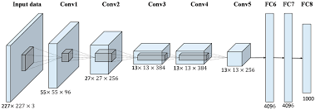
Proposed Work
CNN
11

Slide 10
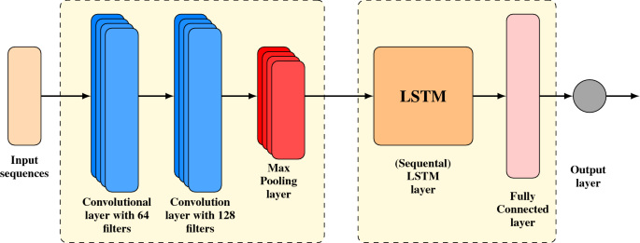
CNN - LSTM
12

Slide 11
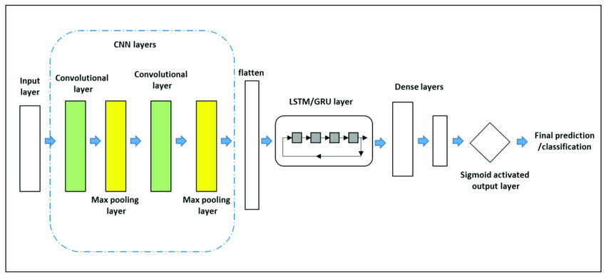
CNN – GRU
13

Slide 12
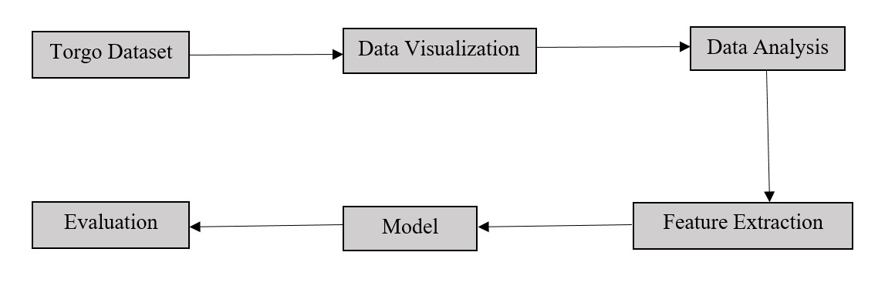
Work Flow Diagram
14

Slide 13
Software & Hardware Requirements
Software Requirements | Hardware Requirements
Speech processing libraries | C.P.U
Acoustic modelling software | G.P.U
Evaluation metrics | Memory
Programming languages | Storage
18

Slide 14
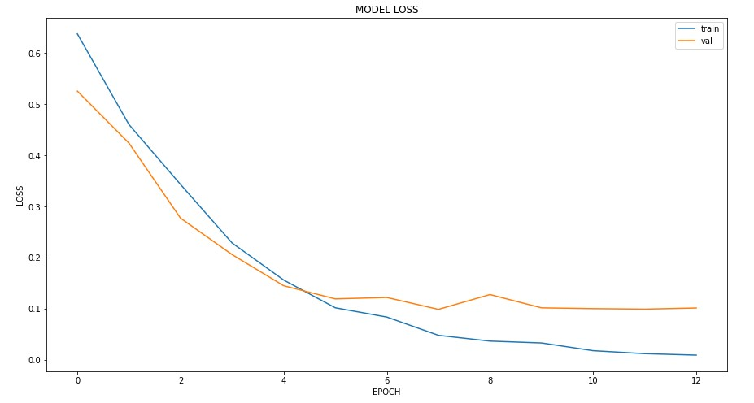
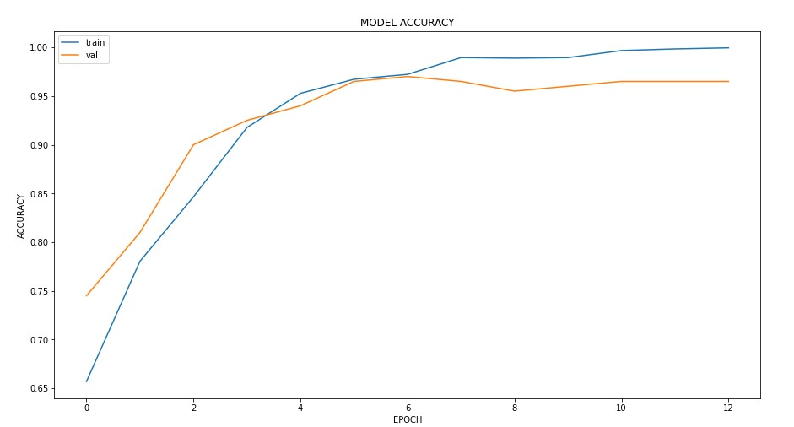
Experimental Results
CNN model
19

Slide 15
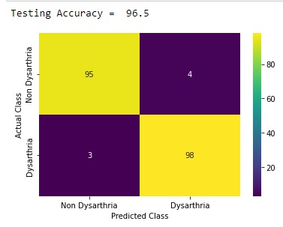
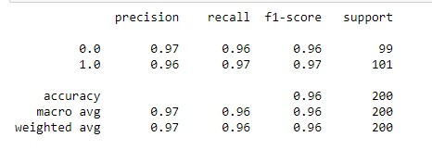
Testing Accuracy – 96.5
20

Slide 16
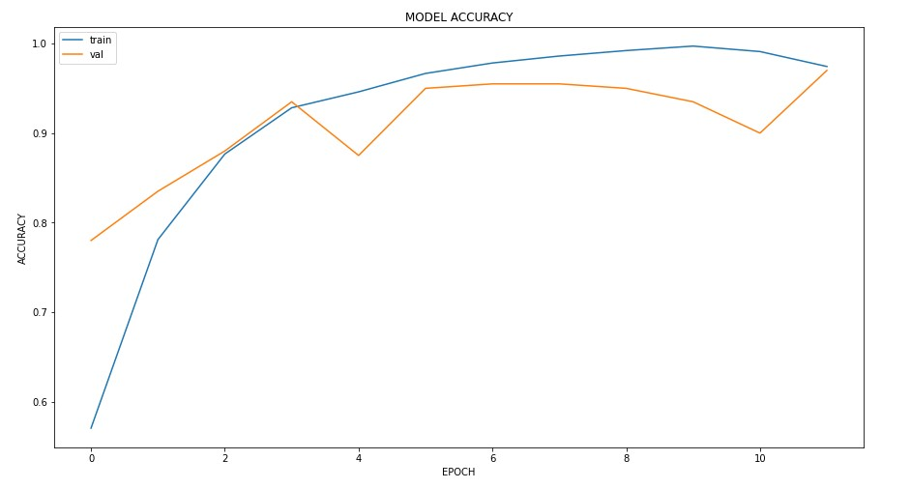
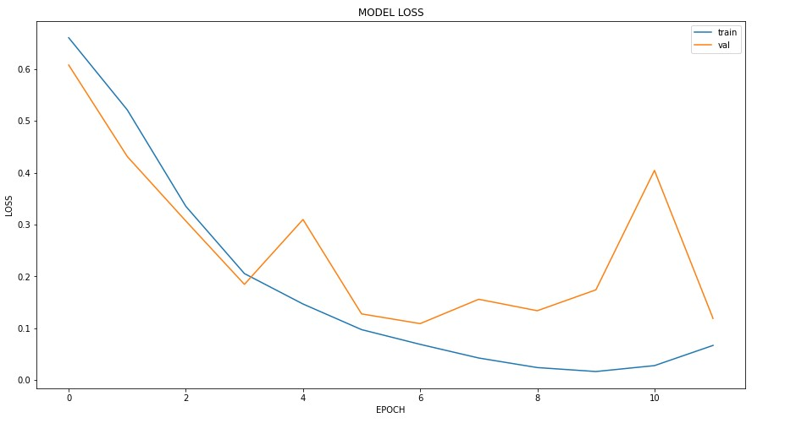
CNN- LSTM model
21

Slide 17
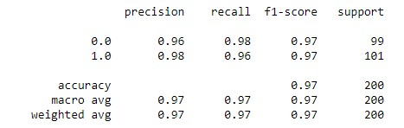
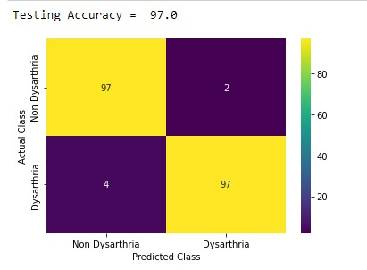
Testing Accuracy – 97
22

Slide 18
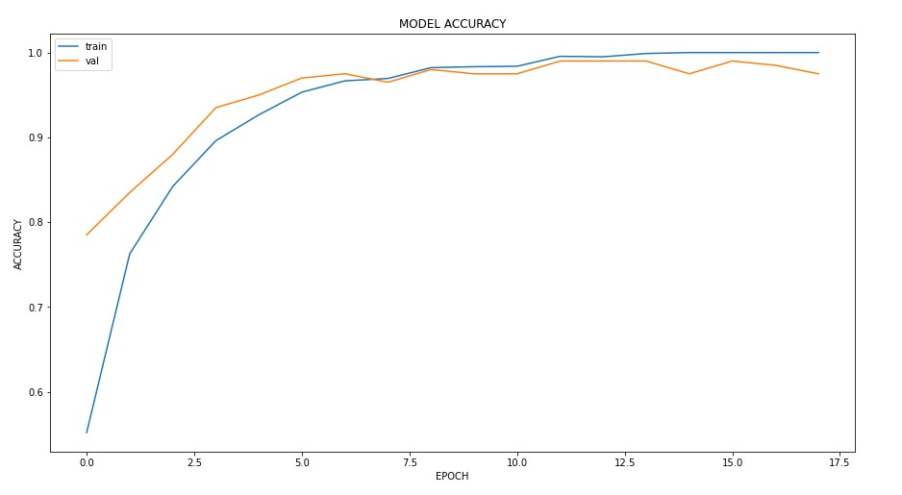
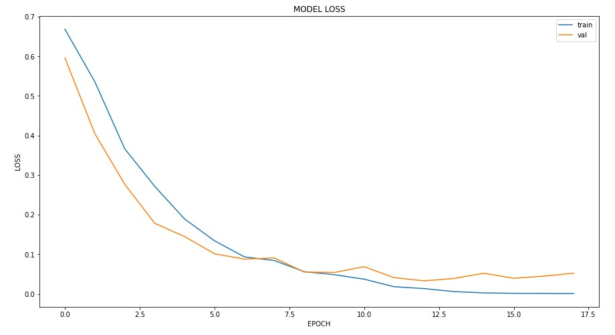
CNN - GRU model
09

Slide 19
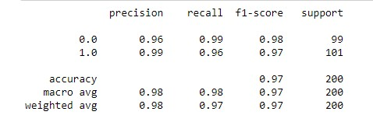
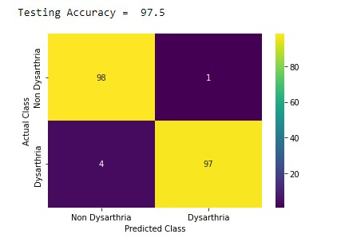
Testing Accuracy – 97.5
10

Slide 20
Conclusion
The CNN model achieved an accuracy of 96.5%.
The CNN-LSTM model achieved even higher accuracies of 97%.
The CNN-GRU model achieved even higher accuracies of 97.5%.
Our report suggests that the CNN-GRU model is the best choice for detecting dysarthric speech, while all three models perform well in recognizing dysarthric speech in the Torgo dataset.
23

Slide 21
References
https://ieeexplore.ieee.org/document/9463679
https://www.cs.ou.edu/~fagg/classes/aml_2019/papers/Dysarthric_speech_recogniton_systems.pdf
https://www.researchgate.net/profile/Myungjong-Kim/publication/289579429_Dysarthric_speech_recognition_using_dysarthria-severity-dependent_and_speaker adaptive_models/links/57db0dca08ae5292a376972e/Dysarthric-speech-recognition-using-dysarthria-severity-dependent-and-speaker-adaptive-models.pdf
https://ieeexplore.ieee.org/abstract/document/8683091
https://www.researchgate.net/profile/ShoukangHu/publication/335395151_The_CUHK_Dysarthric_Speech_Recognition_Systems_for_English_and_Cantonese/links/5d9b3b1b458515c1d39cfdfa/The-CUHK-Dysarthric-Speech-Recognition-Systems-for-English-and-Cantonese.pdf
https://www.tandfonline.com/doi/abs/10.1080/10400435.2022.2061085
https://ieeexplore.ieee.org/abstract/document/9746553/
24

Slide 22
25

