Slide 1


Emotion Recognition using CNN
TEAM 10
Team Members | Registration Number
SAKILAM ABHIMAN | CH.EN.U4AIE20055
SARTHAK YADAV | CH.EN.U4AIE20058
SHAIK HUZAIFA FAZIL | CH.EN.U4AIE20060
SANGEETH AJITH | CH.EN.U4AIE20056
BODE VAMSI KRUSHNA | CH.EN.U4AIE20008

Slide 2
Introduction
The emotion recognition model is trained on FER 2013 dataset.
It can detect 7 emotions
Angry
Disgust
Fear
Happy
Neutral
Sad
Surprise
The project works by getting a live video feed from webcam, and pass it through the model to get a prediction of emotion.
Then according to the emotion predicted, the app will fetch a playlist of songs from Spotify through Spotipy wrapper and recommend the songs by displaying them on the screen

Slide 3
Literature Review
Title | Authors | Methods | Results
Real Time Facial Recognition Using Deep Learning 2019 | Isha Talegaonkar, Kalyani Joshi, Shreya Valunj, Rucha Kohok, Anagha Kulkarni | They used using Convolutional Neural Networks (CNN) to classify facial expressions in real-time. The model is capable of real-time emotion classification using a webcam. | The conclusion states that a CNN model was created and experimented with, achieving satisfactory train and test accuracies, which are, 0.7989 and 0.6012 respectively.
The Facial Emotion Recognition (FER-2013) Dataset for Prediction System of Micro-Expressions Face Using the Convolutional Neural Network (CNN) Algorithm based Raspberry Pi 2020 | Lutfiah Zahara, Purnawarman Musa, Eri Prasetyo Wibowo, Irwan Karim, Saiful Bahri Musa | Real-time facial emotion prediction and classification system using the Convolutional Neural Network (CNN) algorithm and the OpenCV library, specifically TensorFlow and Keras, implemented on a Raspberry Pi. | Their method achieved a facial expression prediction accuracy of 65.97%.
Emotion Recognition on FER-2013 Face Images Using Fine-Tuned VGG-16 | Gede Putra Kusuma, Jonathan, Andreas Pangestu Lim | The proposed approach involves a modified Convolutional Neural Network (CNN) based on the VGG-16 classification model, which was pre-trained on the ImageNet dataset and fine-tuned for emotion classification. | This approach achieves an accuracy of 69.40%

Slide 4
Facial Emotion Recognition: State of the Art Performance on FER2013 2021 | Yousif Khaireddin and Zhuofa Chen | They have employed the VGGNet architecture, carefully fine-tuned its hyperparameters, and experimented with various optimization methods. | their model achieves a single-network accuracy of 73.28% on the FER2013 dataset without the need for additional training data.
Training the Fer2013 Dataset with Keras Tuner 2022 | Benyoussef Abdellaoui, Aniss Moumen, Younes El Bouzekri El Idrissi and Ahmed Remaida | They proposed a custom CNN model and applied Keras Tuner model optimizer for FER2013. | They got a training accuracy of 0.8313 and a validation accuracy of 0.53.
An experimental study in Real-time Facial Emotion Recognition on new 3RL dataset 2022 | Rahmeh Abou Zafra, Lana Ahmad Abdullah, Rouaa Alaraj, Rasha Albezreh, Tarek Barhoum, and Khloud Al Jallad | They make use of new dataset called 3RL in this project, consisting of approximately 24,000 labeled images representing five basic emotions: happiness, fear, sadness, disgust, and anger. Experiments conducted using commonly used algorithms like SVM and CNN demonstrate | They achieved an accuracy of up to 91.4%,

Slide 5
Face Emotion Recognization Using Dataset Augmentation Based on Neural Network 2022 | Mengyu Rao, Ruyi Bao, Liangshun Dong | It is a comparative study between CK+ and FER2013 datasets. They used four different models for the comparison. These models are VGG19, ResNet18, ResNet50, and Xception. | The final results show that the CK+ dataset gives better accuracies in all four models than FER2013. The highest accuracy for FER2013 was 65.67% given by ResNet18.
Hybrid Facial Expression Recognition (FER2013) Model for Real-Time Emotion Classification and Prediction 2022 | Ozioma Collins Oguine, Kanyifeechukwu Jane Oguine, Hashim Ibrahim Bisallah, Daniel Ofuani | They proposes a Hybrid Architecture that combines the Haar Cascade Face Detection algorithm with a CNN Model. | Proposed model achieved an average predictive accuracy of 70%. The weighted average accuracy on the test dataset was also 70%.

Slide 6
Dataset
The dataset comprises a collection of images depicting faces, with each image consisting of grayscale pixels arranged in a 48x48 grid.
The training set comprises 28,709 examples, which will be used to train and fine-tune the emotion classification model. The public test set consists of 3,589 examples, which will be used to assess the performance of the trained model and determine its ability to generalize to unseen data.

Slide 7
Functional Requirements
The system should be able to detect facial emotions accurately.
The system should be able to recognize different facial emotions such as happy, sad, angry, etc.
The system should be able to provide real-time feedback on detected facial emotions.
The system should be able to work under different lighting conditions.
The system should be able to work with different skin tones.
It should recognise the emotion and recommend songs based on the recognised emotion.

Slide 8
Non-Functional Requirements
The system should be reliable and accurate in detecting facial emotions.
The system should have a fast response time to provide real-time feedback.
The system should be easy to use and intuitive for the user.
The system should be compatible with different operating systems and hardware.
The system should be scalable and able to handle a large number of users.
The system should have good accessibility for users with disabilities.

Slide 9
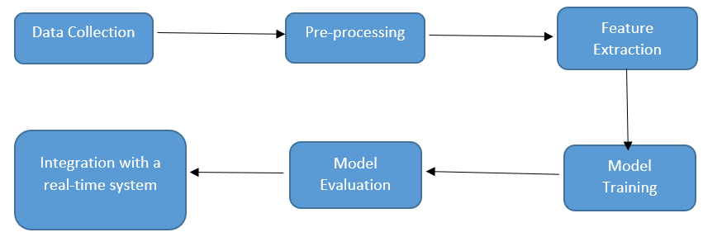
Project Scope
The project scope for detecting facial emotions can vary depending on the specific goals and objectives of the project. Here are some possible components that could be included in the project scope:

Slide 10
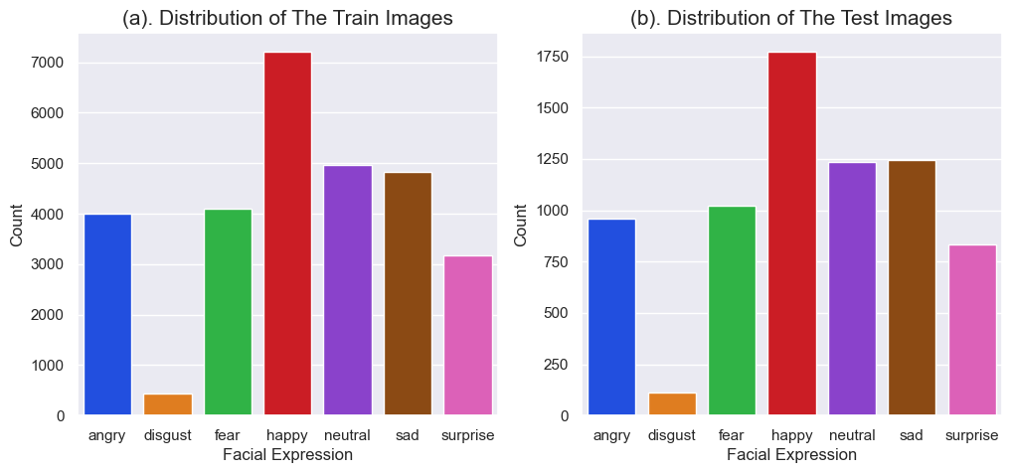
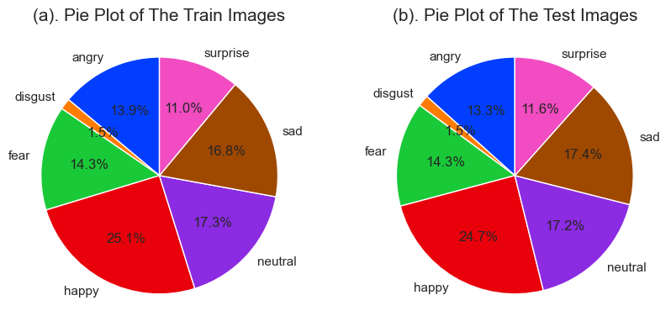
Data Analysis and Visualization
Angry: 3995
Disgust: 436
Fear: 4097
Surprise: 3171
Happy: 7215
Neutral: 4965
Sad: 4830

Slide 11
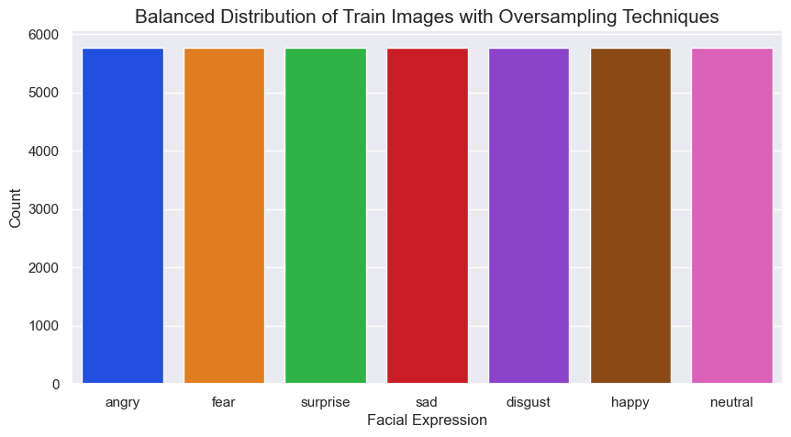
Data Preprocessing
Careful evaluation and consideration of different oversampling techniques are necessary to ensure that the model benefits from the increased representation of the minority class without introducing biases or degrading the performance of the majority class.
This project oversamples the minority classes. The goal is to increase the representation of the minority class in the training dataset by creating additional synthetic samples.
Overall, our code performs oversampling by duplicating or creating synthetic samples to increase the representation of the minority class in the training dataset.

Slide 12
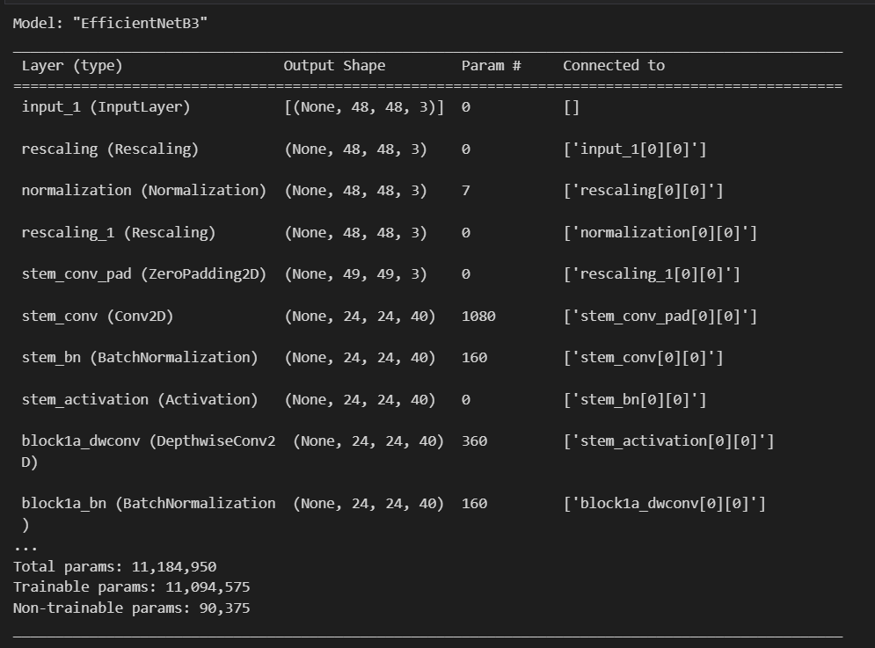
Model Development
We have applied transfer learning in this project, that is, we have taken a pre-trained model as the base model and upgraded the same.
This project makes use of EfficientNetB3. EfficientNetB3 is a specific variant of the EfficientNet architecture.
It refers to the third model in the EfficientNet series, which is known for its balance between model size and performance.

Slide 13
Compared to earlier versions of EfficientNet, EfficientNetB3 typically offers improved performance on image classification benchmarks while maintaining a relatively efficient model size and computational cost.
The model description is as below:
We provide EfficientNetB3 as our base model.
After the base model, we have added the BatchNormalizatoin layer which normalizes the activations of the previous layer. It helps in stabilizing and accelerating the training process.
After this, we add a Dense layer.
Now we apply Dropout. This layer randomly sets a fraction of the input units to 0 at each update during training to prevent overfitting.
Finally, we add one more Dense layer which will be the model’s Output layer.

Slide 14
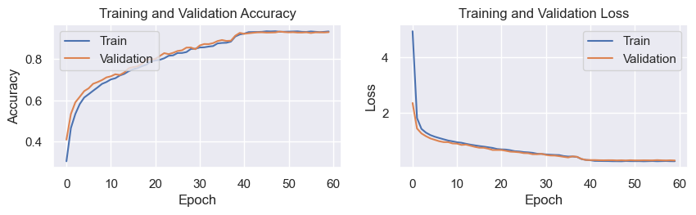
Model Evaluation
Accuracy | 0.9330
Loss | 0.3046

Slide 15
WebApp
Spotipy
Haarcascade
camera.py
main.py
index.html
utils.py
Together, these modules work in tandem to create a web-based application that streams video from a webcam, detects faces in real-time, predicts emotions or facial expressions, and recommends tracks based on the detected emotion. Users can interact with the application through the web page and view the video stream along with the corresponding predictions and recommendations.

Slide 16
Conclusion
Emotion-Based Music Recommender incorporating real-time face recognition, a web app, and Spotipy integration offers an innovative and personalized music recommendation experience.
This technology has the potential to revolutionize the way we engage with music, bridging the gap between our emotions and the songs we listen to.
It adds a layer of emotional intelligence to music recommendations, allowing users to explore a wide range of genres, artists, and tracks that align with their emotional state.

Slide 17
THANK YOU

