Slide 1
Last Time
Color Spaces
File formats

Slide 2
Today
A bit more on JPEG
Color quantization
Dithering
Homework 1 due, here, now

Slide 3
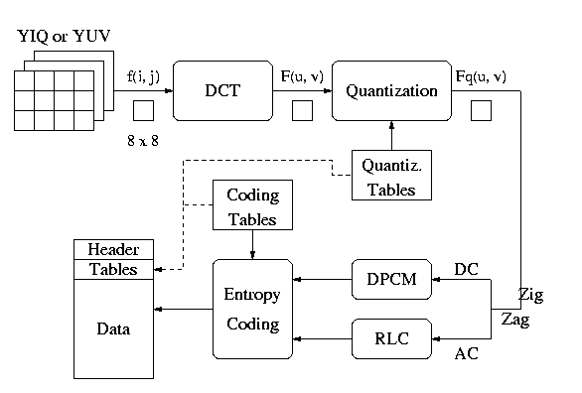
JPEG
Multi-stage process intended to get very high compression with controllable quality degradation
Start with YIQ color
  Why? Recall, it’s the color standard for TV

Slide 4
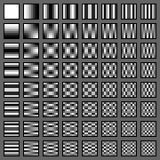
Discrete Cosine Transform
A transformation to convert from the spatial to frequency domain – done on 8x8 blocks
Why? Humans have varying sensitivity to different frequencies, so it is safe to throw some of them away
Basis functions:

Slide 5
Quantization
Reduce the number of bits used to store each coefficient by dividing by a given value
  If you have an 8 bit number (0-255) and divide it by 8, you get a number between 0-31 (5 bits = 8 bits – 3 bits)
  Different coefficients are divided by different amounts
  Perceptual issues come in here
Achieves the greatest compression, but also quality loss
“Quality” knob controls how much quantization is done

Slide 6
Entropy Coding
Standard lossless compression on quantized coefficients
  Delta encode the DC components
  Run length encode the AC components
    Lots of zeros, so store number of zeros then next value
  Huffman code the encodings

Slide 7
Color Quantization
The problem of reducing the number of colors in an image with minimal impact on appearance
  Extreme case: 24 bit color to black and white
  Less extreme: 24 bit color to 256 colors, or 256 grays
Why do we care?
Sub problems:
  Decide which colors to use (if there is a choice)
  Decide which of those each original color maps to

Slide 8
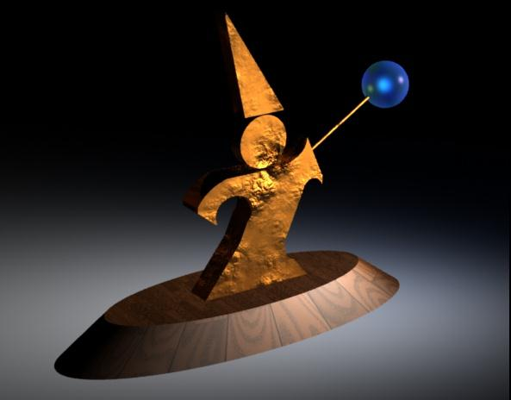
Example (24 bit color)

Slide 9
Uniform Quantization
Break the color space into uniform cells
Find the cell that each color is in, and map it to the center
Generally does poorly because it fails to capture the distribution of colors
  Some cells may be empty, and are wasted
Equivalent to dividing each color by some number and taking the integer part
  Say your original image is 24 bits color (8 red, 8 green, 8 blue)
  Say you have 256 colors available, and you choose to use 8 reds, 8 greens and 4 blues (8 × 8 × 4 = 256 )
  Divide original red by 32, green by 32, and blue by 64

Slide 10
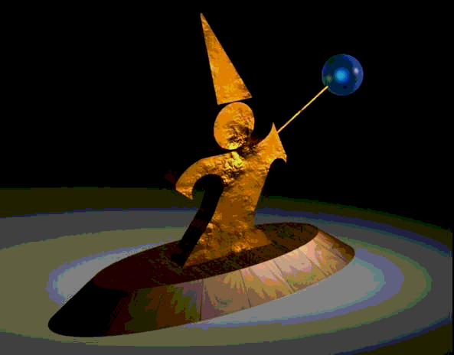
Uniform Quantization
8 bits per pixel in this image
Note that it does very poorly on smooth gradients
Normally the hardest part to get right, because lots of similar colors appear very close together
Does this scheme use information from the image?

Slide 11
Populosity Algorithm
Build a color histogram: count the number of times each color appears
Choose the n most commonly occurring colors
  Typically group colors into small cells first
Map other colors to the closest chosen color
Problem?

Slide 12
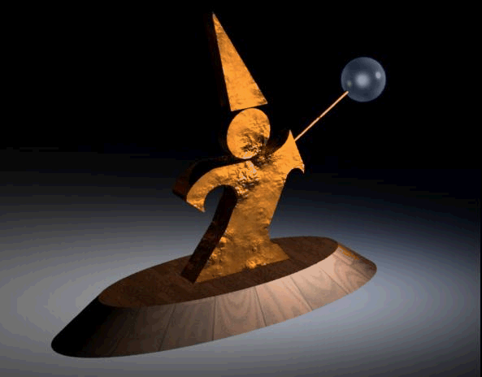
Populosity Algorithm
8 bit image, so the most popular 256 colors
Note that blue wasn’t very popular, so the crystal ball is now the same color as the floor
Populosity ignores rare but important colors!

Slide 13
Median Cut
Look at distribution of colors
Recursively:
  Find the “longest” dimension (r, g, b are dimensions)
  Choose the median of the long dimension as a color to use
  Split along the median plane, and recurse on both halves
Works very well in practice
This algorithm is building a kD-tree, a common form of spatial data structure
  Also used in nearest neighbor computations and many other areas of computer graphics

Slide 14
Median Cut in Action
Original colors in color space
Median in long dimension
Recurse
Put median color in color table

Slide 15

Median Cut
8 bit image, so 256 colors
Now we get the blue
Median cut works so well because it divides up the color space in the “most useful” way

Slide 16
Optimization Algorithms
The quantization problem can be phrased as optimization
  Find the set of colors and mapping that result in the lowest quantization error
Several methods to solve the problem, but of limited use unless the number of colors to be chosen is small
  It’s expensive to compute the optimum
  It’s also a poorly behaved optimization

Slide 17
Perceptual Problems
While a good quantization may get close colors, humans still perceive the quantization
Biggest problem: Mach bands
  The difference between two colors is more pronounced when they are side by side and the boundary is smooth
  This emphasizes boundaries between colors, even if the color difference is small
  Rough boundaries are “averaged” by our vision system to give smooth variation

Slide 18
Mach Bands in Reality
The floor appears banded

Slide 19
Mach Bands in Reality
Still some banding even in this 24 bit image (the floor in the background)

Slide 20
Mach bands Emphasized
Note that each bar on the left appears to have color variation across it
  Left edge appears darker than right
The effect is entirely due to Mach banding

Slide 21
Dithering (Digital Halftoning)
Mach bands can be removed by adding noise along the boundary lines
General perceptive principle: replaced structured errors with noisy ones and people complain less
Old industry dating to the late 1800’s
  Methods for producing grayscale images in newspapers and books

Slide 22
Dithering to Black-and-White
Black-and-white is still the preferred way of displaying images in many areas
  Black ink is cheaper than color
  Printing with black ink is simpler and hence cheaper
  Paper for black inks is not special
To get color to black and white, first turn into grayscale: I=0.299R+0.587G+0.114B
  This formula reflects the fact that green is more representative of perceived brightness than blue is
  NOTE that it is not the equation implied by the RGB->XYZ color space conversion matrix

Slide 23
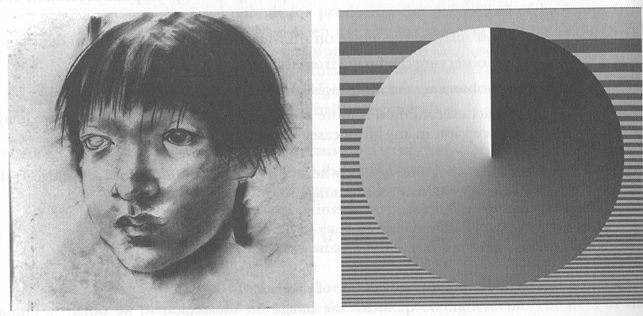
Sample Images

Slide 24
Threshold Dithering
For every pixel: If the intensity < 0.5, replace with black, else replace with white
  0.5 is the threshold
  This is the naïve version of the algorithm
To keep the overall image brightness the same, you should:
  Compute the average intensity over the image
  Use a threshold that gives that average
  For example, if the average intensity is 0.6, use a threshold that is higher than 40% of the pixels, and lower than the remaining 60%
For all dithering we will assume that the image is gray and that intensities are represented as 0-1.0
  If you have a 0-255 image, you can scale all the thresholds (multiply by 255)

Slide 25
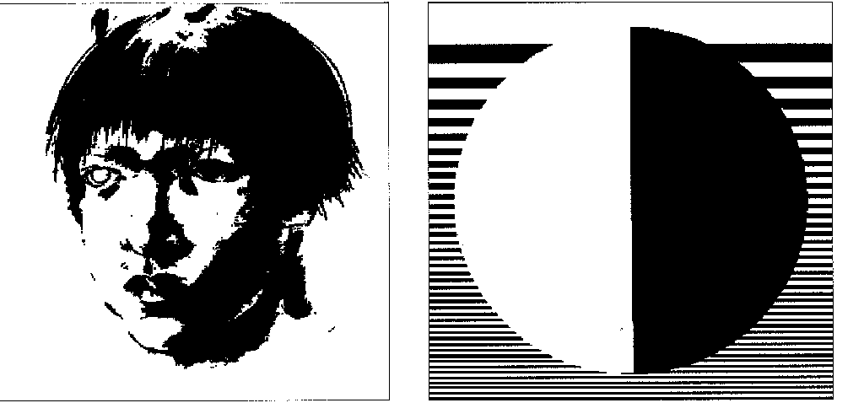
Naïve Threshold Algorithm

Slide 26
Random Modulation
Add a random amount to each pixel before thresholding
  Typically add uniformly random amount from [-a,a]
Pure addition of noise to the image
  For better results, add better quality noise
  For instance, use Gaussian noise
Should use same procedure as before for choosing threshold
Not good for black and white, but OK for more colors
  Add a small random color to each pixel before finding the closest color in the table

Slide 27
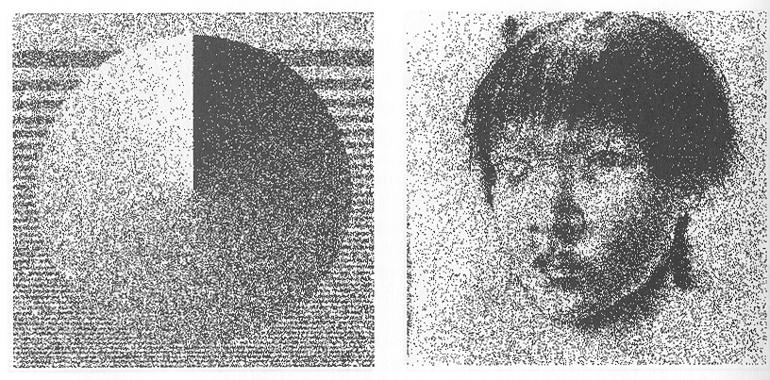
Random Modulation

Slide 28
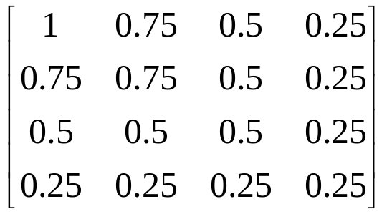
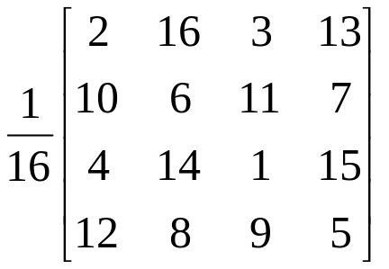
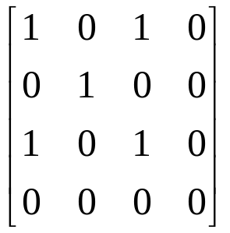
Ordered Dithering
Break the image into small blocks
Define a threshold matrix
  Use a different threshold for each pixel of the block
  Compare each pixel to its own threshold
The thresholds can be clustered, which looks like newsprint
The thresholds can be “random” which looks better
Threshold matrix

Slide 29
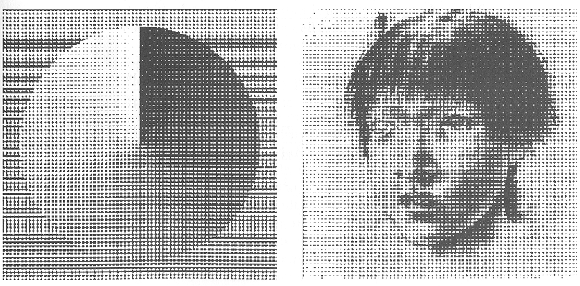
Clustered Dithering
22
23
10
20
14
25
3
8
5
17
15
6
1
2
11
12
9
4
7
21
18
19
13
24
16

Slide 30
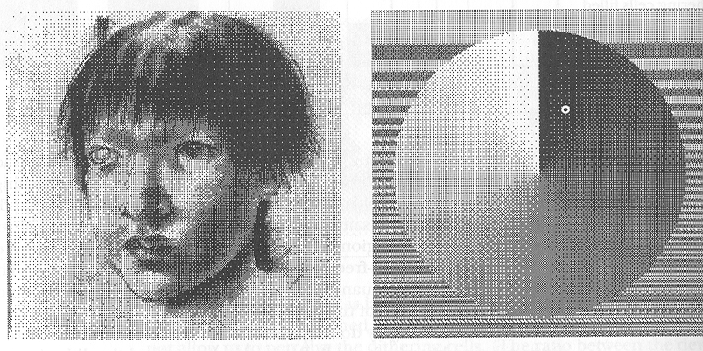
Dot Dispersion
2
16
3
13
10
6
11
7
4
14
1
15
12
8
9
5

Slide 31
Pattern Dithering
Compute the intensity of each sub-block and index a pattern
NOT the same as before
  Here, each sub-block has one of a fixed number of patterns – pixel is determined only by average intensity of sub-block
  In ordered dithering, each pixel is checked against the dithering matrix before being turned on

Slide 32
Floyd-Steinberg Dithering
Start at one corner and work through image pixel by pixel
  Usually scan top to bottom in a zig-zag
Threshold each pixel
Compute the error at that pixel: The difference between what should be there and what you did put there
Propagate error to neighbors by adding some proportion of the error to each unprocessed neighbor
e
7/16
3/16
5/16
1/16

Slide 33
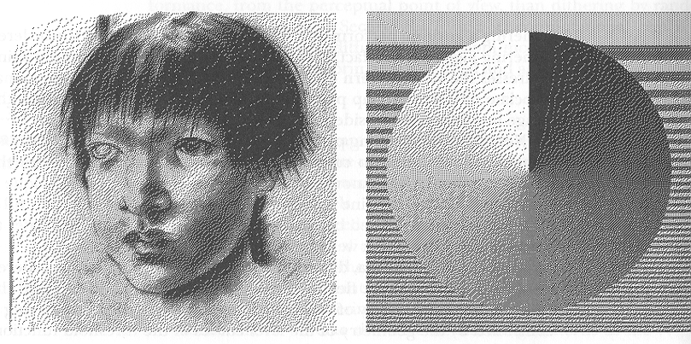
Floyd-Steinberg Dithering

Slide 34
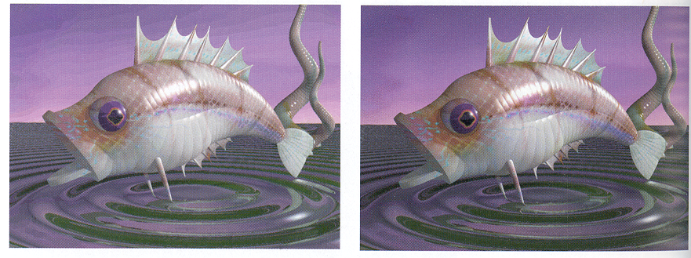
Color Dithering
All the same techniques can be applied, with some modification
  Below is Floyd-Steinberg: Error is difference from nearest color in the color table, error propagation is the same

